Slide 1
Abstraction vs. Memorization in
LLM Binomial Ordering Preferences
Zachary Houghton · University of Oregon

Slide 2
BACKGROUND
Binomials have stable, constrained ordering preferences
▸ "bread and butter", not "butter and bread" — fixed ordering across speakers and time
▸ Constrained by phonology (stress, syllable count), frequency, semantics, pragmatics
▸ Corpus: ~49K binomial pairs with ordering preferences derived from co-occurrence counts
◦ y_true = normalized log-odds of the attested ordering (continuous; |r| < 0.04 with log-freq)
◦ Pairs drawn from a broad web-text corpus; frequencies validated against the Pile
▸ Research question: do LLMs encode these preferences abstractly, or just memorize attested orderings?
▸ Houghton (2025): evidence for memorization over abstraction. We revisit with a finer-grained probe.

Slide 3
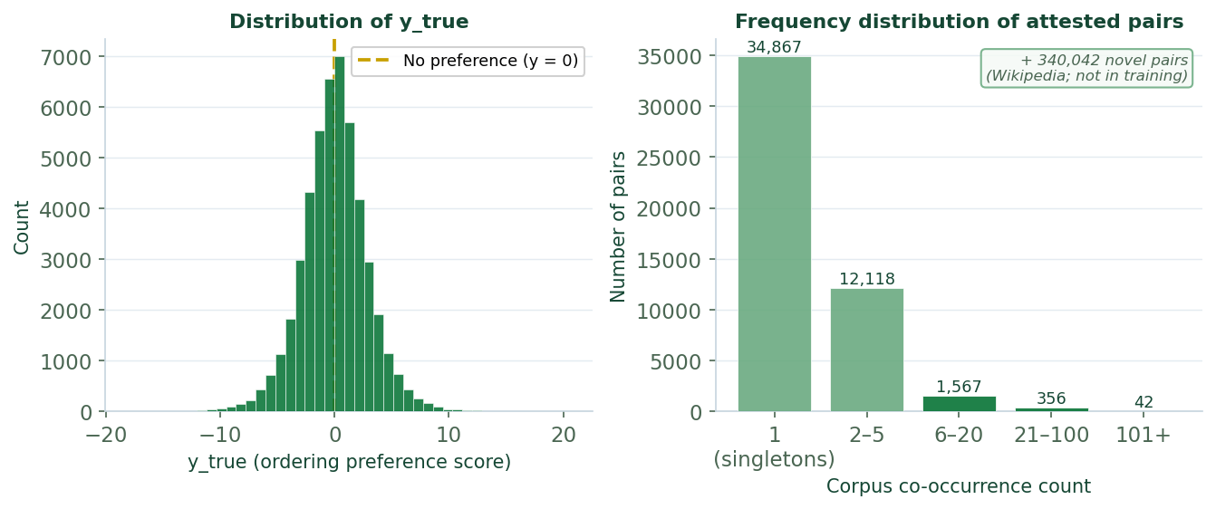
METHODOLOGY · CORPUS & PROBE TRAINING DATA
The binomial corpus: ~49K attested pairs + 340,042 novel pairs
▸ ~49K attested pairs (corpus co-occurrence > 0) + 340,042 novel pairs from Wikipedia
◦ "Attested" = pair appears with measurable ordering preference in a broad web-text corpus
◦ "Novel" (Wikipedia) = not attested in the training corpus; zero observable preference signal
◦ "Novel to the probe during CV" ≠ novel Wikipedia pairs — see CV design slide
▸ y_true: continuous preference score from asymmetric corpus co-occurrence counts
◦ Positive = word₂ preferred first; negative = word₁ preferred first; near zero = no strong preference
◦ Independent of log(freq): |r| < 0.04 across all 16 models
▸ Probe trained to predict y_true from LLM representations of all ~49K attested pairs
◦ 10-fold CV: ~4.9K pairs held out per fold; pair-held-out and word-held-out are separate schemes

Slide 4
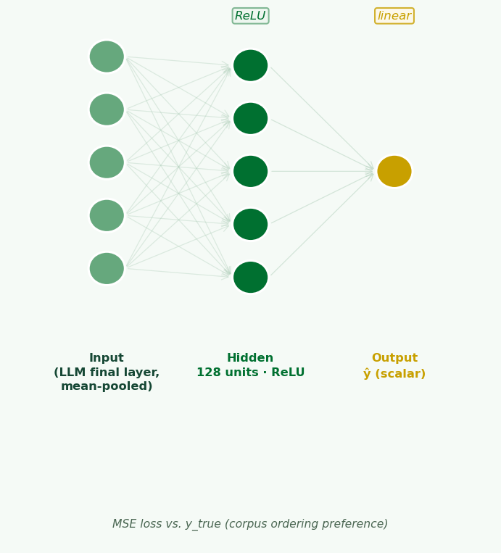
METHODOLOGY · PROBE ARCHITECTURE
MLP probe with one hidden layer on final-layer LLM representations
▸ Input construction:
◦ Template: "the [word1] and the [word2]" passed through the frozen LLM
◦ Final-layer hidden states mean-pooled over all tokens → one vector per binomial
◦ Also tested: words-only pooling (only the two content words) and individual tokens
▸ Probe architecture:
◦ One hidden layer (128 units), ReLU activation, linear output
◦ Trained with MSE loss on y_true; early stopping on held-out fold
◦ 10-fold cross-validation; mean R² reported across folds
▸ Three attention conditions (probe trained separately for each):
◦ Full-context: unmodified LLM forward pass
◦ Attention-zeroed: cross-word attention scores set to −∞ before softmax
◦ Control: scrambled y_true labels (sanity check)

Slide 5
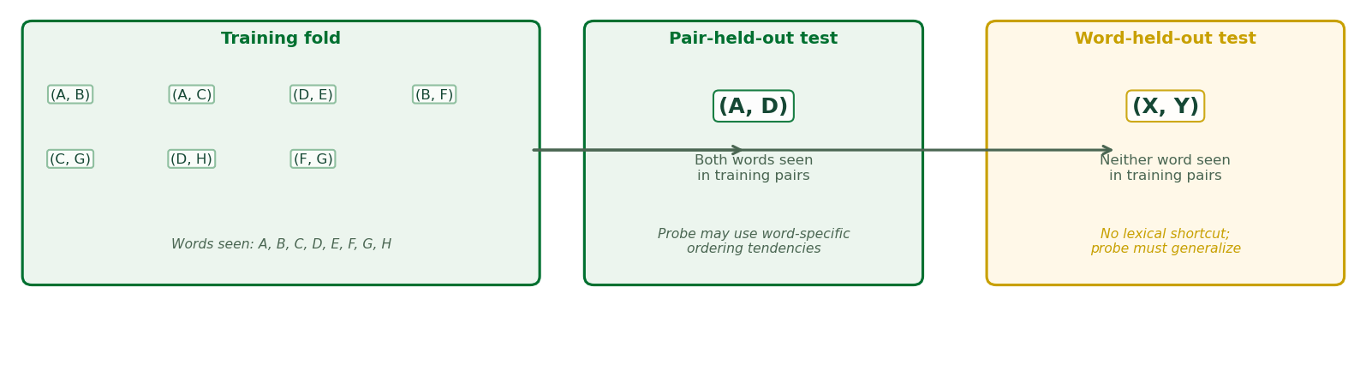
METHODOLOGY · CROSS-VALIDATION DESIGN
Two CV splits test abstract generalization vs. lexical memorization
PAIR-HELD-OUT
Specific pairs withheld; both words appear in other training pairs
Probe can exploit word-specific tendencies (e.g., "salt" tends first regardless of partner)
R² > 0 → probe generalizes beyond training pairs
WORD-HELD-OUT
Both words in test pairs absent from all probe training pairs
No lexical shortcut; probe must use abstract ordering principles
R² > 0 → genuinely abstract preferences
Gap (pair > word R²) → lexical component of the representation

Slide 6
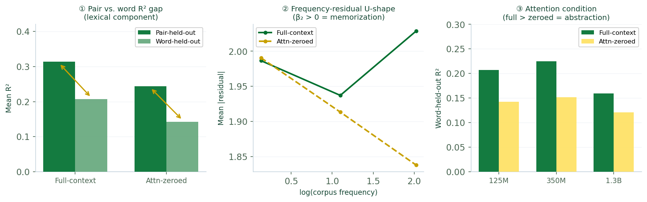
METHODOLOGY · KEY MEASURES
Three measures across every experiment
Pair vs. word R² gap
How much of the encoding is lexical vs. abstract?
①
Frequency-residual curvature (β₂)
β₂ > 0 = U-shape: high-frequency pairs are harder (pair-specific memorization).
②
Full-context vs. attention-zeroed
What is cross-word attention computing: general relational features or pair-specific statistics?
③

Slide 7
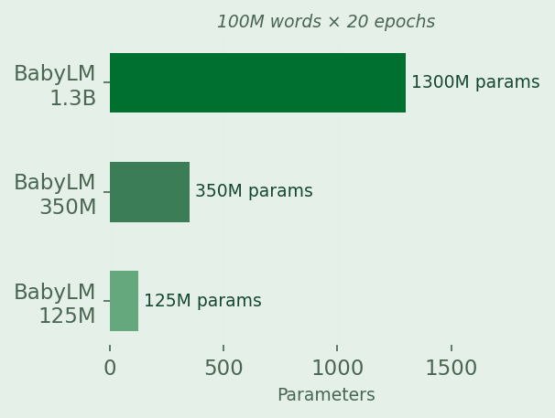
EXPERIMENT 1
BabyLM: Small-Scale, Data-Limited Training
3 models (125M, 350M, 1.3B params) · 100M-word training corpus × 20 epochs Corpus type: child-directed speech, BNC, books, subtitles, Wikipedia Over 70% of corpus binomials appear exactly once in BabyLM pretraining data

Slide 8
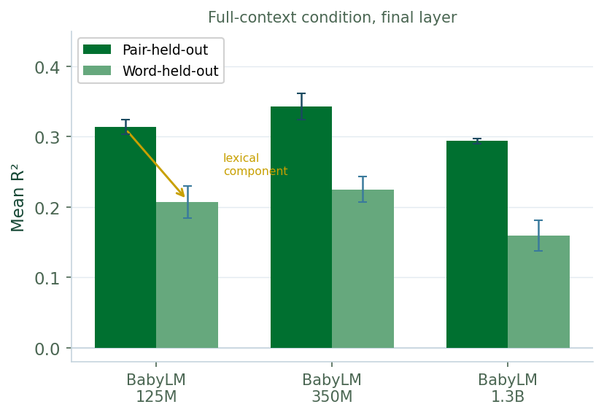
EXPERIMENT 1 · RESULT ①
Probe generalizes, but a consistent lexical component remains
▸ Pair-held-out R²: 0.24–0.34 across all three models (all significantly > 0)
▸ Word-held-out R²: 0.12–0.23 — positive, but consistently lower
▸ BabyLMs do learn abstract ordering preferences — contradicting Houghton (2025)
▸ The gap reflects a lexical component: word-specific ordering tendencies account for part of probe accuracy
◦ E.g., "salt" may tend to appear first across many partners; probe exploits this in pair-held-out but not word-held-out

Slide 9
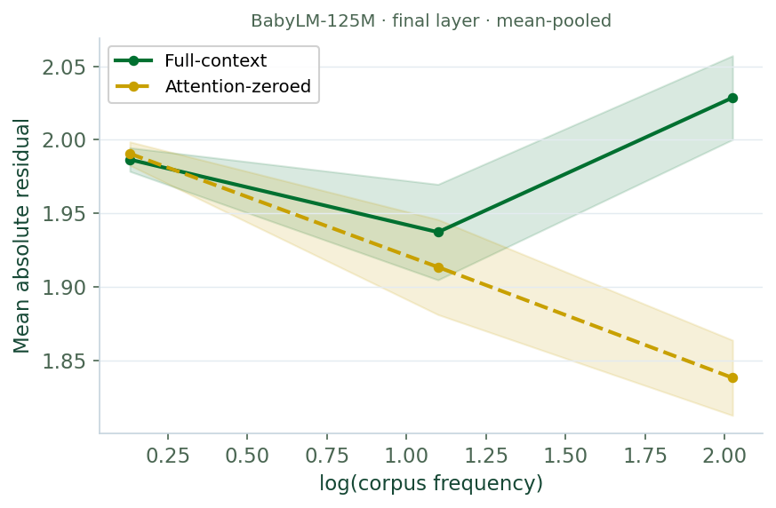
EXPERIMENT 1 · RESULT ②
A U-shaped frequency residual: memorization concentrates at high frequencies
▸ β₂ > 0 for all three BabyLM models (CIs exclude 0 for 125M and 350M)
▸ Middle-frequency pairs are easiest to decode; error rises at both extremes
▸ Low frequency: noisy representations — too few exposures to form stable encodings
▸ High frequency: representations become context-sensitive to the specific pair; they no longer reflect generalizable principles
▸ β₂ is attenuated under attention-zeroed → cross-word attention drives the high-frequency penalty

Slide 10
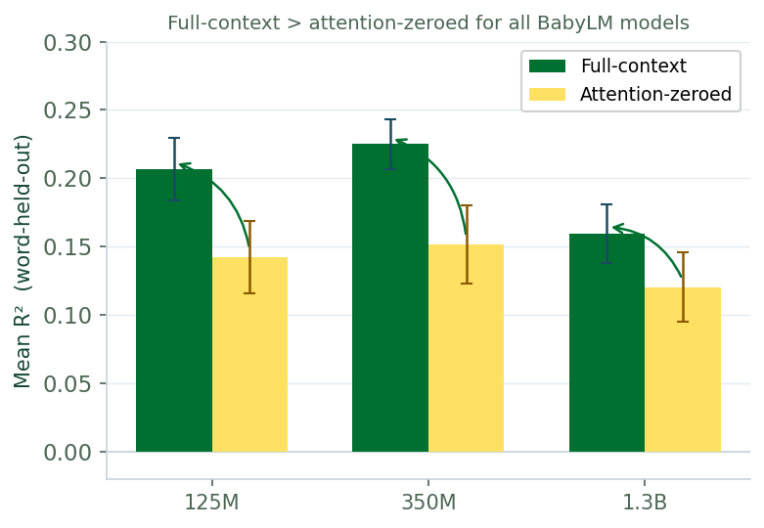
EXPERIMENT 1 · RESULT ③
Cross-word attention is net abstractive for BabyLM
▸ Full-context R² > attention-zeroed R² for word-held-out, all three models
▸ Blocking cross-word attention reduces probe accuracy: attention is helping
▸ We call this a context-integration mechanism — not an "abstraction mechanism"
◦ Same mechanism will produce memorization when training exposure is sufficient
▸ In BabyLM: most pairs appear 1–2× in pretraining — attention cannot learn pair-specific statistics
▸ Instead, cross-word attention computes general relational features between words
▸ Most pairs fall below the threshold where memorization dominates; net effect is abstractive

Slide 11
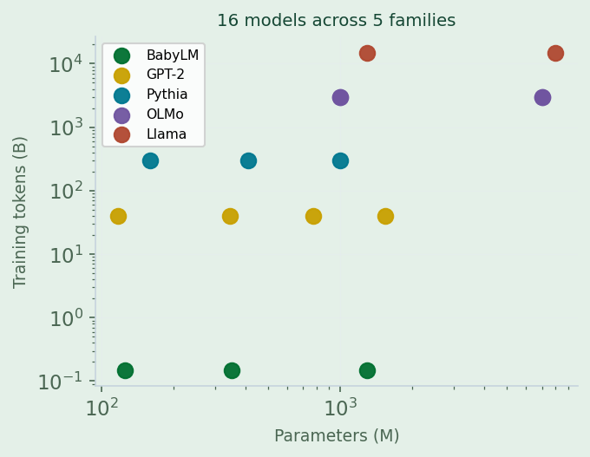
EXPERIMENT 2
Cross-Family Final-Layer Representations
16 models across 5 families: BabyLM, GPT-2, Pythia, OLMo, Llama 117M–8B parameters · BabyLM (~150M tokens) to ~15T tokens (Llama 3) Pile-trained models: GPT-2 (WebText), Pythia (the Pile), OLMo (Dolma), Llama 3 (various)

Slide 12
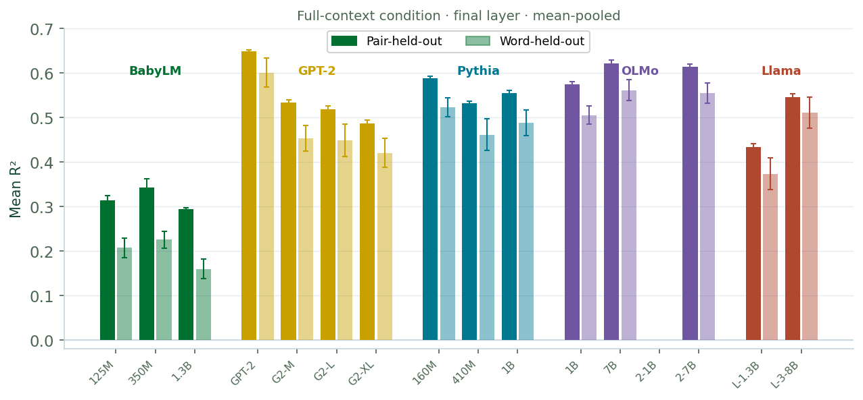
EXPERIMENT 2 · RESULT ①
Scale improves abstraction; the lexical component persists at every scale
▸ Pile-trained models: substantially higher word-held-out R² than BabyLM of comparable size
▸ Scale improves abstract preference representations, not only memorization
▸ Pair vs. word gap persists across all Pile-trained families: lexical component doesn't disappear with scale
▸ Within families: word-held-out R² non-monotonic with parameter count
◦ Corpus composition and diversity (not parameter count) drives abstract preference quality

Slide 13
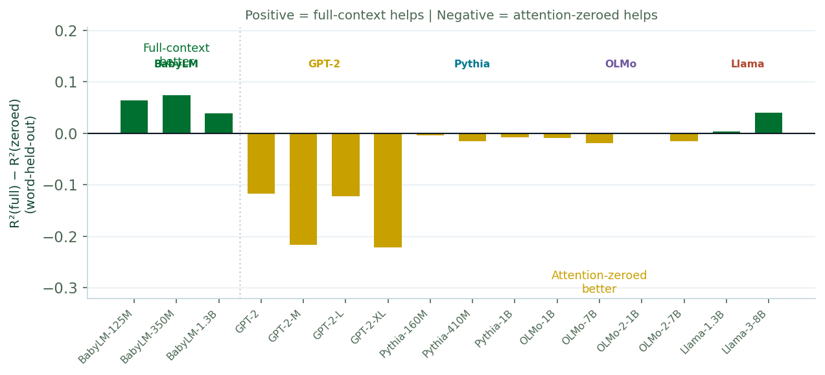
EXPERIMENT 2 · RESULTS ②–③
Universal U-shape and the critical attention flip
▸ β₂ > 0 for all 16 models — the U-shaped frequency residual replicates across families and scales
◦ BabyLM shows larger β₂: more extreme frequency distribution (70% singletons) sharpens the low-freq/high-freq contrast
◦ β₂ attenuation under attention-zeroed: consistent across all 5 families (same mechanism, universal)
▸ Critical flip in attention condition: all Pile-trained families show attention-zeroed > full-context
◦ Blocking cross-word attention now IMPROVES generalizability — the opposite of Experiment 1
◦ Attention has crossed the threshold: from computing general relational features to encoding pair-specific statistics
▸ Same context-integration mechanism — different outcome because pretraining exposure per pair is far greater

Slide 14
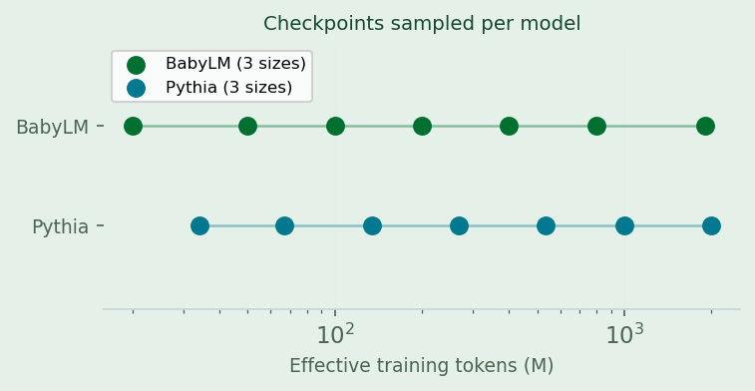
EXPERIMENT 3
Developmental Trajectories Across Training Checkpoints
BabyLM (125M, 350M, 1.3B) and Pythia (160M, 410M, 1B) at multiple checkpoints BabyLM: ~20M–1.9B effective training tokens | Pythia: ~34M–2.1B tokens Pythia window = first 0.7% of its full 300B-token training run

Slide 15
EXPERIMENT 3 · RESULTS ①②③
The developmental arc: memorization → abstraction → memorization
▸ R² gap (①): BabyLM starts with large gap that narrows over training
◦ Lexical component weakens faster than the generalizable component
▸ β₂ trajectory (②): BabyLM starts negative (normal freq benefit), turns positive at ~750M tokens
◦ Pythia β₂ is positive from its first checkpoint — Pile gives far greater absolute token exposure per pair from the outset
▸ Attention condition (③): both families begin with attention-zeroed > full-context (Phase 1: early memorization)
◦ Both flip to full-context > attention-zeroed as training continues (Phase 2: abstraction)
◦ Pythia's Phase 2→3 transition (abstraction → memorization) is not in this checkpoint window
◦ But Experiment 2 establishes it must have occurred: fully-trained Pythia shows the flip

Slide 16
SYNTHESIS
Cross-word attention oscillates between memorization and abstraction across training
Phase 1 Early memorization (or noise)
Phase 2 Abstraction
Phase 3 Memorization
Attention-zeroed > full-context Cross-word attention hurts generalization; consistent with nascent pair-specific encoding
Full-context > attention-zeroed Attention computes general relational features between words
Attention-zeroed > full-context again Attention encodes pair-specific co-occurrence statistics
→
→
Early training · both BabyLM and Pythia
BabyLM (end of training) Pythia (within checkpoint window)
Fully-trained Pile models (Exp 2) [not in Exp 3 checkpoint window]
▸ Phase 1→2: cross-word attention accumulates enough data to shift from pair-specific encoding to generalizable relational features
▸ Phase 2→3: with sufficient pair-specific exposure, pair-specific encoding dominates again — memorization reasserts itself
▸ BabyLM stops at Phase 2; Pile-trained models reach Phase 3 — same mechanism, more data

Slide 17
CONCLUSION
Abstraction and memorization coexist; attention determines their balance
▸ LLMs do learn abstract binomial ordering preferences — word-held-out R² > 0 across all 16 models
◦ This holds across conditions, families, and scales — counter to Houghton (2025)
▸ A lexical component persists at every scale: word-specific ordering tendencies contribute to probe accuracy regardless of training data size
▸ Cross-word attention mediates the abstraction-memorization tradeoff
◦ It is a context-integration mechanism, not an abstraction or memorization mechanism per se
◦ Its outcome depends on training exposure to pair-specific co-occurrence statistics
▸ The developmental arc (memorization → abstraction → memorization) is traceable within the first 0.7% of Pythia's training
◦ The transition from Phase 2 to Phase 3 is driven by cumulative exposure per pair, not model size
The bigger picture
Binomial ordering is jointly determined by abstract principles and pair-specific memorization.
Word-held-out R² > 0 across all 16 models confirms genuine generalization to novel word combinations; the U-shaped frequency residual (β₂ > 0) and the attention flip in large-data models show that high-frequency pairs develop pair-specific representations that resist abstract decoding.
Memorization and abstraction co-occur throughout training — they are not staged.
The pair-word R² gap (lexical memorization) and word-held-out R² > 0 (abstraction) are both non-zero from the earliest training checkpoints. Cross-word attention oscillates between pair-specific and generalizable encoding as exposure increases; what changes is not which process operates, but which dominates.

Slide 18
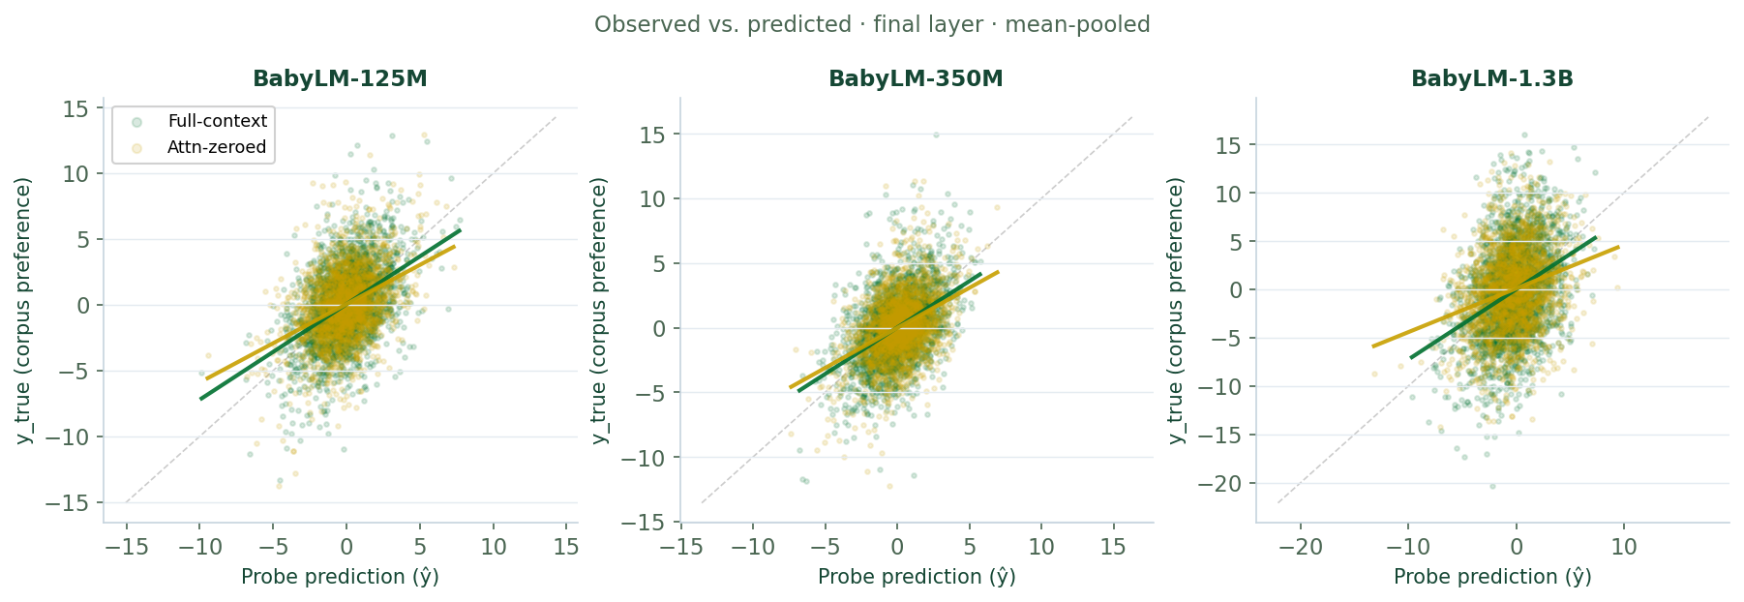
BACKUP · PROBE VALIDITY
BACKUP
Observed vs. predicted: probe performance on full corpus
▸ BabyLM-125M · final layer · full-context condition · mean-pooled
▸ R² on full corpus (in-sample) shown as sanity check alongside CV results
▸ Probe captures a real ordering signal despite data-limited pretraining

Slide 19
BACKUP · BABYLM DETAILS
BACKUP
BabyLM pretraining data vs. Pile-trained models
▸ BabyLM training corpus (Warstadt et al. 2023):
◦ AO-CHILDES, BNC spoken, Gutenberg, OpenSubtitles, simple English Wikipedia, switchboard
◦ ~100M words, trained for 20 epochs → ~2B effective training tokens
◦ Curated for developmental plausibility — NOT the corpus the binomials were drawn from
▸ Pile-trained models (EleutherAI Pile, Common Crawl, etc.):
◦ GPT-2: 40GB WebText; Pythia: 825GB Pile; OLMo: 3T Dolma tokens; Llama 3: ~15T tokens
◦ These corpora overlap substantially with the source of the binomials
▸ Key consequence: BabyLM models have seen far fewer instances of each binomial pair in pretraining
◦ Explains the different regime: cross-word attention hasn't accumulated pair-specific statistics

Slide 20
BACKUP · TECHNICAL NOTES
BACKUP
Attention-zeroed: implementation details and caveats
▸ Implementation: attention scores between tokens in word1 span and word2 span set to −∞ before softmax
◦ Effectively zeroes the cross-word attention weights at every head in every layer
◦ Self-attention within each word's span is unaffected
▸ RoPE models (Pythia, OLMo, Llama): attn_zeroed additionally removes relative position encoding
◦ These models receive no positional information about the relative position of the two words
◦ GPT-2 uses absolute positional embeddings added at the input — position is encoded there, not in attention
◦ Worth a methods footnote when cross-family comparisons are made
▸ The attn_zeroed condition does NOT remove all inter-word information: later-layer MLPs may still integrate
◦ Treats attention as a necessary (not sufficient) mechanism for the effects observed

Slide 21
BACKUP · REGRESSION SPECIFICATION
BACKUP
Frequency-residual regression: model specification
▸ For each condition × model × layer:
◦ Residual_i = |y_true_i − ŷ_i| (absolute probe error for pair i)
◦ Model: Residual ~ β₀ + β₁ log(freq_i) + β₂ log²(freq_i) + ε
◦ β₂ > 0 = U-shape: high-frequency penalty (pair-specific memorization)
◦ β₂ < 0 = inverted U: high-frequency benefit (no memorization penalty)
▸ Bayesian multilevel regression (brms) for β₂ estimation; 95% CIs = 2.5th–97.5th posterior percentiles
▸ Attenuation of β₂ under attn_zeroed is reported as a directional effect (not a formal interaction test)
▸ Frequency = total corpus count (freq_w1_w2 + freq_w2_w1), log-transformed
◦ Correlation between |y_true| and log(freq): |r| < 0.04 across all 16 models (no confound)

Slide 22
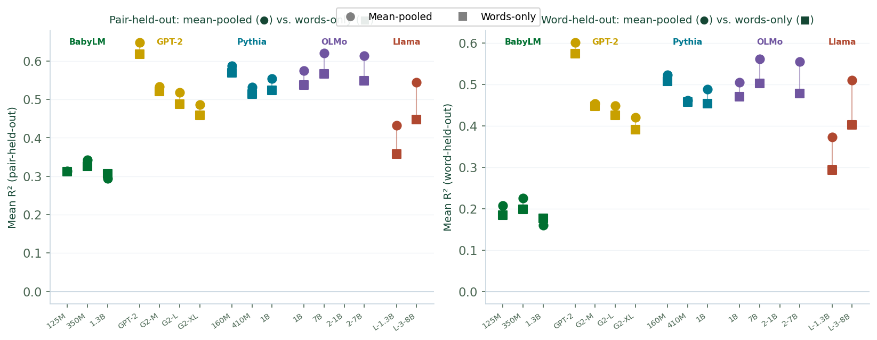
BACKUP · WORD-LEVEL REPLICATION
BACKUP
Words-only mode: trends replicate; absolute values not directly comparable
▸ Words-only: probe receives [h(W₁); h(W₂)] — each word extracted from its own sentence context
◦ W₁ hidden state comes from the sentence where W₁ appears first; W₂ from where W₂ appears first
◦ By construction, no cross-word attention influences these representations (autoregressive)
▸ Absolute R² not comparable to mean-pooled: different input dimensionality and information content
▸ Key trends replicate across all 16 models:
◦ Pair-held-out > word-held-out gap preserved (lexical component is a property of word representations)
◦ Same family ordering: Pile-trained >> BabyLM for word-held-out R²
◦ β₂ > 0 for all models (U-shape replicates at word level)
▸ Attention condition (words-only vs attn-zeroed binomial-level) interpretation differs — see next slide

Slide 23
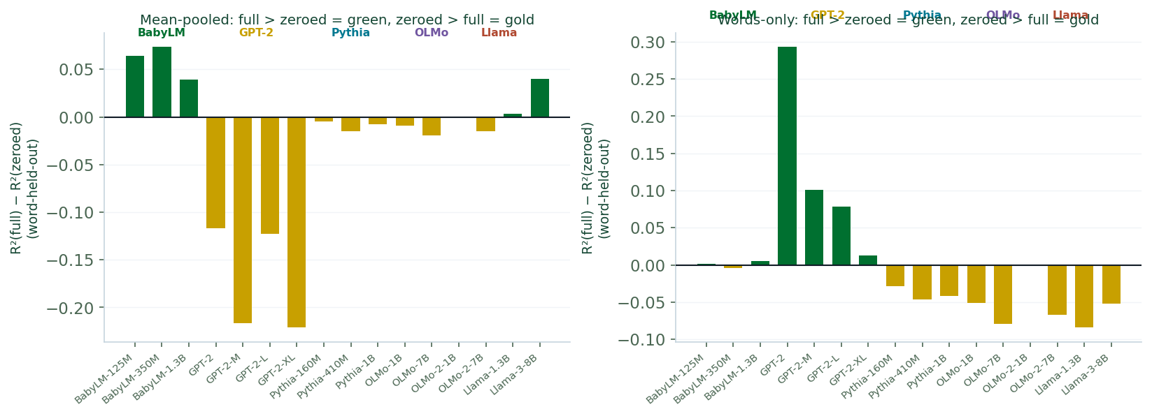
BACKUP · WORD-LEVEL ATTENTION CONDITION
BACKUP
Attention condition dissociation: words-only vs. mean-pooled differ sharply
▸ Recall: words-only extracts each word independently — no cross-word attention by construction
▸ Comparing words-only vs. attn-zeroed binomial-level is NOT the same comparison as full vs. attn-zeroed
▸ Key dissociation for Pile-trained models:
◦ Mean-pooled: attn-zeroed > full-context for word-held-out (the "flip" = memorization)
◦ Words-only: the "full-context" representation already has no cross-word attention
◦ Implication: the memorization signal is encoded at the sequence level, not just the word-token level
▸ For BabyLM: mean-pooled full > attn-zeroed, but words-only shows almost no difference
◦ The abstractive benefit of cross-word attention (Phase 2) operates on the full-sequence representation
◦ Individual word-token representations are roughly equally informative regardless of attention condition
▸ Consistent with the view that cross-word attention in BabyLM enriches the global sequence representation

