Slide 2





MapReduce:
Help you Choose the Airline
Zhuoyi Nie
Notes:
nihao

Slide 3
Summary
Background Information & Technology
Analyses
Overview

Slide 4







1
Overview
Choose Which One???

Slide 5
2
Background Information
IATA Airline code | Airline Company | IATA Airline code | Airline Company
MQ | Envoy Air | HA | Hawaiian Airline
OO | SkyWest Airline | EV | Atlantic Southeast Airline
UA | United Airline | US | US Airways
VX | Virgin America | WN | Southwest Airline
F9 | Frontier | FL | AirTran Airways
AA | American Airline | Bb | JetBlue
AS | Alaska Airlines | DL | Delta

Slide 6
2
Background Information
The basic format of data is:
"FL_DATE","CARRIER","FL_NUM","ORIGIN_CITY_NAME","ORIGIN_STATE_ABR","DEST_CITY_NAME","DEST_STATE_ABR","CRS_DEP_TIME","DEP_TIME","CRS_ARR_TIME","ARR_TIME","CANCELLED","AIR_TIME","DISTANCE”
E.g.: 2014-01-01,"AA","1","New York, NY","NY","Los Angeles, CA","CA","0900","0914","1225","1238",0.00,359.00,2475.00,
There are totally 5819811 data.

Slide 7
2
Background Information
Language: Python
Tools: Hadoop (MapReduce)
Environment: Eclipse
Map(): performs filtering function
MapReduce
Reduce(): performs the summary operation, such as counting the number

Slide 8
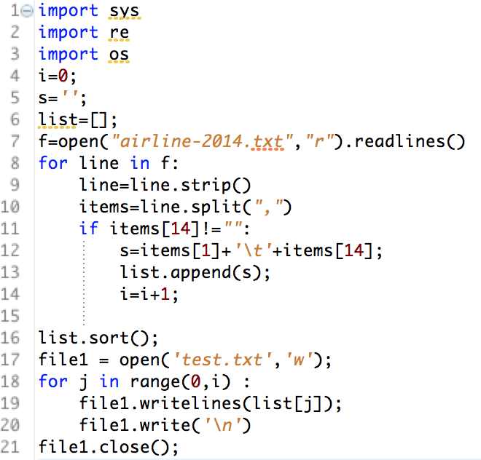
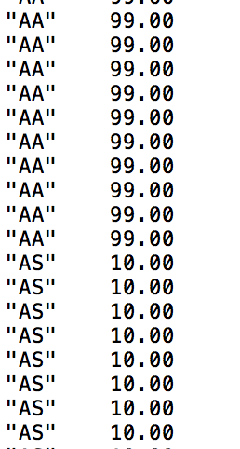
Calculate the total minutes of airtime each carrier have
Map() function

Slide 9
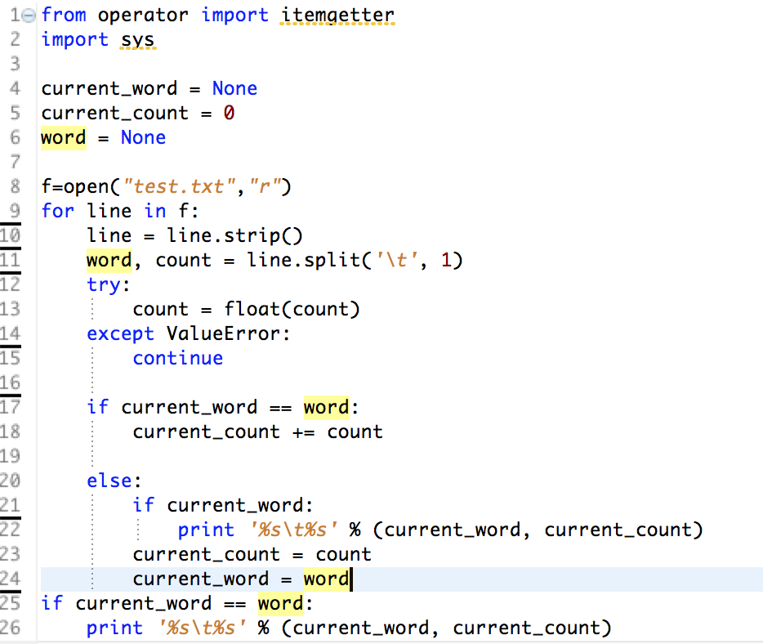
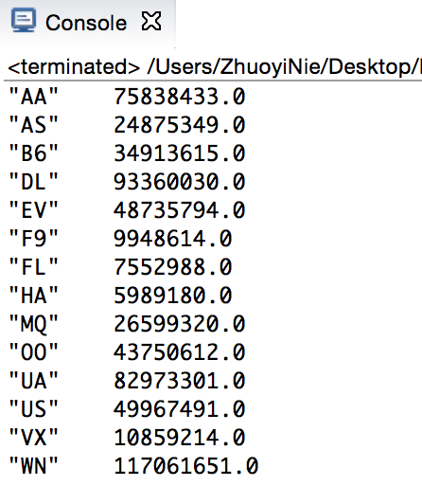
Reduce() function

Slide 10
3
Analyses
1
Analyze each carrier based on the same questions
Procedure
2
Analyze the airline information which is related to DC

Slide 11
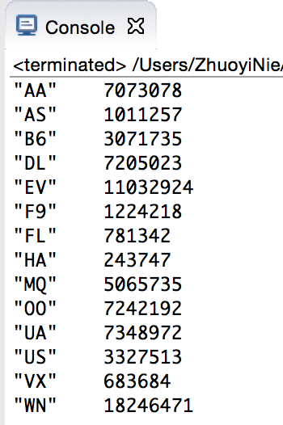
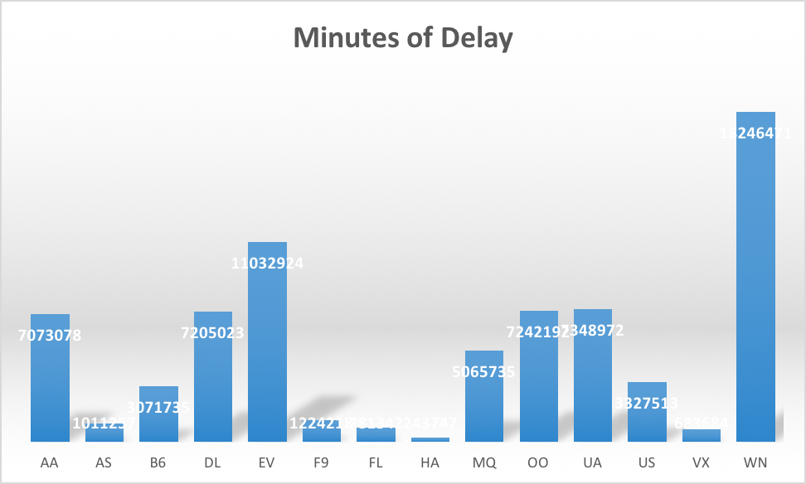
3
Analyses
How many minutes of delay did each carrier have?

Slide 12
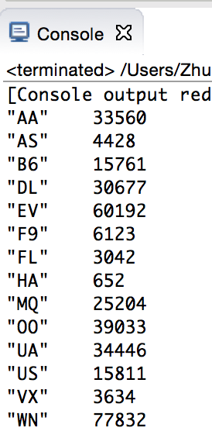
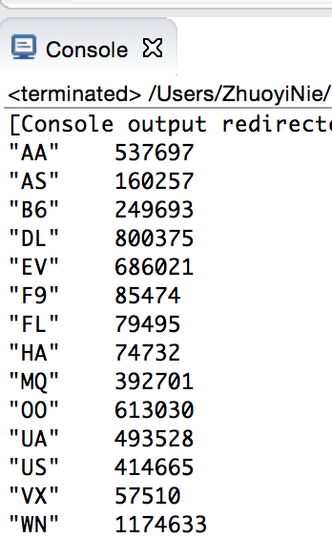
3
Analyses
What is the percentage departures later than 60 minutes from every carrier?

Slide 13
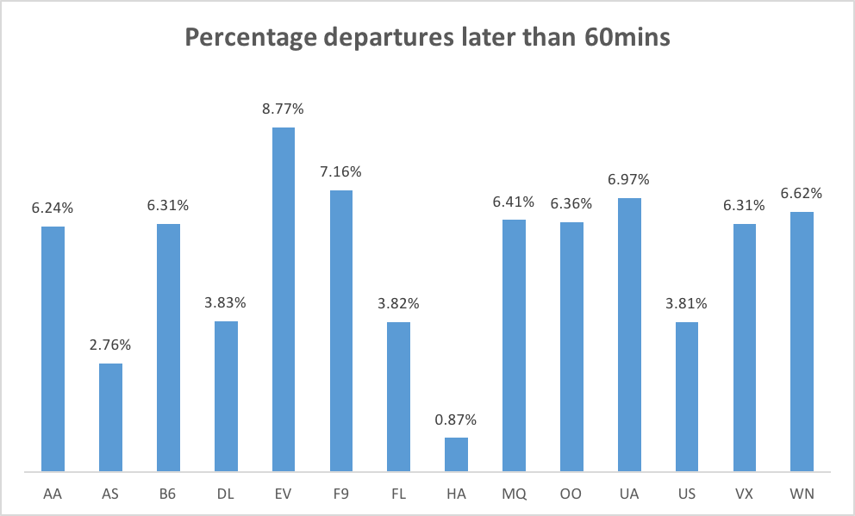
3
Analyses
What is the percentage departures later than 60 minutes from every carrier?

Slide 14
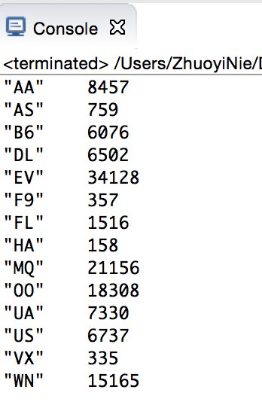
3
Analyses
What is the percentage of cancel from every carrier?

Slide 15
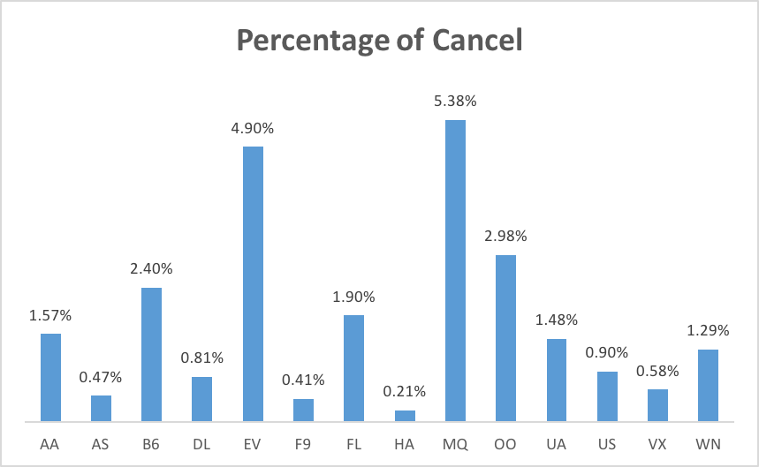
3
Analyses
What is the percentage of cancel from every carrier?

Slide 16
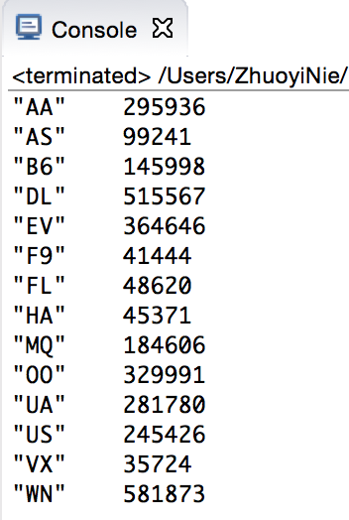
3
Analyses
What is the percentage of each carrier that can arrive on time?

Slide 17
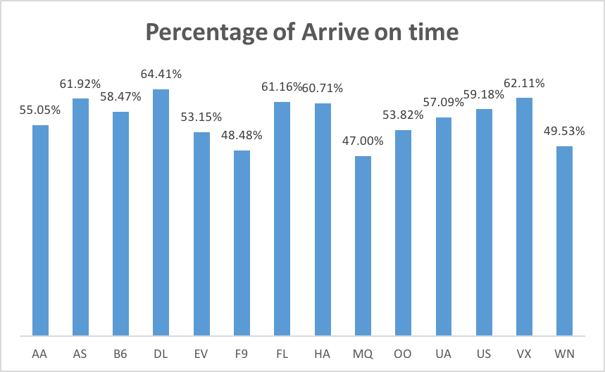
3
Analyses
What is the percentage of each carrier that can arrive on time?

Slide 18
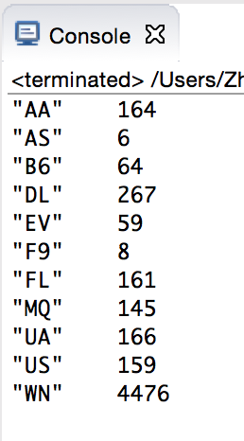
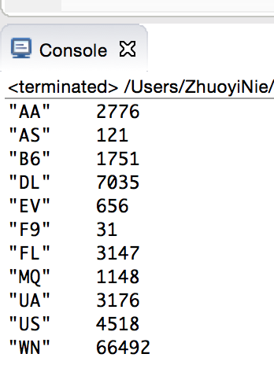
3
Analyses
Analyze the airlines whose ORIGIN_CITY_NAME or DEST_CITY_NAME is Washington, DC or Baltimore
What is the percentage departures later than 60 minutes from DC or Baltimore?

Slide 19
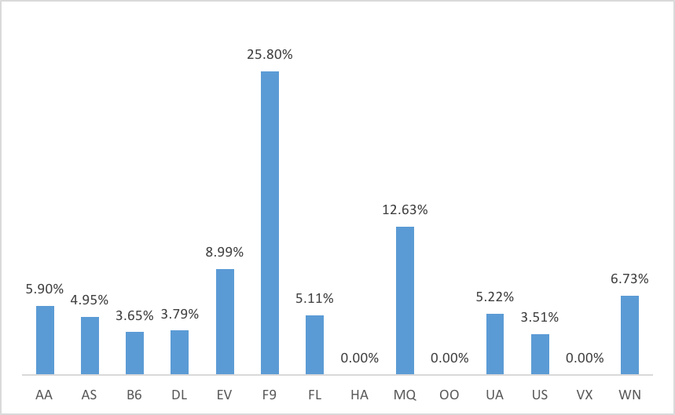
3
Analyses
What is the percentage departures later than 60 minutes from DC or Baltimore?

Slide 20
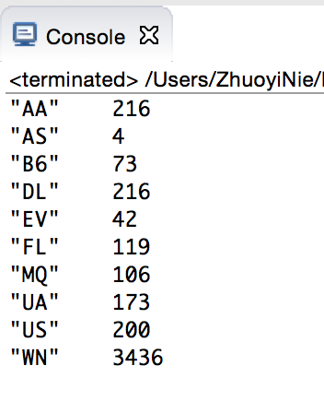
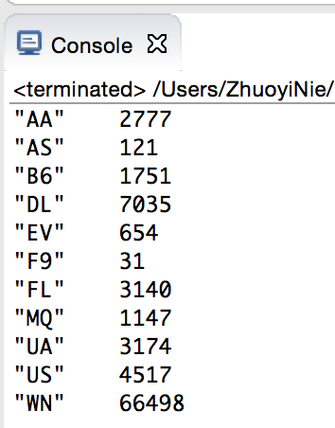
3
Analyses
What is the percentage arrive later than 60 minutes in DC or Baltimore?

Slide 21
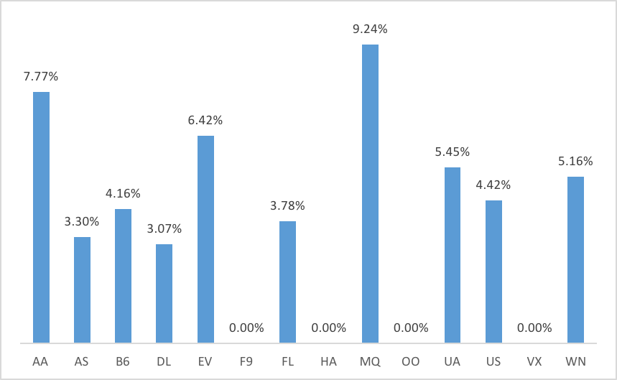
3
Analyses
What is the percentage arrive later than 60 minutes in DC or Baltimore?

Slide 22
4
Summary
Limitations:
Incomplete
Which airline to choose is based on people’s preference.

Slide 23
Thanks!

