Slide 1
model=FcNetwork([400, 320, 250, 140, 70, 10])
.
.
.
.
.
.
.
.
.
. . .

Slide 2
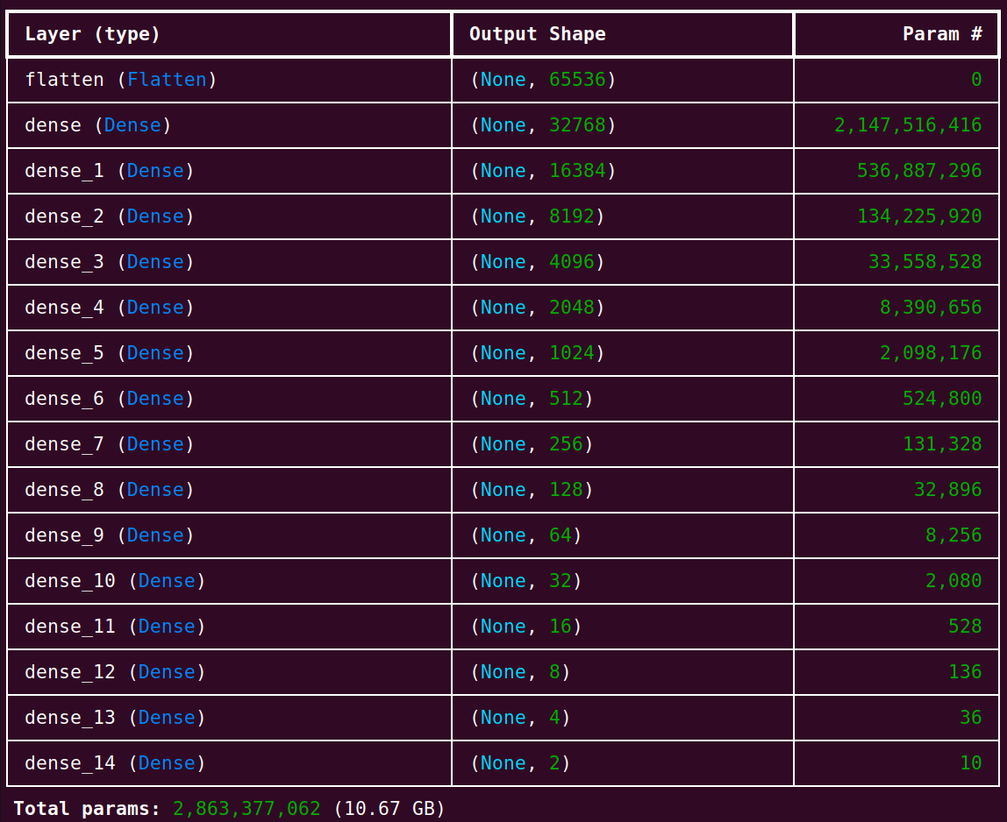
from tefcnetwork import *
xtr, ytr, xtst, ytst=loadData()
model=TeFcNetwork([65536, 32768, 16384, …, 2])
model.train(xtrain=xtr, ytrain=ytr)
model.test(xtest=xtst, ytest=ytst)

