Slide 1
Pre- and Post-Debate Democratic Primary Data: Twitter, Google Trends, and Polls
Fundamentals of Computing and Data Display, Fall 2019 Zoe Padgett and Fatou Thiam

Slide 2
Overview
Can Twitter data and Google trends data be used to supplement polling results, by providing real-time information to candidates while they wait for polling data to come in?
Exploratory analysis to see if pre- and post-debate polling data during the 2020 U.S. Democratic primary election aligns with these real-time sources

Slide 3
Twitter Data
Used Rweet package and searh_tweet function with selected keywords to gather tweets between November 20th and November 21st
Separated the 1.3 million tweets after removing irrelevant tweets in 2 groups: pre and post debate
Generated maps by number of tweets per candidate and ran sentiment analysis for 5 candidates

Slide 4
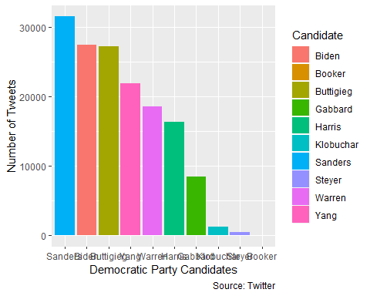
Pre-debate number of tweets
Pre-debate Mentions in Tweets, by Candidate

Slide 5
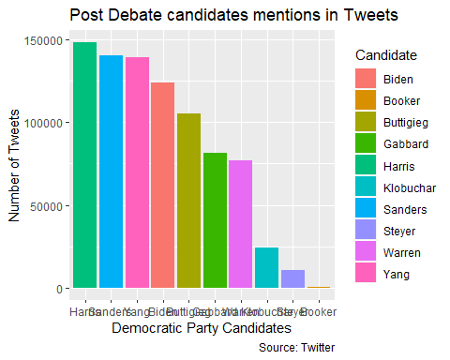
Post-debate number of tweets
Post-debate Mentions in Tweets, by Candidate

Slide 6
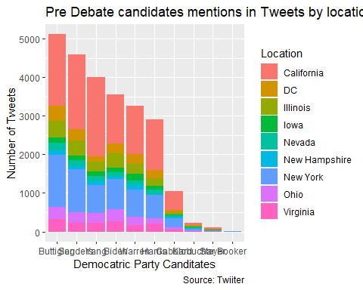
Tweets location pre-debate
Pre-debate Mentions in Tweets, by Candidate & location

Slide 7
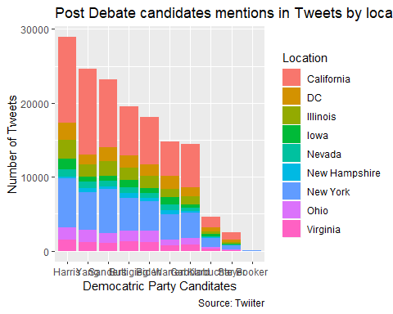
Tweets location post-debate
Post-debate Mentions in Tweets, by Candidate & location

Slide 8
Google Trends Data
Used gtrends package to pull Google Trends data for each candidate before and after the debate
Generated maps for each candidate to see the geographic distribution of searches
Graphed the search popularity of each candidate pre- and post-debate

Slide 9
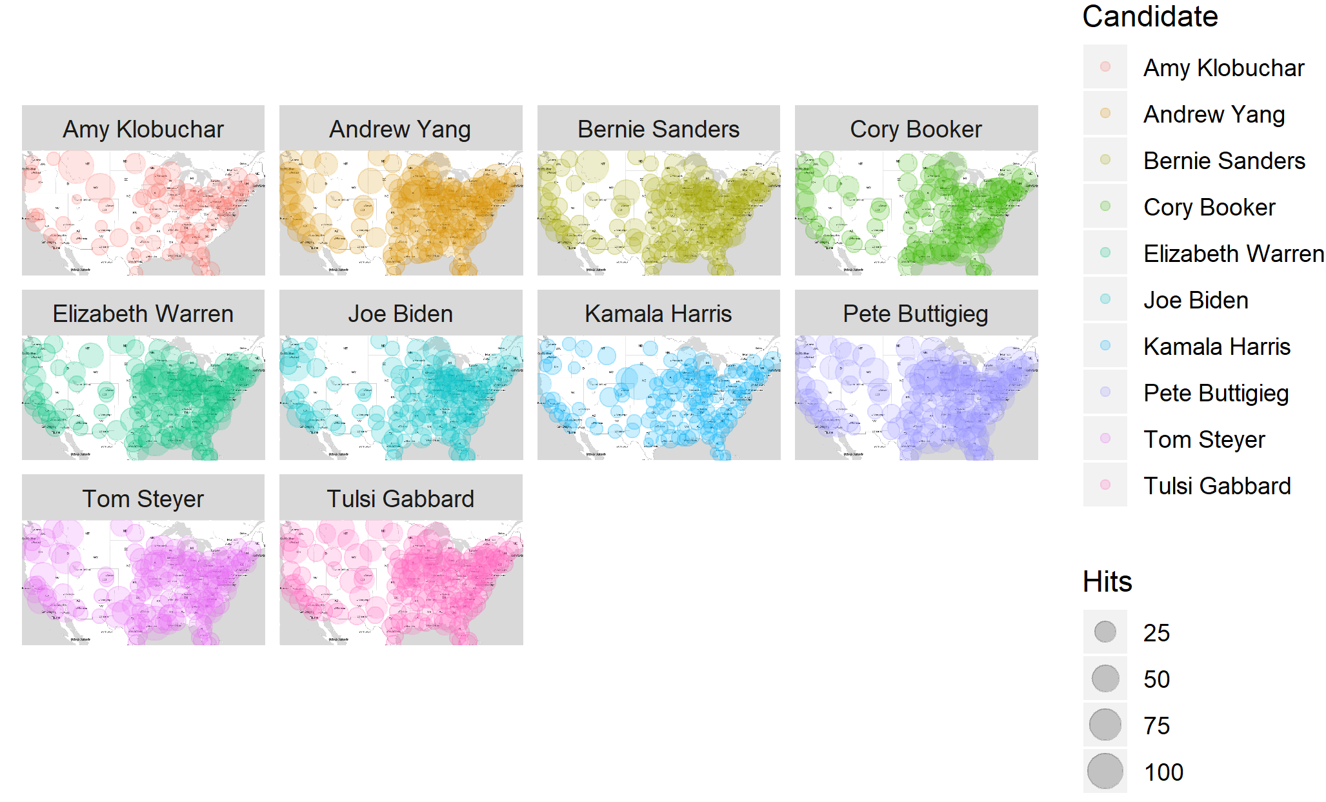
Google Trends Map

Slide 10
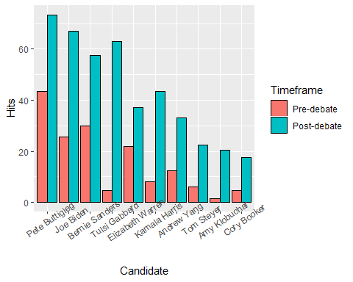
Candidate Search Popularity
Pre- and Post-debate Google Trends Data, by Candidate

Slide 11
Polling Data
Data from RealClearPolitics, average polling results pre- and post-debate

Slide 12
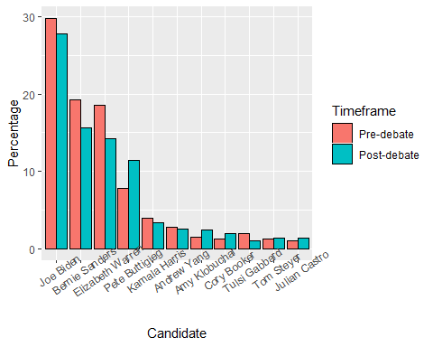
Pre- and Post-debate Polling Data, by Candidate

Slide 13
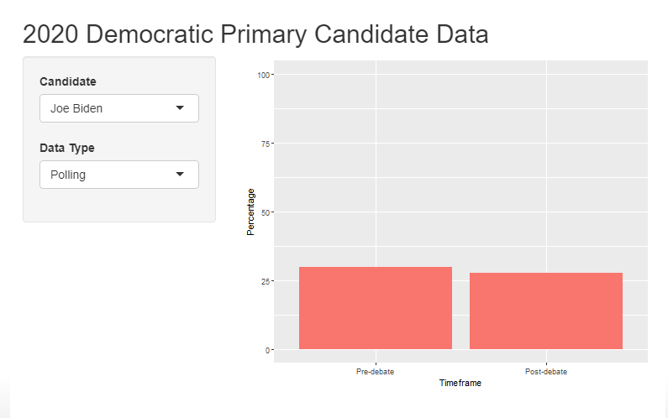
Results

Slide 14
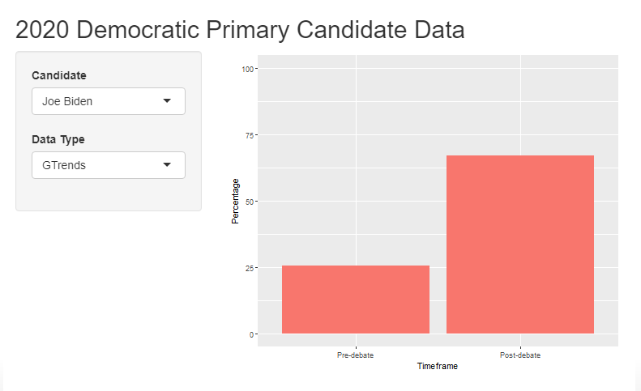

Slide 15
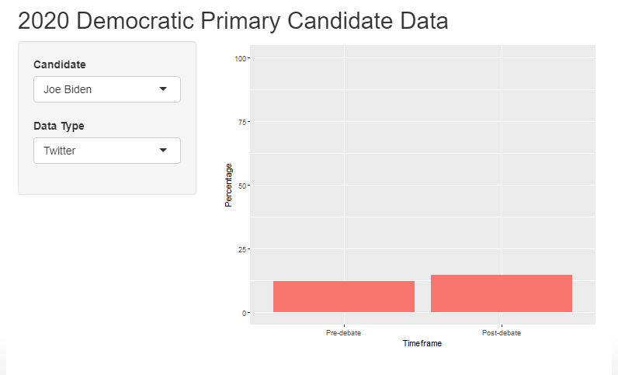

Slide 16
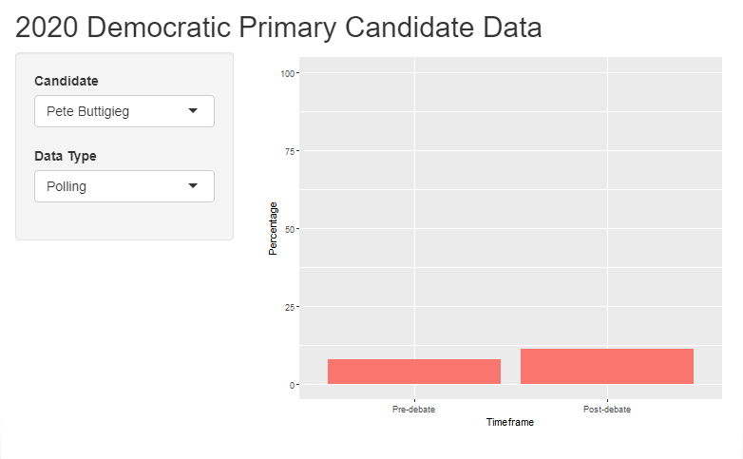

Slide 17
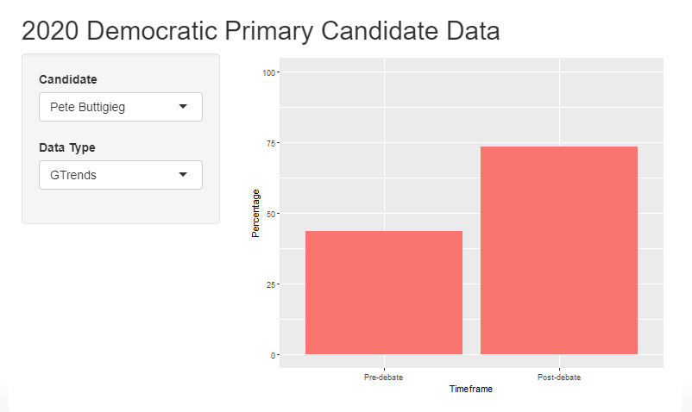

Slide 18
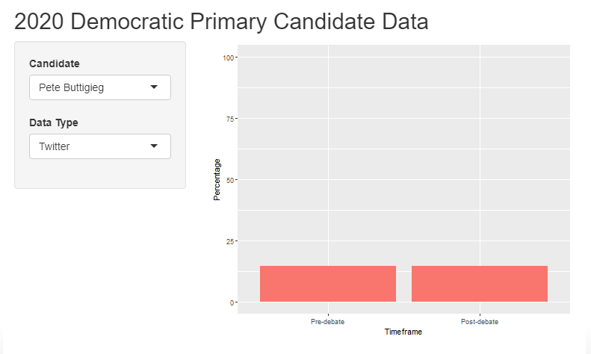

Slide 19
Conclusion
Neither Twitter nor Google Trends data align with polling data
These data are not representative of US voters, lack of demographic data for adjustment
Variable-to-variable comparison between two data sources may not be realistic (e.g., do number of searches and positivity of tweets actually mean more people will vote for a candidate?)
Many difficulties in practical usage of this data (e.g., location fields)
Overall, we don’t think this data should be used in place of survey data
However, this data could still be useful for candidates in understanding how social media users percieve them before and after a debate, or in understanding their search popularity

