Slide 1
UNRAVELING THE CONCEPTS OF REINFORCEMENT LEARNING

Slide 2
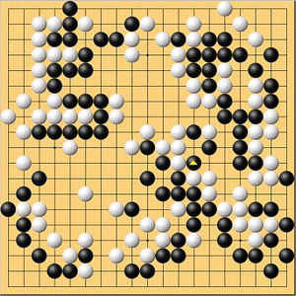
Problem 1
Teaching an AI agent to play Go
The players take turns placing the stones
on the intersections of a board with a
19×19 grid of lines
Challenges
The lower bound on the number of legal
moves in Go has been estimated to be
2 x 10¹⁷⁰ .
After first two moves, number of possible
next moves are close to 130,000

Slide 3
Problem 2
A mobile robot has to decide whether it should enter a new room in search of dirt to collect or start trying to find its way back to its battery recharging station. It has to make its decision based on how quickly and easily it has been able to find the recharger in the past.
Challenges
Agent needs to interact with its environment and adjust its behavior
The next action it takes has to be considered by taking into account indirect and delayed consequences for the agent (reaching out the charger before batteries run down)
Agent requires planning considering all uncertainties in the environment
Agent needs to use knowledge gained from previous experience

Slide 4
Reinforcement Learning
Reinforcement Learning (RL) is a subfield of Machine Learning where an agent learns by interacting with its environment, observing the results of these interactions and receiving a reward (positive or negative) accordingly. This way of learning mimics the fundamental way in which humans and human-alike animals learn.
Three aspects of formulation – sensation, action and goal.

Slide 5
RL vs Supervised and Unsupervised Learning
RL | Supervised Learning
Learning from interaction and experience | Learning from training examples
Dynamic environment | Static environment
Optimal solution from number of possible solutions that maximizes the reward | Prior knowledge of input and true solution(output)
RL | Unsupervised Learning
Finds optimal actions or most accurate labels for each particular situation to maximize long-term benefits | Assigns labels to similar data samples as clusters
For classification, reward if classified correctly else penalized | For classification, finds patterns for similar data

Slide 6
Features of Reinforcement Learning
Trial-and-error search
Delayed reward
Exploration vs exploitation problem

Slide 7
Elements of Reinforcement Learning
Along with agent and environment, there are four sub-elements of RL
A policy - agent's behaviour function
A reward function - defines the goal in a reinforcement learning problem
A value function - how good is each state and/or action in long run
A model of the environment - agent's representation of the environment

Slide 8
Steps for Reinforcement Learning
The agent observes an input state
An action is determined by a decision making function (policy)
The action is performed
The agent receives a scalar reward or reinforcement from the environment
Information about the reward given for that state / action pair is recorded

Slide 9
Maze example
Rewards: -1 per time-step
Actions: N, E, S, W
States: Agent's location

Slide 10
Maze example : Policy
Rewards: -1 per time-step
Actions: N, E, S, W
States: Agent's location

Slide 11
Maze example : Value Function
Rewards: -1 per time-step
Actions: N, E, S, W
States: Agent's location

Slide 12
Maze example : Model
Agent may have an internal
model of the environment
It has seen the trajectory through the
maze and reached the goal
Builds the model
Dynamics: how actions
change the state

Slide 13
On-Policy vs Off-Policy Learning
On Policy – Improving/Evaluating on the original policy
Off Policy – Improving/Evaluating a new policy
If a good starting policy is available: on-policy may be interesting, but may not explore other policies well
If more exploration is necessary, then perhaps off-policy is advisable, but maybe slow
May lead to the same result (e.g. after greedification)
Examples: On Policy – TD Learning, SARSA
Off Policy – Q Learning, R Learning

Slide 14
Passive vs Active learning
Passive learning
The agent has a fixed policy and tries to learn the utilities of states by observing the world go by
Often serves as a component of active learning algorithms
Often inspires active learning algorithms
Active learning
The agent attempts to find an optimal (or at least good) policy by acting in the world

Slide 15
Model-Based vs Model-Free RL
Model based approach to RL:
learn the MDP model, or an approximation of it use it for policy evaluation or to find the optimal policy
Model free approach to RL:
derive the optimal policy without explicitly learning the model
useful when model is difficult to represent and/or learn

Slide 16
Exploration vs Exploitation Dilemma
Online decision making involves a fundamental choice:
Exploitation: make the best decision given current information
Exploration: gather more information

Slide 17
Exploration vs Exploitation Dilemma
Restaurant Selection
- Exploitation: Go to your favorite restaurant
- Exploration: Try a new restaurant
Game Playing
- Exploitation: Play the move you believe is best
- Exploration: Play an experimental move

Slide 18
N-armed Bandit Problem
Choose repeatedly from one of n actions; each choice is called a play
After each play , you get a reward , where,
E<r_{t} |a_{t}> = Q*(a_{t})
These are unknown action values
Distribution of r_{t} depends only on a_{t}
Objective is to maximize the reward in the long term, e.g., over 1000 plays
To solve the n-armed bandit problem, you must explore a variety of actions and then exploit the best of them.

Slide 19
Exploration vs Exploitation Dilemma
Suppose you form estimates
Q_{t} (a) ~ Q*(a) Action value estimates
The greedy action at t is
A*_{t} = argmax Q_{t} (a)
A_{t} = A*_{t} => Exploitation
A_{t} ≠ A*_{t} => Exploration
You can’t exploit all the time; you can’t explore all the time
You can never stop exploring; but you should always reduce exploring

Slide 20
Balancing between Exploration and Exploitation
Action-Value Methods
Softmax Action Selection
Incremental Implementation
Tracking a Non Stationary Problem
Optimistic Initial Values
Associative Search (Contextual Bandits)

Slide 21
Action Value Method
we denote the true (actual) value of action a as q*(a), and the estimated value on the t^{th} time step as Q_{t}(a).
True Value: True value of an action is the mean reward received when that action is selected.
How to estimate the reward?
Q_{t}(a) = R1 + R2 + R3 +…..+ R_{kn} / K_{a}
The simplest action selection rule is to select the action (or one of the actions) with highest estimated action value, that is, to select at step t one of the greedy actions, At for which Q_{t}(A) = max_{a} Q_{t}(a).
This method always exploits the current knowledge to maximize the immediate reward, it spends no time sampling the rewards.

Slide 22
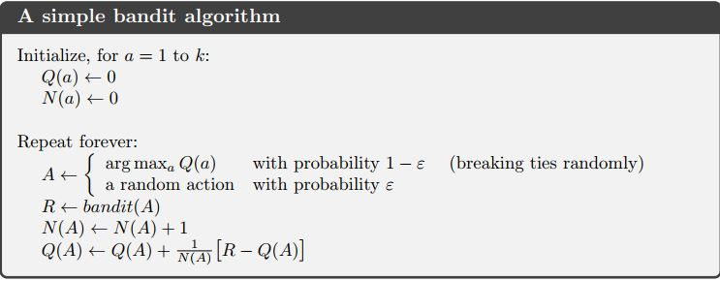
ε-Greedy Algorithm

Slide 23
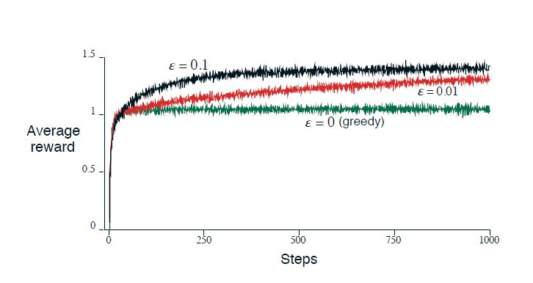
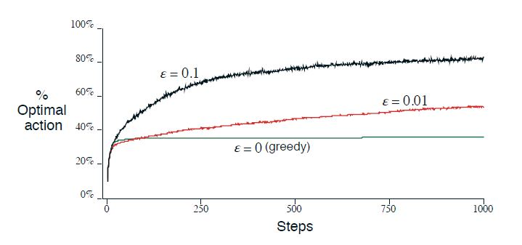

Slide 24
Softmax Action Selection
Epsilon greedy action selection is an effective and popular means of balancing exploration and exploitation in reinforcement learning.
There is one drawback
When it explores it chooses equally among all actions. This means that it is as likely to choose the worst-appearing action as it is to choose the next-to-best action
What could be the solution?
To vary the action probabilities as a graded function of estimated value.
The greedy action is still given the highest selection probability, but all the others are ranked and weighted according to their value estimates.

Slide 25

The most common softmax method uses a Gibbs, or Boltzmann, distribution.
It chooses action a on the t^{th} time step with probability.
The formula is given as:
e = Exponent of Natural logarithm
T = Positive parameter called Temperature

Slide 26

Incremental Implementation
In this also we start as Greedy algorithm and count the
Q_{t}(a) = R1 + R2 + R3 +…..+ R_{kn} / K_{a}
A problem with this straightforward implementation is that its memory and computational requirements grow over time without bound. That is, each additional reward following a selection of action a requires more memory to store it and results in more computation being required to determine Qt(a).
Now after getting this value we perform the incrementation

Slide 27
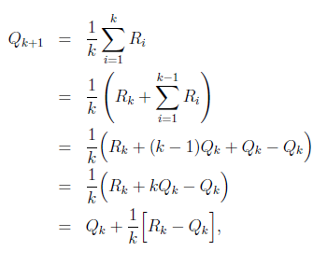
Average of all k rewards can be computed by

Slide 28

Tracking a Non-Stationary problem
The averaging methods discussed so far are appropriate in a stationary environment, but not if the bandit is changing over time.
In such cases it makes sense to weight recent rewards more heavily than long-past ones.
One of the most popular ways of doing this is to use a constant step-size parameter.
For example, the incremental update rule for updating an average Q_{k} of the k-1 past rewards is modified to be

Slide 29
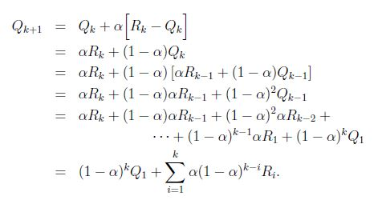
Incremental rule for non-stationary problem
where the step-size parameter, alpha , 0 < 1, is constant
The quantity 1 - alpha is less than 1, and thus the weight given to Ri
decreases as the number of intervening rewards increases.

Slide 30

Optimistic Initialization
Simple and practical idea: initialize Q(a) to high value
Update action value by incremental Monte-Carlo evaluation
Starting with N(a) > 0
Encourages systematic exploration early on
But can still lock onto suboptimal action

Slide 31
Associative Search
So far we have considered only non associative tasks, in which there is no need to associate different actions with different situations.
In these tasks the learner either tries to find a single best action when the task is stationary, or tries to track the best action as it changes over time when the task is nonstationary.

Slide 32
Temporal-Difference Learning
The central and novel idea of Reinforcement Learning
Learns a prediction of future rewards from another later learned prediction
Ultimately learns to make long-term predictions without a model of the environment's dynamics
Update estimates based in part on other learned estimates, without waiting for a final outcome
TD error is the difference between two temporally successive predictions, called Temporal Difference

Slide 33
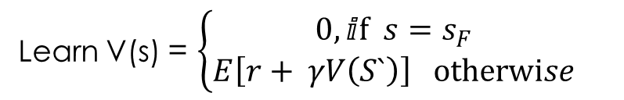
Temporal-Difference Learning
0.9
S
S1
S4
+1
+0
+1
S3
SF
S2
S5
+10
+2
0.1
Learn V(s) = $\left\{\begin{matrix}0,ⅈf s=s_{F} \\ E\left[r+ γV\left(S`\right)\right] otherwise\end{matrix}\right.$

Slide 34
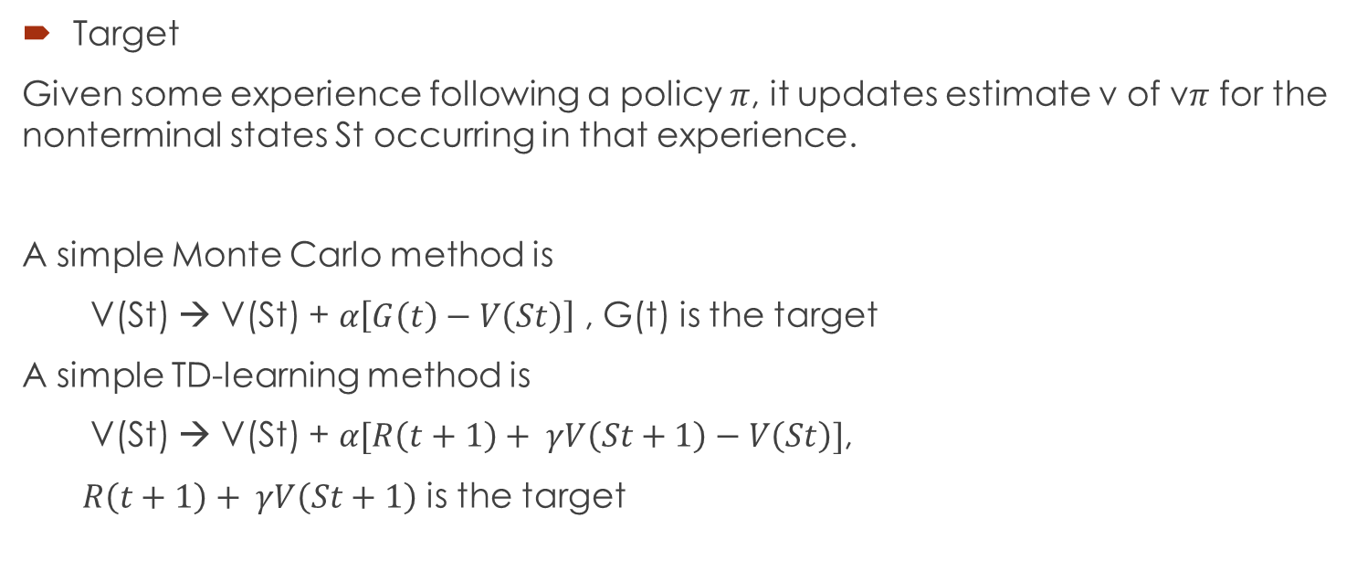
Temporal-Difference Learning (cntd.)
Target
Given some experience following a policy $π$, it updates estimate v of v$π$ for the nonterminal states St occurring in that experience.
A simple Monte Carlo method is
V(St) → V(St) + $α\left[G\left(t\right)−V\left(St\right)\right]$ , G(t) is the target
A simple TD-learning method is
V(St) → V(St) + $α[R\left(t+1\right)+ γV\left(St+1\right)−V\left(St\right)]$,
$R\left(t+1\right)+ γV\left(St+1\right)$ is the target

Slide 35
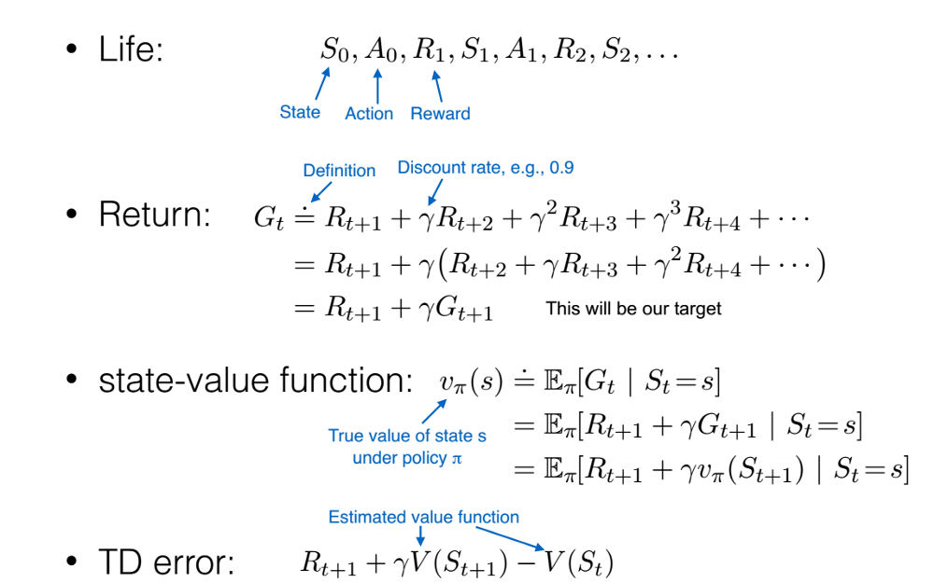
Temporal-Difference Learning (cntd.)

Slide 36
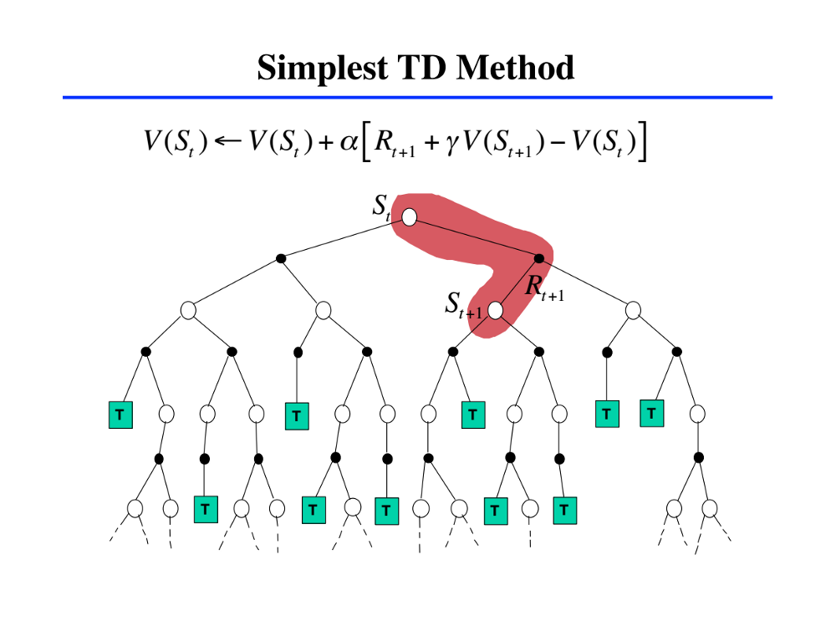
Simplest TD method - TD (0)
TD method: state value V(St) is updated (backed up) with immediate reward R(t+1) and discounted value of the next state — V(St+1)

Slide 37
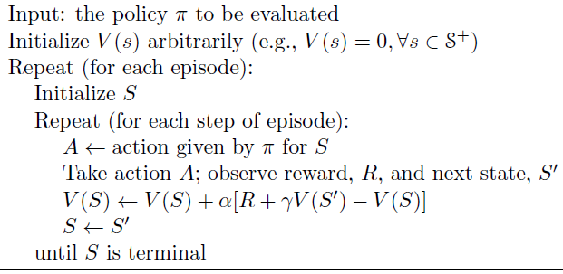

TD Prediction using TD (0)
Tabular TD(0) for estimating policy v$π$

Slide 38
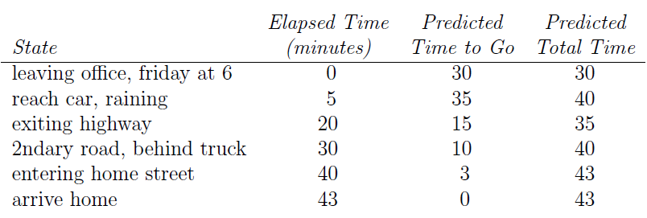
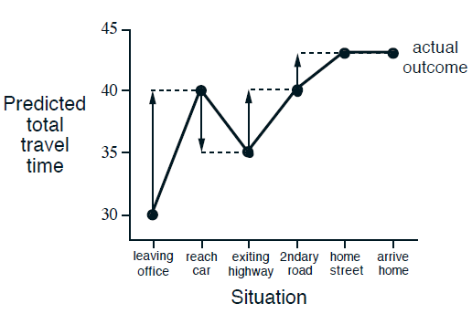
TD Prediction using TD (0)
The Driving Home Problem

Slide 39
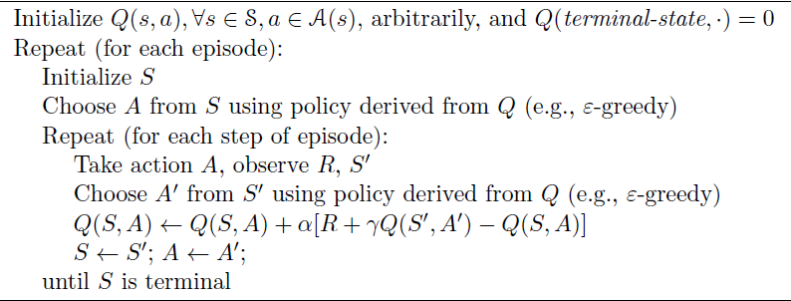
TD Control using SARSA
Quintuple of events,
(S_{t+1} , A_{t+1} , R_{t+1} , S_{t} , A_{t})
S A R S A

Slide 40
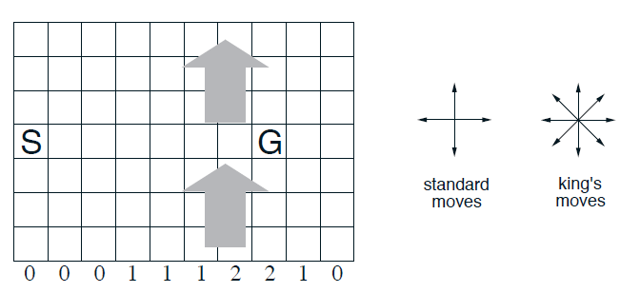
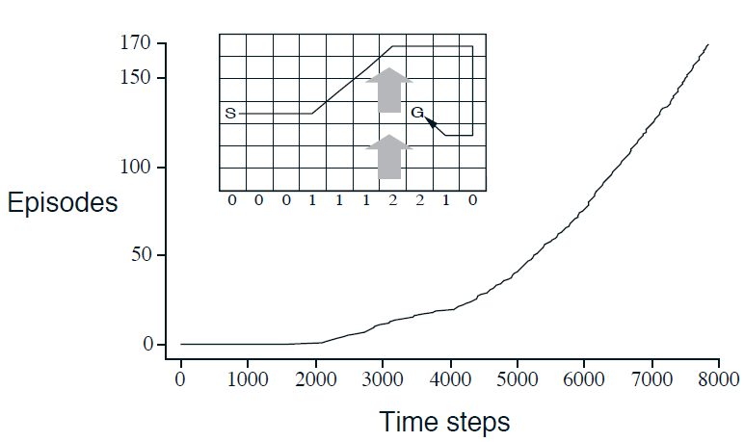
TD Control using SARSA
The Windy Gridworld Problem

Slide 41
When to use TD-Learning
Multi-step prediction problems
Only when the reward predicted is multiple steps in future
And each step reveals some information about the final prediction
Examples
Predicting outcome of a game, like chess or backgammon
Predicting what a stock market index will be at the end of a year

Slide 42
Challenges of RL
Time-consuming training procedure
The optimal policy must be inferred by trial-and-error interaction with the environment
The only learning signal the agent receives is the reward
Convergence and parameters optimization is not guaranteed in continuous reinforcement learning
Credit assignment problem – a common problem where we are not sure how to decide which action an AI took contributed to the reward it received

Slide 43
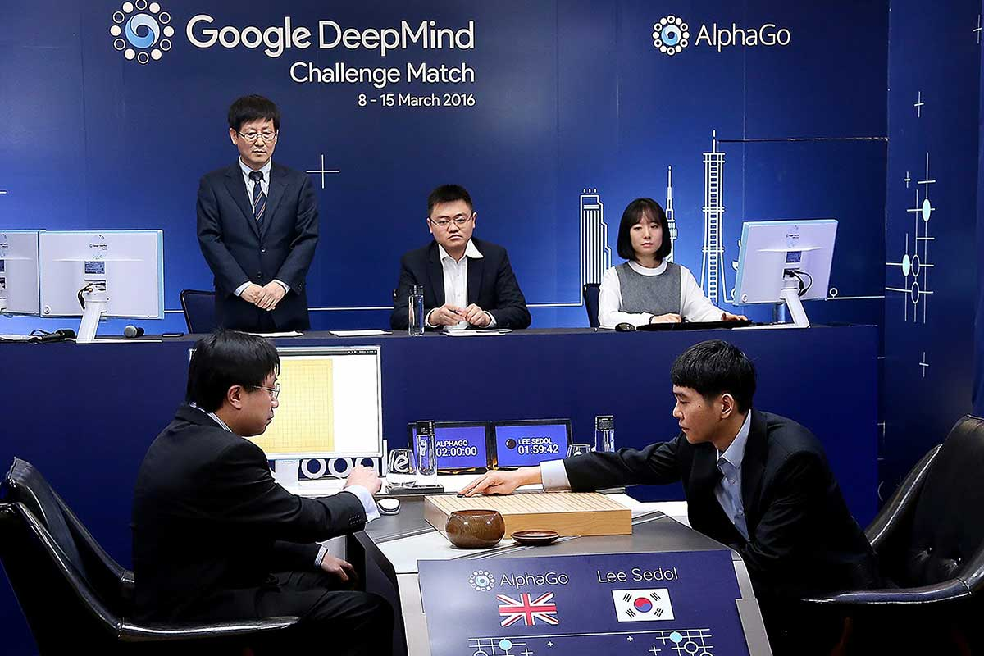
Recent Success in RL
Google’s DeepMind
trained AI AlphaGO beats
world champion Lee Sedol
in GO

Slide 44
Ongoing researches
Deep Reinforcement Learning
Multi-agent Reinforcement Learning
Transfer learning – transferring previously acquired knowledge from one task to another related task
Imitation Learning and behavioral cloning – adaptation to new situations

Slide 45
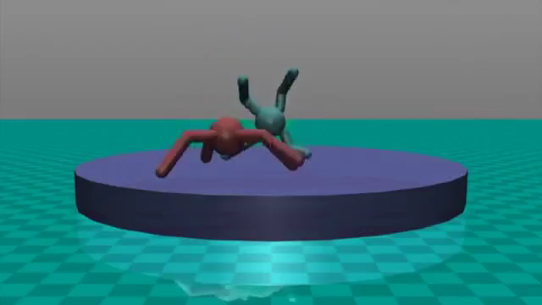

Slide 46
Conclusion
Scientists are hoping that integrating Reinforcement Learning techniques with other traditional AI approaches will create the general-purpose AI systems that can interact with and learn from the world around them. Despite of having some limitations, RL endows agents with the ability to perform experiments to better understand their surroundings and learn even high-level causal relationships. Perhaps we are not too far away from AI systems that can learn and act in more human-like ways in increasingly complex environments.

Slide 47
Reference
[1] Sutton, R. S., & Barto, A. G. (2012). Introduction to reinforcement learning. Cambridge, Mass: MIT Press.
[2] Jaderberg, M., Mnih, V., Czarnecki, W. M., & M Schau, T. (2016). Reinforcement learning with unsupervised auxiliary tasks. ArXiv:1611.05397v1.
[3] Arulkumaran, K., Deisenroth, M. P., Brundage, M., & Bharath, A. A. (2017). Deep Reinforcement Learning: A Brief Survey. IEEE Signal Processing Magazine, 34(6), 26-38. doi:10.1109/msp.2017.2743240
[4] http://www.cs.cmu.edu/~rsalakhu/10703/Lecture_Exploration.pdf
[5] https://sites.google.com/view/multi-agent-competition

