Slide 1
Whole Lotta Heart
Zehra Tokatli Melinda Eudy
Lauren Parrish Kelly Rose
Sarah Green

Slide 2


Project background
The Whole Lotta Heart project sought to understand which health indicators are most significant to your heart, mind, and even financial health.
The healthcare industry being one of the biggest consumers of Machine Learning and predicative analysis we chose to dive whole heartedly into it.
We will show you the power of machine learning in an aspect of our lives that is so very important… health!

Slide 3
Questions to answer
Which of the health indicators are more important to heart health?
Which of the health indicators are more likely to cause a stroke?
Which health indicators have the potential of costing you the most medically?

Slide 4

The data
The team leveraged three datasets from Kaggle.com which reflected predictors like smoking, blood pressure, and relationship status, and how they contribute to heart disease, stroke, and medical cost.

Slide 5
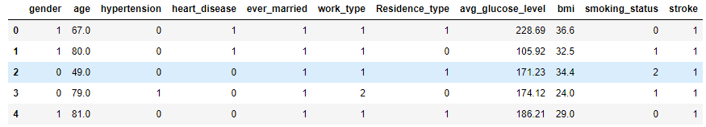
Etl process
During the data cleansing process, columns were renamed, and the team dropped rows with incomplete datasets to enhance understanding.
String formatted data was converted to integers to assist the machine learning algorithm.
Once data cleansing was completed the data was uploaded into a Postgres database.

Slide 6
Flask, visuals and machine learning
Utilizing Flask, D3, JavaScript, HTML/CSS, and Tableau, we were able to create an interactive dashboard full of visuals that will expand your mind on the different health indicators that play a large role in your heart, mind and financial health.
Using our knowledge of Machine Learning we were able to deploy a logistic regression algorithm with use of the pickle library that will return a prediction of your likelihood of having a stroke.

Slide 7
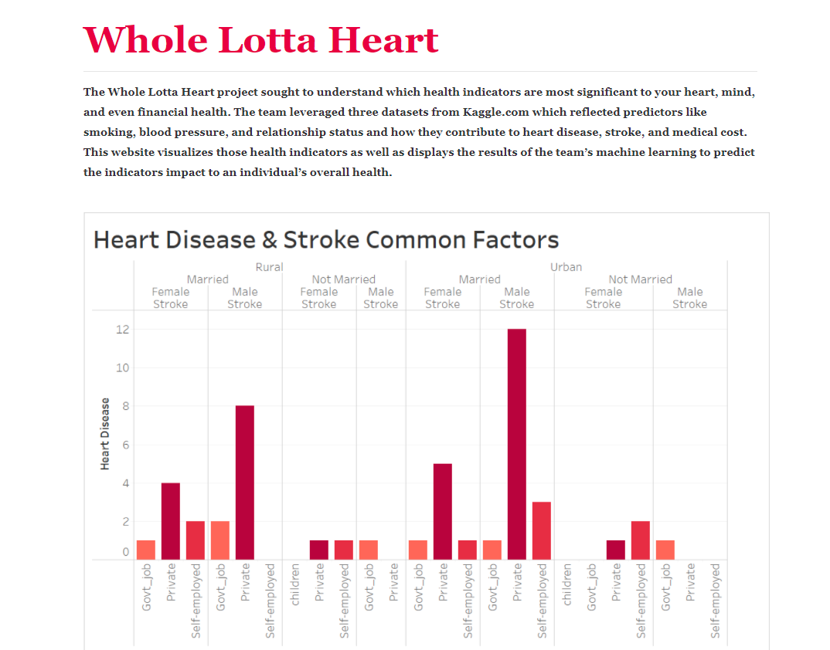
Heroku
We have hosted and published our dashboard on Heroku cloud platform.
https://whole-lotta-heart.herokuapp.com/

