Slide 1
Deep Learning Term Project (Enhancement of the reliability and security of the PUF authentication key in the wireless communication environment)
20191064
Jihoon LEE

Slide 2
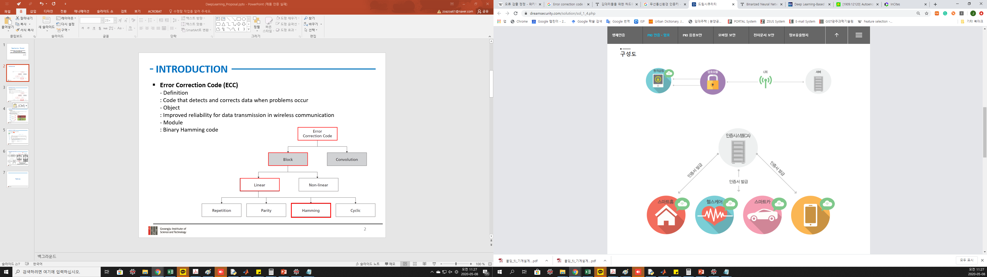

introduction
Authentication keys - Roles : Required for encryption and decrypted cryptogram : data confidentiality, data integrity, authentication and non-repudiation features
https://www.dreamsecurity.com/solution/sol1_4_.php
Notes:
https://www.dreamsecurity.com/solution/sol_1_4.php

Slide 3
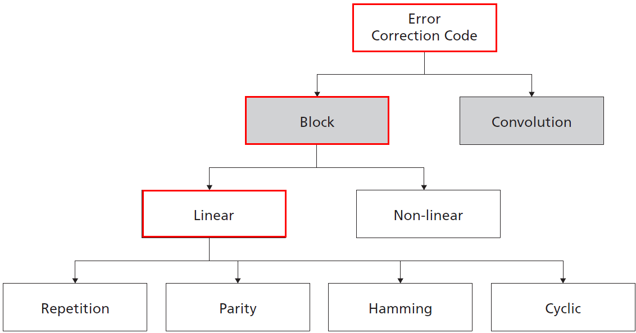
introduction
Error Correction Code (ECC) - Definition : Code that detects and corrects data when problems occur - Objects : Improved reliability for data transmission in wireless communication - Examples : Binary Hamming code
Notes:
백그라운드

Slide 4
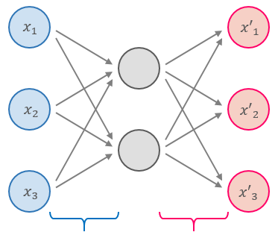
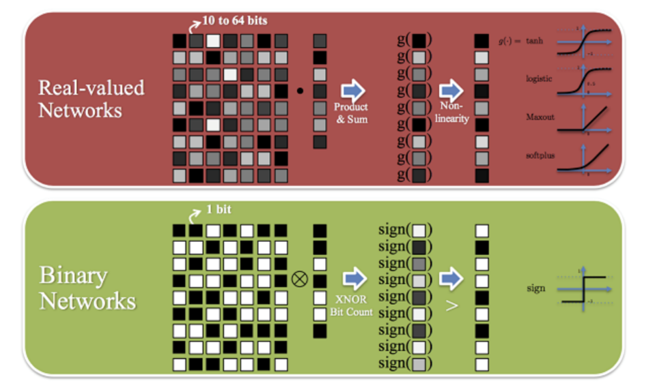
introduction
Autoencoder
BNN(Binarized Neural Network)
- Unsupervised learning - Determine the parameter value so that the output comes close to the input - Extract meaningful features(ex. ReLU CNN)
- Neural net with binary(1, -1) weights and activation function - Bit reduction to accelerate deep learning
w, fn
Encoder
Decoder
https://github.com/jaygshah/Binary-Neural-Networks
w: Weights
fn: Activation function
Notes:
이전 워크

Slide 5
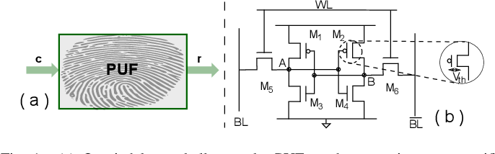
Datasets
SRAM PUF(Physical Unclonable Function) - Definition : Generate a security key using differences in the microstructure of semiconductors produced in the same manufacturing process - Roles : Optimized solution for IoT device security due to high security with a small chip - Properties ① Physical cloning is impossible by randomness ② Secure key management is possible ③ Data composed of small number of bits (Ex. 8bits)
Gao, Y., Su, Y., Yang, W., Chen, S., Nepal, S., & Ranasinghe, D.C. (2019). Building Secure SRAM PUF Key Generators on Resource Constrained Devices. 2019 IEEE ICPCCW, 912-917.
Notes:
Fig. 1. (a) Queried by a challenge, the PUF produces an instance-specific response. (b) SRAM PUF: Threshold voltage Vth mismatches of the transistors determines the response [7]. For example, when the Vth,M1 is slightly smaller than Vth,M2 , at power-up, the transistor M1 starts conducting before M2, thus, A = ‘1’. This in turn prevents M2 switching on. As a consequence, the SRAM power-up state prefers to be ‘1’ (A = ‘1’, B =‘0’), which is the response, while the address is the challenge.

Slide 6

Related studies
Perfectly trained DNN model providing optimum channel code for one-bit quantization
Designing a novel and practical DNN-based channel coding scheme well-suited for receivers
Hybrid module containing turbo code and DNN model
Notes:
이전 워크

Slide 7
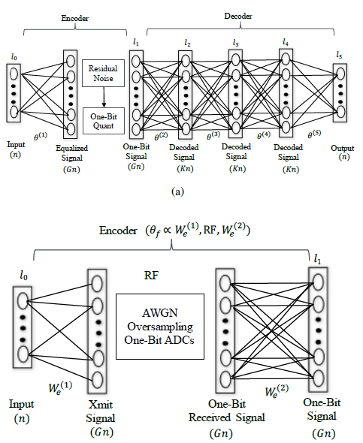
Related studies
Schema
Notes:
이전 워크

Slide 8
problem
SRAM PUF(Physical Unclonable Function) - authenticated even with a small number of bits (n bits) → However, this also implies the risk that an attacker → randomly authenticate and pass through an attempt to hack
Application to Model - Performed communication by increasing the size (k, k>n) of the hidden layer - Reduced risk of hacking trial → 16-bits or 32-bits per neuron rather than an integer → Disadvantage in terms of size
Gao, Y., Su, Y., Yang, W., Chen, S., Nepal, S., & Ranasinghe, D.C. (2019). Building Secure SRAM PUF Key Generators on Resource Constrained Devices. 2019 IEEE ICPCCW, 912-917.
Notes:
Fig. 1. (a) Queried by a challenge, the PUF produces an instance-specific response. (b) SRAM PUF: Threshold voltage Vth mismatches of the transistors determines the response [7]. For example, when the Vth,M1 is slightly smaller than Vth,M2 , at power-up, the transistor M1 starts conducting before M2, thus, A = ‘1’. This in turn prevents M2 switching on. As a consequence, the SRAM power-up state prefers to be ‘1’ (A = ‘1’, B =‘0’), which is the response, while the address is the challenge.

Slide 9
Proposed method
Schema
* :Attacker replay signal
Challenge signal
Authentication
* : Binarized Neural Net (Binary Yn)
System
User
Server
SRAM PUF
Reconstruction
Xn (n bits)
Xn (n bits)
Auto-Encoder(Encoder)
Auto-Encoder(Decoder)
Yn (k bits, k>n)
ECC (Hamming code)
Channel(AWGN)
Reliability, Security ↑ for Keys
Notes:
이전 워크

Slide 10
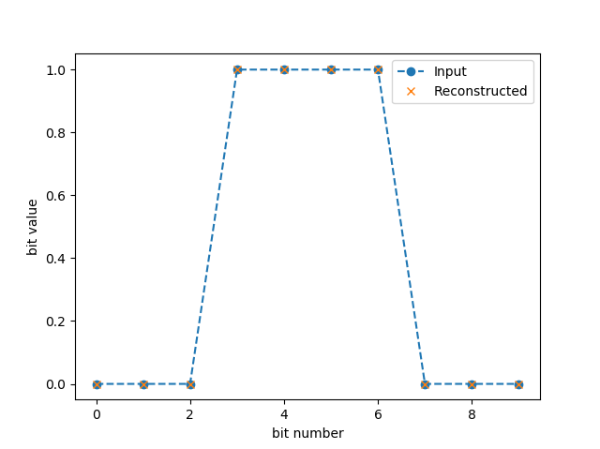
results
Paper Follow up - Check about perfectly reconstructed after decoding
Notes:
https://www.dreamsecurity.com/solution/sol_1_4.php

Slide 11
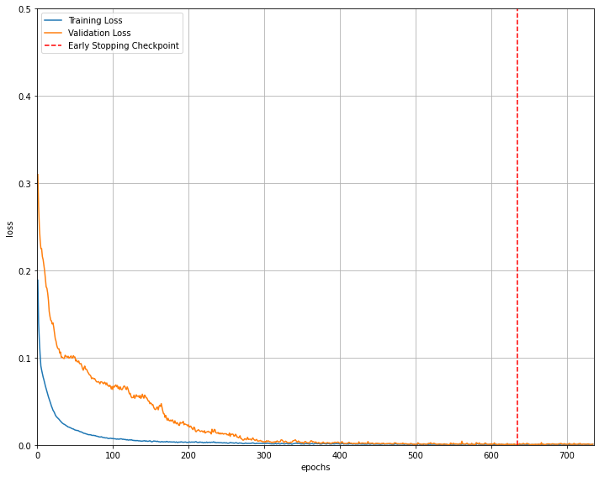

results
Proposed Method - Reconstruction w. 0.02% error after decoding - Input: Size 10, Bit string of 0~1023(2^10 ) number - Latent vector: Size 20 - Adam optimizer, MSE loss, Learning rate: 0.001
Loss = 100 * (# of False bits) / (# of total bits)
= 100 * 2 / (1024*10) = 0.02[%]
Notes:
https://www.dreamsecurity.com/solution/sol_1_4.php

Slide 12
Conclusion
Failure of application to various Autoencoder model - ex. Denoise-Autoencoder, adjustment # of hidden layers, Parameter tuning
Information loss - when converted float data to binary data in a hidden layer
Autoencoder with different model structure - increased size of hidden layer
Computational efficiency on BNN
Notes:
https://www.dreamsecurity.com/solution/sol_1_4.php

Slide 13
Thank you
Notes:
Chunk size

