Slide 1
Cloud Computing Security
Presented by:
Zobaer Hasan ID: 13-22874-1
Sakib, Md. Najmus ID: 14-25582-1
Mahfuj, Sheikh Ashik ID: 14-27184-2

Slide 2
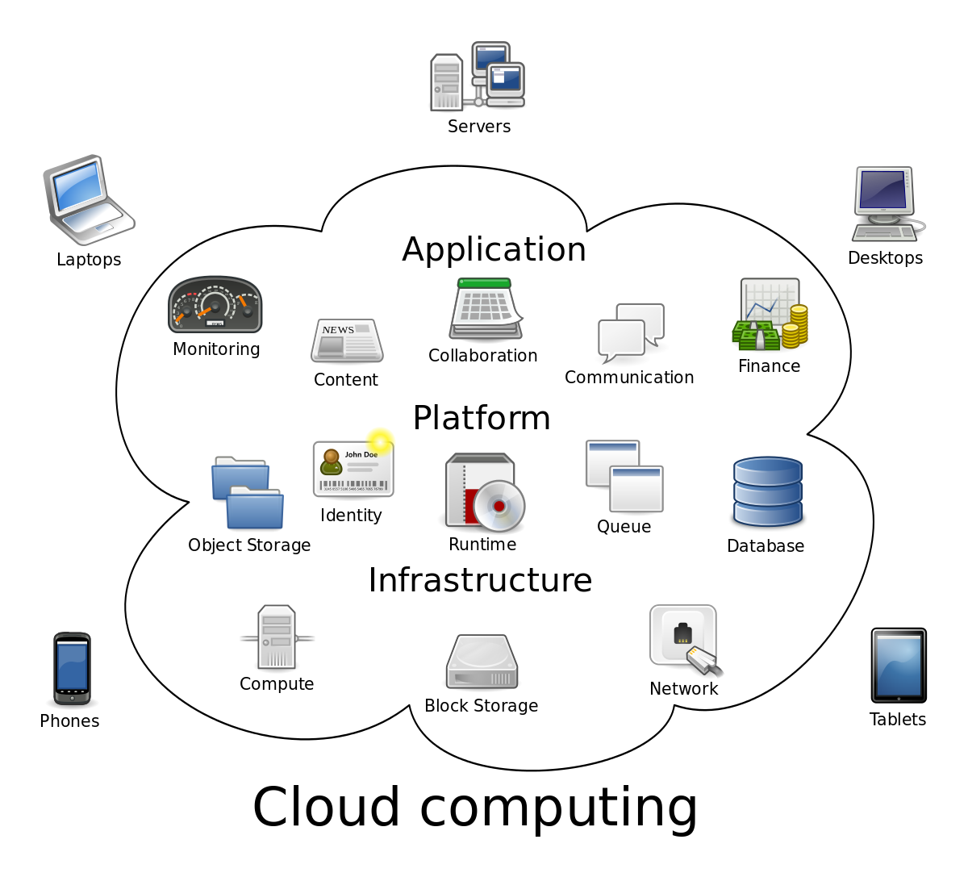
What is cloud Computing..?

Slide 3
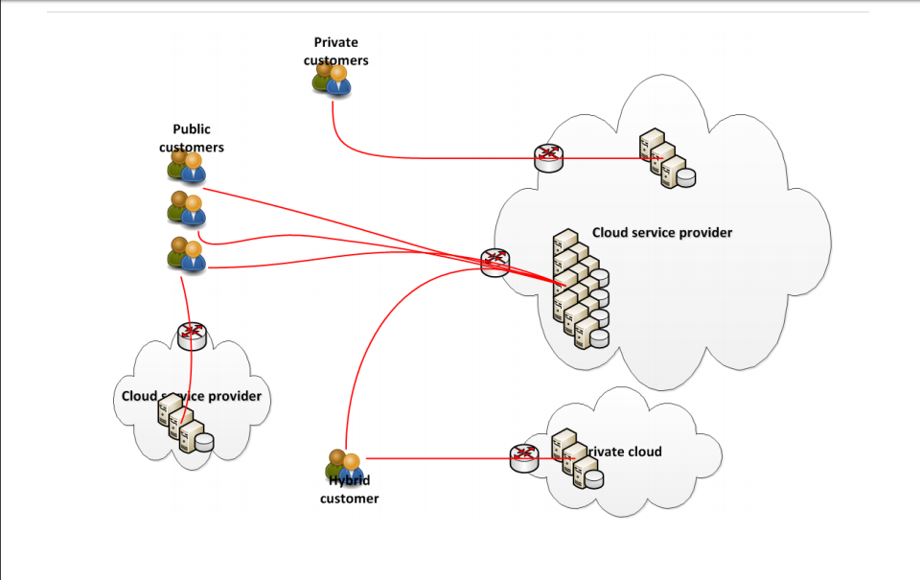
Cloud System

Slide 4
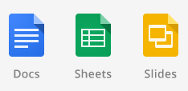








Cloud Computing Landscape
Applications
Storage
Computing
Development platform
Gartner predicts revenue of USD 131billion in 2013

Slide 5










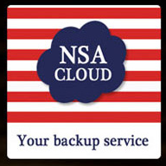
Who uses cloud computing?

Slide 6
Advantages
Accessibility
Collaboration
Cost Saving

Slide 7
Disadvantages
Security Risks
Storing Sensitive Data Off-Site

Slide 8
Some attack in cloud computing
Malware-Injection Attack
Wrapping Attack
Denial of service Attack

Slide 9
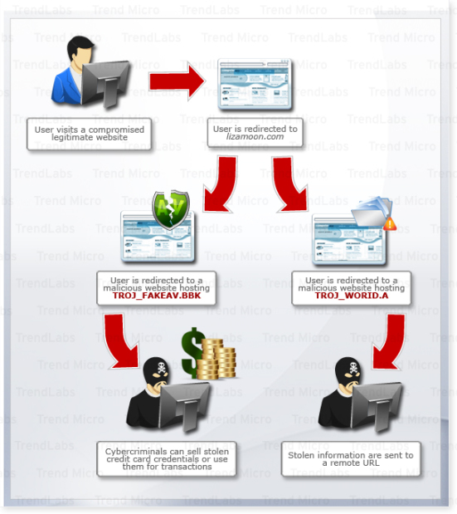
Malware-Injection Attack

Slide 10
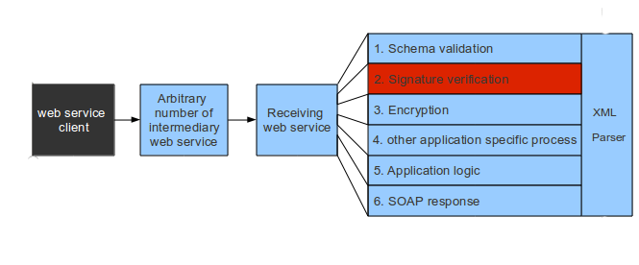
Wrapping Attack

Slide 11
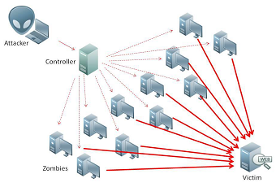
Denial of Service (DoS) attacks: A DoS attack is an attempt to make the services assigned to the authorized users unavailable. In such an attack, the server providing the service is flooded by a large number of requests and hence the service becomes unavailable to the authorized user. Sometimes, when we try to access a site we see that due to overloading of the server with the requests to access the site, we are unable to access the site and observe an error.

Slide 12
Data loss
Sometimes data lost from cloud servers is not due to cyber attack. Non-malicious causes of data loss include natural disasters like floods and earthquakes and simple human error, such as when a cloud administrator accidentally deletes files. Threats to your cloud data don’t always look like clever kids wearing hoodies. It’s easy to underestimate the risk of something bad happening to your data due to an innocent mistake.

Slide 13
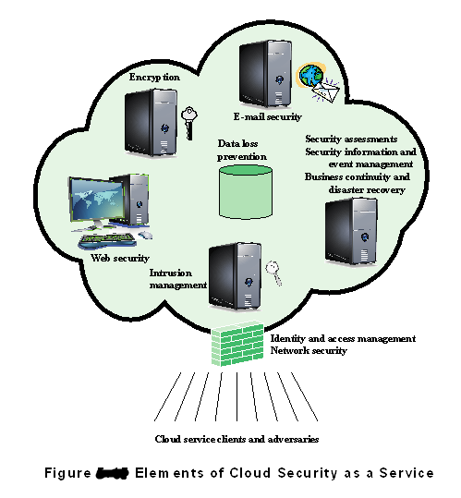

Slide 14
Security Improvement
Visibility
Collaboration
Infrastructure

Slide 15
Types of Cloud Security
Data Encryption Standard (DES)
Advance Encryption Algorithm (AES)
RSA

Slide 16

Thank you

