Slide 1
Presentation on Lexical Analyzer

Slide 2

Supervised By
T.M. Amir-Ul-Haque Bhuiyan
Assistant Professor
Department of Computer Science & Engineering, BUBT
Presented By
Tunazzinur Rahman Kabbo
ID: 19202103268
MD. Zobayer Hasan Nayem
ID: 19202103274
Afrina Akter Mim
ID: 19202103310

Slide 3
Table of contents
01
02
03
Introduction
Objectives
Motivation
04
05
06
Features
Conclusion
Reference

Slide 4
01
Introduction

Slide 5
Introduction
Programs that perform Lexical Analysis in compiler design are called Lexical Analyzers.
Converts the High level input program into a into a series of Tokens.
Removes any extra space or comment written in the source code.
Can be implemented with the Deterministic Finite Automata or DFA.
Stores the tokens in Symbol Table and as well as sends it to next phase as the input.

Slide 6
Lexical Analyzer Architecture
Lexical
Analyzer
Parser
Token
Rest of Compiler
Source
Program
Get Next Token
Symbol
Table
Compilation Error

Slide 7
02
Objectives

Slide 8
Objectives
Scan code from a file or take user input.
Break taken code into a series of Tokens, by removing any white-space or comments in the source code.
Match user input expression for default compiler expression.

Slide 9
03
Motivation

Slide 10
Motivation
Avoid manual works and repetitive tasks.
Create a system for detecting errors from the syntax of the code.
Understand sentence tokenization.

Slide 11
04
Features

Slide 12
Features
01
02
03
04
NFA
DFA
NFA stands for non-deterministic finite automata.
DFA stands for deterministic finite automata.
NFA to DFA
NFA with Epsilon
Conversion from non-deterministic to deterministic finite automata.
Non-deterministic finite automata with epsilon (ε).
Regular Expression
A regular expression is a sequence of characters that specifies a search pattern in text.
05

Slide 13
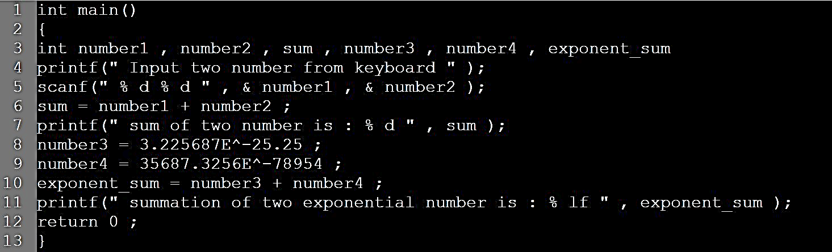
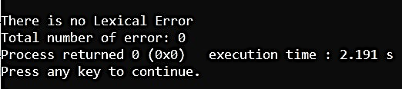
Features
Input:
Result:

Slide 14
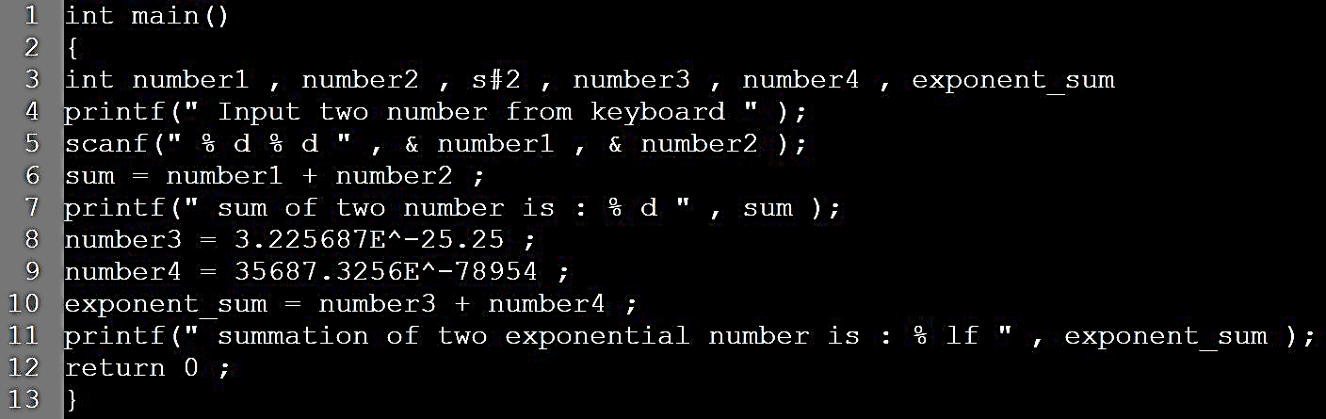
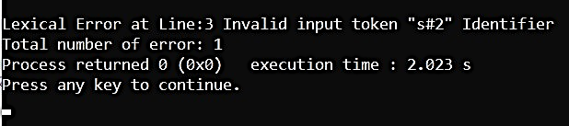
Features
Input:
Result:

Slide 15
05
Conclusion

Slide 16
Conclusion
Lexical Analyzer is a checker that analyze the code written in one programming language to another.
Symbol Table is a data structure that the compiler generates and maintains to keep track of the semantics of variables.
Error Handling routine detects errors, reports them to the user, and follows some recovery plan to handle the errors.

Slide 17
06
Reference

Slide 18
Reference
Aho, A. V., S. C. Johnson, and J. D. Ullman, “Deterministic parsing of ambiguous grammars,” Comm. ACM 18:8 (Aug., 1975), pp. 441-452.
Birman, A. and J. D. Ullman, ”Parsing algorithms with backtrack, “Information and Control 23:l (1973), pp. 1-34.
Cantor, D. C., “On the ambiguity problem of Backus systems,” J. ACM 9:4 (1962), pp. 477-479.
Chomsky, N., “Three models for the description of language,” IRE Trans. On Information Theory IT-2:3 (1956), pp. 113-124.
Etc.

Slide 19
Thank You!
Do you have any questions?

