Slide 1

Bangla Dorji Application

Slide 2
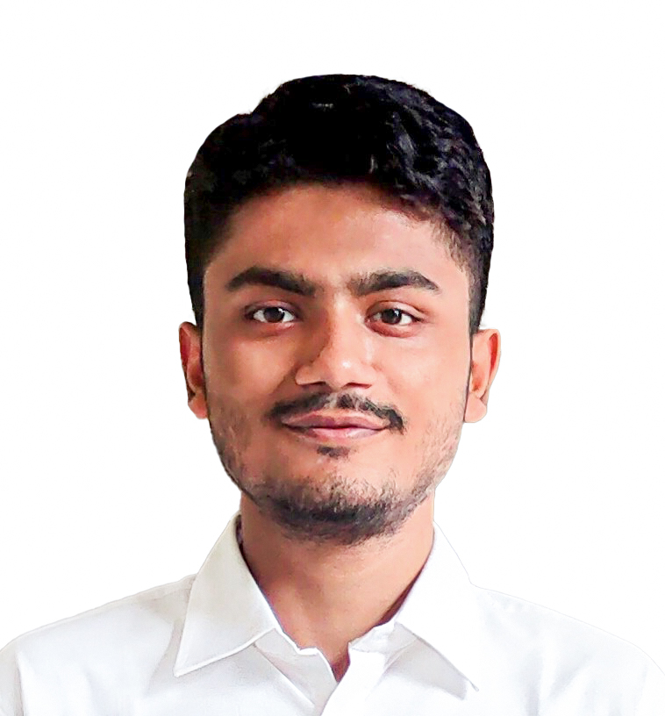
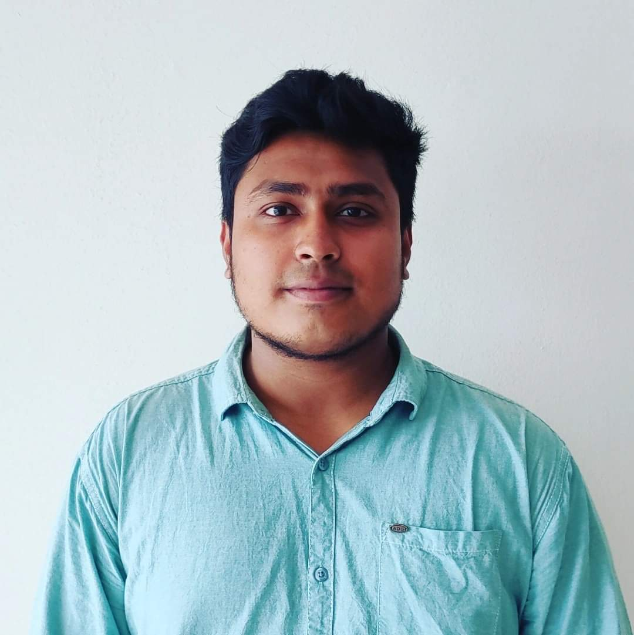
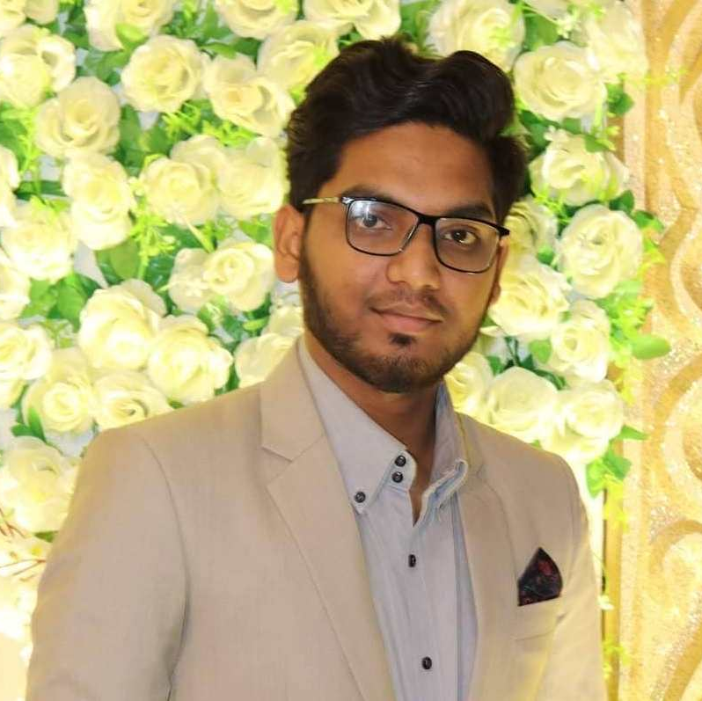
Our Team
Tunazzinur Rahman Kabbo
MD. Zobayer Hasan Nayem
Sayeed Ahmed
App Developer, Counselor
Graphic Designer, UI/UX Developer
App Developer

Slide 3
Introduction
This application is based on online custom clothing and laundry service for both male and female. This will add another level to our (Bangladesh) clothing industry.

Slide 4
Table of contents
01
02
03
04
App overview
Problem & solution
Market & competition
Business model

Slide 5

LOGO
It represents Bangladesh flag with the Bangla Dorji letters. This is the first thing users will think of when they see this logo with a sewing machine “This app might sell custom made goods.”

Slide 6
Product overview
Custom Fittings
Choice on Fabric
Choice on Product Color
Order in Big Amount
Easy To Order System
Users can choose their desired fittings
Users can choose their desired fabric
Users can pick any color which are available
Users can order is huge amount according to their needs
Quick Laundry Service
One click order system is implemented
Users can use our laundry service through the user app (on process)

Slide 7

Product Demo

Slide 8
User Panel

Slide 9
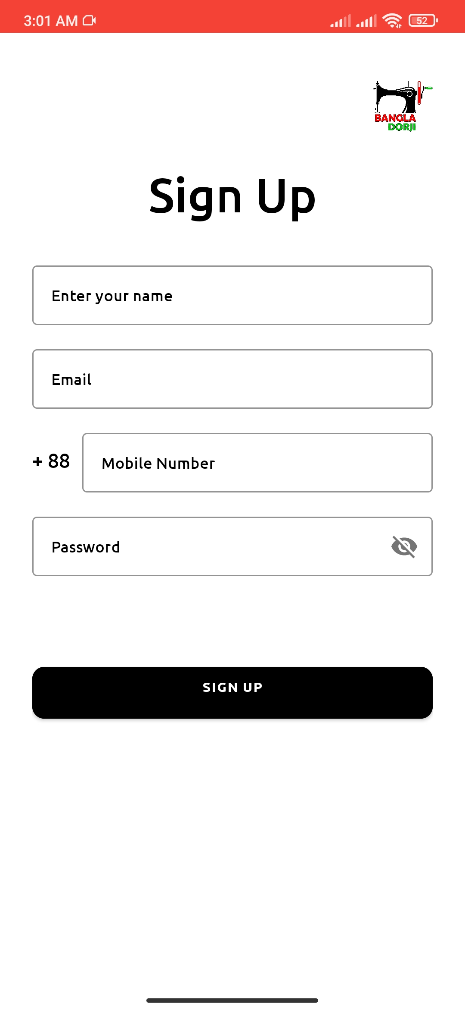
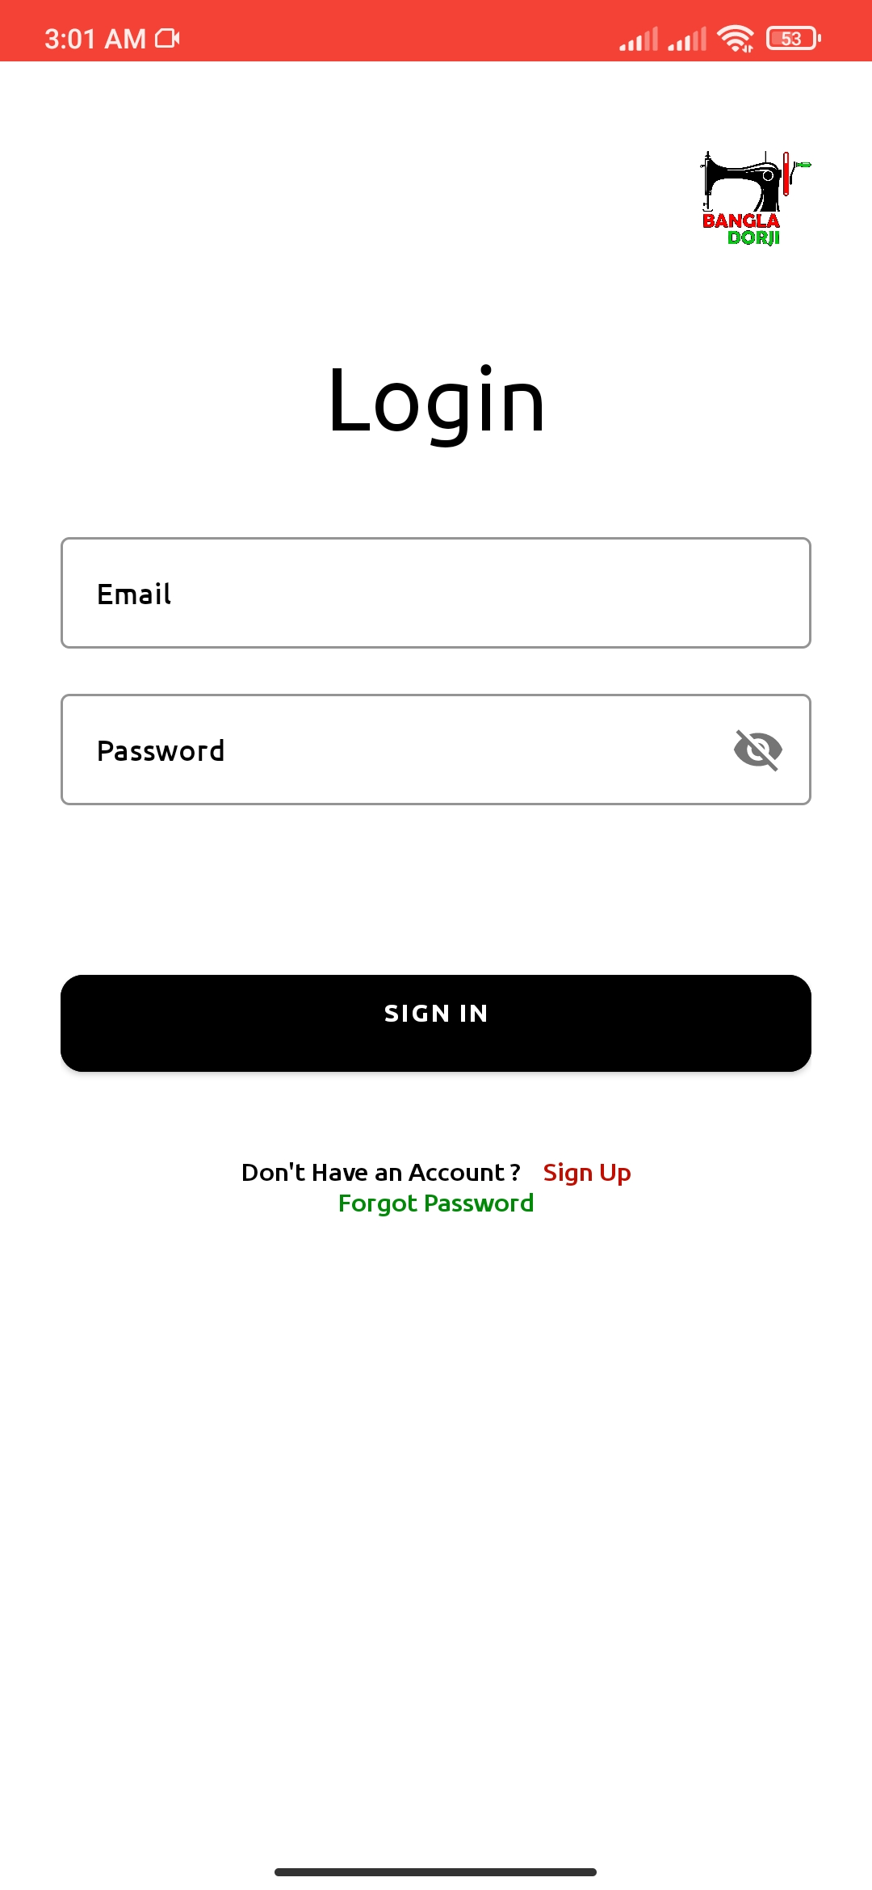
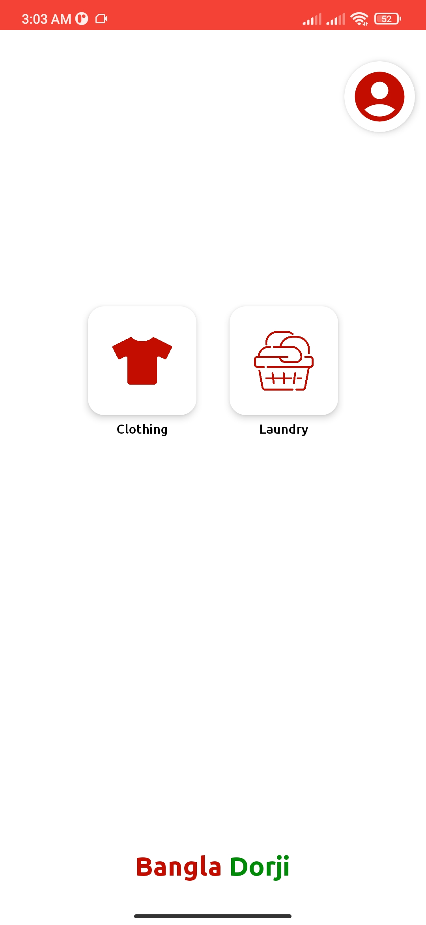
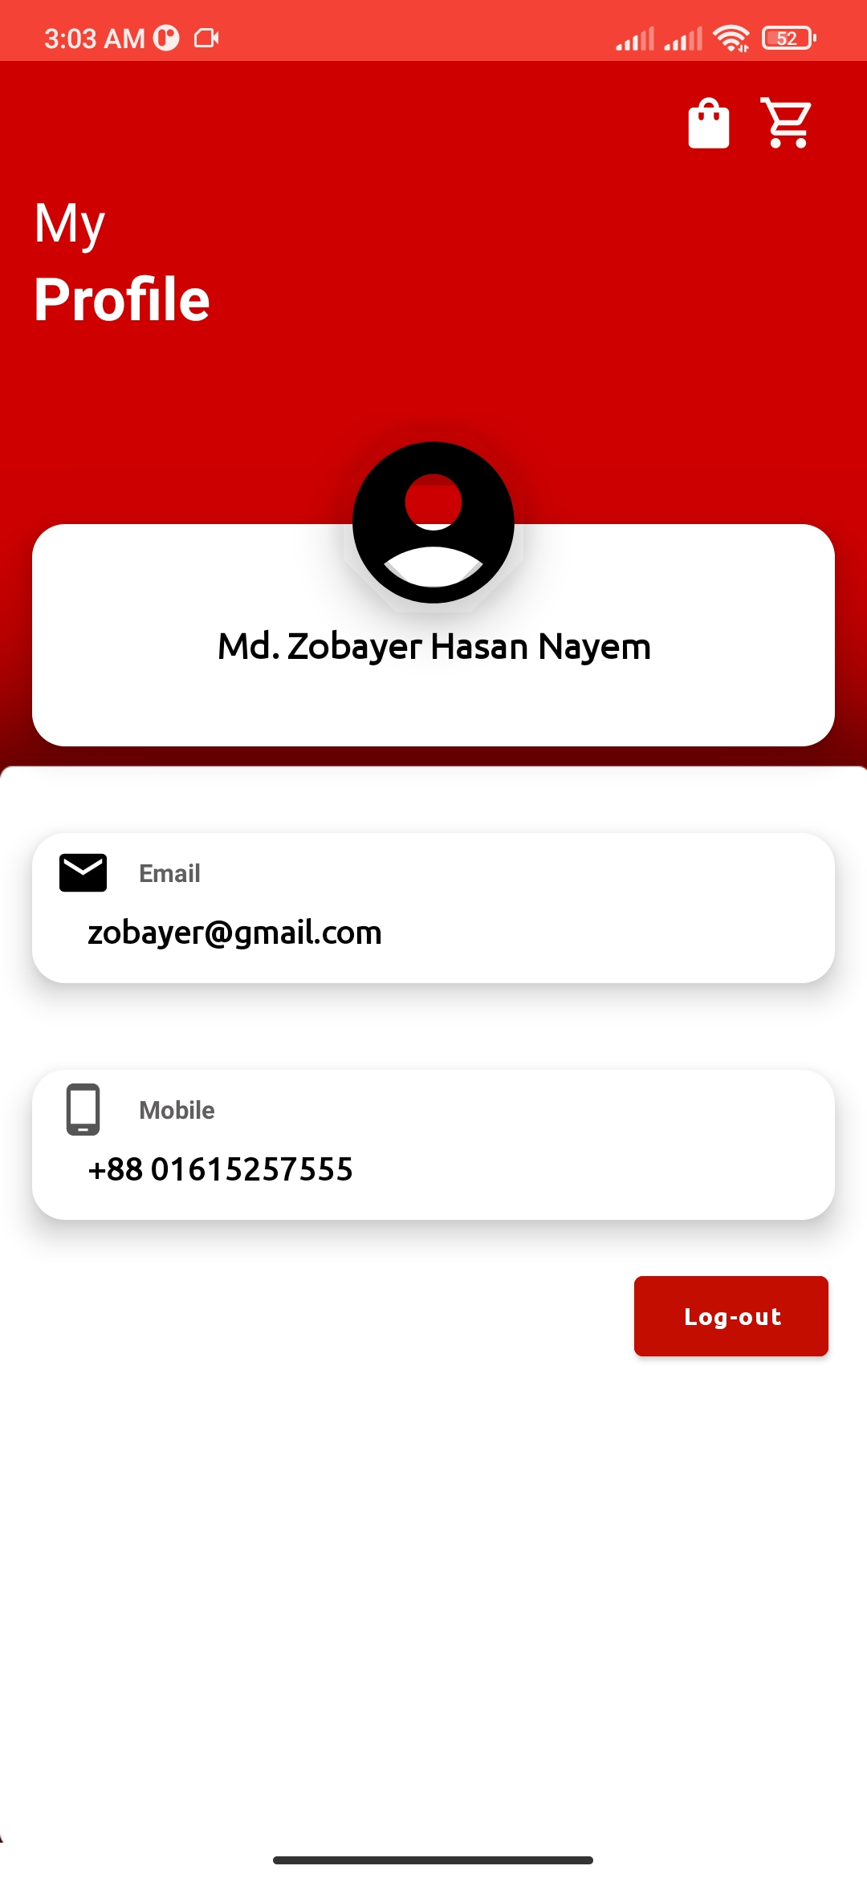
Sign Up
Sign In
Dashboard
User Profile

Slide 10
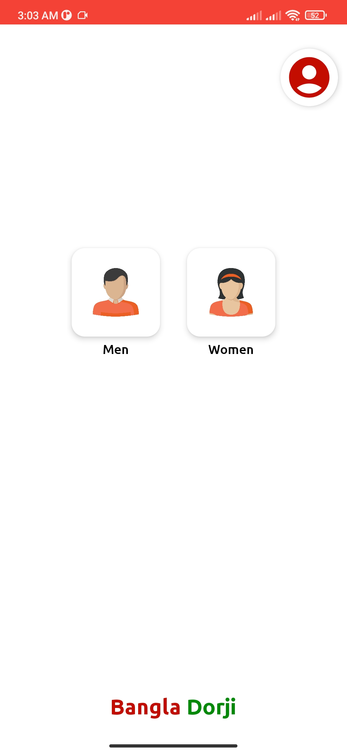
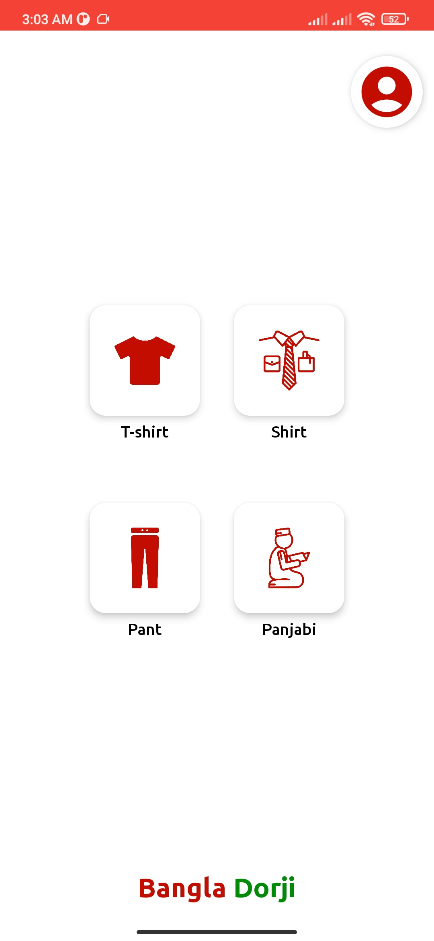
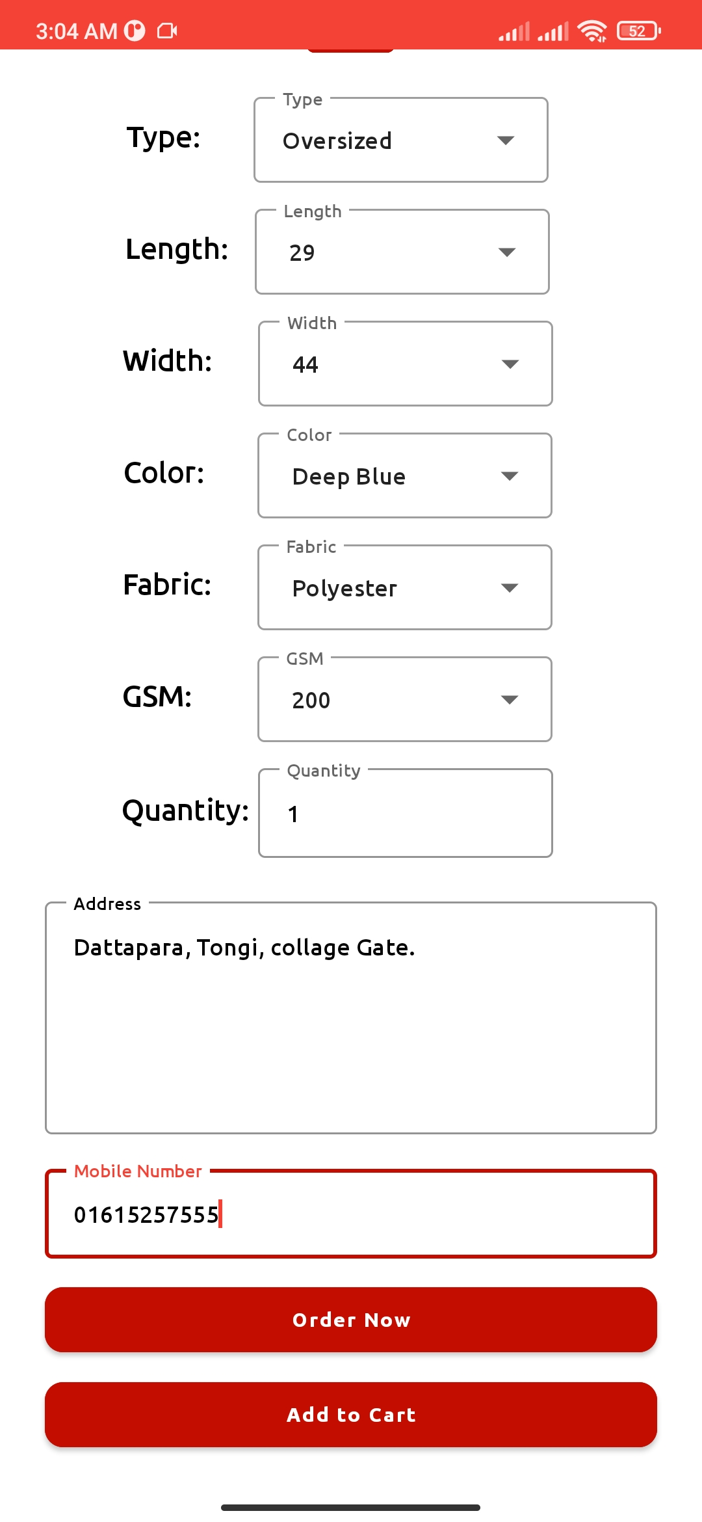
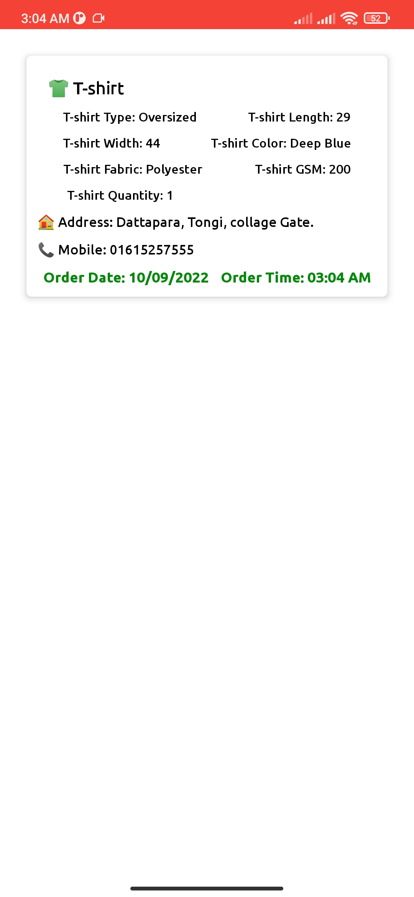
Clothing
Men Option
Custom Form
Order History

Slide 11
Admin Panel

Slide 12
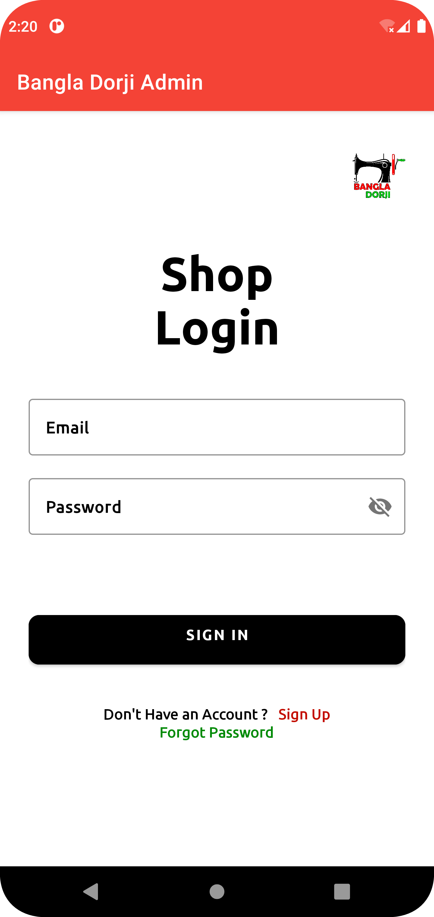
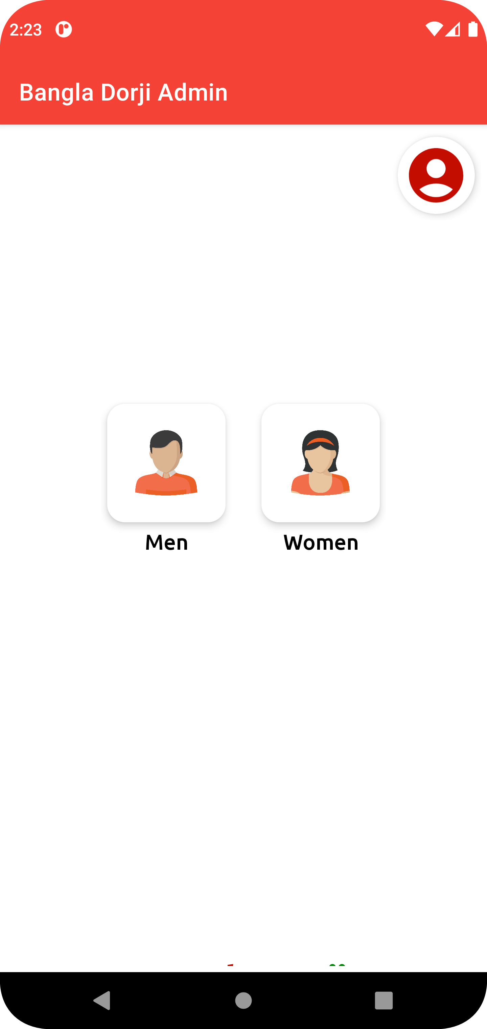
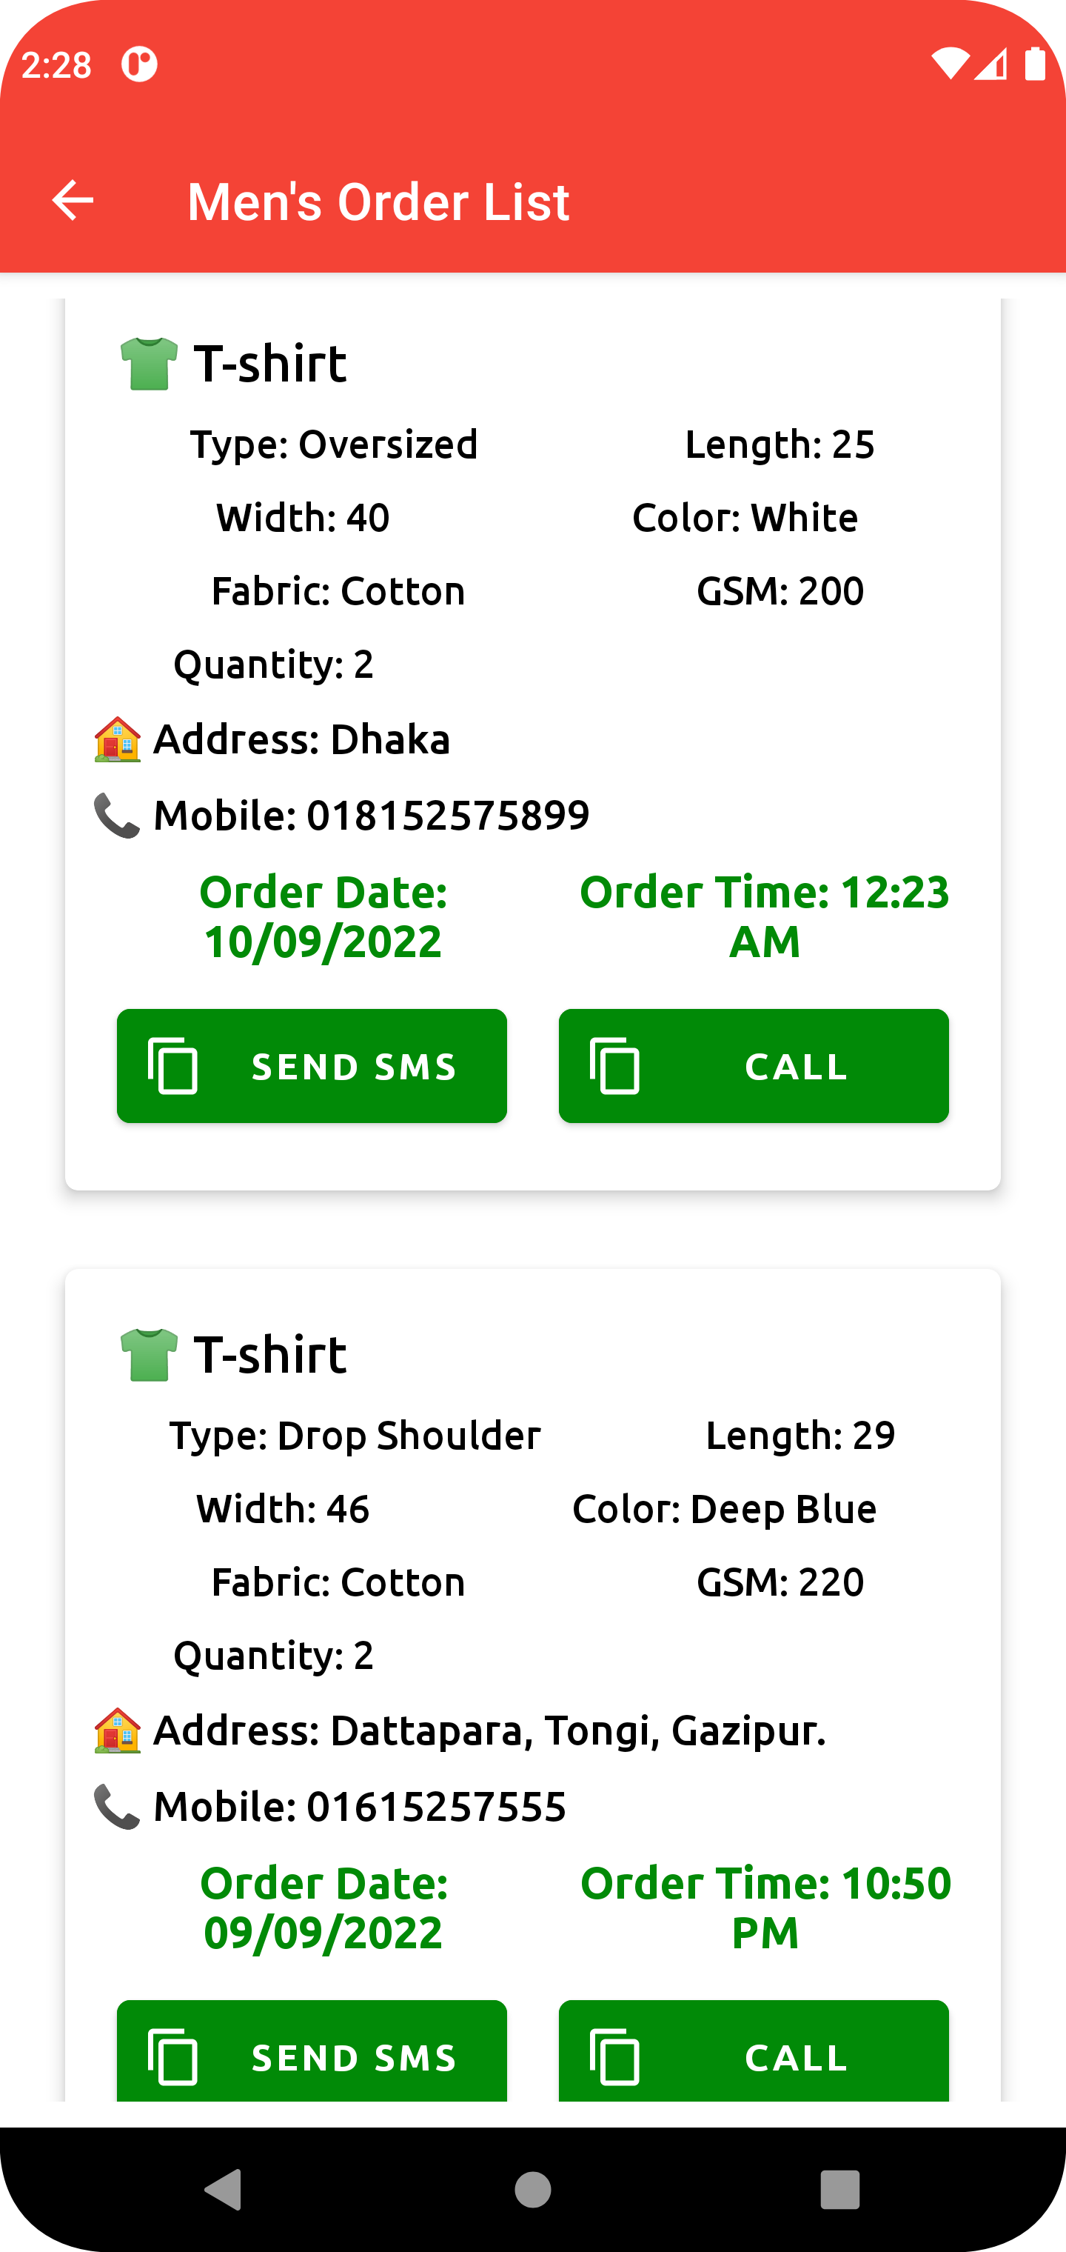
Admin Order Check Panel
Admin Login
Admin Dashboard
Admin
Login

Slide 13
Problem
There are many online clothing industries in Bangladesh. But no one provides custom fittings. Everytime users get confused selecting their desired size. This often dissapoint users. Secondly, There are no online based laundry system in Bangladesh. Users always waste their time when they go to a laundry shop and they demand extra time. But if this process can brought to online it will be a game changing idea.

Slide 14
Competitor
Rulmaker
BanglaDorji
They are web based and have handful amount of product selections.
We are launching BanglaDorji for both app and website. We have varity of products to select from. We have another option, that is “Laundry System”.

Slide 15
Business Model
Market Analysis | Sign Contract | Assessment | Technology
We have analyzed the market to see the response of the people | We have contact with some garments and laundry services. They are excited to work with us | We are collecting real time data and giving assessment to ourselves to fullfill the project perfectly | We are bringing everything online so that it can be accessed by everyone from all over the country

Slide 16
Target
21-32
75%
33-45
65%
46-56
39%
Gender
Age range
43%
57%

Slide 17
Project Timing
We are working on Phase-2 (Build full application and Signing contract with vendors)
Phase-4 is to launch both the website and the app
Phase 2
Phase 4
Phase 1
Phase 3
We have successfully implemented Phase-1 (Designing and Collecting data from vendors)
Phase-3 is to build a dynamic website for various platform

Slide 18
Thanks!

