Slide 1
WELCOME
TO
OUR PRESENTATION

Slide 2
TEAM MEMBERS
Presented By:
Tunazzinur Rahman Kabbo (ID: 19202103268)
Imran Nazir (ID: 19202103248)
Md. Zobayer Hasan Nayem (ID: 19202103274)
Afrina Akter Mim (ID: 19202103310)
Rizvia Razzak Abani (ID: 19202103528)
Intake: 44
Section: 8
Supervised By:
Nourin Khandaker
Lecturer
Department of Computer Science and Engineering, BUBT

Slide 3
CONTENTS
1
Introduction
2
Motivation
3
Equipments
4
Implementation
5
Conclusion

Slide 4
INTRODUCTION
A project on Car Parking System using Arduino.
It has two barrier to control the entry and exit of the cars.
It counts the number of the cars.
It shows message if the parking space run out.

Slide 5
MOTIVATION
Finding an available parking space is considered as time and fuel consuming.
Therefore, drivers may get frustrated; which will lead to inappropriate parking.
This will lead to bad traffic around the parking space and may also lead to accident.
That is why this project proposes an Arduino Car Parking System that will solve the problems mentioned.

Slide 6
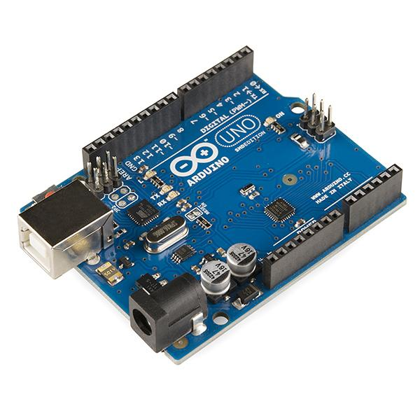
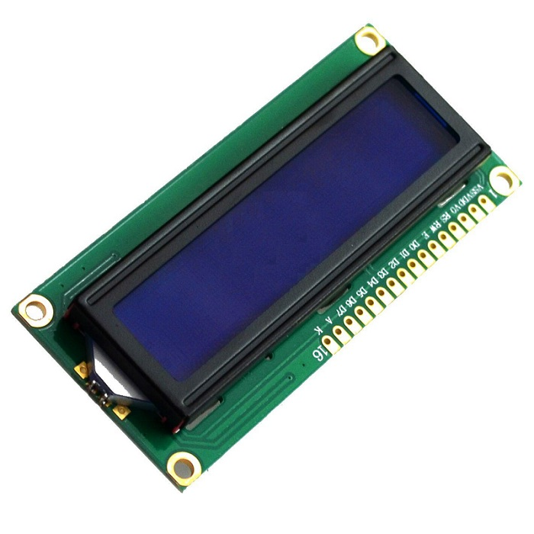
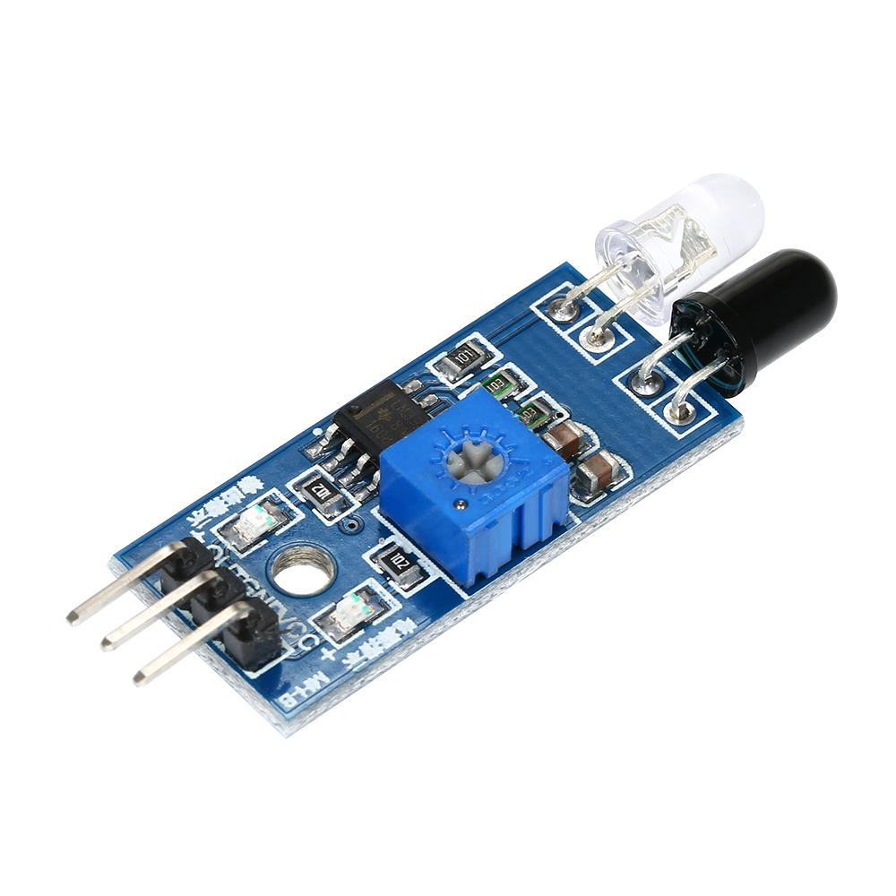


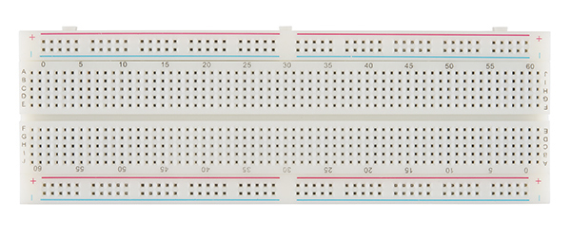
EQUIPMENTS
Fig. IR Proximity Sensor
Fig. 16x2 LCD i2c Display
Fig. Servo Motor
Fig. Arduino Uno
Fig. Bread Board
Fig. Jumper

Slide 7
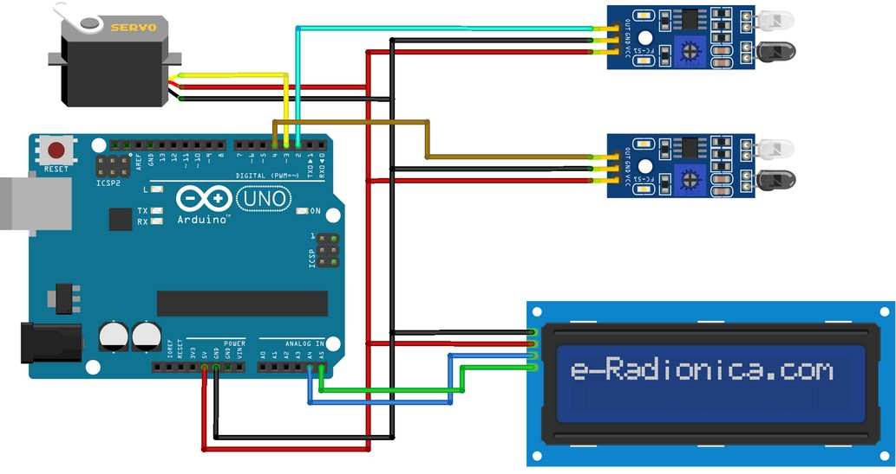
IMPLEMENTATION
Fig. Circuit Diagram

Slide 8
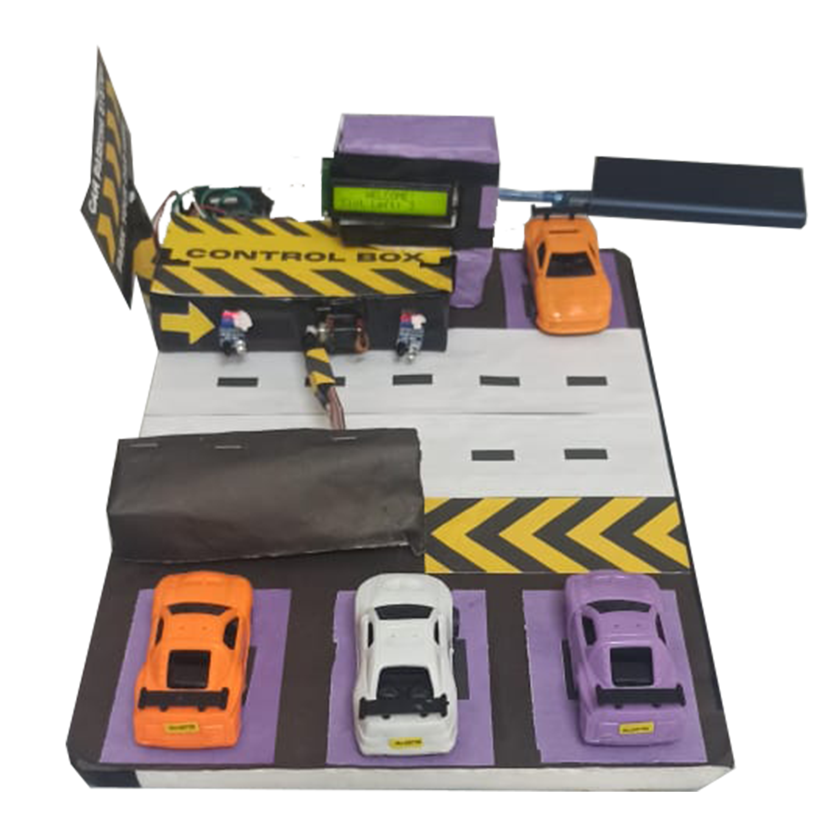
IMPLEMENTATION
Fig. Overall view of the project

Slide 9
CONCLUSION
It will reduce the amount of time a driver has to spend around in the parking to find available spot.
It will reducing the traffic around the parking area.
It will reduce the bad parking around the parking space.
On a large scale, this can be adopted as a unpaid car parking system anywhere.

Slide 10
THANK YOU

