Slide 1
ALIBABA CLOUD AI HACKATHON · HOSTED BY AL-KHIDMAT FOUNDATION
Mustahiq AI
Finding, verifying and fairly allocating aid — and helping beneficiaries grow.
A staff decision-support layer for Al-Khidmat's beneficiary programmes, plus a no-fee marketplace for micro-entrepreneurs.
A team submission · built end to end on free-tier infrastructure

Slide 2
MUSTAHIQ AI
Allocating limited aid is a hard problem
True for any organisation — these questions come with the work, not with any one process.
?
Who, among everyone eligible, needs help most right now?
Eligibility is only the first filter. Ranking real need across a whole pool is the harder judgement.
?
Can a decision be explained — the same way, every time?
The person who was not chosen deserves a reason, and two officers should reach the same one.
?
Does someone qualify for help they never hear about?
A household may be eligible for several programmes and only ever be told about one.
?
What keeps a business going after the loan?
A financed micro-business still needs suppliers, customers, workers or partners to survive.
Mustahiq AI · Alibaba Cloud AI Hackathon · hosted by Al-Khidmat Foundation
2

Slide 3
MUSTAHIQ AI
One platform, two sides, a shared engine
STAFF PORTAL
Al-Khidmat field officers & managers
MARKETPLACE APP
Beneficiaries with a business loan
Enter a profile in conversation
Review suggested programmes
Verify need · rank the pool · allocate
Describe a business by voice, any language
Get matched: inputs · customers · workers · partners
Both sides notified — they connect directly
SHARED ENGINE
Deterministic rules + XGBoost confidence model + retrieval over real policy text
FastAPI · Supabase / Postgres + pgvector · Groq (text only) · free-tier infrastructure
Mustahiq AI · Alibaba Cloud AI Hackathon · hosted by Al-Khidmat Foundation
3

Slide 4
MUSTAHIQ AI
Eligibility: a five-stage pipeline, humans in control
1 DISCOVER
Score the profile
against every active
programme
2 POOL
Staff choose which
suggestions to pursue.
Nobody contacted yet
3 VERIFY
A home visit confirms
real need — can fail
and exit here
4 RANK
Bi-weekly cycle ranks
everyone waiting on one
transparent rubric
5 ALLOCATE
Staff fund the top of
the list within budget.
Rest roll over
Rules ELIMINATE. The model only RANKS confidence that verification will confirm need.
No LLM anywhere in scoring · no automatic enrolment · a failed verification simply exits
Mustahiq AI · Alibaba Cloud AI Hackathon · hosted by Al-Khidmat Foundation
4

Slide 5
MUSTAHIQ AI
Every ranking is explainable — to the factor
THE RUBRIC, SHOWN TO STAFF · one example
STRUCTURAL FAIRNESS
How someone entered — staff-identified or walk-in — is recorded for audit and can never enter a ranking calculation.
Income (inverse)
30%
Dependents
20%
Disability
15%
PLAIN-LANGUAGE REASONS
Every suggestion and every rank comes with a sentence a caseworker can read aloud — traceable to the real policy text it came from.
No prior assistance
20%
School-age children
15%
Weights are set per programme and snapshotted with every cycle.
Mustahiq AI · Alibaba Cloud AI Hackathon · hosted by Al-Khidmat Foundation
5

Slide 6
THE CONFIDENCE MODEL
One measurable job, done carefully
WHAT THE MODEL IS
WHAT IT DOES NOT DO
XGBoost — gradient-boosted trees
No LLM in the scoring path — deterministic
Trained on 15,000 synthetic profiles
No training on real beneficiary data
~54,000 labelled (profile, programme) rows
Never enrols anyone — staff decide
Held-out ROC-AUC ~0.76 · F1 ~0.71
Never a funding priority — that's the rubric
Predicts one thing: will verification confirm need?
Confidence shown only as low / medium / high
In production, real verification outcomes become the training labels — the platform improves as it is used.

Slide 7
MUSTAHIQ AI
The marketplace: from a loan to a network
Business loan
recorded
Beneficiary opens
the app, describes
their business by voice
Matched across
3 models
Both sides notified
by SMS / email
They connect and
deal directly
MATCHED ACROSS 3 MODELS
SUPPLY CHAIN
a supplier ↔ a business that needs those inputs
EMPLOYMENT
a business that needs a skill ↔ someone who has it
JOINT VENTURE
two owners, complementary skills → one new business
No fees, ever. No commission. Al-Khidmat introduces only — terms and pricing are between the two businesses.
Mustahiq AI · Alibaba Cloud AI Hackathon · hosted by Al-Khidmat Foundation
7

Slide 8
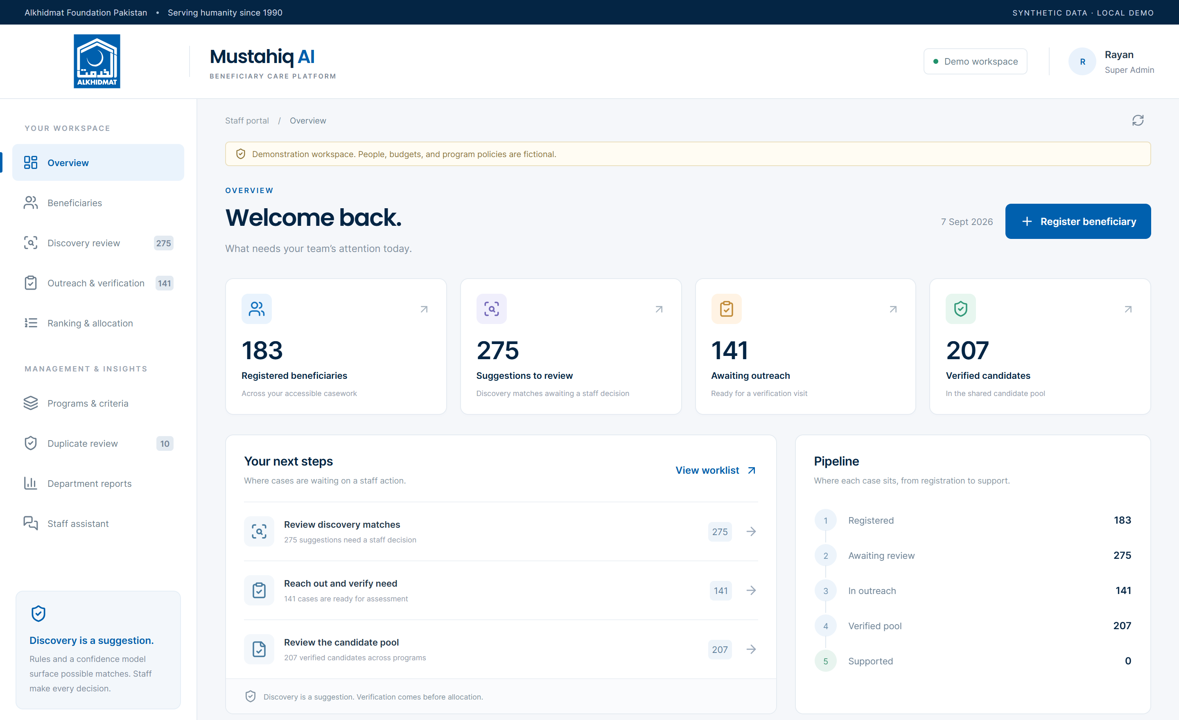
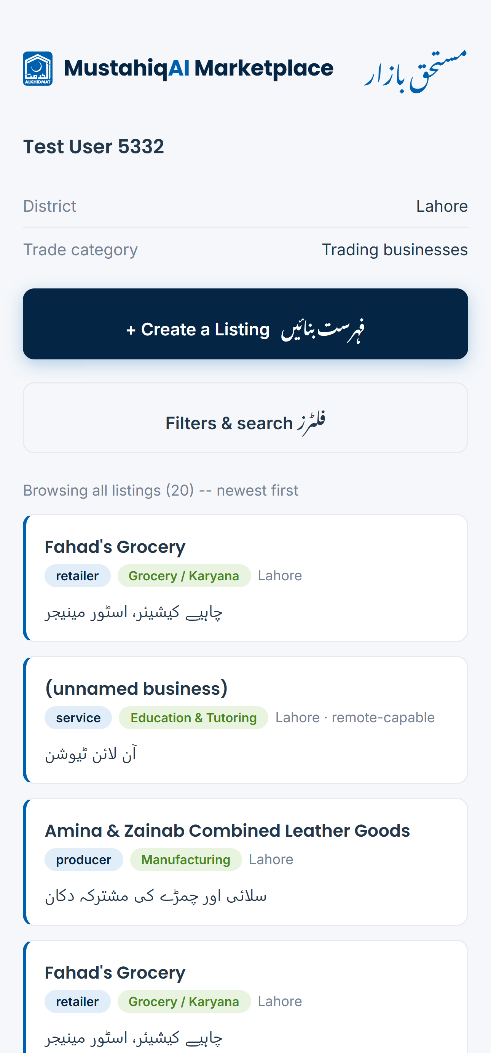
MUSTAHIQ AI
The staff portal and the marketplace app
Two web apps over one API and engine. Every screen here is running on synthetic demo data.
STAFF PORTAL · overview
MARKETPLACE APP
Built end to end and tested — 41 eligibility tests, 33 staff-workflow tests, plus marketplace smoke tests.
Mustahiq AI · Alibaba Cloud AI Hackathon · hosted by Al-Khidmat Foundation
8

Slide 9
MUSTAHIQ AI
Built for the real constraints
Free tier only
No GPU. Local CPU embeddings, hosted rules + trees, Groq free tier for text only.
Every answer is cited
Retrieval runs over uploaded policy documents — never the open web.
Any language in, English pipeline
A beneficiary speaks Urdu or Punjabi; matching still works.
Staff-operated by design
Beneficiaries never log into the eligibility side. The marketplace is the deliberate exception.
Two scheduled jobs
Bi-weekly ranking cycle and a daily marketplace cleanup — the only things not real-time.
Rate-limit aware
One Groq wrapper, live token logging, automatic fallback key on a 429.
Mustahiq AI · Alibaba Cloud AI Hackathon · hosted by Al-Khidmat Foundation
9

Slide 10
THE VALUE IT ADDS
What Mustahiq AI puts on top of the existing process
+
Every active programme, scored in one pass
A profile is checked against all of them at once — nothing a household is eligible for is left unseen.
+
One rubric, applied identically — and snapshotted
The same weighted factors for everyone in a cycle; the exact weights are saved with the results.
+
A plain-language reason on every suggestion and every rank
Traceable to the policy passage it came from — a caseworker can read it aloud.
+
A bridge from the loan into a working network
Financed businesses matched to nearby suppliers, customers, workers or partners — at no cost.
It informs the decision — it does not make it. Staff verify, staff rank-review, staff allocate.

Slide 11
Clearer decisions,
a bridge to self-reliance.
Mustahiq AI · Alibaba Cloud AI Hackathon · hosted by Al-Khidmat Foundation
Repository: github.com/zobiahussain/mustahiq-ai
Thank you.

