Slide 1
Motivation of Data Plane Development Kit
An Intro of Packet Processing Solution From Intel®
Zhuobin Huang
Network Engineering, KB109
University of Electronic Science and Technology of China
Nov.3 2021

Slide 2
Content
Pre-knowledge:
Mircoarchitecture
IA64 ISA
Linux Kernel Architecture
Testbed Environment Built in KB210
Motivation
Investigation on kernel processing pipeline
Conduct performance profiling
Internal Design of DPDK
TODO: Performance Evaluation of DPDK
TODO: Classic Applications on DPDK
Open-vSwitch (OVS-DPDK)
Storage Performance Development Kit (SPDK)
Conclusion and Future

Slide 3
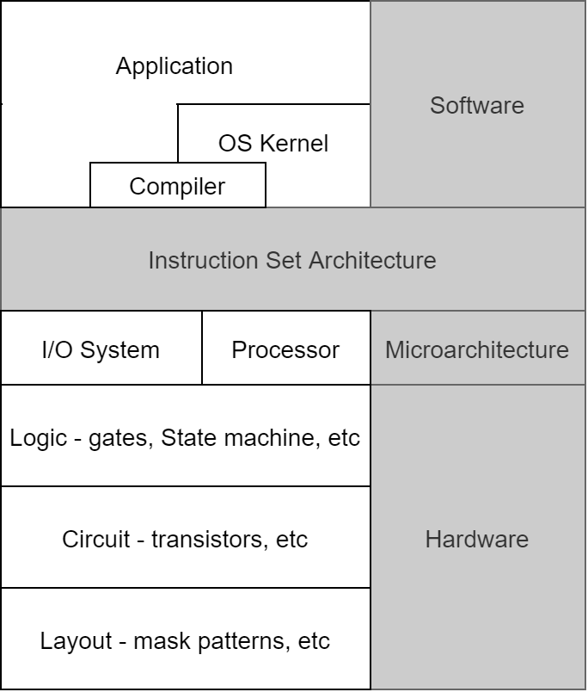
Preface: Where’s DPDK?
Goal:
To provide high performance packet processing and forwarding on general processors.
Optimization Aspects:
Microarchitecture:
Multi-core & NUMA
Hyper-thread
Cache System
ISA:
CISC (e.g. x86-64)
RISC (e.g. arm64)
Kernel:
Memory Management
Process Scheduling
Network Subsystem
Device Driver
System Architecture

Slide 4
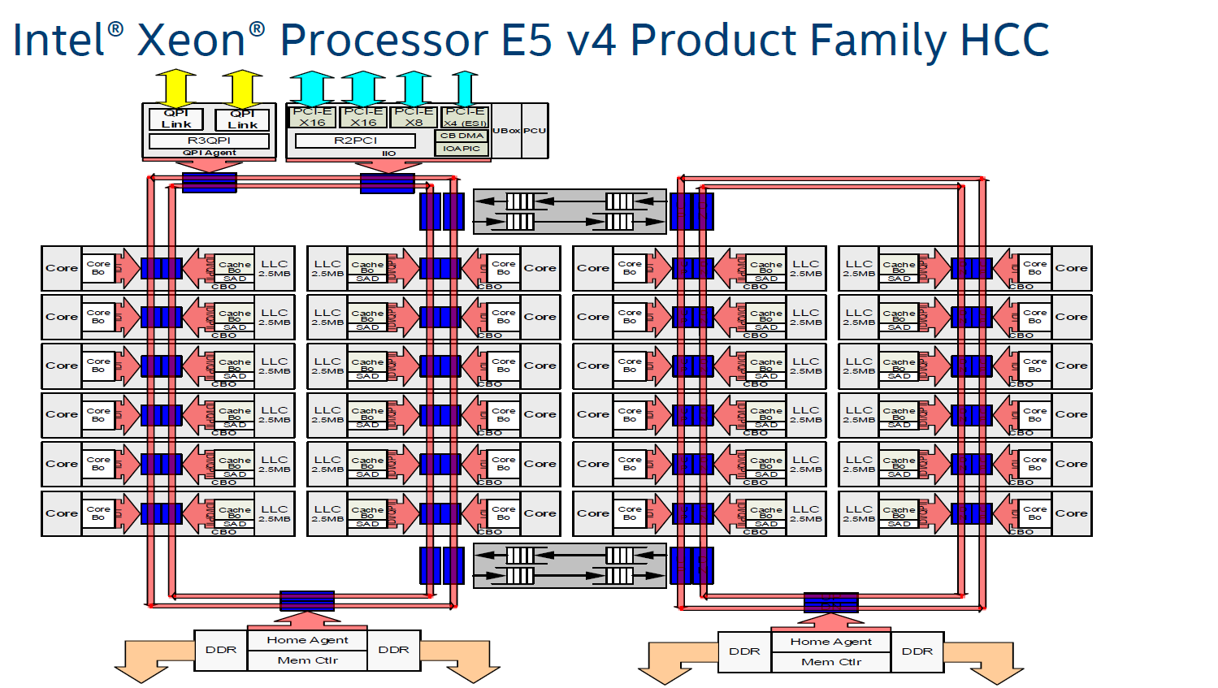
Pre-Knowledge: Microarchitecture
NUMA
Image Source: https://www.anandtech.com/show/10158/the-intel-xeon-e5-v4-review/2

Slide 5
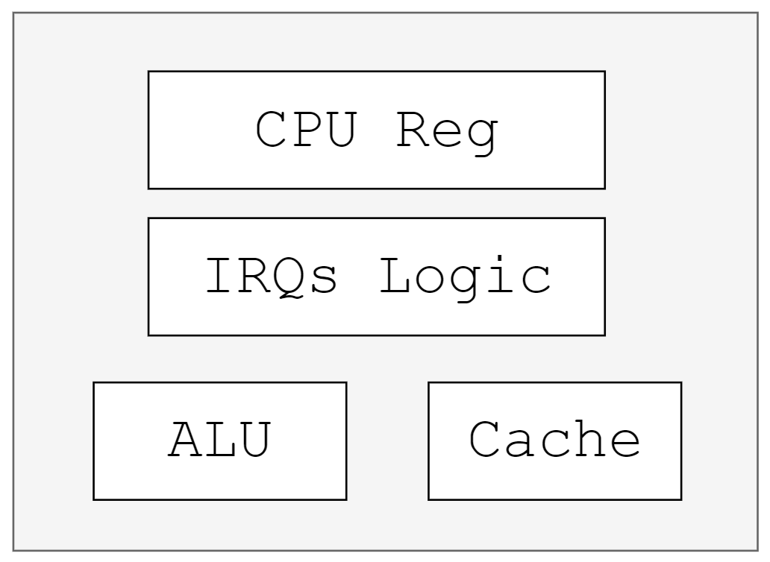
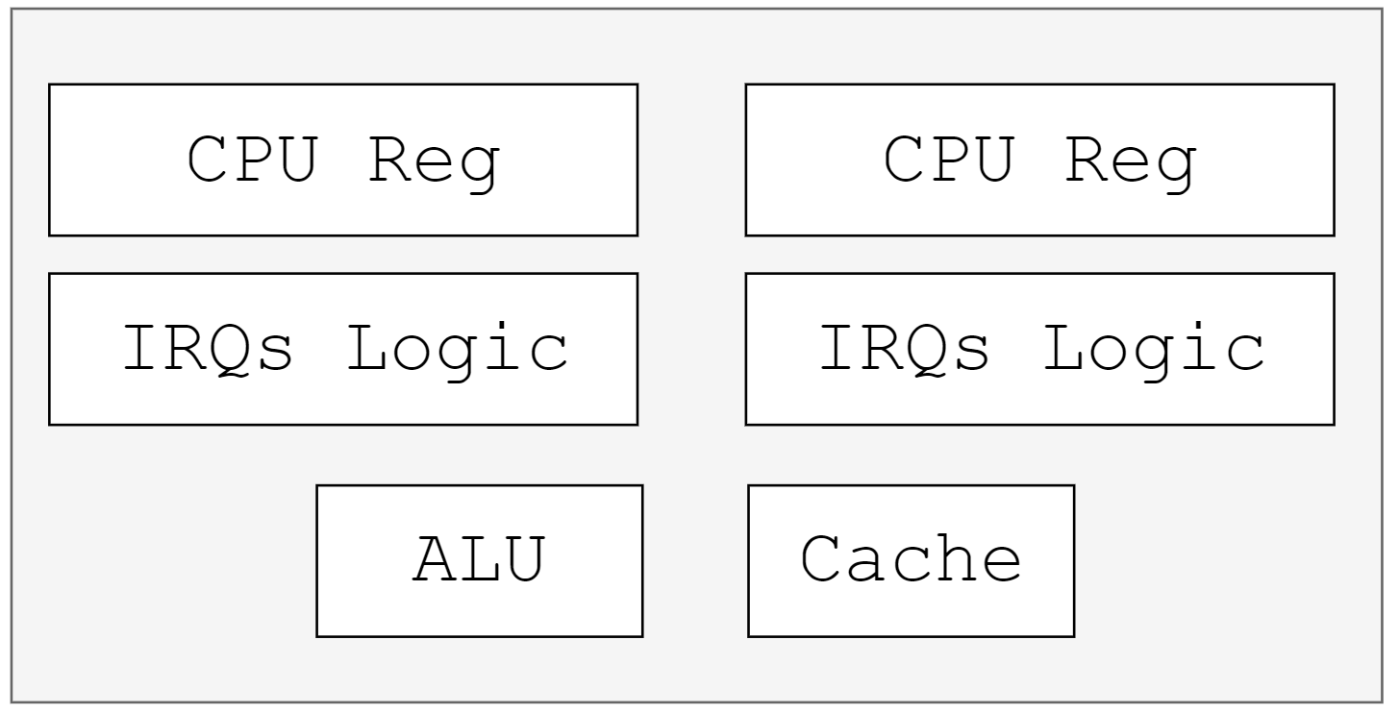
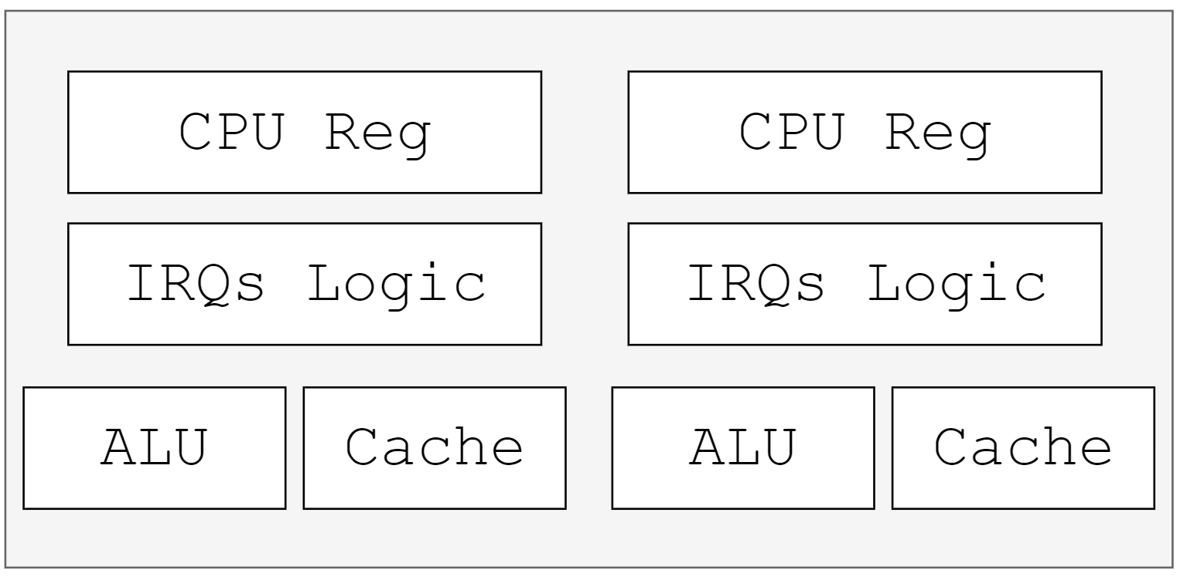
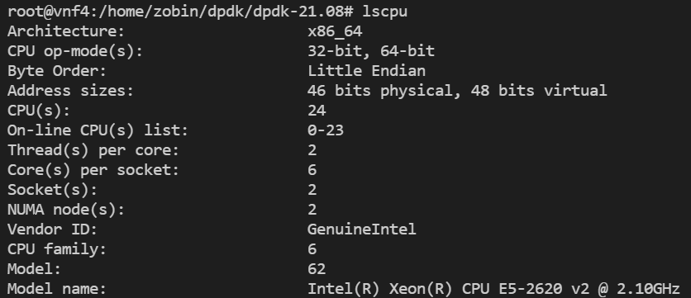
Pre-Knowledge: Microarchitecture
Single-core
Hyper-thread
Multi-core
System Info of Severs in KB210

Slide 6
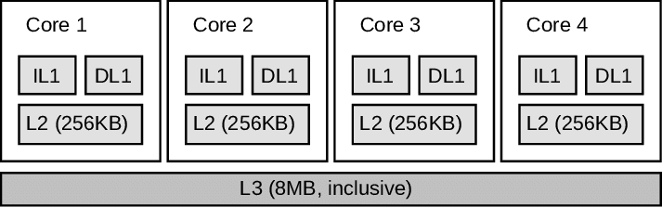
Pre-Knowledge: Microarchitecture
Cache System
TLB： Translation Look-aside Buffer
Mapping virtual address [high-20-bits] to physical address [high-20-bits]

Slide 7
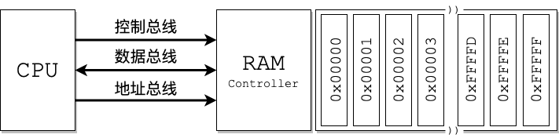
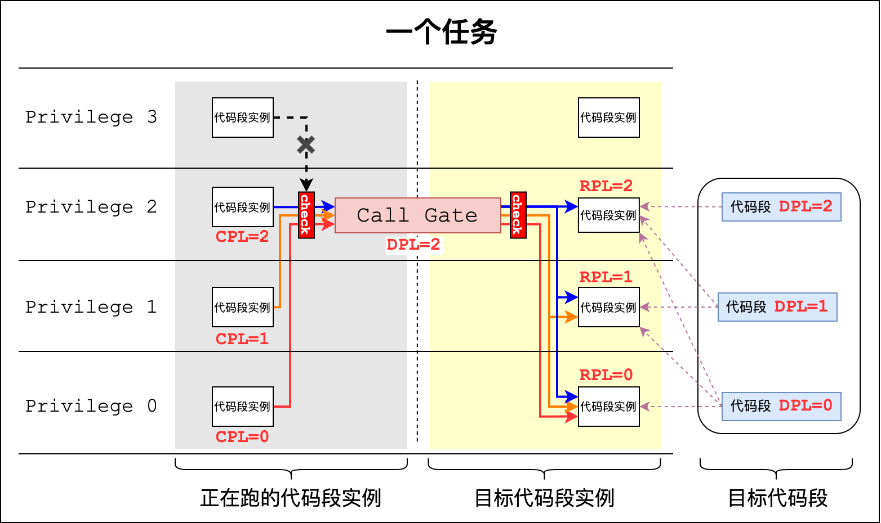
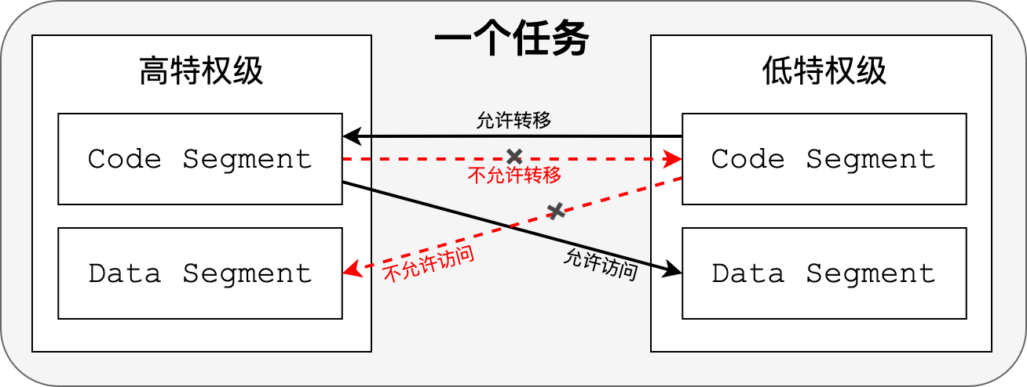
Pre-Knowledge: x86-64 ISA
Real Mode (Intel 8086)
Protect Mode (Intel 80386)
Memory Accessing under Real Mode
Example: Jump to high privilege code segment through call gate
Memory Accessing under Protect Mode
Blog: https://zobinhuang.com/sec_learning/Tech_OS_And_Linux_Kernel/Assembly_8_Protect_Mode/index.html

Slide 8
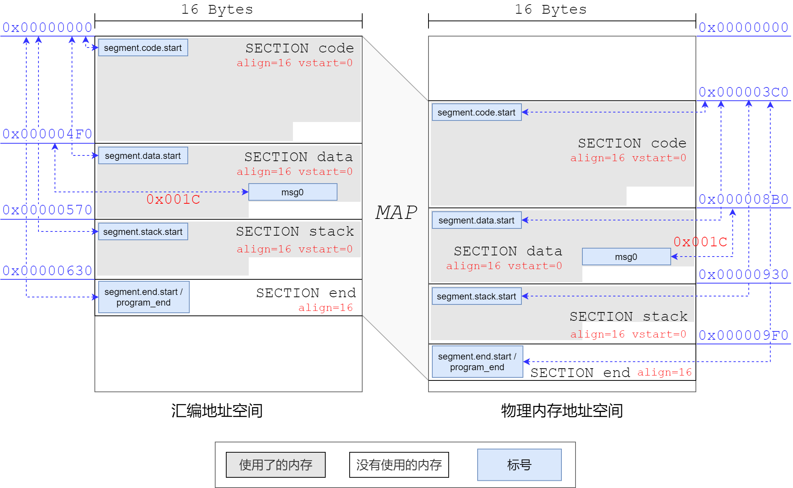


Pre-Knowledge: x86-64 ISA
Segment-based Memory Access (分段内存访问)
Segment-based mechanism can help conduct redirecting in physical memory
For Intel 16-bits Mode:
Based Address
Offset Address
4$bits$
16$bits$
$$\left(Base Address Reg≪4\right)+ Offset Address$$
Redirecting in physical memory

Slide 9
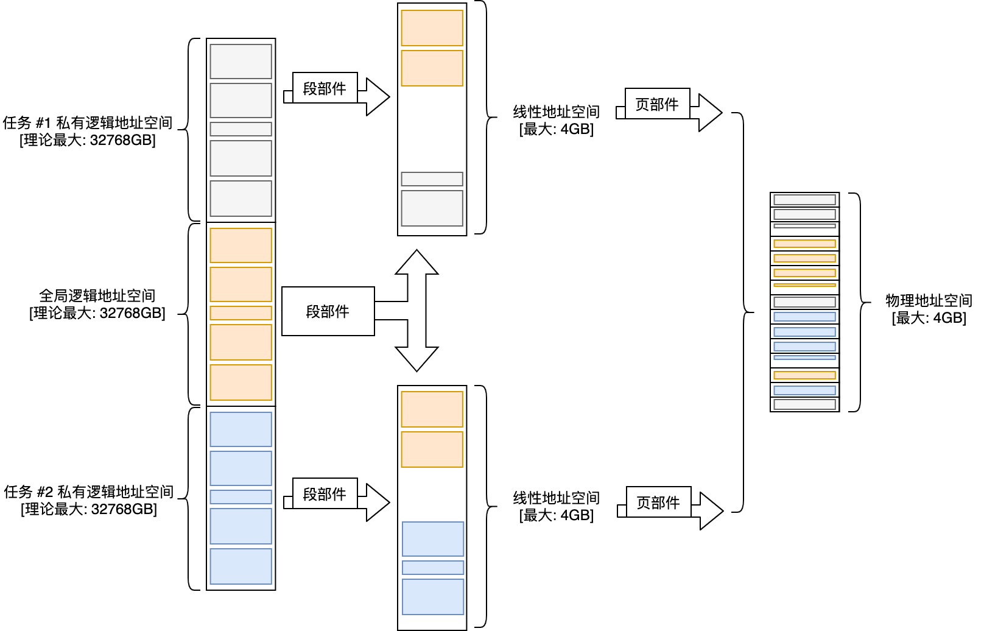
Pre-Knowledge: x86-64 ISA
Page-based Memory Access (分页内存访问)
Page-based Memory Access help build virtual memory space for each process
Logic Address
Segmentation Component
Linear Address
Page Component
Physical Address
How paging mechanism create virtual memory space for each process

Slide 10
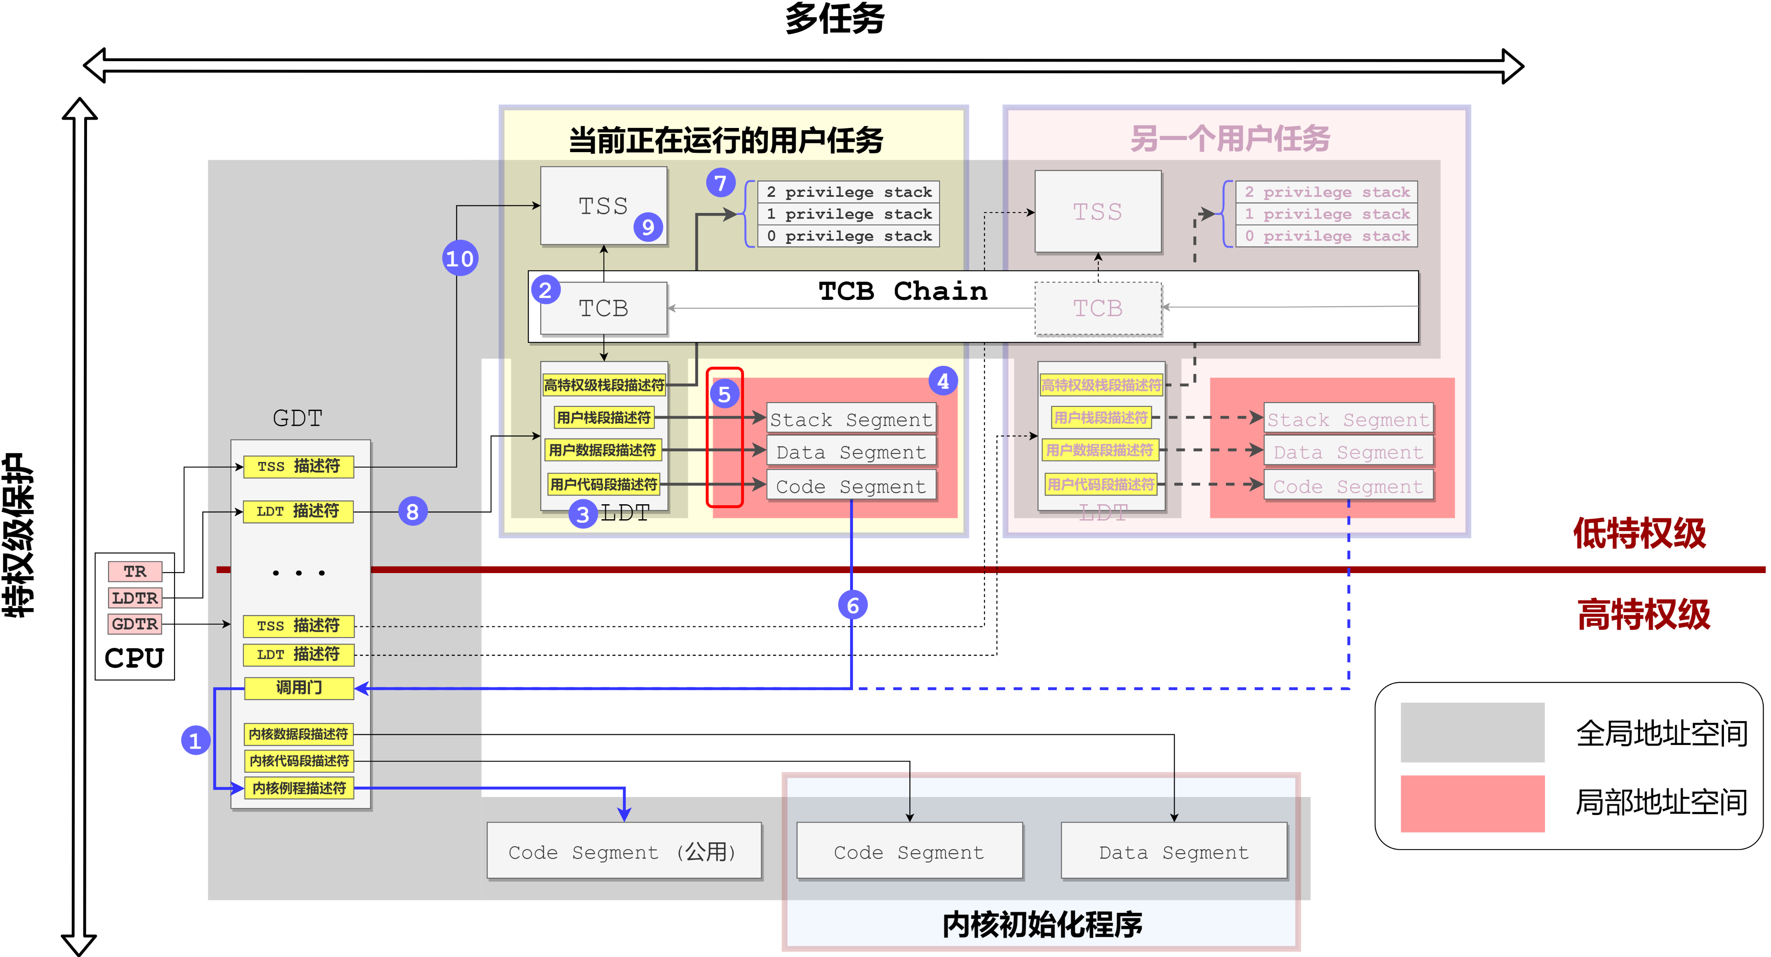
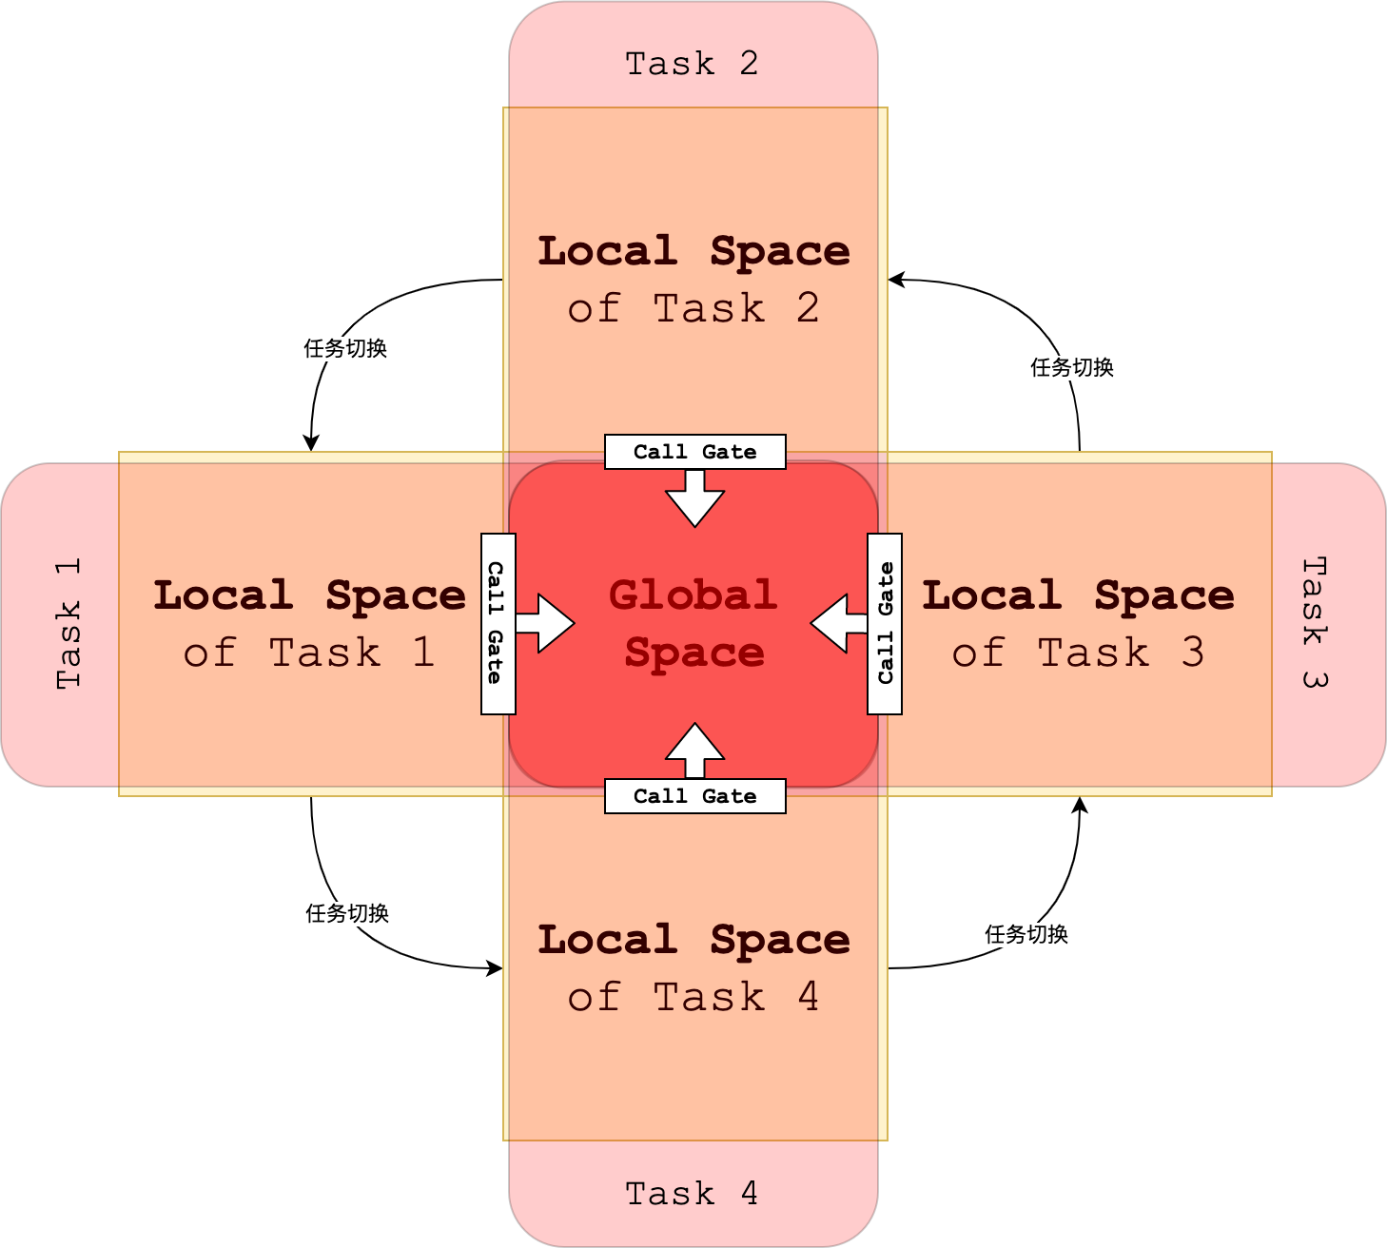
Pre-Knowledge: Kernel Architecture
Multi-task Scheduler
User Space and Kernel Space

Slide 11
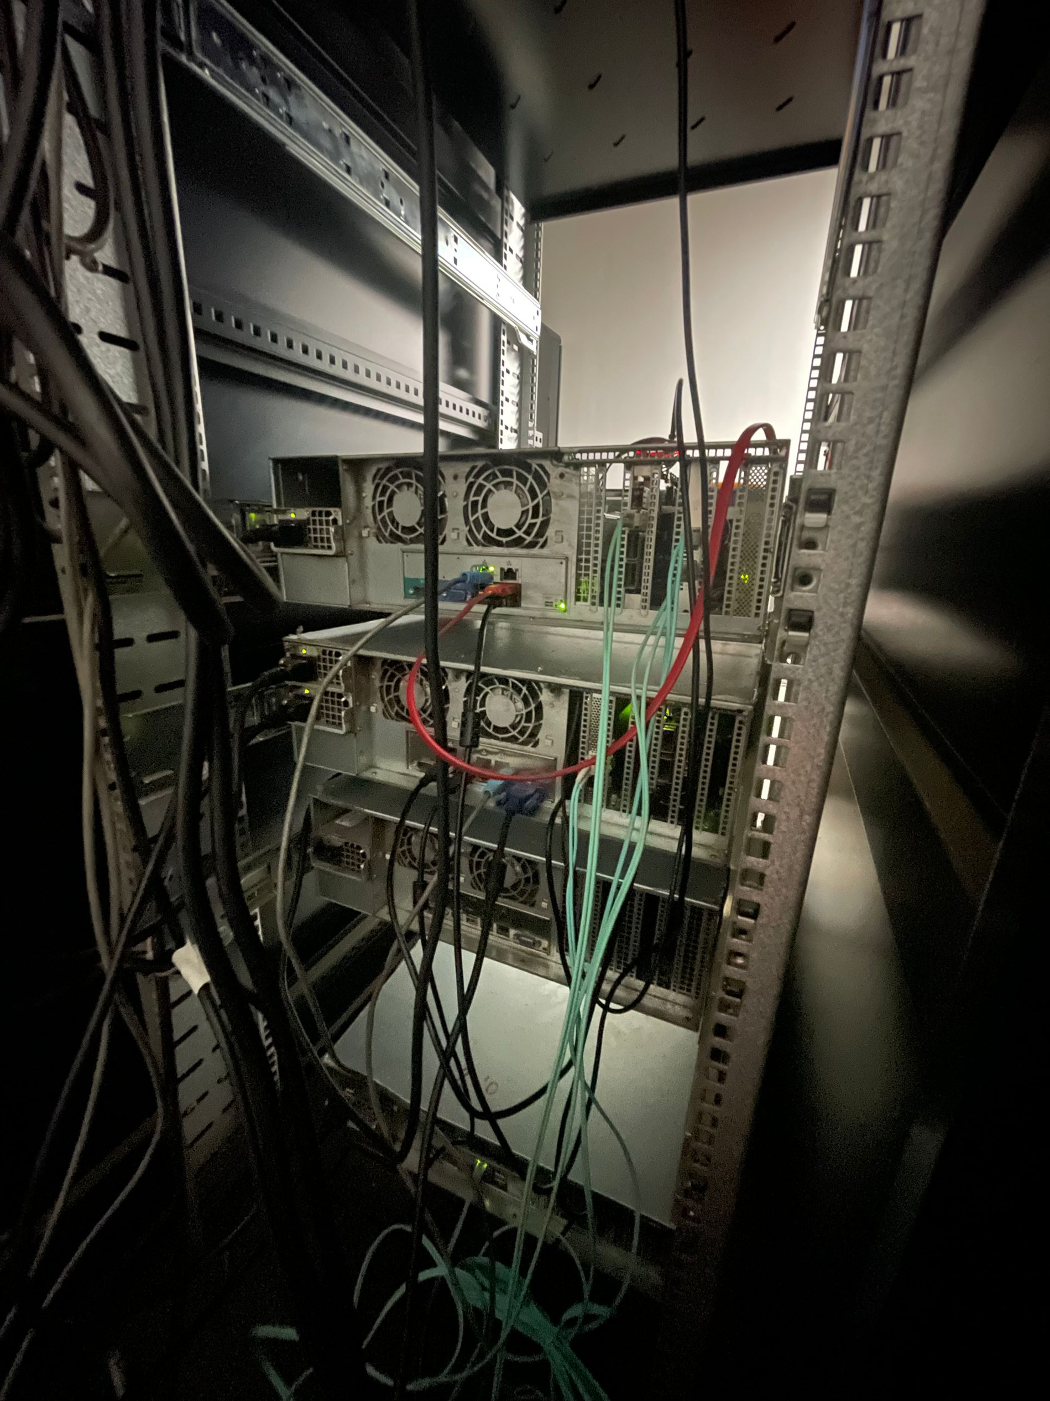
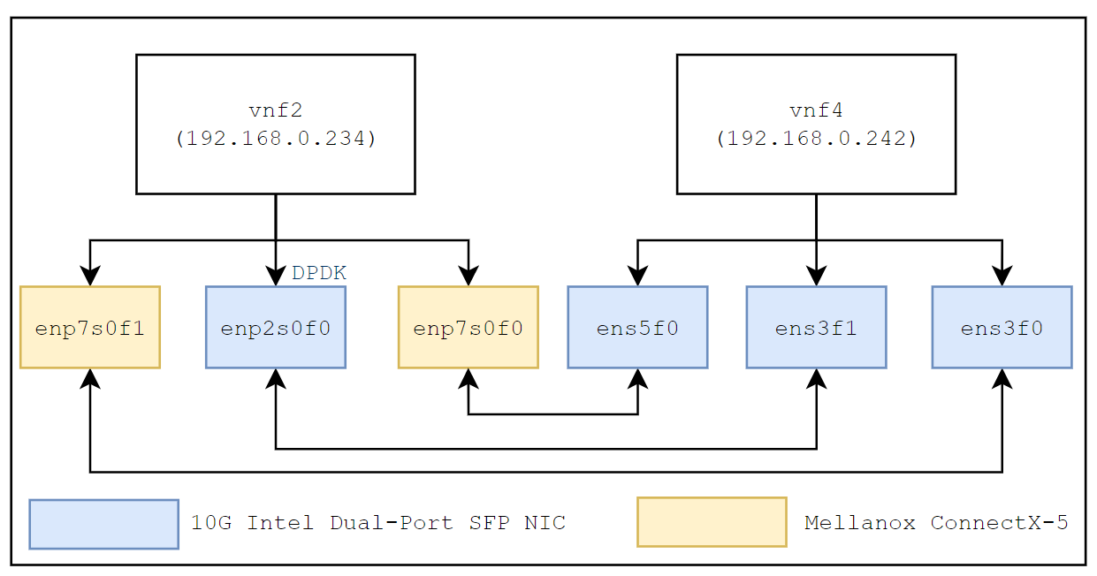
Testbed Environment Built in KB210
Component | Configuration
Hardware Component
#NUMA Node | 2
#Logic Cores per NUMA Node | 12
Processor | Intel(R) Xeon(R) CPU E5-2620 v2 @ 2.10GHz
L1 Data Cache | 384 KB
L1 Instruction Cache | 384 KB
L2 Cache | 3 MB
L3 Cache | 30 MB
System Memory | 64GB
NIC | Intel 10Gb Dual SFP+ NVDIA Mellanox ConnectX-5 25GB [ Actual Link Bandwidth: 9.38Gbits/sec measured by iperf ]
Co-processor | NVDIA Mellanox BlueField SmartNIC (8 x ARM64 cores)
Software Component
Kernel | 5.11.0-38-generic
DPDK
Testbed Servers in KB210 for This Work
System Network Interface Topology

Slide 12
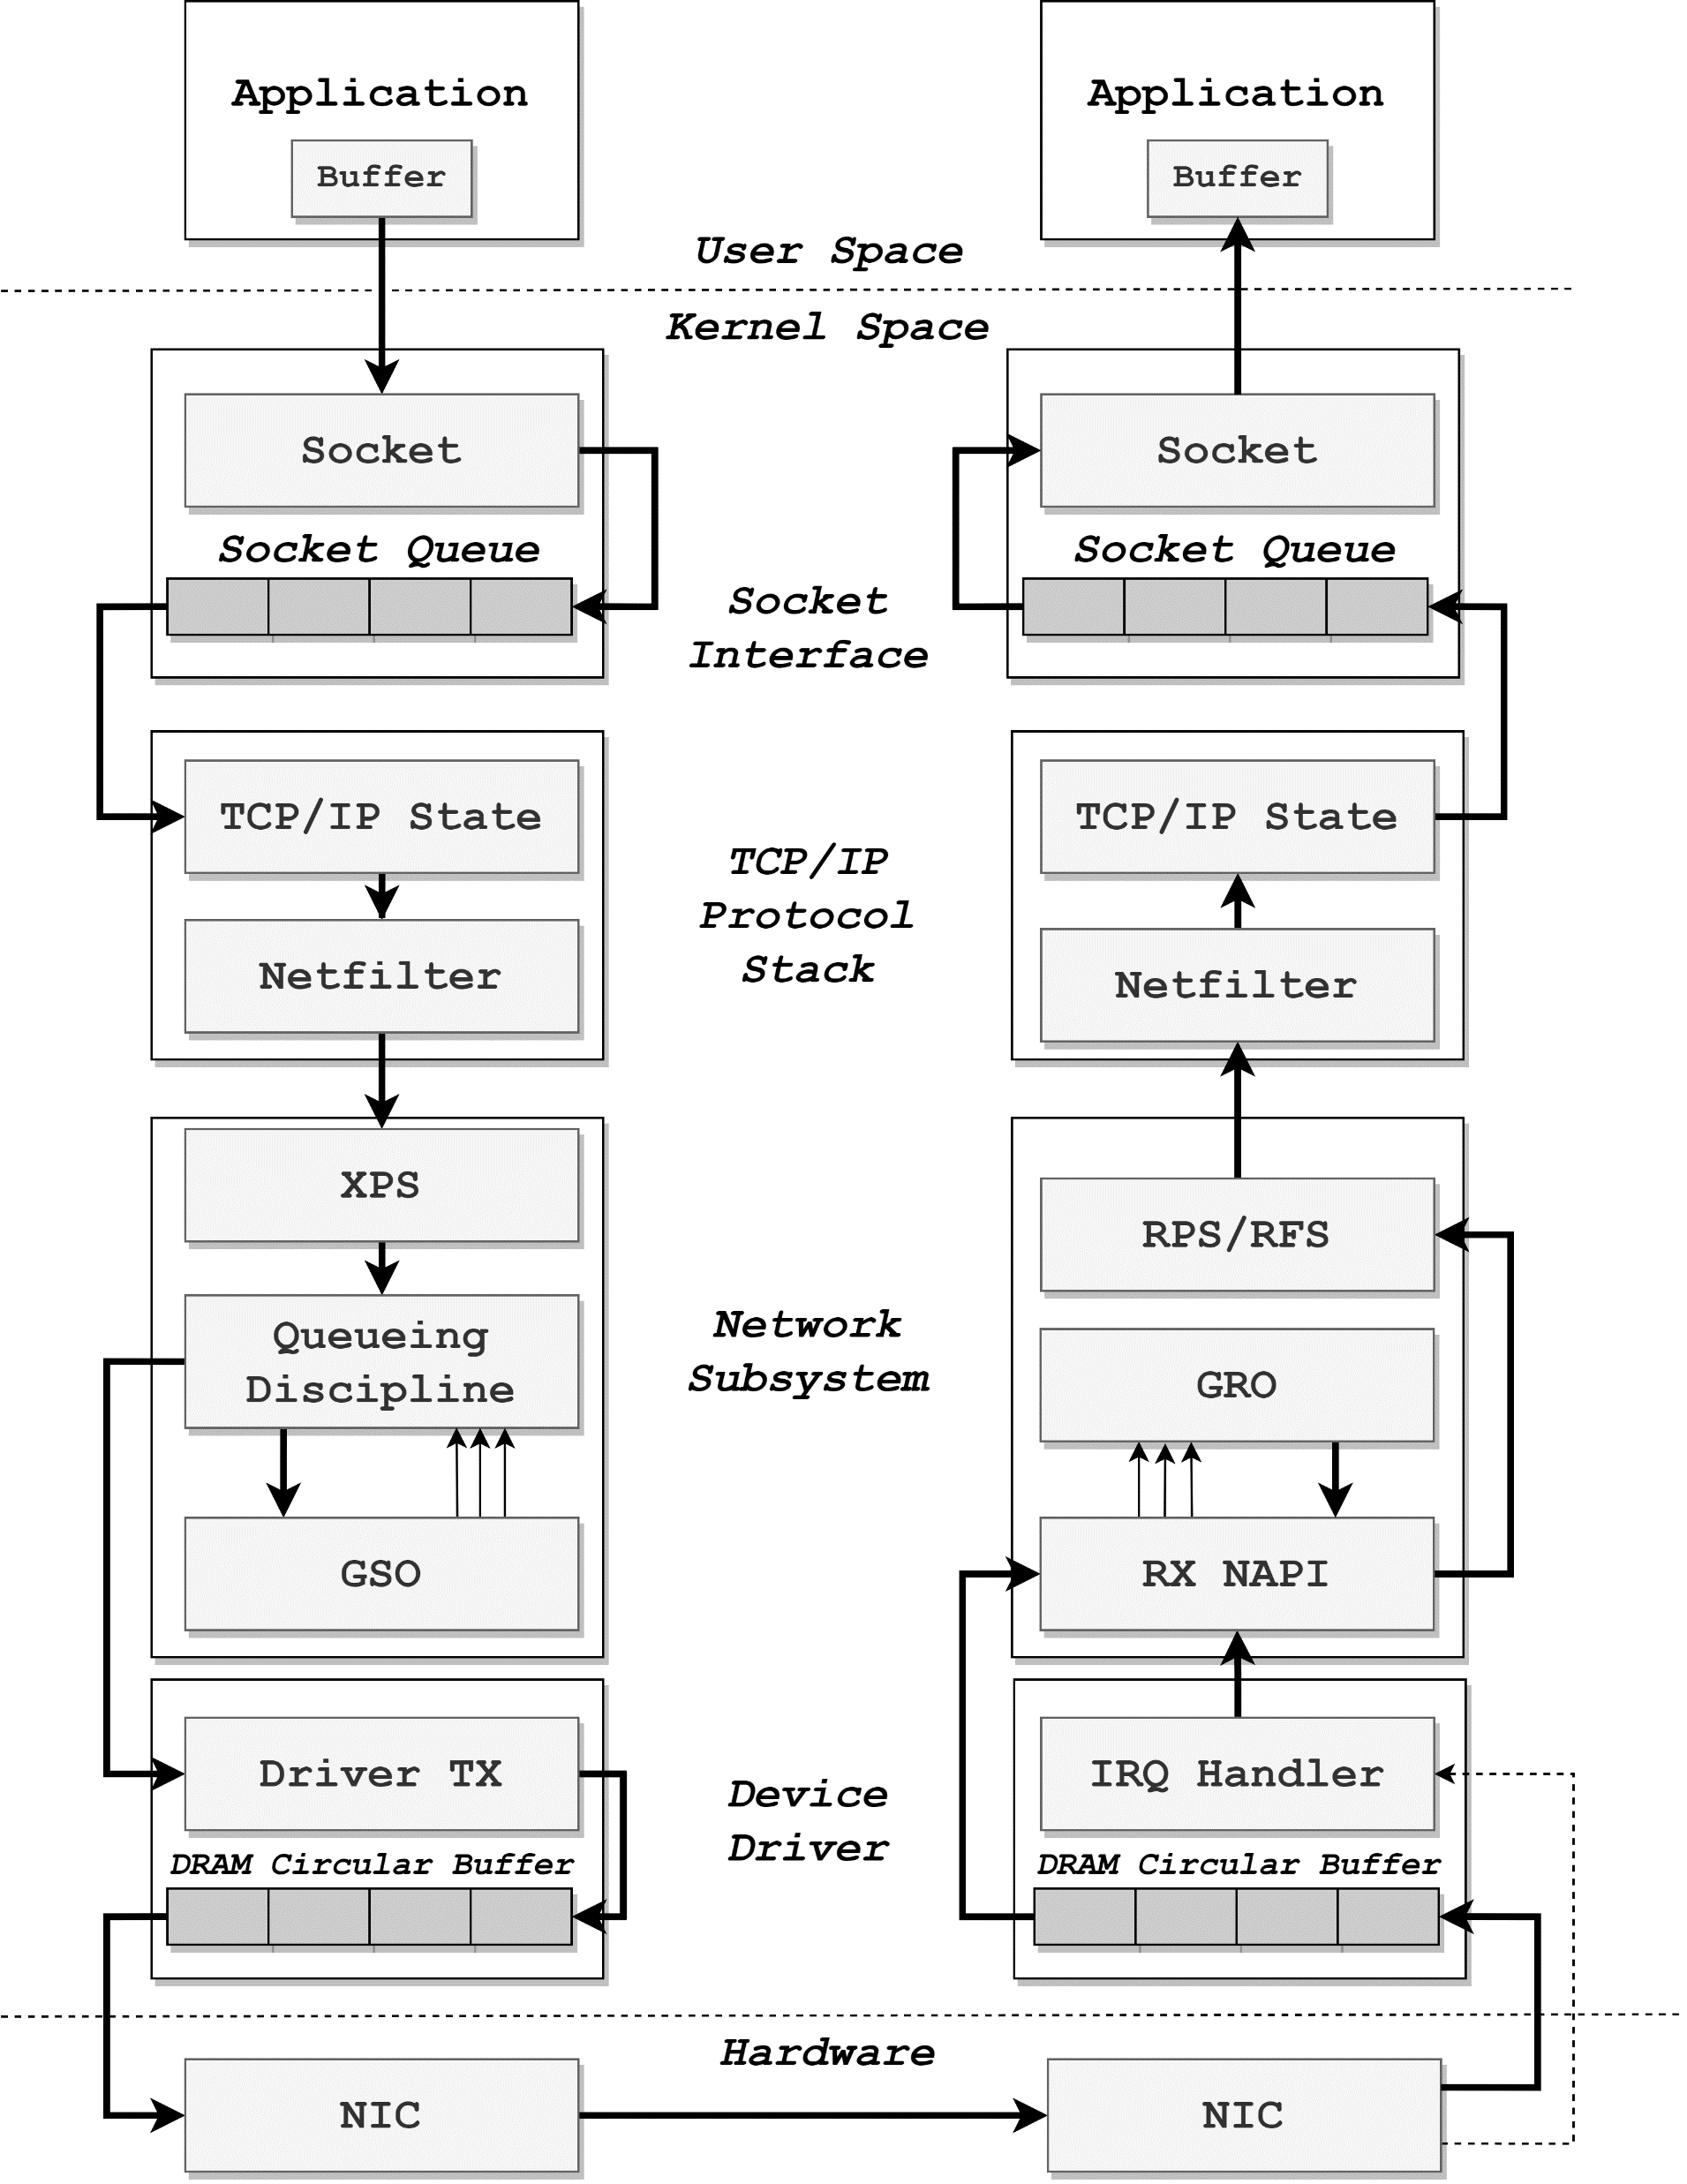
Motivation: Revisiting Packet Processing Pipeline
Copying data from kernel to user space is nowadays the bottleneck in datacenter for those long flows which dominate the datacenter flows [1]
To reduce data copy overhead from kernel space to user space, Netmap introduced a high performance I/O processing framework to reduce cross-bound copy
Segmentation Offloading and Receive Offloading can significantly increase system throughput, these technologies including:
Segmentation Offloading | Receive Offloading
TSO (TCP Segmentation Offloading) | LRO (Large Receive Offloading)
UFO (UDP Fragmentation Offloading)
GSO (Generic Segmentation Offloading) | GRO (Generic Receive Offloading)
Packet processing will cost zero data copy in kernel space through sk_buf structure
To avoid amounts of IRQs, New API (NAPI) will typically be enabled in modern systems
To determine which core to conduct subsequent processing after IRQ be issued, one of the four following steering mechanism would be applied:
Mechanism
Receive Packet Steering (RPS) | Receive Flow Steering (RFS)
Receive Side Steering (RSS) | Accelerated RFS (aRFS)
Kernel Packet Processing Pipeline
Highlights

Slide 13
Motivation: Kernel Network Performance Profiling
Ethernet MTU: 1500 Bytes
Ethernet MTU: 1500 Bytes
Test code of this profiling experiment is in [3]
Notes:
第一个实验发现 NUMA Remote Access 会引入大时延
第二个实验发现 NUMA Remote Access 的 Cache Miss Rate 会比较大
得到暂时结论：必须避免跨 NUMA Node 的内存访问
第三个实验发现将数据包 aRFS 到与应用程序同个 core 进行处理的时候，在小包性能表现较好，超过 Ethernet MTU 1500 后表现较差；

Slide 14

Motivation: Kernel Network Performance Profiling
Line Rate Definition
$$Frame Forward Rate=\frac{Bit Rate/8}{IPG+Preamble+SFD+Packet Size}$$
$$Packet Arrival Interval=\frac{1}{Frame Forward Rate}$$
Some Observation Conclusions
In a multi-NUMA-node system, remote memory accessing should be avoided since it will cause high cache missing rate and introduce tremendous latency;
Cache isn’t able to rescue cross-NUMA-node accessing
Traditional steering mechanism can’t apply with a application-specific allocation scheme [Problem]

Slide 15
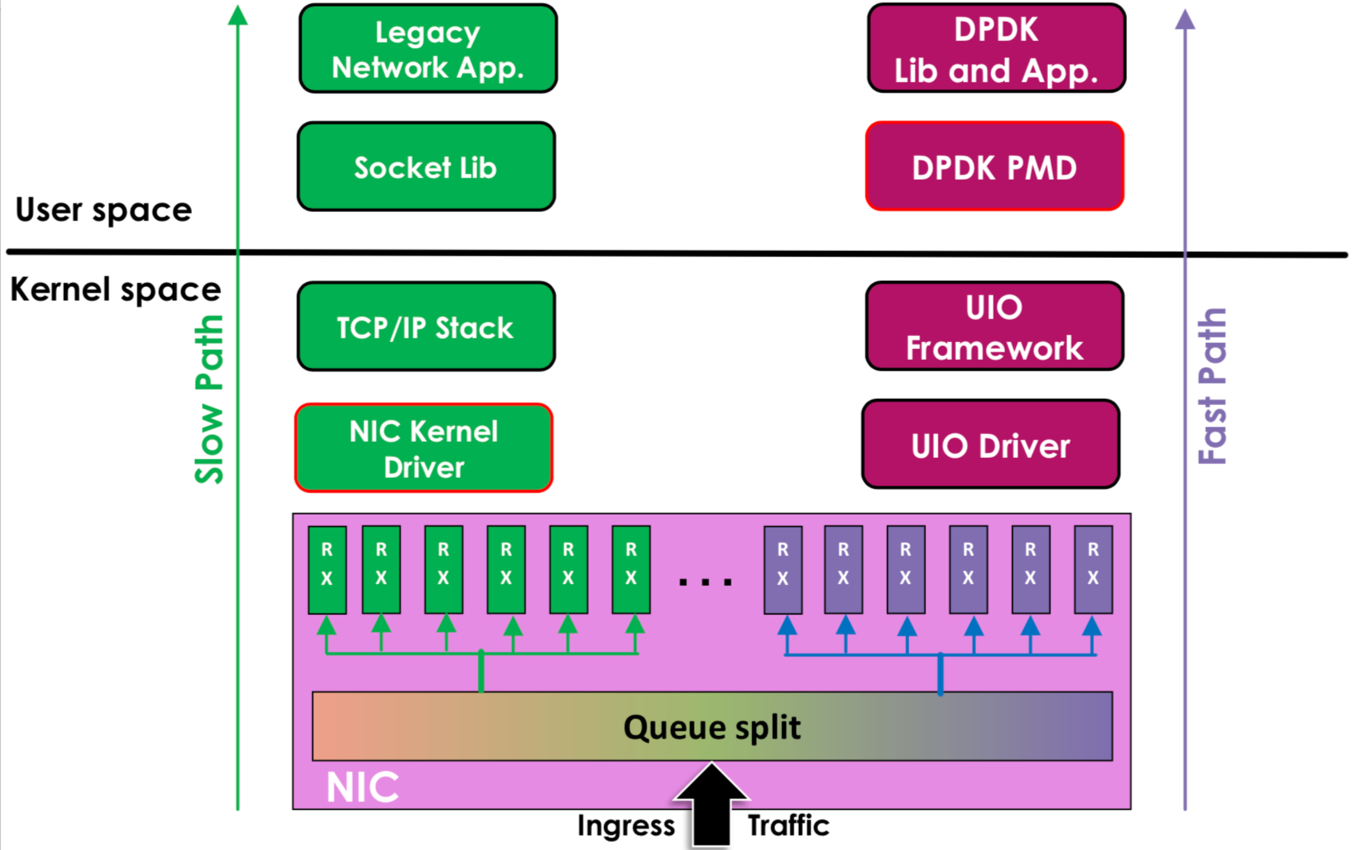
DPDK Basic Insight: Upload
Image Source: Jingjing Wu, Flow Bifurcation on Intel® Ethernet Controller X710/XL710

Slide 16
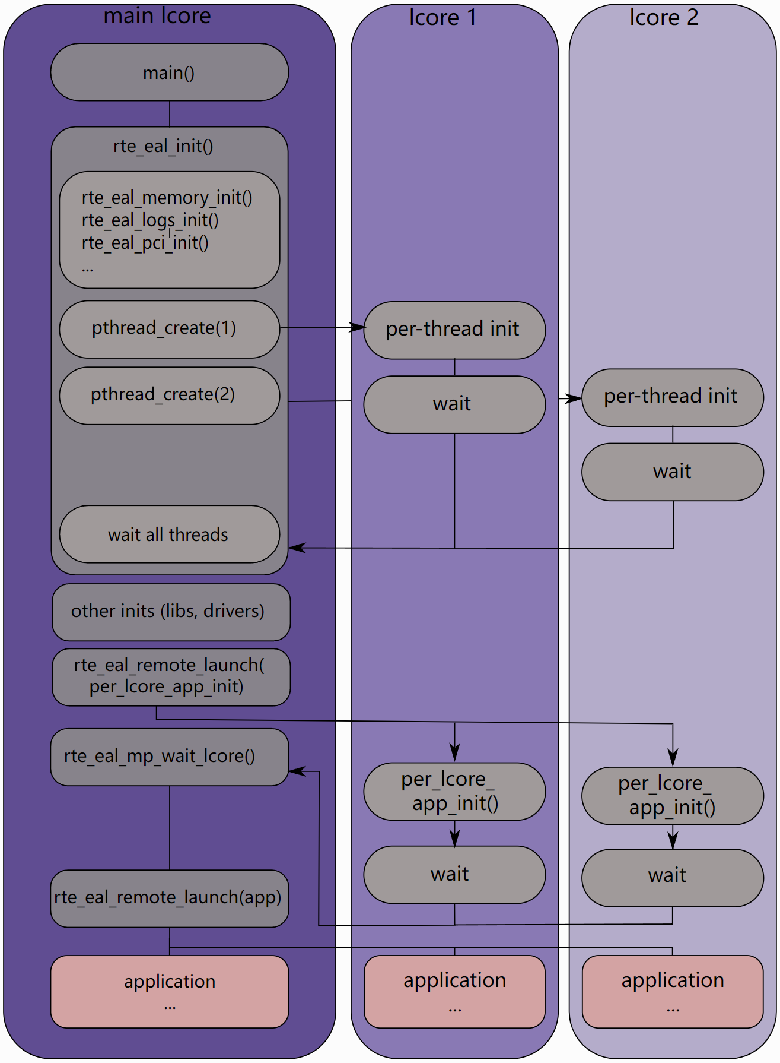
DPDK: Overview Architecture
Application
Library
Environment Abstraction Layer (EAL)
System Call Layer
Memory
Device
Timer
…
EAL Initialization Process

Slide 17
DPDK: Design Principles
Memory Accessing
Data Prefetch: Data must exist in cache while core accessing;
Cacheline Alignment: Key data structure must aligned to 64-bytes cacheline;
Per-core Copy: Key data structure must keep per-core copy to avoid consistency overhead;
Local NUMA-node Processing: Packet should processed in device local NUMA node;
Enable Hugepage: Increase the hit rate of TLB cache
…
Thread Scheduling:
Core Affinity: Bind thread to a particular logic core to avoid switching overhead;
Reduce the number of locks: Implement non-lock circular queue in key datapath
…

Slide 18
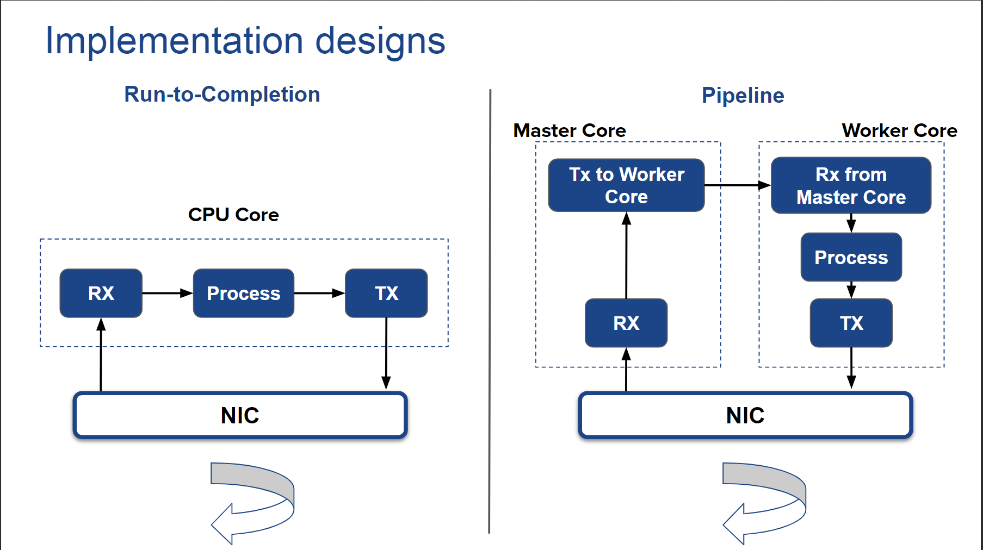
Two DPDK Processing Model

Slide 19
Userspace Framework base on DPDK
FD.io (The Fast Data Project): https://fd.io/
VPP (Vector Packet Processing): https://wiki.fd.io/view/VPP
TLDK: https://wiki.fd.io/view/TLDK
F-Stack: https://github.com/f-stack/f-stack
SeaStar: https://github.com/scylladb/seastar

Slide 20
Reference
Understanding host network stack overheads. Cai, Q., Chaudhary, S., Vuppalapati, M., Hwang, J. and Agarwal, R., 2021, August. In Proceedings of the 2021 ACM SIGCOMM 2021 Conference (pp. 65-77).
Monitoring and Tuning the Linux Networking Stack: Receiving Data (https://blog.packagecloud.io/eng/2016/06/22/monitoring-tuning-linux-networking-stack-receiving-data/)
Measuring latency in the Linux network stack between kernel and user space (https://vilimpoc.org/research/ku-latency/)
Linux環境中的網路分段解除安裝技術 GSO/TSO/UFO/LRO/GRO (https://iter01.com/533165.html)
网卡多队列：RPS、RFS、RSS、Flow Director（DPDK支持）(https://blog.csdn.net/Rong_Toa/article/details/108987658)
Introduction to Intel® Ethernet Flow Director and Memcached Performance White Paper Intel® Ethernet Flow Director and Memcached Performance (https://www.intel.com/content/dam/www/public/us/en/documents/white-papers/intel-ethernet-flow-director.pdf)
Data Plane Development Kit (http://doc.dpdk.org/guides-21.08/prog_guide/overview.html)
腾讯云高性能架构 (https://cloud.tencent.com/developer/article/1198333)

