Slide 1
Introduction to Matlab
CSE-318

Slide 2
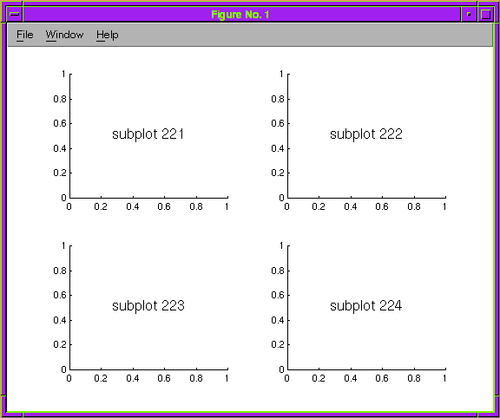
Subplot:

Slide 3
Analog-to-Analog Modulation

Slide 4
Analog-to-analog Modulation
Analog-to-analog modulation is the representation of analog information by analog signal
Modulation is needed:
  If we want to make the signal stronger
  If the medium is bandpass in nature
Three types of Analog-to-analog conversion:
  Amplitude Modulation (AM)
  Frequency Modulation (FM)
  Phase Modulation (PM)

Slide 5
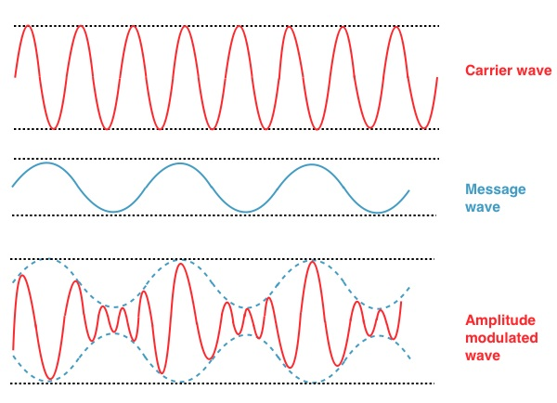
Amplitude Modulation
Carrier signal (radio frequency signal) is modulated so that amplitude varies with the changing amplitude of the modulating signal
The frequency and phase remain the same

Slide 6
Amplitude Modulation
Message Signal, S_{m}= A_{m}sin(2πf_{m}t)
Carrier Signal, S_{c}= A_{c}sin(2πf_{c}t)
Modulated Signal, S_{am} = [1+ m_{i}sin(2πf_{m}t)] S_{c}
Here, mi = A_{m} /A_{c}

Slide 7
Amplitude Modulation Code
t=0:0.001:1;
set(0,'defaultlinelinewidth',2);
A=5; %Amplitude of signal
fm=input('Message frequency='); %Accepting input value
fc=input('Carrier frequency='); %Accepting input value (fc>fm)
mi=input('Modulation Index='); %Modulation Index
%Message Signal
Sm=A*sin(2*pi*fm*t);
subplot(3,1,1);
%Plotting frame divided in to 3 rows and this fig appear at 1st
plot(t,Sm);
xlabel('Time');
ylabel('Amplitude');
title('Message Signal');

Slide 8
Amplitude Modulation Code
%Carrier Signal
Sc=A*sin(2*pi*fc*t);
subplot(3,1,2);
plot(t,Sc);
xlabel('Time');
ylabel('Amplitude');
title('Carrier Signal');
%AM Signal, Amplitude of Carrier changes to (A+Message)
Sfm=(1+mi.* sin(2*pi*fm*t)).*Sc;
subplot(3,1,3);
plot(t,Sfm);
xlabel('Time');
ylabel('Amplitude');
title('AM Signal');

Slide 9
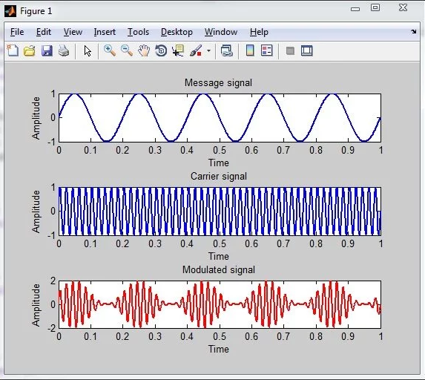
Amplitude Modulation Code
If f_{m}=5, f_{c}=50, m=1

Slide 10
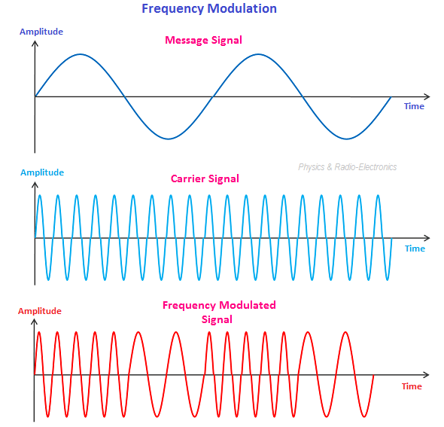
Frequency Modulation
Frequency of the carrier signal is modulated; peak amplitude and phase of carrier signal remain constant

Slide 11
Frequency Modulation
Let, A_{c} = A_{m} = A
Message Signal, S_{m}= Asin(2πf_{m}t)
Carrier Signal, S_{c}= Asin(2πf_{c}t)
Modulated Signal,
S_{fm}= Asin(2πf_{c}t + (m_{i}sin(2πf_{m}t)))

Slide 12
Phase Modulation
Try By Yourself!!!

Slide 13
Thank You…

