Slide 1
Traffic Dynamics in Futuristic Urban Environments: An Analysis of Vehicle Types, Weather, and Economic Conditions
Team Members: Zoe Becker, Islam Rajei, Alex Lewis
Date: 4/25/2024

Slide 2
Project Summary
This project explores the complexities of traffic dynamics in six futuristic cities, using a dataset with over 1.2 million records. We aim to understand how vehicle types, weather, and economic conditions affect traffic flow and energy consumption.

Slide 3
Methodology
We employed a combination of statistical and machine learning techniques, starting with exploratory data analysis to understand the dataset's characteristics. For predictive modeling, we used Linear Regression and Decision Tree Regressors to assess how different factors impact energy consumption and traffic density

Slide 4
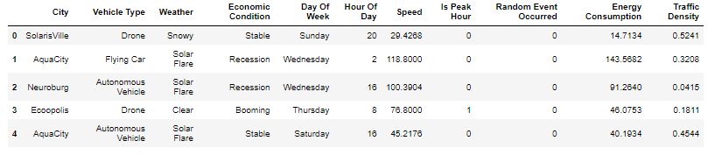
Data Overview
Notes:
The dataset covers diverse aspects of mobility, such as vehicle speeds, types, and traffic density under different weather and economic conditions. Initial data image

Slide 5
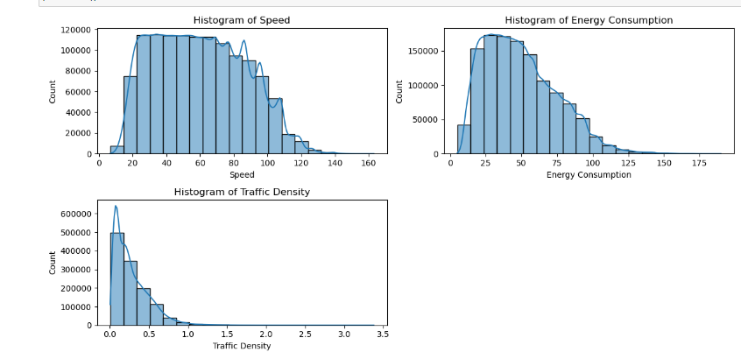
Exploratory Data Analysis (EDA)
Notes:
Histograms for continuous variables like speed and energy consumption. Explain any patterns or outliers observed.
Bar plots for categorical variables like day of the week and vehicle type. Talk about trends.

Slide 6
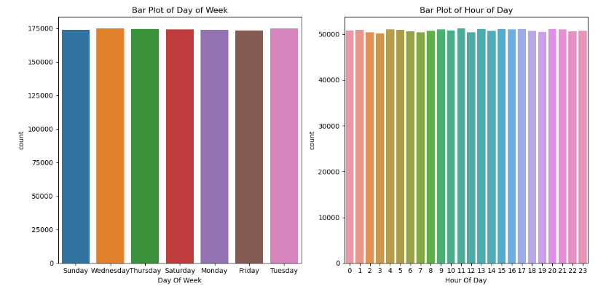
Exploratory Data Analysis (EDA)
Notes:
Histograms for continuous variables like speed and energy consumption. Explain any patterns or outliers observed.
Bar plots for categorical variables like day of the week and vehicle type. Talk about trends.

Slide 7
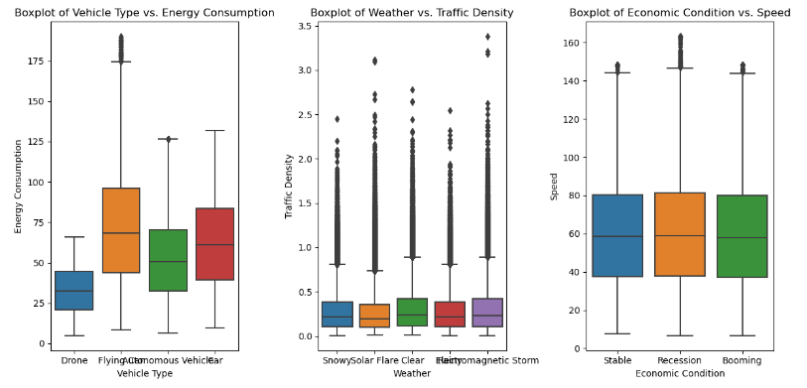
Exploratory Data Analysis (EDA)
Notes:
Boxplots to explore relationships between vehicle type and energy consumption, weather conditions, and traffic density.
Scatter plots for speed vs. traffic density and energy consumption vs. weather conditions to identify potential correlations.

Slide 8
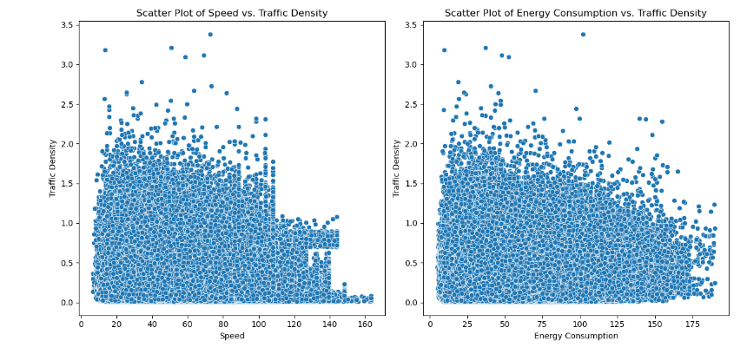
Exploratory Data Analysis (EDA)
Notes:
Boxplots to explore relationships between vehicle type and energy consumption, weather conditions, and traffic density.
Scatter plots for speed vs. traffic density and energy consumption vs. weather conditions to identify potential correlations.

Slide 9
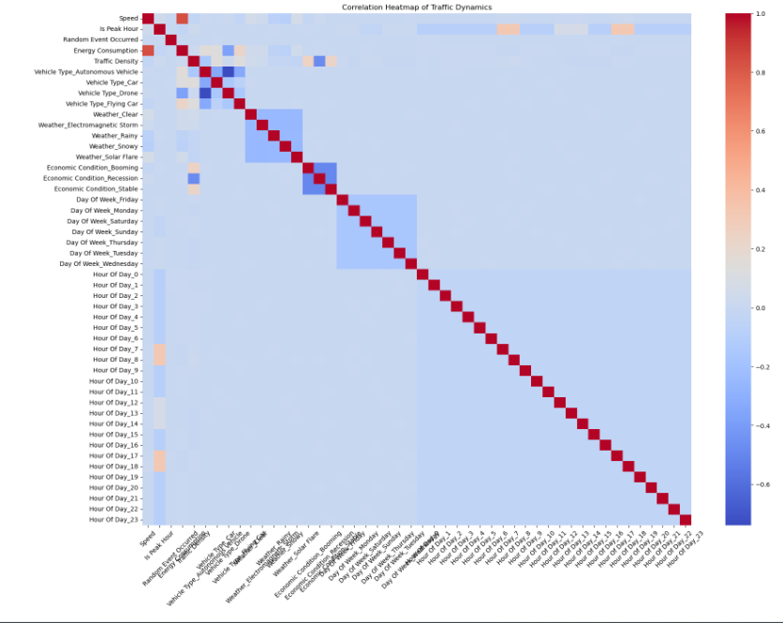
Correlation Analysis
Notes:
Heat map for positive or negative correlations.

Slide 10
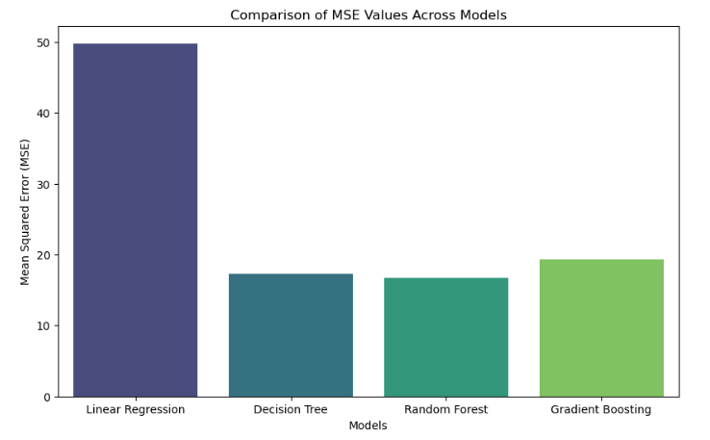
Results - Comparisons and Graphs
Notes:
Our EDA focused on identifying patterns and outliers through histograms and boxplots. We also used scatter plots to examine relationships between variables like speed and traffic density, which helped us pinpoint key factors affecting traffic flow. The baseline Linear Regression model gave us a mean squared error of about 49.80. However, when we employed the Decision Tree model, the MSE significantly dropped to 17.25, indicating a much better fit for the data. As we enhanced our model complexity with Random Forest and Gradient Boosting, we noticed further improvements. The Random Forest model achieved an MSE of 16.67, while Gradient Boosting recorded an MSE of 19.33.

Slide 11
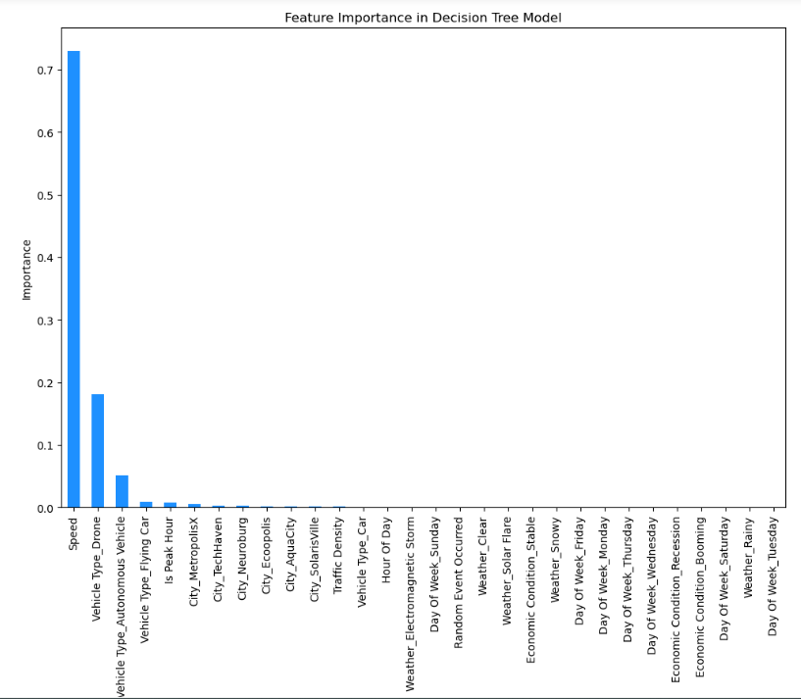
Feature Importance
Notes:
Analyzing feature importance helped us understand which variables most significantly impact energy consumption. Speed and vehicle type were among the top predictors.

Slide 12
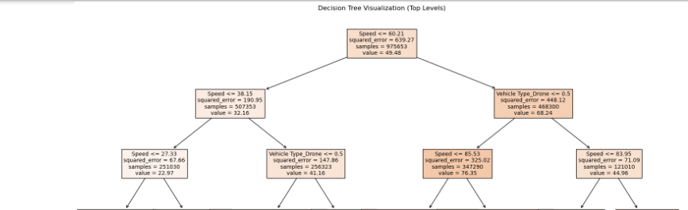
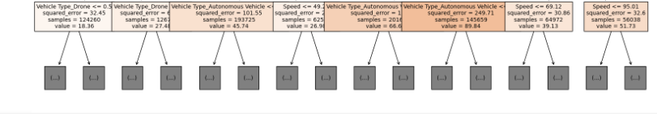
Model Visualizations
Notes:
Visualization of the Decision Tree model. This view helps us see how different features affect our predictions at various decision points

Slide 13
Conclusion and Future Work

