Slide 1



$$t=0$$
$$N_{t}=1$$

Slide 2


$$t=1$$
$$N_{t}=2$$

Slide 3


$$t=2$$
$$N_{t}=4$$

Slide 4


$$t=3$$
$$N_{t}=8$$

Slide 5


$$t=4$$
$$N_{t}=16$$

Slide 6


$$t=5$$
$$N_{t}=32$$

Slide 7


$$t=6$$
$$N_{t}=64$$

Slide 8


$$t=7$$
$$N_{t}=128$$

Slide 9


$$t=0$$
$$N_{0}=1=2^{0}$$

Slide 10

$$t=1$$
$$N_{1}=2N_{0}=2^{1}=2$$

Slide 11

$$t=2$$
$$N_{2}=2N_{1}=2×2=2^{2}=4$$

Slide 12

$$t=3$$
$$N_{3}=2N_{2}=2×2^{2}=2^{3}=8$$

Slide 13

$$t=4$$
$$N_{4}=2N_{3}=2×2^{3}=2^{4}=16$$

Slide 14

$$t=5$$
$$N_{5}=2N_{4}=2×2^{4}=2^{5}=32$$

Slide 15

$$t=6$$
$$N_{6}=2N_{5}=2×2^{5}=2^{6}=64$$

Slide 16

$$t=7$$
$$N_{7}=2N_{6}=2×2^{6}=2^{7}=128$$

Slide 17
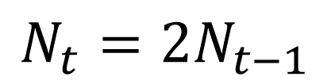

$$N_{t}=2N_{t−1}$$
$$N_{t}=2^{t}$$

Slide 18
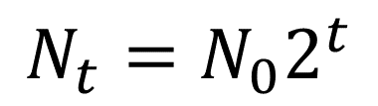
$$N_{t}=2N_{t−1}$$
$$N_{t}=N_{0}2^{t}$$

Slide 19
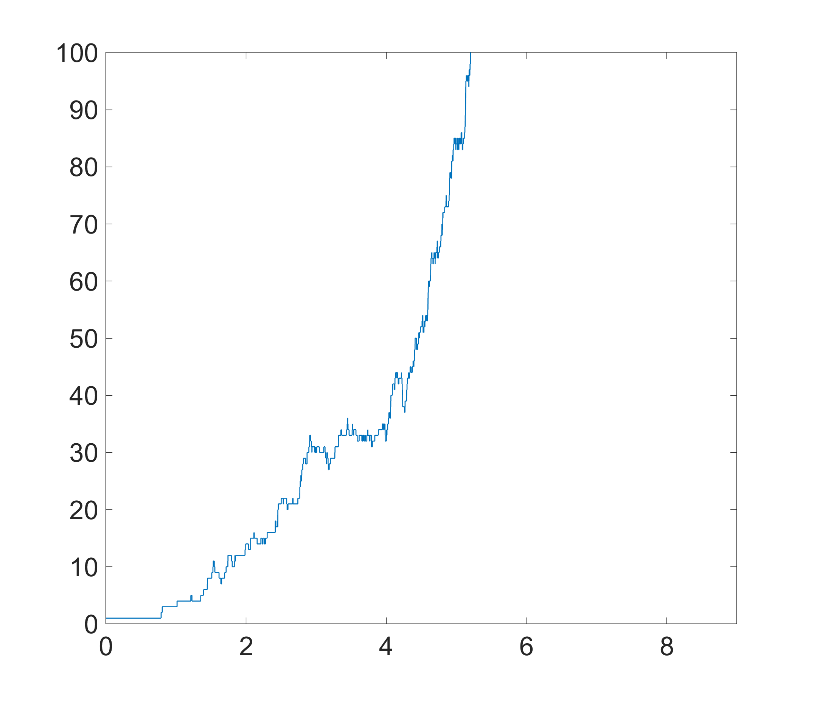
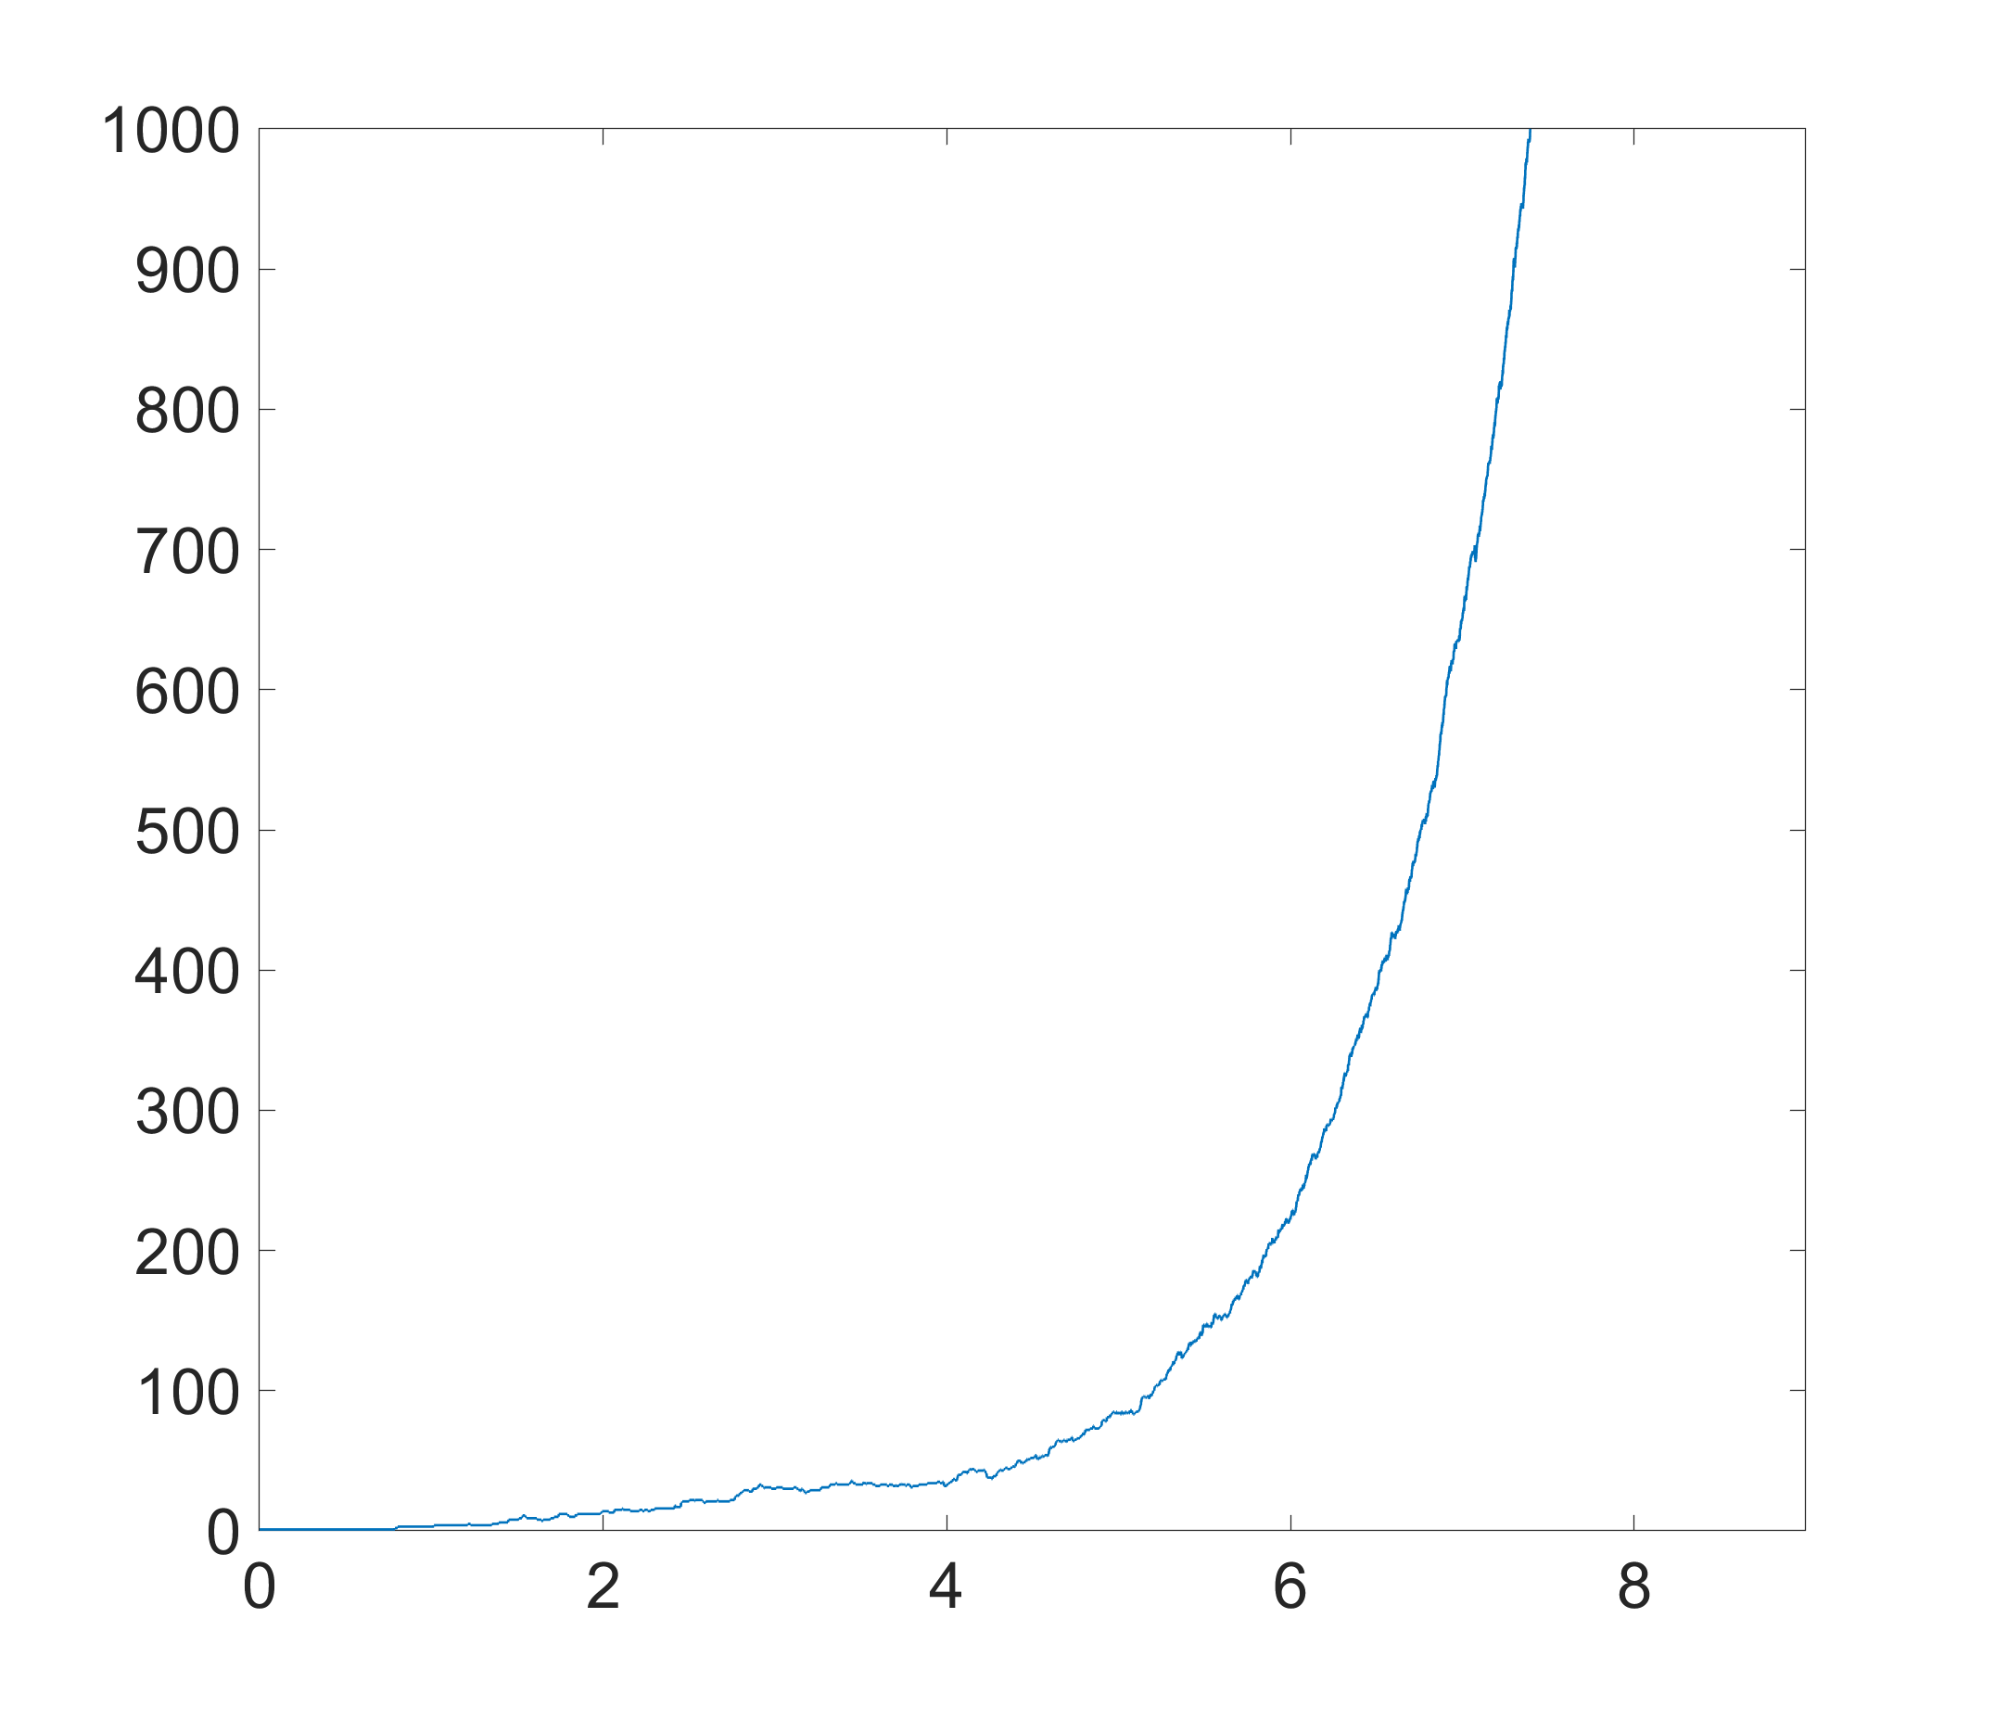





Discrete time to continuous time
Organisms typically reproduce/divide at random times (overlapping generations)
Proper description stochastic — but once $N$ is “large” growth deterministic & exponential
Continuous time stochastic exponential growth simulations
(Gillespie/Kinetic Monte Carlo)
$$N(t)$$
$$N(t)$$
$$t$$
$$t$$

Slide 20
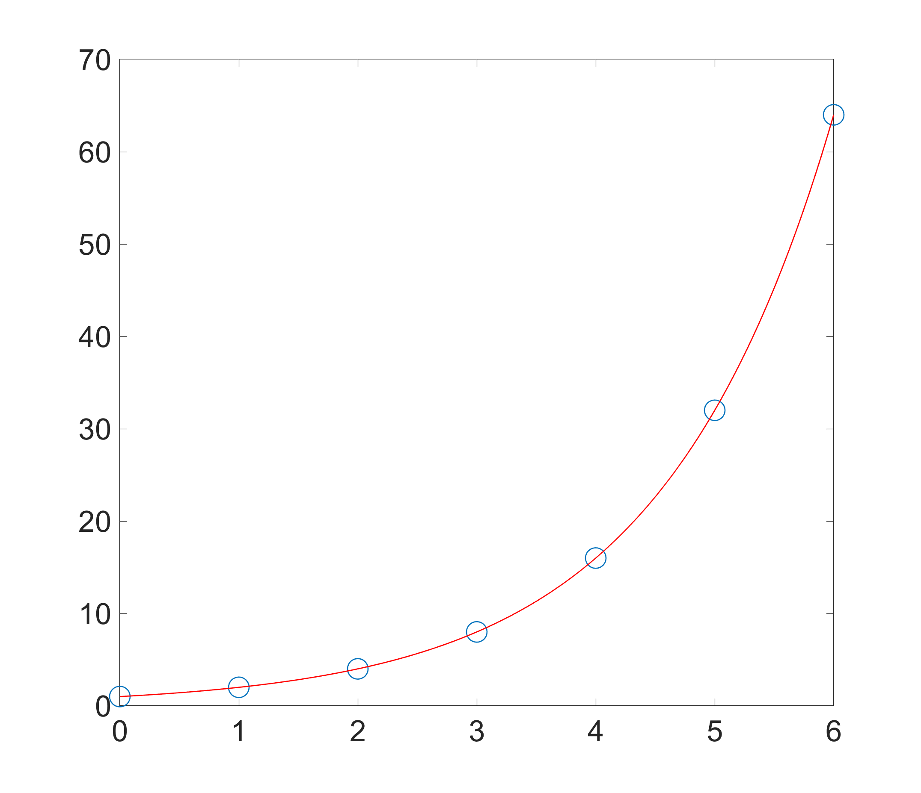








Discrete time to continuous time
Exponential function $e^{vt}$ exactly interpolates discrete exponential growth $N_{t}=2^{t}$ (or $N_{t}=w^{t}$ in general)
$$⇒2^{t}=e^{vt} \\ ={\left(e^{v}\right)}^{t}$$
$${N_{t}=N}_{0}2^{t}$$
$$N\left(t\right)=N_{0}e^{vt}$$
$$⇒2=e^{v} \\ ⇒v=\ln{2}$$
$$N$$
More generally $$⇒v=\ln{w}$$
$$t$$

