Slide 1



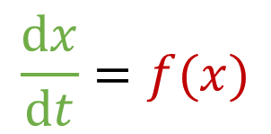



Dynamical systems
$$\frac{dx}{dt}=f(x)$$
1st order differential equation
$$x(t)$$
$$f(x)$$
$$x_{0}$$
$$t$$
$$x_{0}$$
$$x$$

Slide 2






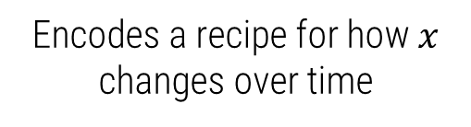
1st order differential equation
$$\frac{dx}{dt}=f(x)$$
Encodes a recipe for how $x$ changes over time
$$x(t)$$
$$f(x)$$
$$\frac{Δx}{Δt}=f(x_{0})$$
$$x_{0}$$
$$Δx$$
$$Δt$$
$$t$$
$$x_{0}$$
$$x$$

Slide 3





1st order differential equation
$$\frac{dx}{dt}=f(x)$$
Encodes a recipe for how $x$ changes over time
$$x(t)$$
$$f(x)$$
$$\frac{Δx}{Δt}=f(x_{1})$$
$$x_{1}$$
$$Δx$$
$$Δt$$
$$t$$
$$x_{1}$$
$$x$$

Slide 4





1st order differential equation
$$\frac{dx}{dt}=f(x)$$
Encodes a recipe for how $x$ changes over time
$$x(t)$$
$$f(x)$$
$$x_{2}$$
$$Δt$$
$$Δx$$
$$\frac{Δx}{Δt}=f(x_{2})$$
$$t$$
$$x_{2}$$
$$x$$

Slide 5
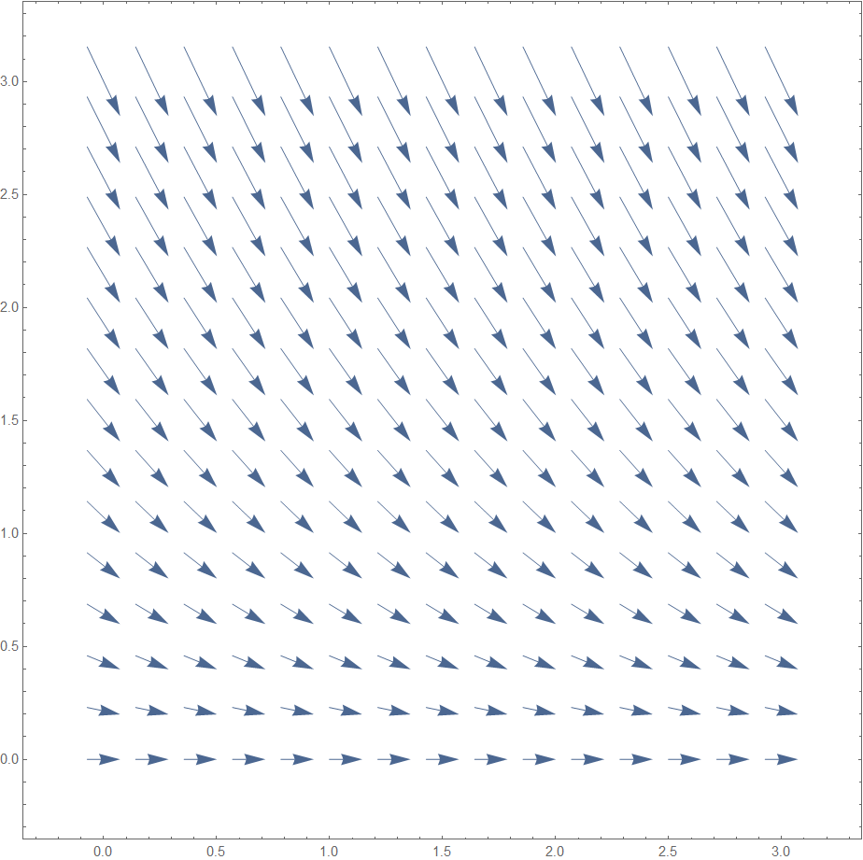

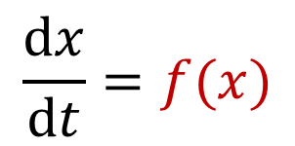

$$\frac{dx}{dt}=f(x)$$
$$x$$
$$t$$

Slide 6






$$\frac{dx}{dt}=f(x)$$
$$Δt$$
$${x=x}_{1}$$
$$Δx$$
$$\frac{Δx}{Δt}=f(x_{1})$$
$$x$$
$$t$$

Slide 7
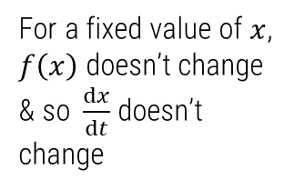

$$\frac{dx}{dt}=f(x)$$
For a fixed value of $x$, $f\left(x\right)$ doesn’t change
& so$\frac{dx}{dt}$ doesn’t change
$$x=x_{1}$$
$$x$$
$$t$$

Slide 8


$$\frac{dx}{dt}=f(x)$$
$$x\left(t=0\right)=x_{0}$$
$$x$$
$$t=0$$
$$t$$

Slide 9
$$\frac{dx}{dt}=f(x)$$
$$x$$
$$t$$

Slide 10
$$\frac{dx}{dt}=f(x)$$
$$x$$
$$t$$

Slide 11
$$\frac{dx}{dt}=f(x)$$
$$x$$
$$t$$

Slide 12
$$\frac{dx}{dt}=f(x)$$
$$x$$
$$t$$

Slide 13
$$\frac{dx}{dt}=f(x)$$
$$x$$
$$t$$

Slide 14
$$\frac{dx}{dt}=f(x)$$
$$x$$
$$t$$

Slide 15
$$\frac{dx}{dt}=f(x)$$
$$x$$
$$t$$

Slide 16
$$\frac{dx}{dt}=f(x)$$
$$x$$
$$t$$

Slide 17
$$\frac{dx}{dt}=f(x)$$
$$x$$
$$t$$

Slide 18
$$\frac{dx}{dt}=f(x)$$
$$x$$
$$t$$

Slide 19
$$\frac{dx}{dt}=f(x)$$
$$x$$
$$t$$

Slide 20
$$\frac{dx}{dt}=f(x)$$
$$x$$
$$t$$

Slide 21
$$\frac{dx}{dt}=f(x)$$
$$x$$
$$t$$

Slide 22
$$\frac{dx}{dt}=f(x)$$
$$x$$
$$t$$

Slide 23
$$\frac{dx}{dt}=f(x)$$
$$x$$
$$t$$

Slide 24
$$\frac{dx}{dt}=f(x)$$
$$x$$
$$t$$

Slide 25
$$\frac{dx}{dt}=f(x)$$
$$x$$
$$t$$

Slide 26
$$\frac{dx}{dt}=f(x)$$
$$x$$
$$t$$

Slide 27
$$\frac{dx}{dt}=f(x)$$
$$x$$
$$t$$

Slide 28
$$\frac{dx}{dt}=f(x)$$
$$x$$
$$t$$

Slide 29
$$\frac{dx}{dt}=f(x)$$
$$x$$
$$t$$

Slide 30
$$\frac{dx}{dt}=f(x)$$
$$x$$
$$t$$

Slide 31
$$\frac{dx}{dt}=f(x)$$
$$x$$
$$t$$

Slide 32

$$\frac{dx}{dt}=f(x)$$
$$x\left(t=0\right)=x_{0}$$
$$x$$
$$t=0$$
$$t$$

Slide 33
$$\frac{dx}{dt}=f(x)$$
$$x$$
$$t$$

Slide 34
$$\frac{dx}{dt}=f(x)$$
$$x$$
$$t$$

Slide 35
$$\frac{dx}{dt}=f(x)$$
$$x$$
$$t$$

Slide 36
$$\frac{dx}{dt}=f(x)$$
$$x$$
$$t$$

Slide 37
$$\frac{dx}{dt}=f(x)$$
$$x$$
$$t$$

Slide 38
$$\frac{dx}{dt}=f(x)$$
$$x$$
$$t$$

Slide 39
$$\frac{dx}{dt}=f(x)$$
$$x$$
$$t$$

Slide 40
$$\frac{dx}{dt}=f(x)$$
$$x$$
$$t$$

Slide 41
$$\frac{dx}{dt}=f(x)$$
$$x$$
$$t$$

Slide 42
$$\frac{dx}{dt}=f(x)$$
$$x$$
$$t$$

Slide 43
$$\frac{dx}{dt}=f(x)$$
$$x$$
$$t$$

Slide 44
$$\frac{dx}{dt}=f(x)$$
$$x$$
$$t$$

Slide 45
$$\frac{dx}{dt}=f(x)$$
$$x$$
$$t$$

Slide 46
$$\frac{dx}{dt}=f(x)$$
$$x$$
$$t$$

Slide 47
$$\frac{dx}{dt}=f(x)$$
$$x$$
$$t$$

Slide 48
$$\frac{dx}{dt}=f(x)$$
$$x$$
$$t$$

Slide 49
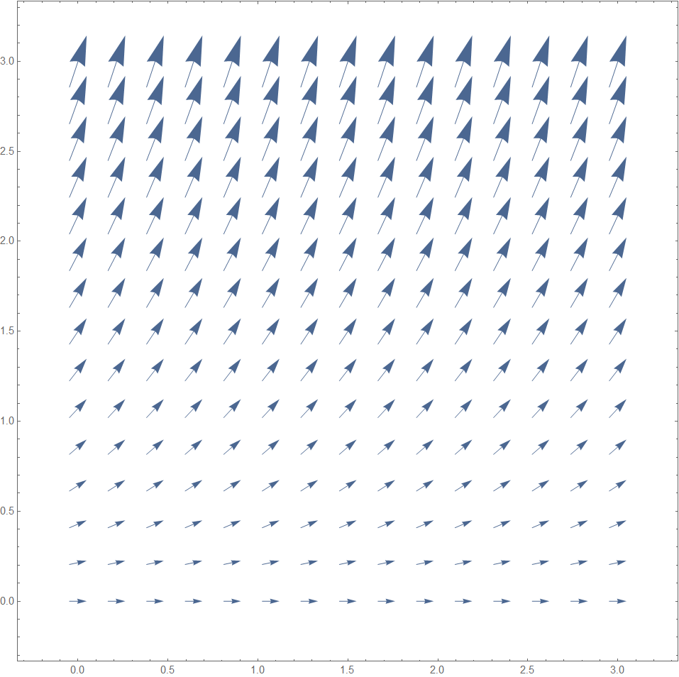
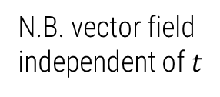
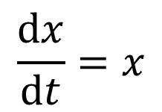

$$\frac{dx}{dt}=x$$
$$x$$
$$f\left(x\right)=x$$
N.B. vector field independent of $t$
$$t$$

Slide 50
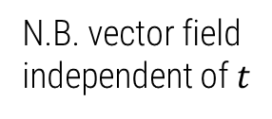
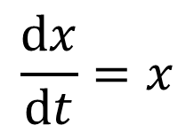

$$\frac{dx}{dt}=x$$
$$x$$
$$f\left(x\right)=x$$
N.B. vector field independent of $t$
$$t$$

Slide 51
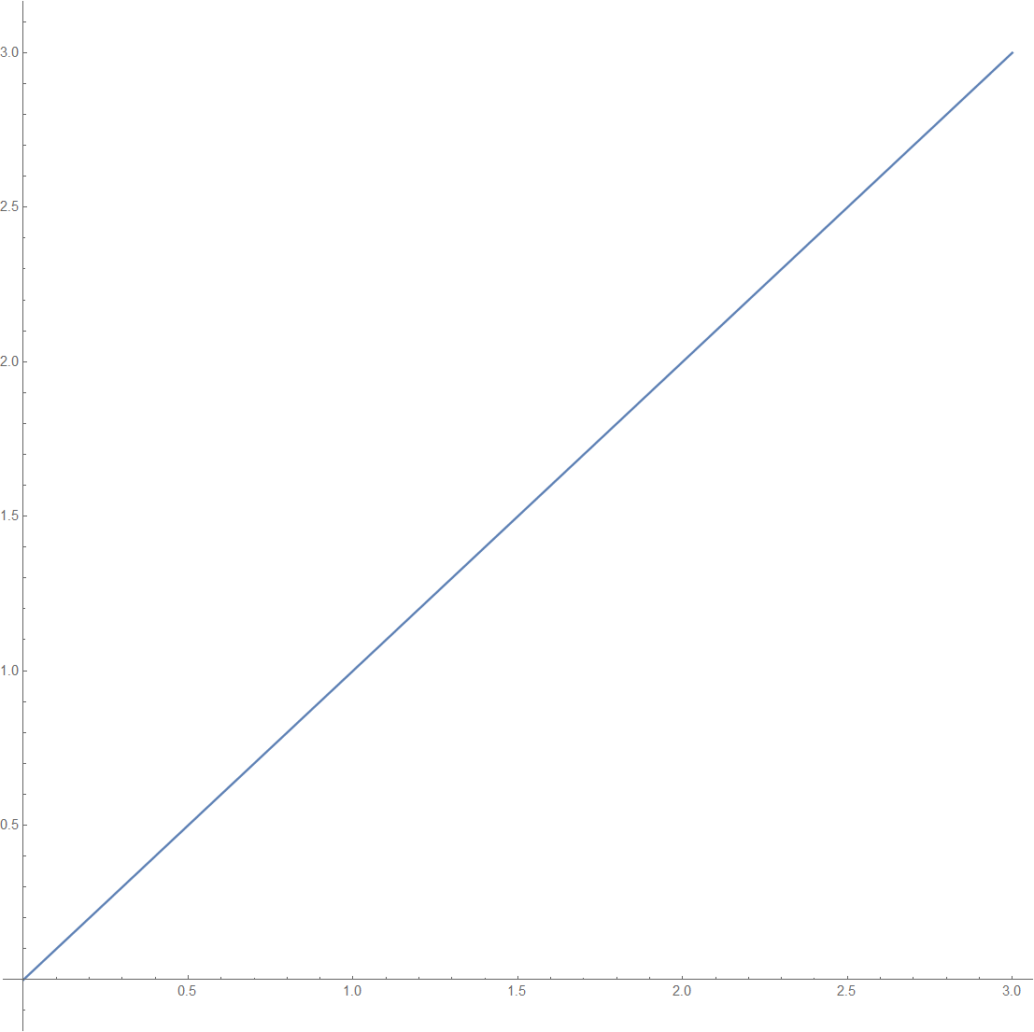
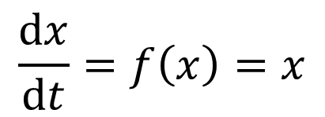



$$\frac{dx}{dt}=x$$
$$x$$
$$x$$
$$t$$
$$\frac{dx}{dt}=f\left(x\right)=x$$

Slide 52
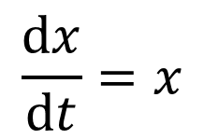
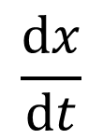

$$\frac{dx}{dt}=x$$
$$\frac{dx}{dt}$$
$$x$$

Slide 53

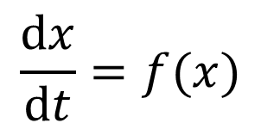

$$\frac{dx}{dt}=f(x)$$
$$\frac{dx}{dt}=f(x)$$
$$x$$

Slide 54

$$\frac{dx}{dt}=f(x)$$
$$x$$
Fixed point as $\frac{dx}{dt}=f\left(x\right)=0$

Slide 55
$$\frac{dx}{dt}=f(x)$$
$$x$$

Slide 56
$$\frac{dx}{dt}=f(x)$$
$$x$$

Slide 57
$$\frac{dx}{dt}=f(x)$$
$$x$$

Slide 58
$$\frac{dx}{dt}=f(x)$$
$$x$$

Slide 59
$$\frac{dx}{dt}=f(x)$$
$$x$$

Slide 60
$$\frac{dx}{dt}=f(x)$$
$$x$$

Slide 61
$$\frac{dx}{dt}=f(x)$$
$$x$$

Slide 62
$$\frac{dx}{dt}=f(x)$$
$$x$$

Slide 63
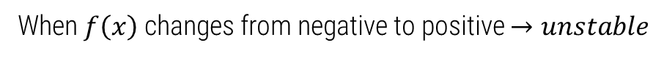
Phase Portrait
$$\frac{dx}{dt}=f(x)$$
$$x$$
Fixed points indicate change in sign of derivative
& change in “direction of travel”
When $f\left(x\right)$ changes from negative to positive $→unstable$

Slide 64
Phase Portrait
$$\frac{dx}{dt}=f(x)$$
$$x$$

Slide 65


Phase Portrait
$$\frac{dx}{dt}=f(x)$$
$$x$$

Slide 66
Phase Portrait
$$\frac{dx}{dt}=f(x)$$
$$x$$

Slide 67
Phase Portrait
$$\frac{dx}{dt}=f(x)$$
$$x$$

Slide 68

Phase Portrait
$$\frac{dx}{dt}=f(x)$$
$$x$$
At the fixed point $\frac{dx}{dt}=0$ $⇒$ no change in $x$

Slide 69
Phase Portrait
$$\frac{dx}{dt}=f(x)$$
$$x$$

Slide 70
Phase Portrait
$$\frac{dx}{dt}=f(x)$$
$$x$$

Slide 71
Phase Portrait
$$\frac{dx}{dt}=f(x)$$
$$x$$

Slide 72
Phase Portrait
$$\frac{dx}{dt}=f(x)$$
$$x$$
At the fixed point $\frac{dx}{dt}=0$ $⇒$ no change in $x$

Slide 73
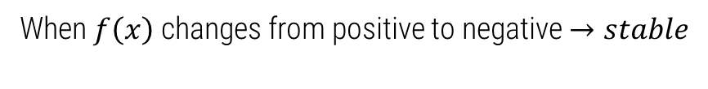
Phase Portrait
$$\frac{dx}{dt}=f(x)$$
$$x$$
Fixed points indicate change in sign of derivative
& change in “direction of travel”
When $f\left(x\right)$ changes from positive to negative $→stable$

Slide 74




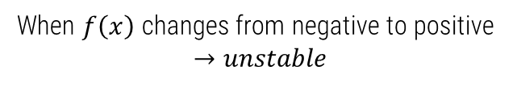

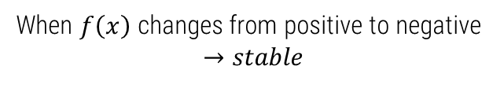
Phase Portrait
$$\frac{dx}{dt}=f(x)$$
$$f(x)$$
$$f(x)$$
$$x$$
$$x$$
When $f\left(x\right)$ changes from positive to negative
$$→stable$$
When $f\left(x\right)$ changes from negative to positive
$$→unstable$$

Slide 75

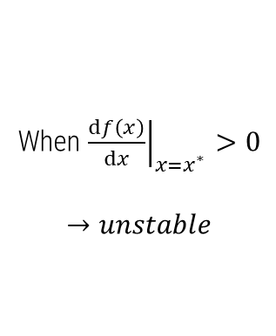
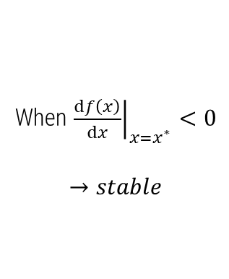

Phase Portrait
$$\frac{dx}{dt}=f(x)$$
$$f(x)$$
$$f(x)$$
$$x$$
$$x$$
$$x^{∗}$$
$$x^{∗}$$
When ${\left.\frac{df\left(x\right)}{dx}\right|}_{x=x^{∗}}<0$
$$→stable$$
When ${\left.\frac{df\left(x\right)}{dx}\right|}_{x=x^{∗}}>0$
$$→unstable$$

Slide 76
Special cases

Slide 77
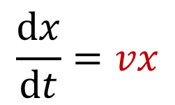


Exponential growth
$$\frac{dx}{dt}=vx$$
Slope $v$
$$x$$

Slide 78
Exponential growth
$$\frac{dx}{dt}=vx$$
Fixed point?
Slope $v$
$$x$$

Slide 79

Exponential growth
$$\frac{dx}{dt}=vx$$
Fixed point?
$$x=0$$
unstable
Slope $v$
$$x$$

Slide 80
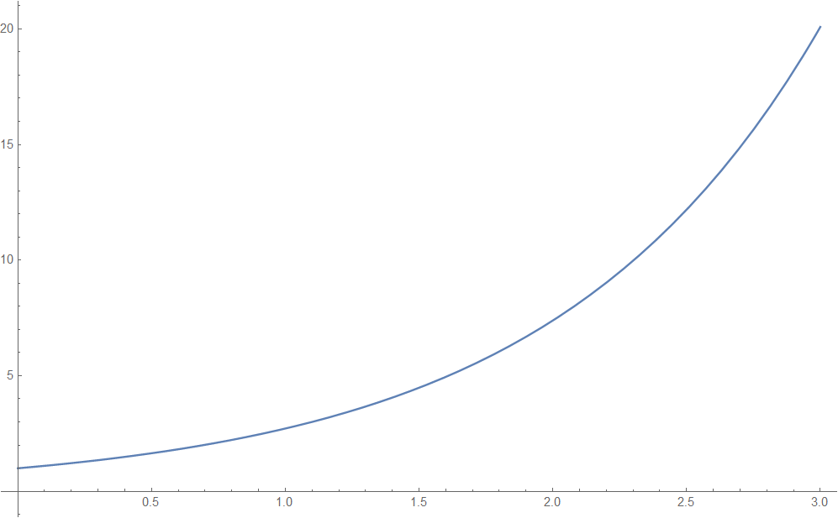

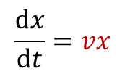


Plot exponential solution using phase portrait
$$x(t)$$
$$x$$
$$t$$
$$\frac{dx}{dt}=vx$$

Slide 81
Plot exponential solution using phase portrait
$$x(t)$$
$$x$$
$$t$$
$$\frac{dx}{dt}=vx$$

Slide 82
Plot exponential solution using phase portrait
$$x(t)$$
$$x$$
$$t$$
$$\frac{dx}{dt}=vx$$

Slide 83
Plot exponential solution using phase portrait
$$x(t)$$
$$x$$
$$t$$
$$\frac{dx}{dt}=vx$$

Slide 84
Plot exponential solution using phase portrait
$$x(t)$$
$$x$$
$$t$$
$$\frac{dx}{dt}=vx$$

Slide 85
Plot exponential solution using phase portrait
$$x(t)$$
$$x$$
$$t$$
$$\frac{dx}{dt}=vx$$

Slide 86

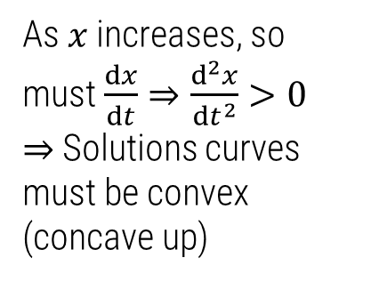
Plot exponential solution using phase portrait
$$x(t)$$
As $x$ increases, so must $\frac{dx}{dt}⇒\frac{d^{2}x}{dt^{2}}>0$
$⇒$Solutions curves must be convex (concave up)
$$\frac{d^{2}x}{dt^{2}}>0$$
$$x$$
$$t$$
$$\frac{dx}{dt}=vx$$

Slide 87
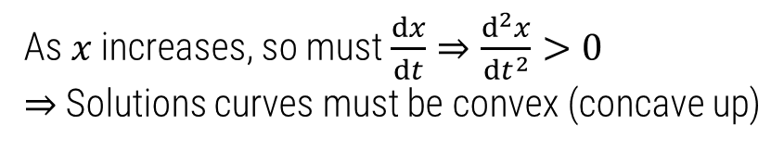



Plot exponential solution using phase portrait
As $x$ increases, so must $\frac{dx}{dt}⇒\frac{d^{2}x}{dt^{2}}>0$
$⇒$Solutions curves must be convex (concave up)
$$x(t)$$
$$\frac{d^{2}x}{dt^{2}}>0$$
$$t$$

Slide 88
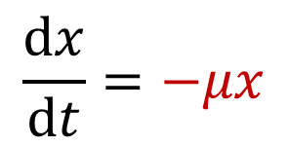


Exponential decay (e.g. infinite alleles model)
$$\frac{dx}{dt}=−μx$$
Fixed point
$$x=0$$
stable
$$x$$
Slope $−μ$
Notes:
Get students to sketch the solution

Slide 89
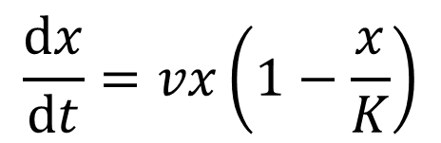
Logistic growth
$$\frac{dx}{dt}=vx\left(1−\frac{x}{K}\right)$$

Slide 90






Logistic growth
$$\frac{dx}{dt}=vx\left(1−\frac{x}{K}\right)$$
Fixed points:
$x=0$(unstable)$, x=K$ (stable)
$$\frac{dx}{dt}$$
$$0$$
$$x$$
$$K/2$$
$$K$$

Slide 91
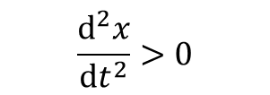


Logistic growth
$$\frac{dx}{dt}=vx\left(1−\frac{x}{K}\right)$$
Fixed points:
$x=0$(unstable)$, x=K$ (stable)
$$\frac{dx}{dt}$$
$$0$$
$$x$$
$$K/2$$
$$K$$
$$\frac{d^{2}x}{dt^{2}}>0$$
$$\frac{d^{2}x}{dt^{2}}<0$$
$$\frac{d^{2}x}{dt^{2}}>0$$

Slide 92












Logistic growth
$$\frac{dx}{dt}=vx\left(1−\frac{x}{K}\right)$$
$$\frac{dx}{dt}$$
$$0$$
$$K/2$$
$$x$$
$$K$$
$$\frac{d^{2}x}{dt^{2}}>0$$
$$\frac{d^{2}x}{dt^{2}}<0$$
$$\frac{d^{2}x}{dt^{2}}>0$$
$$x$$
$$K$$
$$K/2$$
$$0$$
Notes:
Get students to

Slide 93

Logistic growth
$$\frac{dx}{dt}=vx\left(1−\frac{x}{K}\right)$$
$$\frac{dx}{dt}$$
$$0$$
$$K/2$$
$$x$$
$$K$$
$$\frac{d^{2}x}{dt^{2}}>0$$
$$\frac{d^{2}x}{dt^{2}}<0$$
$$\frac{d^{2}x}{dt^{2}}>0$$
$$x$$
$$K$$
$$K/2$$
$$\frac{d^{2}x}{dt^{2}}>0$$
$$0$$

Slide 94

Logistic growth
$$\frac{dx}{dt}=vx\left(1−\frac{x}{K}\right)$$
$$\frac{dx}{dt}$$
$$0$$
$$K/2$$
$$x$$
$$K$$
$$\frac{d^{2}x}{dt^{2}}>0$$
$$\frac{d^{2}x}{dt^{2}}<0$$
$$\frac{d^{2}x}{dt^{2}}>0$$
$$x$$
$$K$$
$$\frac{d^{2}x}{dt^{2}}<0$$
$$K/2$$
$$\frac{d^{2}x}{dt^{2}}>0$$
$$0$$

Slide 95

Logistic growth
$$\frac{dx}{dt}=vx\left(1−\frac{x}{K}\right)$$
$$\frac{dx}{dt}$$
$$0$$
$$K/2$$
$$x$$
$$K$$
$$\frac{d^{2}x}{dt^{2}}>0$$
$$\frac{d^{2}x}{dt^{2}}<0$$
$$\frac{d^{2}x}{dt^{2}}>0$$
$$x$$
$$K$$
$$\frac{d^{2}x}{dt^{2}}<0$$
$$\frac{d^{2}x}{dt^{2}}<0$$
$$K/2$$
$$\frac{d^{2}x}{dt^{2}}>0$$
$$0$$

Slide 96

Logistic growth
$$\frac{dx}{dt}=vx\left(1−\frac{x}{K}\right)$$
$$\frac{dx}{dt}$$
$$0$$
$$K/2$$
$$x$$
$$K$$
$$\frac{d^{2}x}{dt^{2}}>0$$
$$\frac{d^{2}x}{dt^{2}}<0$$
$$\frac{d^{2}x}{dt^{2}}>0$$
$$x$$
$$\frac{d^{2}x}{dt^{2}}>0$$
$$K$$
$$\frac{d^{2}x}{dt^{2}}<0$$
$$\frac{d^{2}x}{dt^{2}}<0$$
$$K/2$$
$$\frac{d^{2}x}{dt^{2}}>0$$
$$0$$

Slide 97
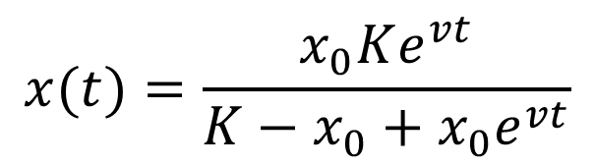
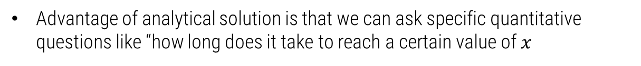
Logistic growth
$$\frac{dx}{dt}=vx\left(1−\frac{x}{K}\right)$$
$$x(t)=\frac{x_{0}Ke^{vt}}{K−x_{0}+x_{0}e^{vt}}$$
Advantage of analytical solution is that we can ask specific quantitative questions like “how long does it take to reach a certain value of $x$

Slide 98
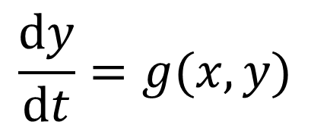
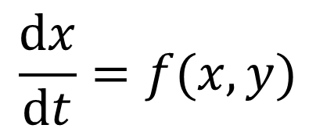
2D non-linear ODEs
$$\frac{dx}{dt}=f(x,y)$$
$$\frac{dy}{dt}=g(x,y)$$
In general, not possible to solve in closed form/analytically

Slide 99
2D phase portraits
We use phase portraits to gain a qualitative understanding

Slide 100
2D phase portraits
We use phase portraits to gain a qualitative understanding
Generial strategy is to analyse linear behaviour near fixed points

Slide 101
2D phase portraits
Limit cycle
We use phase portraits to gain a qualitative understanding
General strategy is to analyse linear behaviour near fixed points

