Slide 1

2020-21 5-1 Epidemiological models. Measles, flu, covid Host and pathogens. The reproductive number
Vincent Jansen
vincent.jansen@rhul.ac.uk

Slide 2
Outline
5-1 Host and pathogens. The reproductive number
5-2 The SIR model
5-3 Measles
5-4 Pandemics: Flu and Covid

Slide 3
Epidemiology:
Is the study of a disease within a population of hosts
Population biology and ecology of pathogens/parasites, vectors and hosts is important for disease control and management
Links processes/parameters at the individual level to population level
Uses mathematical models and statistical techniques

Slide 4

London School of
Hygiene and Tropical Medicine

Slide 5
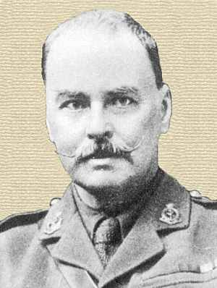
Sir Ronald Ross
Nobel Prize (1902) for his demonstration that malaria is transmitted by mosquitoes
This laid the foundation for methods to control the disease

Slide 6
Sir Ronald Ross
Key insight: there is no need to completely eradicate the mosquito
It suffices to reduce the mosquito population such that one infected human does not cause more than one new infection
This pioneered the use of the reproductive number

Slide 7
Parasitism
Parasitoids live a large part of their life on a host and cause considerable harm or death
Parasitism is a lifestyle in which the parasite benefits from its host (+-)
Parasites are smaller than their host
It is like a very small predator, although the interaction need not result in death

Slide 8
Two groups of parasites:
Microparasites
Have direct and often rapid reproduction within the host
Macroparasites
Do not multiply directly within their host
This difference leads to a convenient dichotomy

Slide 9
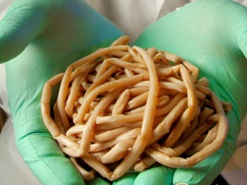
Macroparasites
Do not multiply directly within their host
Are larger and often sexual, e.g parasitic helminths and arthropods
Disease intensity depends on burden
As a consequence:
The individual parasite is a convenient basic unit of study

Slide 10
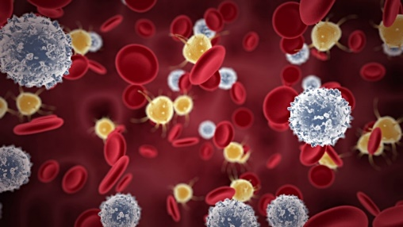
Microparasites
Reproduce directly and rapidly within the host
Are small and often asexual, e.g bacteria, viruses and protozoa
Burden not very relevant/difficult to measure; host is either infected or not
As a consequence:
The host individual is the convenient basic unit of study

Slide 11
Microparasites
I will discuss two standard models (SIS and SIR) to describe the epidemiology of microparasites
This model describes different classes of hosts
And the processes of infection, recovery and mortality (+ births and deaths)

Slide 12
Host classes:
Susceptible hosts can be infected by parasites
Infected hosts carry the parasite
I will assume that all infected hosts transmit the parasite (not doing so leads to a slightly different model which has an extra class)
Infected individuals that recover return to the S class
This is the SIS model
S
I

Slide 13
Transmission process
Susceptible host can become infected
This turns them into infecteds
The rate with which susceptibles encounter infected is given by βSI, where β is the transmission parameter
For human population it is often assumed that the force of infection is proportional to the fraction of the population that is infected and βSI/N is used.

Slide 14
Recovery process
Infected hosts can recover
If we assume that the rate of recovery is a constant (which is saying that the time until recovery is exponentially distributed), the per capita recovery rate is γ with 1/γ the average time until recovery
We assume that the disease has no lasting effect, and doesnot kill

Slide 15
SIS model
The SIS model reads
As the number of contacts is independent of population size and assumed proportional to the fraction of the population that is infected
In this model so that S+I=N is constant

Slide 16
SIS model
We can thus rewrite the model
S
I

Slide 17
SIS model
In the SIS model you return to a susceptible state after you have had the disease
This is rarely true, but it could be a valid assumption for the common cold, or head lice

Slide 18
SIS model
We can rewrite this as the change in the fraction of the population that is infected:
Does the equation look familiar?
What is the equilibrium?

Slide 19
SIS model
The equilibrium is
The parameter combination β/γ can be interpreted as the transmission rate (β) times the average duration of the infection (1/γ).
It is the average number of new infections that an infected individual produces in a completely susceptible population.
This is called the basic reproductive number: R₀.

Slide 20
R₀: The basic reproductive number
The number of secondary infections caused by a single infected individual in a completely susceptible population
If R₀<1 the disease will disappear
If R₀>1 an epidemic is possible

Slide 21
SIS model
The equilibrium is
If R₀<1 the disease will disappear
If R₀>1 the disease has a non-trivial equilibrium

Slide 22
Learning outcomes
Understand how models and knowledge of the reproductive number can be used to understand the dynamics of a disease

