Slide 1

2020-21 5-3 Epidemiological Models. Measles, Flu, Covid Measles
Vincent Jansen
vincent.jansen@rhul.ac.uk

Slide 2
Outline
5-1 Host and pathogens. The reproductive number
5-2 The SIR model
5-3 Measles
5-4 Pandemics: Flu and Covid

Slide 3
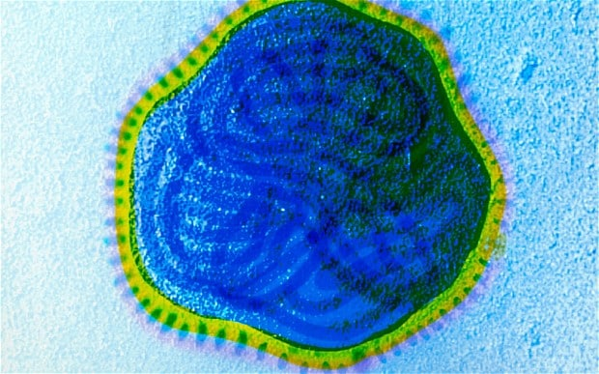
Measles
Measles is an infectious disease caused by the measles virus
Measles can be contracted at any age.
It is spread by infected persons through coughing and sneezing, and through contact with contaminated items and surfaces.
Measles virus

Slide 4
Measles
Upon infection with measles the host normally fully recovers and develops lifelong immunity
In rare cases (1/500-1/5000) measles causes death or lasting damage (1/1500)
In 2017 an estimated 110,000 people (mainly children) died of measles
During 2000-2017 measles vaccination prevented an estimated 21.1 million deaths.
Measles virus

Slide 5
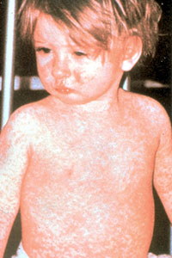
Measles
Symptoms include coughing, runny nose, stuffy nose, malaise, red eyes, tearing and fever.
Two to four days after these initial symptoms, blue-white spots with a red background (Koplik's spots), located on the inside of the cheeks near the back molars start to appear.
They are accompanied, either at the same time or slightly later, by the appearance of the measles rash.

Slide 6
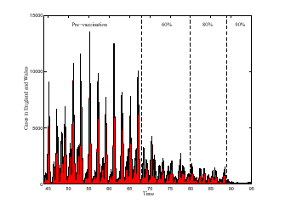
Measles in England and Wales (1945-1995)
Cases in England and Wales
Time (years)
Source: M. Keeling

Slide 7
A model for measles
We can use the SIR model to describe measles
We will assume a constant population size: on the time scale of interest population growth is limited
We will assume a fixed nr of contacts hence the transmission is βIS/N
We will assume that there is no disease caused mortality, i.e. ν=0

Slide 8
A model for measles
the SIR model:
S+I+R=N

Slide 9
A model for measles
The parameters:
Let’s say the average life time is 75 years, hence the mortality rate μ=1/75 [yr]⁻¹
The duration of the infectious period is about one week, hence γ=50 [yr]⁻¹
There are about 3 infectious contacts per day, hence β=1000 [yr]⁻¹ [individual]⁻¹
The R₀ in this model is β/(μ+γ)
R₀ is then about 20.
R₀ has been estimated to be between 15 and 25

Slide 10
A model for measles
the equilibria of the model

Slide 11
A model for measles
the equilibria of the model

Slide 12
A model for measles
On the basis of these parameters you can work out what the average age of contraction measles is, if the disease is endemic
The force of infection at equilibrium is βI*/N
The average time until infection is
This is the average lifetime divided by R₀-1
This is about 4-5 years of age
Measles is a childhood disease because the R₀ is high, not because it cannot infect adults

Slide 13
A model for measles
Solutions:

Slide 14
Measles in England and Wales (1945-1995)
Cases in England and Wales
Time (years)
Source: M. Keeling

Slide 15
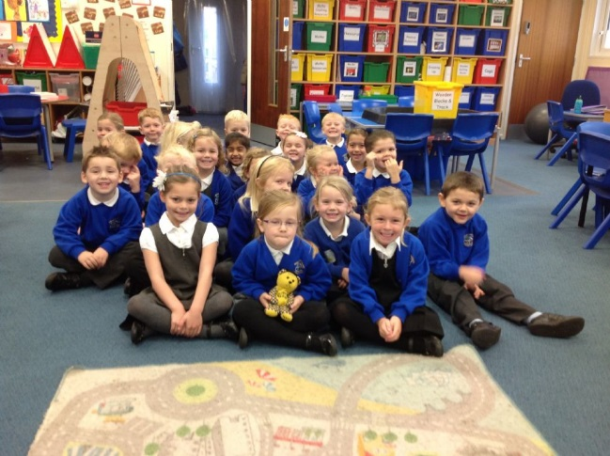
Variation in transmission
Measles incidence peaks every second year
It has been suggested that this is because the transmission is not constant but varies over the season (school terms)
We can include this in the model by changing β with time, so that it changes periodically

Slide 16
A model for measles
the SIR model:
But now
time

Slide 17
If variation in transmission included in the model:
Result:

Slide 18
Variation in transmission
This lends support to the suggestion that the periodicity is caused because of the seasonal forcing of the transmission rate

Slide 19
Seasonal variation in transmission
Earn et al. (2000) studied a SEIR (susceptible-exposed-infected-recovered) model with seasonal forcing
They produced the following figure

Slide 20
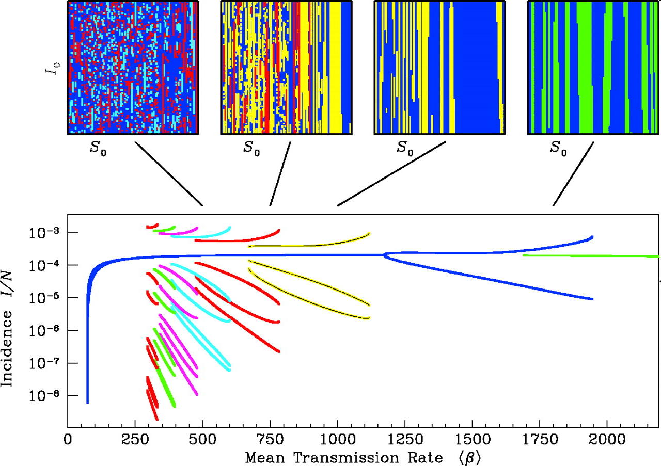
What is going on here?
Notes:
The main panel is the bifurcation diagram for the term-time forced SEIR model, showing incidence on 1 January, normalized by (constant) population size; the control parameter is the mean transmission rate 〈β〉. The fixed parameter values are γ−1 = 5 days, σ−1 = 8 days, μ = ν/N = 0.02 year−1, seasonal amplitude 0.25 [see (5) and (13) for the meaning of these parameters]. Each attractor is identified with a different color. For sufficiently high 〈β〉, there is a unique (annual) attractor. As 〈β〉 is reduced, biennial, 3-, 4-, 5-, 6-, 7-, and 8-year cycles all occur, before all but the annual attractor are extinguished. The term-time forcing function used to produce this figure corresponds to school terms in England and Wales. In the United States, the summer holiday is longer; this does not affect the structure of the bifurcation diagram, but with a longer summer holiday each of the various bifurcations occurs at lower 〈β〉 (10). Above the bifurcation diagram, basins of attraction (initial susceptibles, 0 < S0/N < 0.1, versus initial infectives, 0 < I0/N < 0.0001, with E0/N = 0.0001) are shown for the various attractors at four particular values of 〈β〉. Figure 2 identifies regions of this diagram that correspond to the dynamics observed at various times and places.

Slide 21
Seasonal variation in transmission
This is caused by resonance
The is a general phenomenon in forced systems where the original system has its own amplitude
“Arnold tongues”

Slide 22
Seasonal variation in transmission
This is caused by resonance
The is a general phenomenon in forced systems where the original system has its own amplitude
“Arnold tongues”

Slide 23
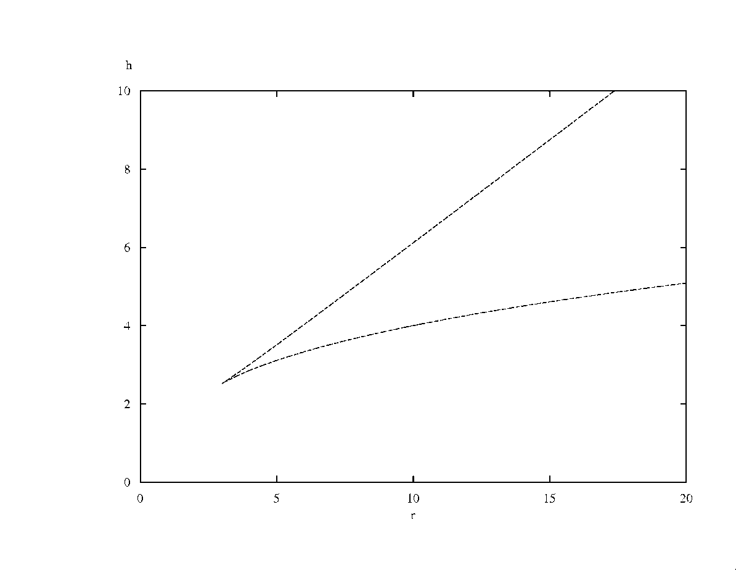
Seasonal variation in transmission: resonance of an undamped oscillator
α
Amplitude of forcing
At this point the unforced system has a period, which is a multiple of the forcing period

Slide 24

Seasonal variation in transmission: resonance of a damped oscillator
α
Amplitude of forcing
At this point the unforced system has a period, which is a multiple of the forcing period

Slide 25
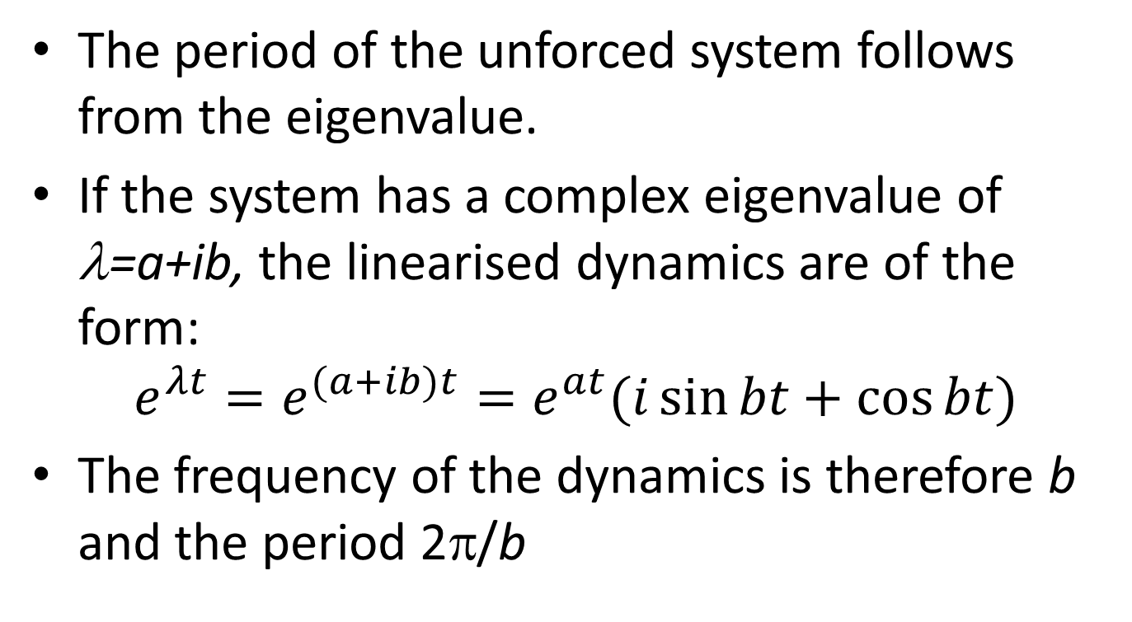
Variation in transmission rates
The period of the unforced system follows from the eigenvalue.
If the system has a complex eigenvalue of λ=a+ib, the linearised dynamics are of the form:
$$e^{λt}=e^{(a+ib)t}=e^{at}(i\sin{bt+\cos{bt}})$$
The frequency of the dynamics is therefore b and the period 2π/b

Slide 26
Variation in tranmission rates
To find the period of the unforced system we need the imaginary part of the eigenvalues at equilibrium

Slide 27
Variation in tranmission rates
To find the period of the unforced system we need the imaginary part of the eigenvalues at equilibrium
One eigenvalue is -μ
The other two come from the matrix

Slide 28
Variation in transmission rates
To find the period of the unforced system we need the imaginary part of the eigenvalues at equilibrium
Has eigenvalues with approximate imaginary part

Slide 30
Variation in transmission rates
We can now find the period ( ) and predict the position of the Arnold tongues from
6
5
4
3
2
791
379
235

Slide 31
some Arnold tongues
amp
Period 5
Period 4
Period 3
Period 2
β

Slide 32
Effects of seasonal variation
The dynamics of a seasonally forced epidemic strongly depend on the R0 (approx β/γ)
High R0: annual or biannual cycles.
Low R0: outbreaks followed by years of absence, e.g influenza
For low R0 the densities can reach very low numbers, and lead to “fade out”
Therefore the disease can disappear, even if the R0>1

Slide 33
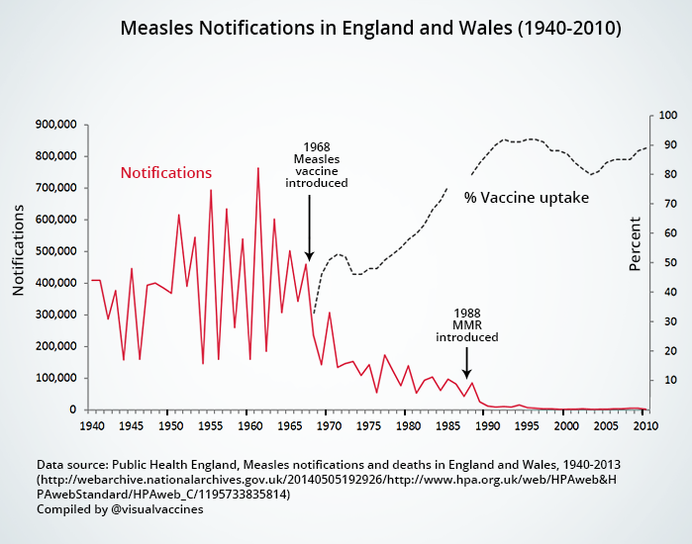
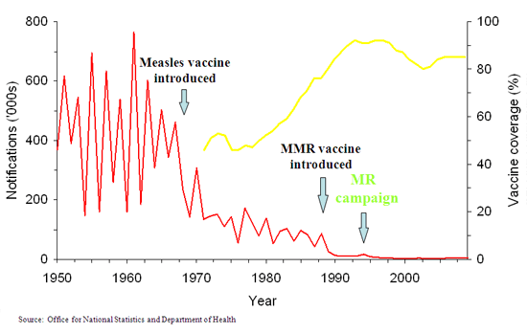
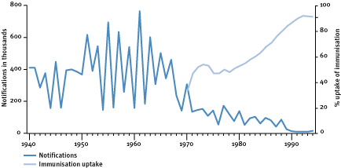
Vaccination
In the last years measles has as good as disappeared because of vaccination

Slide 34
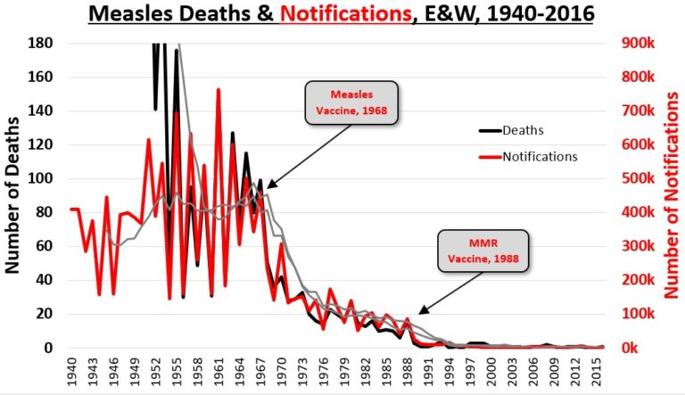
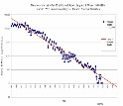
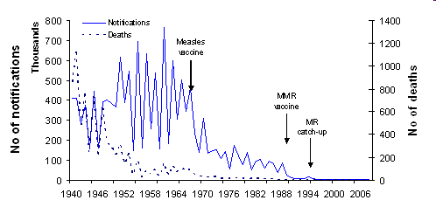
Vaccination saves lives
In the last years measles has as good as disappeared because of vaccination
Notes:
https://www.vaccineevidence.com/2019/09/the-historical-conquest-of-measles/

Slide 35
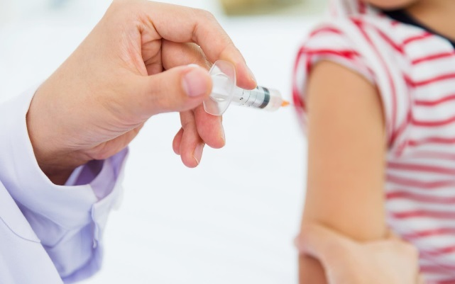
Vaccination
Vaccination worked because the vaccination rate was high enough to stop the disease being endemic
But even in the years when incidence was very low, measles still occasionally appeared following importations in the population

Slide 36
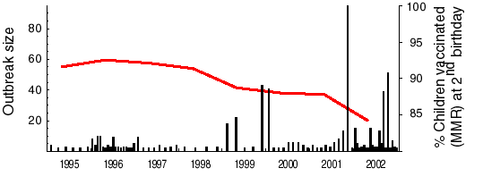
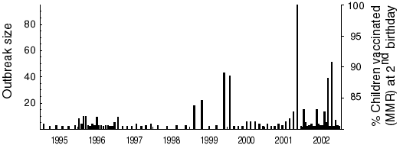
Measles outbreaks in England and Wales in 1995-2002

Slide 37
Vaccination
In the years following 1999 vaccination levels decreased due to the MMR scare
This caused larger outbreaks and in increase in the reproductive number
This has led to a cohort of unvaccinated individuals

Slide 38
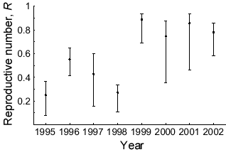
Reproductive number after vaccination R₀(1-p)
From: Jansen et al. Science, 301, 804 (2003)

Slide 39
Vaccination
Based on the same principles as the deterministic SIR model, a stochastic model can be formulated
A stochastic model describes the chance processes

Slide 40
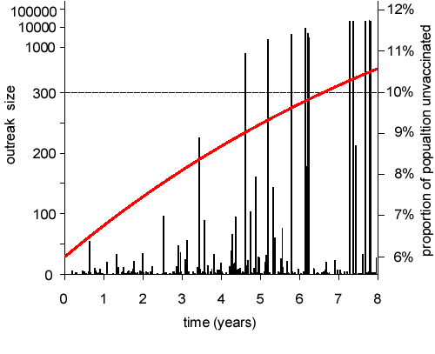
Outbreak size depends on R₀
Number of cases
1.0
R₀ = β/γ times fraction not vaccinated

Slide 41
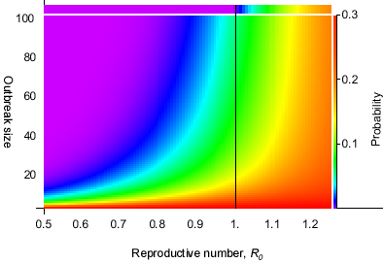
Probability of getting a outbreak of certain size or larger

Slide 42
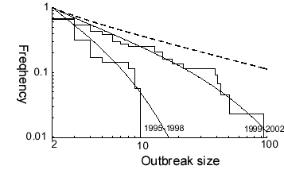
Outbreak distribution shows progression toward R₀=1
R₀=1

Slide 43
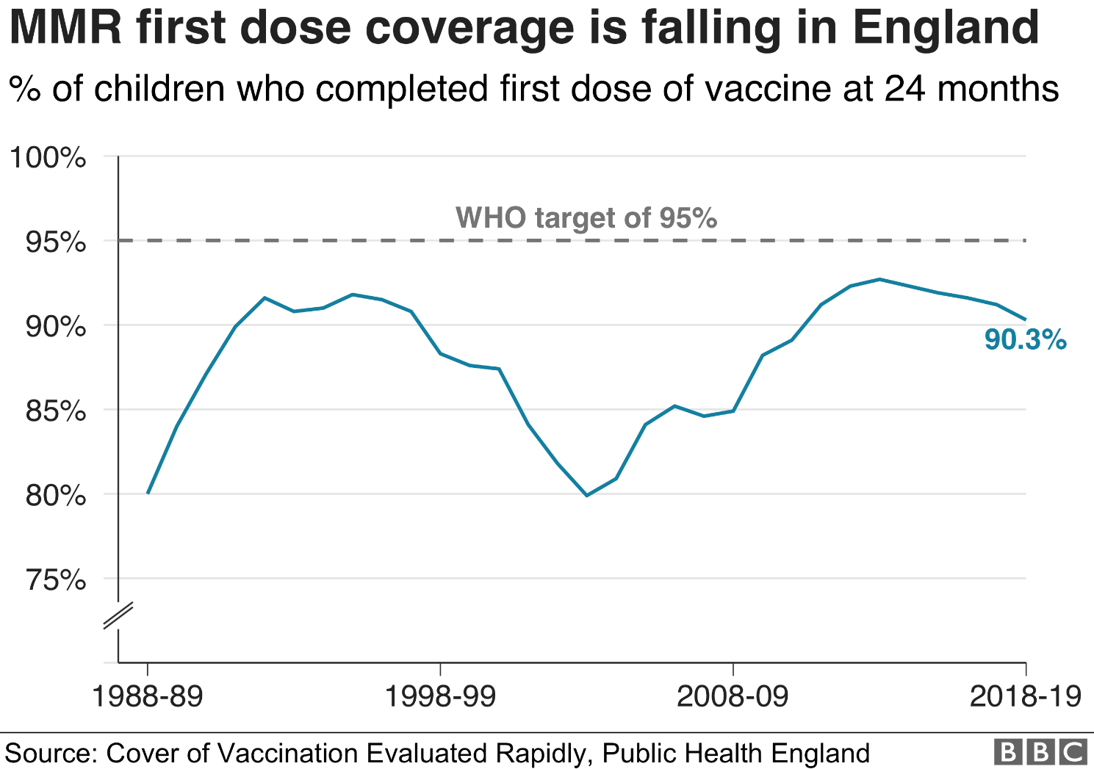
MMR vaccine uptake at 2nd birthday
91.2
Uptake has kept rising:
Notes:
MMR coverage in England
Figure from https://www.bbc.co.uk/news/uk-england-49831581
2019@ 90.6 %

Slide 44
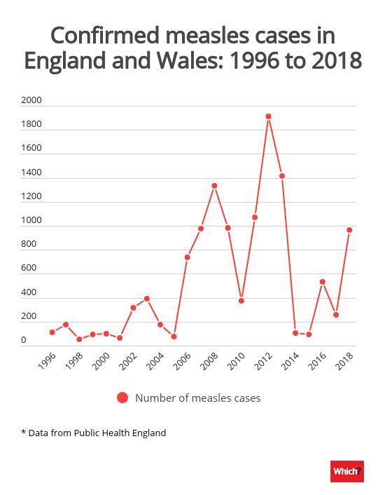
Notes:
2019@ 808

Slide 45
Measles time line last decades
2002-04. Scientific studies find no link between MMR and autism. Co-authors of the 1998 Wakefield paper issue a retraction.
2004-05–Uptake of MMR vaccine falls to 81%.
2008 MMR catch-up campaign for children 13 months to 18 years.
2010 Wakefield guilty of serious professional misconduct and struck off the medical register
2012 Large measles outbreak affecting mainly teenagers.
2013 A national catch-up campaign for children aged 10 to 16 years. First MMR dose coverage in children peaked at 93%.
2016 UK achieved measles elimination (status granted by WHO in 2017). Coverage of MMR dose 1 reached 95% for the first time.
2018 Several measles outbreaks linked to importations from Europe with majority of cases in teenagers. MMR dose 2 coverage is sub-optimal at 87% - well below the 95% WHO target.

Slide 46
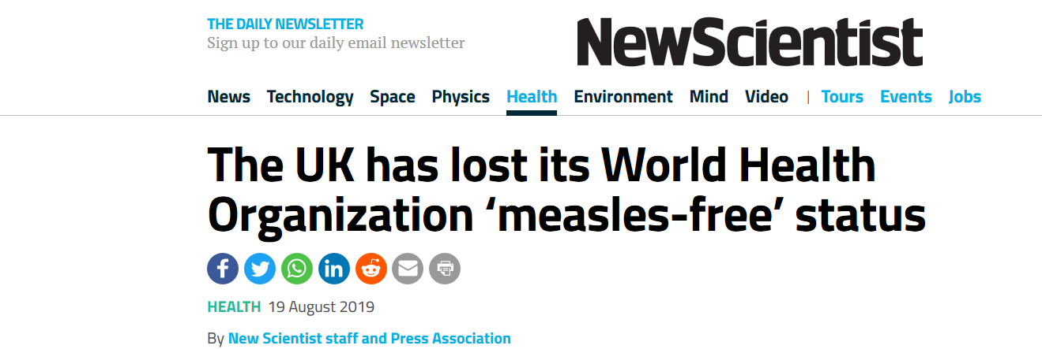
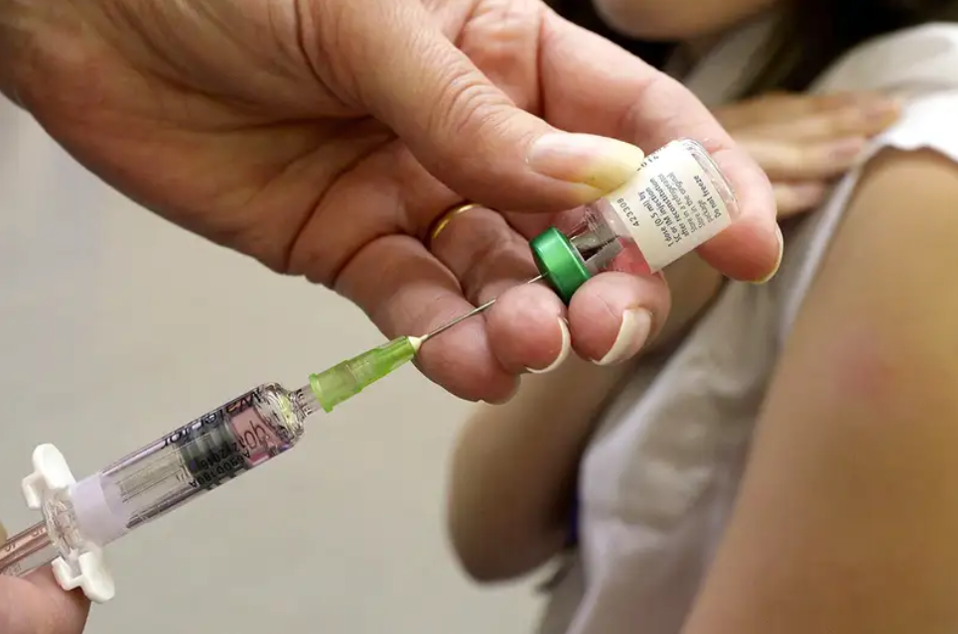
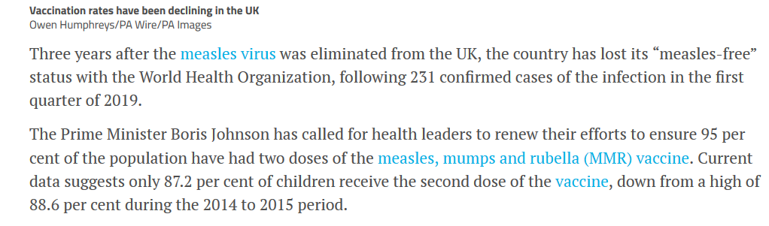

Slide 47
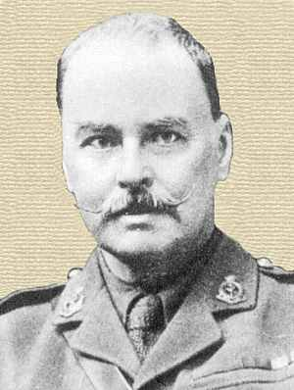
Conclusion
Following the drop in vaccine uptake the number of unvaccinated individuals kept accumulating and for years we saw substantial measles outbreaks
All these control efforts are possible because we can calculate the critical level of vaccination (based on the reproductive number)
Notes:
Consider including the New Zealand case?

Slide 48
Learning outcomes
Understand how models and knowledge of the reproductive number can be used to understand the dynamics of a disease
Understand how this can be used as a basis for public health policies and disease management

