Slide 1

2020-21 5-4 Epidemiological models. Measles, flu, covid Pandemics: flu, covid
Vincent Jansen
vincent.jansen@rhul.ac.uk

Slide 2
Outline
5-1 Host and pathogens. The reproductive number
5-2 The SIR model
5-3 Measles
5-4 Pandemics: Flu and Covid

Slide 3
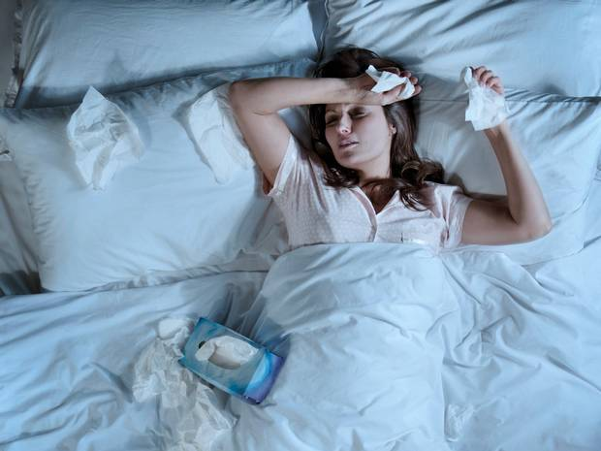
Influenza

Slide 4
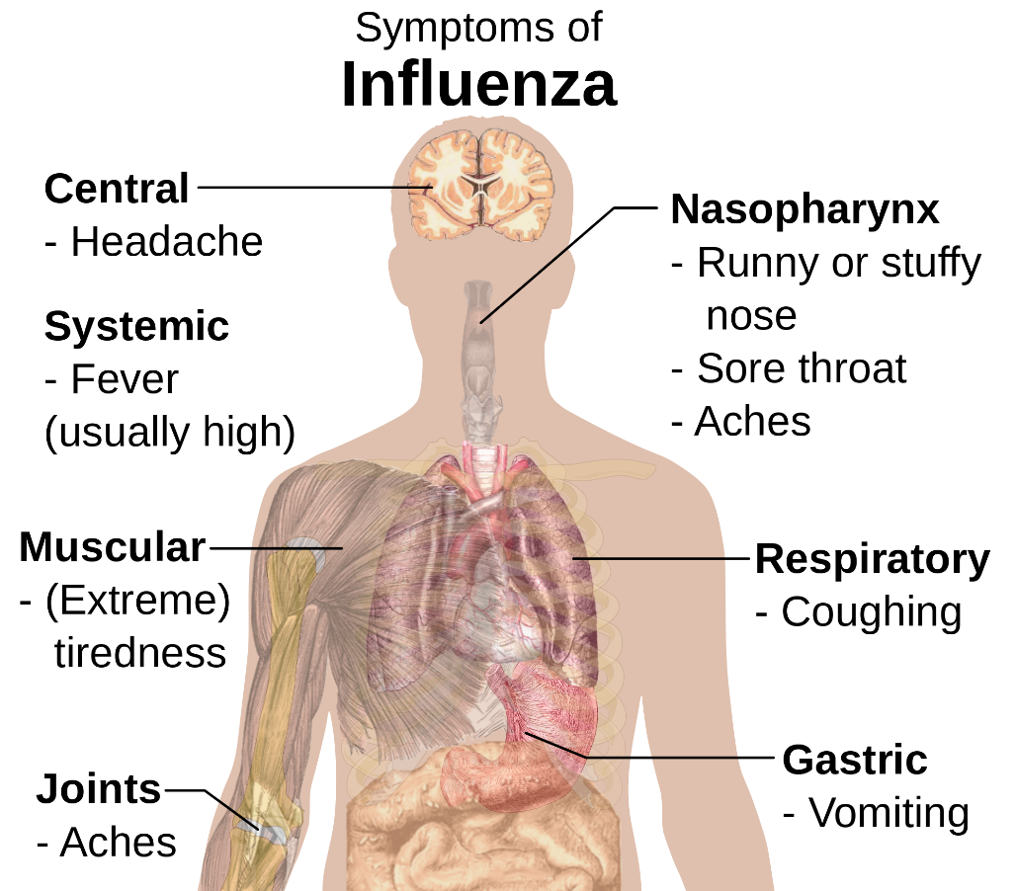
Influenza
Influenza is a common infectious disease
Caused by RNA virus, classed in types A,B and C
A infects birds, pigs and humans and humans tend to have less immunity

Slide 5
Influenza
Influenza virus causes yearly epidemics, which immunises people for life
The yearly epidemics are caused by strains that are immunologically similar (antigenic drift)

Slide 6
Influenza
Seasonal influenza kills approx. 12,000 (!) people/year in the UK, mostly elderly and ill (fatality rate approx. 0.1 %)
Vaccines are developed yearly based on the present and it lasts for about a year

Slide 7
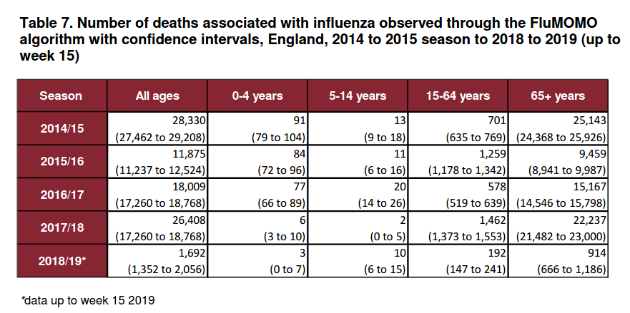
Notes:
https://assets.publishing.service.gov.uk/government/uploads/system/uploads/attachment_data/file/895233/Surveillance_Influenza_and_other_respiratory_viruses_in_the_UK_2019_to_2020_FINAL.pdf

Slide 8
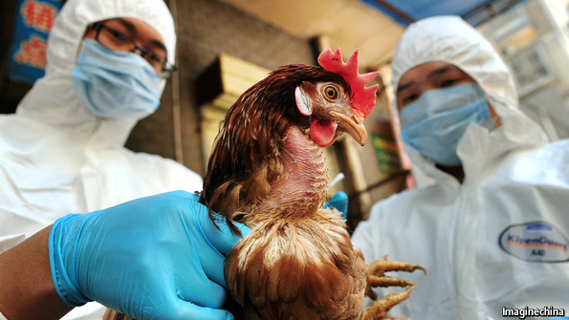
Avian Influenza
Avian influenza is a disease of birds
15 subtypes are circulating in birds
Occasionally humans are infected
Influenza can swap genetic material if it coinfects with other viruses or flu strains.

Slide 9
Avian Influenza
This can lead to a new type which can transmit from human to human
This causes a new type of virus against which the human population has no immunity (antigenic shift) resulting in a pandemic
Previous century pandemics in 1918, 1957, 1968 and 2009

Slide 10
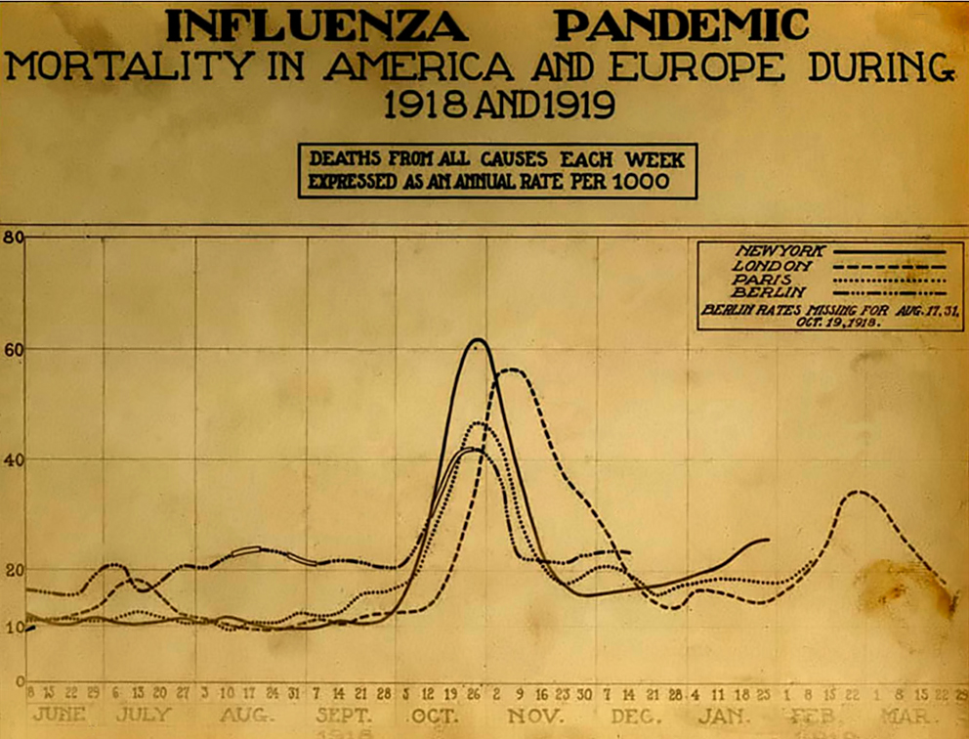
Influenza
Surprisingly, little is known about epidemiological parameters of flu, but for the spanish flu of 1918 it was estimated that the reproductive number was 3. (Mills et al, 2004) or between 1.7-2 (Ferguson et al. 2006)
The infectious period of influenza starts about 1-3 days after infection and lasts 3-6 days (4 days on average).
The spanish flu (1918) killed 200,000 in the UK, many young adults.

Slide 11
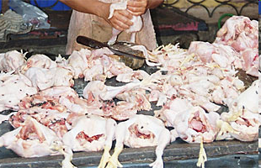
Avian Influenza
Three avian flu strains are currently cause for concern: H5N1, H5N6, H7N9 and H9N2, all infect humans and can kill
H5N1 appeared 1996. A massive poultry cull in Hong Kong in 1997 averted an epidemic. Since 2003 the disease has started to spread again in birds. It has so far infected 861 people, 455 have been fatal
No evidence of human-to-human transmission for either strain but “continued vigilance is needed
Notes:
http://www.who.int/csr/disease/avian_influenza/country/cases_table_2008_09_10/en/index.html

Slide 12
The latest on avian flu
Variant H7N9 was found in China in 2013, 1,567 confirmed; 615 deaths
H5N6, 24 cases since 2014, 7 deaths
In 2016 a first human case of H9N2 was reported, in total 26 have been found
No evidence of human-to-human transmission for either strain but “continued vigilance is needed”
Notes:
http://www.who.int/docs/default-source/wpro---documents/emergency/surveillance/avian-influenza/ai-20180914.pdf?sfvrsn=eee9f82_2

Slide 13
Influenza
If such strains would start to spread between humans what will happen?
How many people will be affected?
How many would die?
Can we control it?
Notes:
http://www.who.int/csr/disease/avian_influenza/country/cases_table_2008_09_10/en/index.html

Slide 14
Influenza: How big will a pandemic be?
Surprisingly, little is known about epidemiological parameters of flu, but for the Spanish flu of 1918 it was estimated that the reproductive number was 3. (Mills et al, 2004) or between 1.7-2 (Ferguson et al. 2006)
The infectious period of influenza starts about 1-3 days after infection and lasts 3-6 days (4 days on average).

Slide 15
Influenza: How big will a pandemic be?
In 2009 the 1918 strain (H1N1) returned and an pandemic was feared
The predicted nr of deaths in the UK was 20,000-70,000.
The R0 at the time was estimated at about 1.5, the fatality rate 0.1-0.35%
How did they do that?

Slide 16
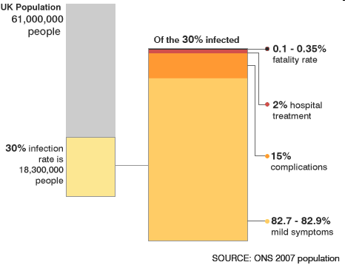

Slide 17
Influenza: How do they do that?
The R0 was estimated at 1.5
The fatality rate was thought to be 0.1-0.35%
The predicted fraction that will have contracted the disease is at least 1-1/R0=1/3 of the population (herd immunity, same as vaccination threshold, gives indication of final size)
That is about 20 million in the UK
Using the fatality rates 0.1-0.35% this gives 20,000-70,000 fatalities

Slide 18
Influenza: How big will a pandemic be?
Fortunately, the fatality rate in 2009 for the H1N1 strain was much much lower
But fatality rates can be high: the Spanish flu (1918) had a fatality rate of 2-5 % (200,000 cases in the UK), fatal cases had average age of about 30.

Slide 19
Influenza: Can we control a pandemic?
Vaccines can be made and have been developed against avian flu (but as the disease has not spread yet, we don’t know how good they really are)
In case of a pandemic, it could take months to develop an effective vaccine against the particular strain causing the pandemic.
Development of a standard vaccine takes 4-6 months.
Normally, the vaccine protects 70-80% against infection (effective if the R₀ is below 4-ish)

Slide 20
Influenza
There are antiviral drugs available: Oseltamivir (Tamiflu) and Zanamivir.
Oseltamivir reduces severity if administered within 48 hrs and shortens duration by about 1 day
If administered as a prophylaxis it reduces susceptibility to infection to 70%, and infectiousness to 60%
This can theoretically control the disease provided the R₀ is less than about 2.5

Slide 21

How prepared are we for a pandemic?
‘The fact is’, he says, ‘we are really no better prepared for a bad outbreak today than we were when Spanish flu killed tens of millions of people a hundred years ago. The reason we haven’t had another experience like that isn’t because we have been especially vigilant. It’s because we have been lucky.‘
Bill Bryson citing Michael King in
“The body, a guide for occupants.”
Published 2019.

Slide 22
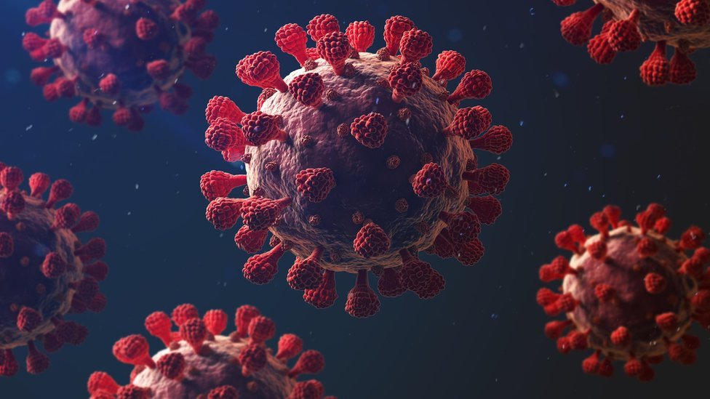
COVID-19

Slide 23
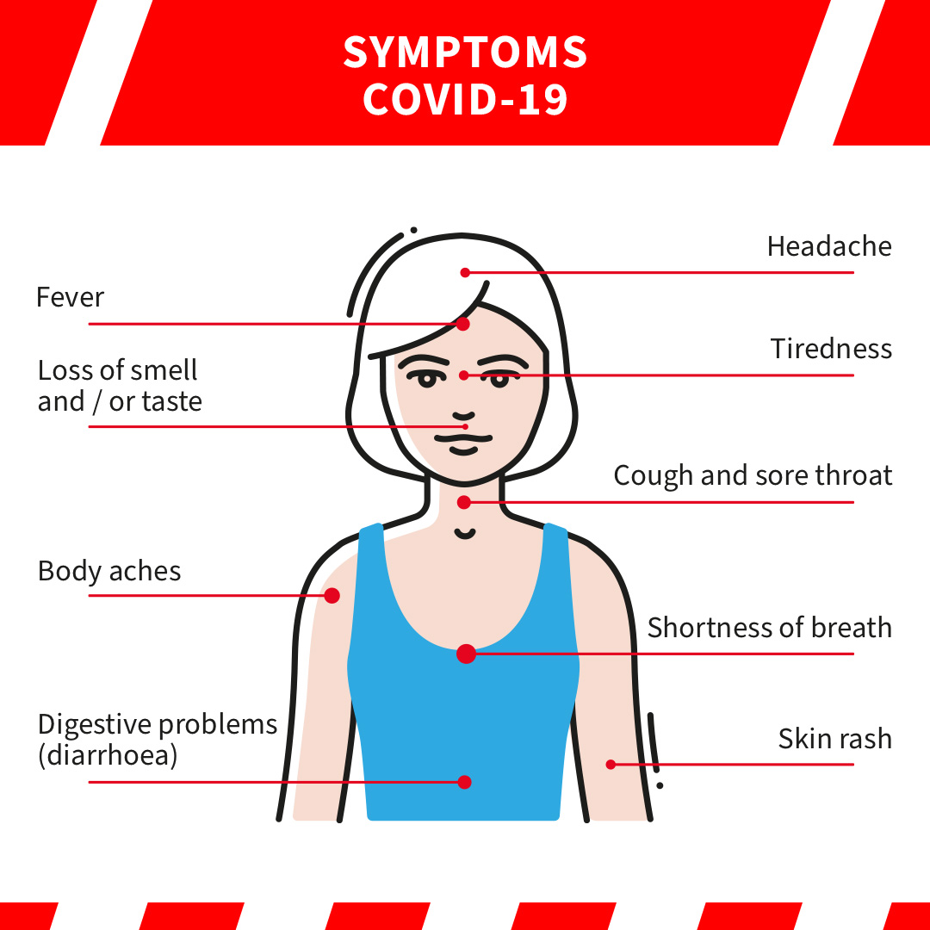

Slide 24
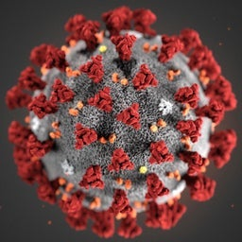
COVID-19
The disease is caused by the coronavirus SARS-CoV-2
Transmission is mainly through respiratory (droplet and aerosol) and contact routes. Transmission risk is highest where people are in close proximity (within 2 metres).
Many infections are asymptomatic (15%, range from 5-80%). Of those symptomatic, 40% mild, 40% moderate symptoms, 15% significant disease, 5% experience critical disease with life-threatening complications.
Risk of severe disease and death is higher in people who are older, male, from deprived areas or from certain non-white ethnicities.

Slide 25
Wuhan Coronavirus (2019-nCoV)
The first occurred in early December 2019 in Wuhan, China
Probably of animal origin, now spreading human to human
The virus subsequently spread within China and to other countries

Slide 26
COVID-19 Time line
The first cases occurred in early December 2019 in Wuhan, China
23 January 2020: Wuhan is quarantined
WHO designated a global health emergency on 30 January 2020
Italy and the UK report first cases 31 January 2020
1 February: a passenger from the Diamond Princess tests positive.
9 March Italy goes into lockdown
22 March: Wuhan loosens its two-month lockdown
23 March UK goes into lockdown

Slide 27
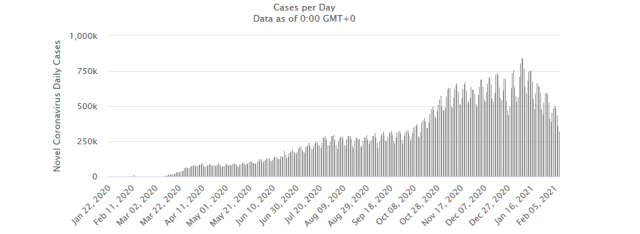
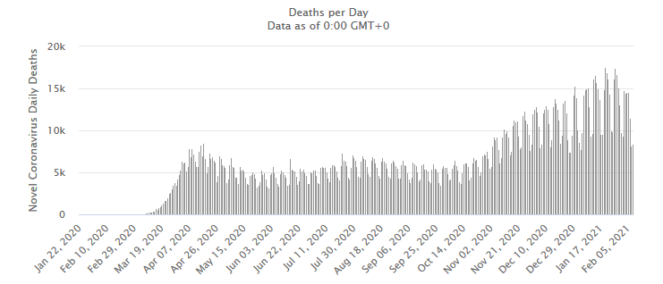
COVID-19 Time line
Globally > 100 million confirmed cases
Globally > 2 million deaths through covid-19

Slide 28
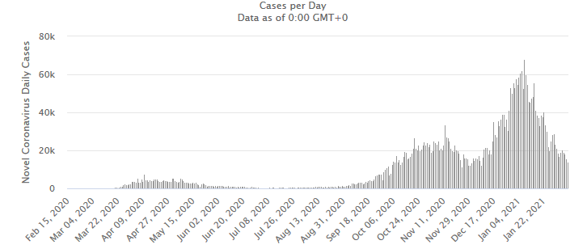
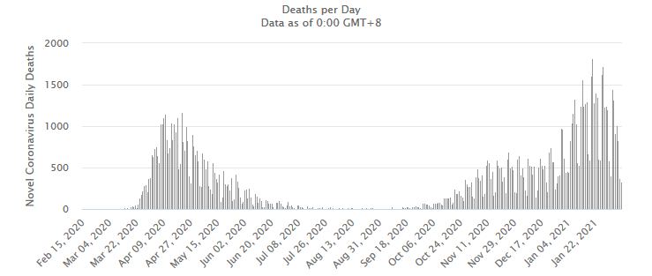
COVID-19 Time line
UK > 4,000,000 confirmed cases
UK > 115,000 deaths through covid-19

Slide 29
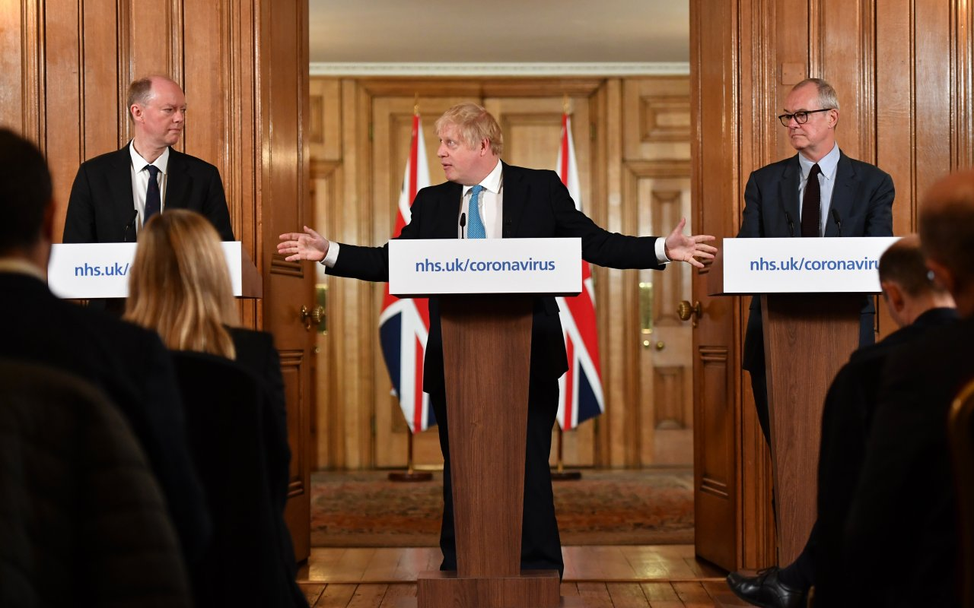
COVID-19. Modelling became daily news

Slide 30
COVID-19 Need a model. SIR? Possibly
Susceptible hosts can be infected by parasites
Infected hosts carry the parasite
Infecteds are assumed to be infectious
Infectious hosts transmit the parasite
Recovered (immune) hosts do not transmit the parasite and cannot be infected
S
I
R

Slide 31
COVID-19. Need a model. SEIR is mostly used.
Susceptible hosts can be infected by parasites
Exposed hosts carry the virus but are not yet infectious
Infected hosts carry the virus and are not infectious
Recovered (immune) hosts do not transmit the parasite and cannot be infected
S
E
I
R
A model anyone?

Slide 32
COVID-19. Analysis
How can we use modelling to help in the decision making?
We need to know the epidemiological parameters
What is the infectious period?
In February 2020, no one knew. It was assumed the same as SARS: 8.4 days on average
Current thinking is that it is 3-7 days, (hence the advice to self isolate for 10 days after testing positive.)
The key issue is the R₀
A model anyone?

Slide 33
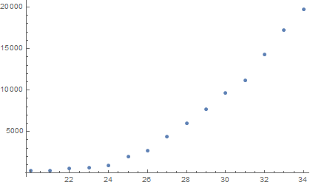
Cases in China from 20/1/20-4/2/10
Total nr of cases
A model anyone?
Time (days from 1/1/20)

Slide 34
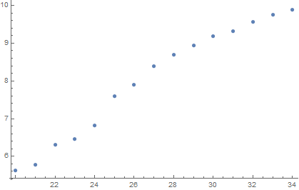
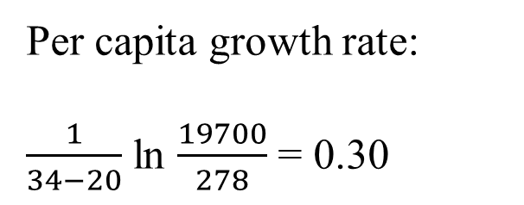
COVID-19. Infer R₀ from the data
Increase nr of infecteds, China from 20/1/20-4/2/20
ln[Total nr of cases]
A model anyone?
Time (days from 1/1/20)

Slide 35
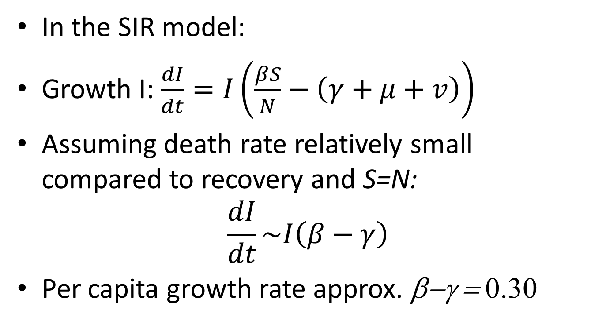
COVID-19. Infer R₀ from the data
In the SIR model:
Growth I: $\frac{dI}{dt}=I\left(\frac{βS}{N}−\left(γ+μ+v\right)\right)$
Assuming death rate relatively small compared to recovery and S=N:
$$\frac{dI}{dt}\sim I\left(β−γ\right)$$
Per capita growth rate approx. β−γ = 0.30

Slide 36
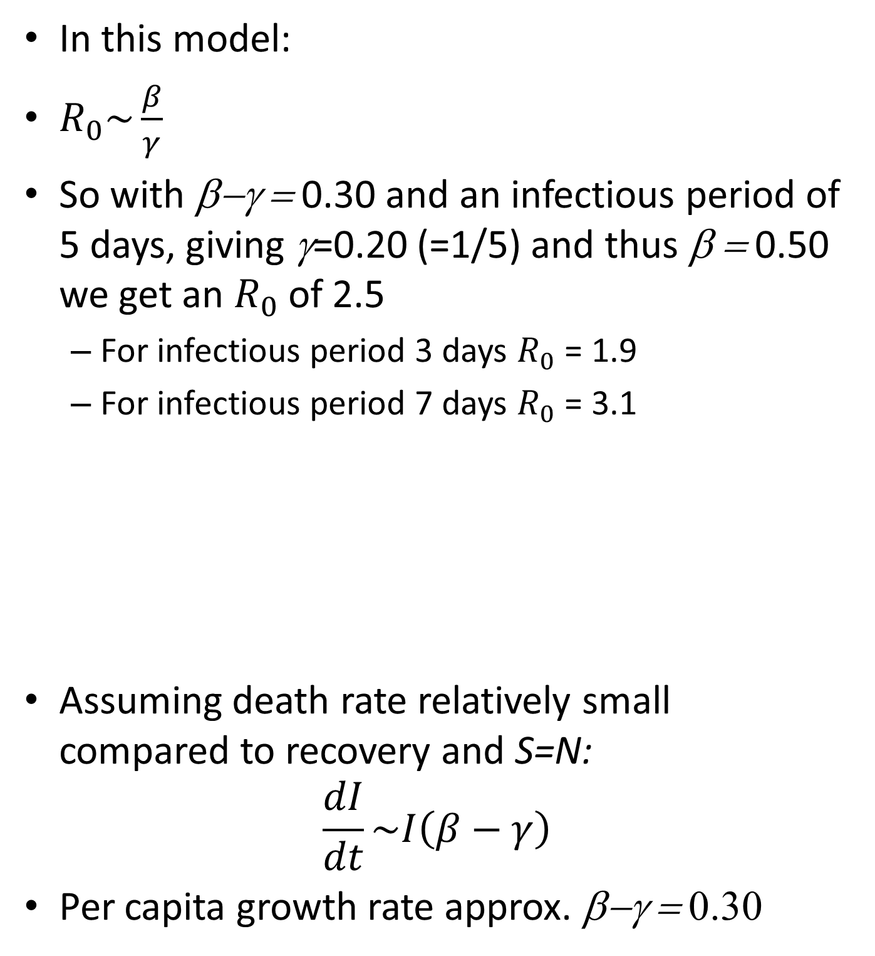
COVID-19. Infer R₀ from the data
In this model:
$R_{0}\sim \frac{β}{γ}$
So with β−γ = 0.30 and an infectious period of 5 days, giving γ=0.20 (=1/5) and thus β = 0.50 we get an $R_{0}$ of 2.5
For infectious period 3 days $R_{0}$ = 1.9
For infectious period 7 days $R_{0}$ = 3.1
Assuming death rate relatively small compared to recovery and S=N:
$$\frac{dI}{dt}\sim I\left(β−γ\right)$$
Per capita growth rate approx. β−γ = 0.30

Slide 37
COVID-19. Fatality rate
Two fatality rates are being used
Case fatality rate (CFR): nr of deaths due to covid divided by nr of reported cases
Problem: depends on how many case you detect and therefore changes with testing
A model anyone?

Slide 38
COVID-19. Fatality rate
UK > 4,000,000 confirmed cases
UK > 115,000 deaths through covid-19

Slide 39
COVID-19. Fatality rate
Two fatality rates are being used
Infection fatality rate (IFR): nr of deaths due to covid divided by total nr of infections
Problem: you normally don’t know exactly how many people are infected because of asymptomatic cases and people not reporting symptoms.
Two natural experiments where cases were closely monitored:
Travellers from China
Diamond Princess
A model anyone?

Slide 40
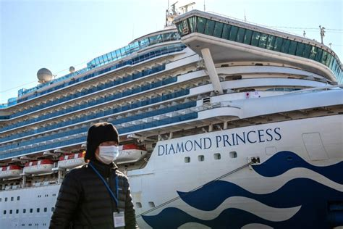

Slide 41
COVID-19. Fatality rate
Diamond Princess: CFR 2.6%, IFR 1.3%
China data; CFR 1.2%, IFR 0.6%
Over a range of later studies it was estimated 0.68% (0.53%–0.82%)
IFR is very variable, depends on age group, location, nr of cases, detection rate. In the early phases of the epidemic, it is also very uncertain
A model anyone?
Notes:
https://www.eurosurveillance.org/content/10.2807/1560-7917.ES.2020.25.12.2000256
https://www.ncbi.nlm.nih.gov/pmc/articles/PMC7524446/

Slide 42
Corona virus fatality rate
A year ago, based on travellers from China (who were screened and closely monitored) there was 1 death among 216 infections
That gives an IFR of 1/216=0.46%
How certain are we about that?

Slide 43
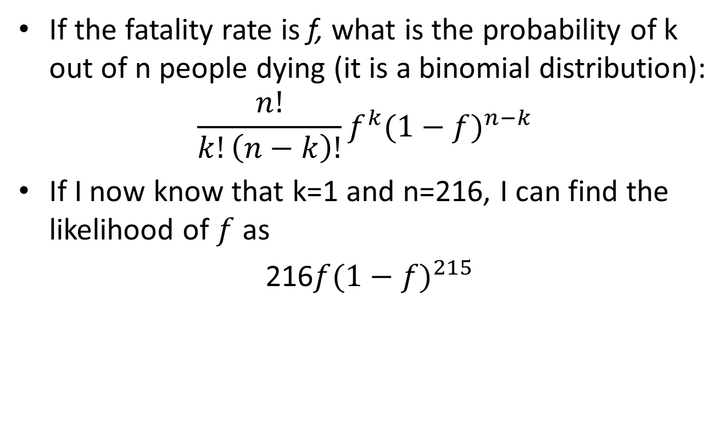
Corona virus an introduction into likelihood
If the fatality rate is f, what is the probability of k out of n people dying (it is a binomial distribution):
$$\frac{n!}{k!\left(n−k\right)!}f^{k}{(1−f)}^{n−k}$$
If I now know that k=1 and n=216, I can find the likelihood of $f$ as
216$f{(1−f)}^{215}$

Slide 44
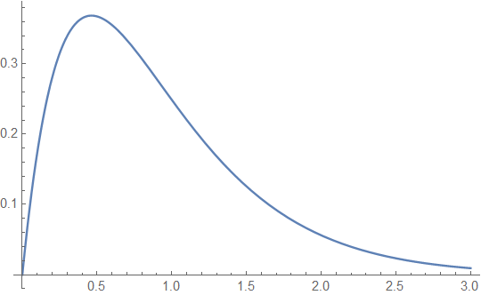

Corona virus an introduction to likelihood
So the likelihood of the fatality rate is
216$f{(1−f)}^{215}$
likelihood
fx100

Slide 45
COVID-19. Is COVID like flu?
Simple answer: No!
The R0 is bigger (Covid 2-3, Flu, 1-2)
(even bigger for Kent variant, 50-70% higher: range 3-5)
IFR is bigger (Covid 0.53-0.82, flu 0.1-0.35 )
A model anyone?

Slide 47
COVID-19. Is COVID like flu?
Simple answer: No!
The R₀ is larger (Covid 2-3, flu, 1-2)
IFR is larger (Covid 0.5-0.8, flu 0.1-0.35 )
Predicted nr of deaths without intervention:
Flu: 21,000 - 76,000
Covid: 195,000 - 312,000
(but higher than that if Kent variant is included)
A model anyone?

Slide 48
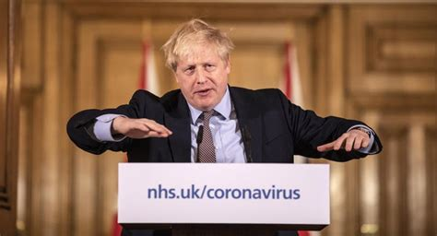
COVID-19. Herd immunity
Herd immunity for COVID when
1-1/ R₀ =1-1/2.5=0.6, that is 60% of the population has gained immunity.
But to let the epidemic run its course would mean a death toll in the order of 186,000 - 317,000.

Slide 49
COVID-19. Herd immunity
Herd immunity for COVID when
1-1/ R₀ =1-1/2.5=0.6, that is 60% of the population has gained immunity.
(Kent variant 1-1/ R₀ =1-1/4=0.75). To let the epidemic run its course would mean a death toll in the order of 195,000 - 312,000 (or even more with Kent variant).
Also gives indication of the vaccination threshold

Slide 50
COVID-19. the R number
Note the “R number” in general is
Depends on how big S is (how much herd immunity)
How big β is (behaviour, playing your part, etc.)
R
βS
< R₀
/N
=
μ+ν+γ
A model anyone?

Slide 51
COVID-19. What can we do?
How to control a disease:
Reduce transmission (β)
Reduce the duration of the infections (γ)
Increase mortality of infecteds (ν)
Reduce the nr of susceptibles (S₀)

Slide 52
COVID-19. What can we do?
How to control a disease:
Reduce transmission (β)
Reduce the duration of the infections (γ)
Increase mortality of infecteds (ν)
Reduce the nr of susceptibles (S₀)

Slide 53
COVID-19. Vaccines
Several vaccines are now available and vaccine programmes being rolled out
Efficacy ranges from 60-95% in preventing disease
This protects individuals and reduces pressure on the NHS
We don’t know how good the vaccines are in preventing transmission, or how they will stand up to new variants of the virus

Slide 54

COVID-19. What can we do?
How to control a disease:
Reduce transmission (β)
Reduce the duration of the infections (γ)
Increase mortality of infecteds (ν)
Reduce the nr of susceptibles (S₀)
Change behaviour, quarantine,

Slide 55
Learning outcomes
Being able to do simple R₀ and threshold calculations
Understand how models and knowledge of the reproductive number can be used to understand the dynamics of a disease
Understand how this can be used as a basis for public health policies and disease management
Notes:
Consider including the New Zealand case?

Slide 56
Learning outcomes (overall)
I hope that you have:
gained an appreciation of different models and dynamics that these models produce
learned what sort of dynamics models can show, how to interrogate the output of models, and interpret dynamics
appreciated that the math you have learned can sometimes be useful
enjoyed it

