Slide 1

2020-21 4-1 Predator-prey models, limit cycles, Hopf bifurcation Trophic Interactions, D’Ancona and Volterra
Vincent Jansen
vincent.jansen@rhul.ac.uk

Slide 2
Outline
4-1 Trophic Interactions, D’Ancona and Volterra
4-2 The Lotka-Volterra predator-prey model
4-3 Variations on the predator-prey theme
4-4 Spatial predator-prey interactions

Slide 3
Trophic interactions
Trophic interactions capture all interactions where one species uses another species to feed and reproduce on.
This includes predation, herbivory and parasitism.

Slide 4
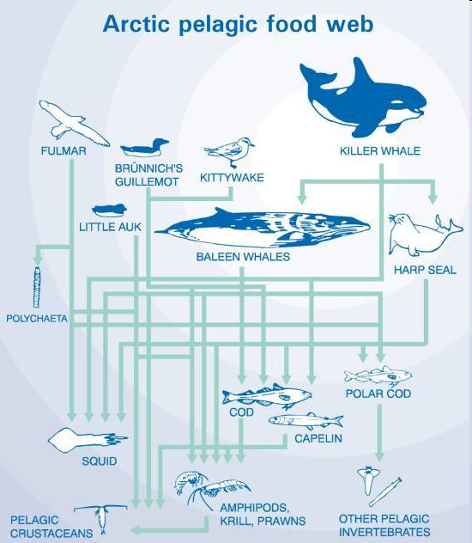
Trophic interactions
Trophic interactions are conspicuous
They are fairly easy to detect and quantify (gut contents)
They are therefore probably over-represented in ecological studies compared to competitive interactions
Food web theory is almost exclusively dedicated to trophic interactions, competition in food webs is rarely measured

Slide 5
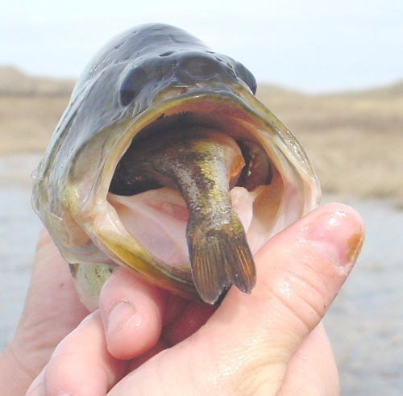
D’Ancona’s observation

Slide 6
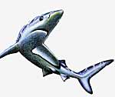
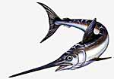
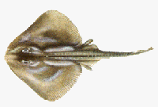
D’Ancona’s observation
Umberto D’Ancona studied data of the Adriatic fisheries
During the first world war (1914-1918) the fishery effort in the Adriatic had been much reduced

Slide 7
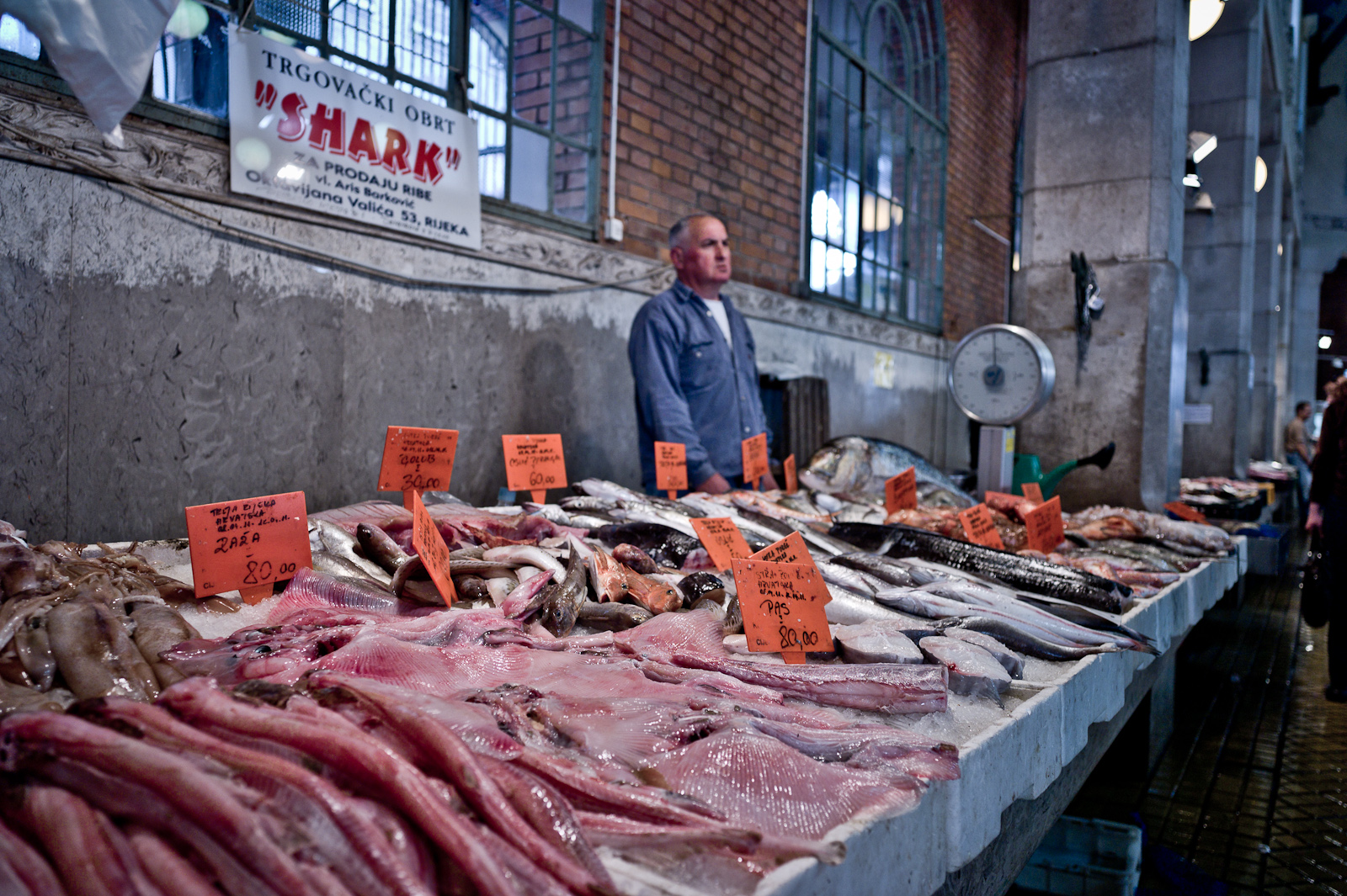
Fiume (Riyeka) fishmarket

Slide 9
D’Ancona’s observation
He noticed that the proportion of predatory fish (sharks, skates, rays etc.) had increased.
Fishermen concentrate on prey fish.
Why the increase?

Slide 10
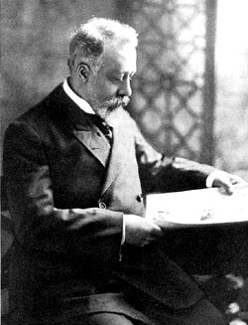
D’Ancona’s observation
This is puzzling as fishermen prefer to catch prey fish.
D’Ancona asked his fiancee’s father, Vito Volterra, how this could be explained.
Vito Volterra was a theoretical
physicist who was developing
an interest in biology.
Vito Volterra
(1860-1940)

Slide 11
Lotka-Volterra predator-prey model
Volterra produced a model (Alfred Lotka produced a similar model at about the same time)
The model is similar in structure to the L-V competition model. In the competition model both species suffer from each others presence (--) in this model the prey suffers, the predator benefits (-+)

Slide 12
Predators and their prey
Volterra assumed:
Without predators the prey population grows unbounded, no density dependence
Without prey the predator population disappears
The number of prey caught only depends on encounter probabilities

Slide 13
Lotka-Volterra predator-prey model
We will use a slightly different notation (following Gotelli)
V: density of the prey (victim) population
P: density of the predator population
In the absence of the predator the prey grows exponentially

Slide 14
Lotka-Volterra predator-prey model
Functional response: the per predator effect of predation on the prey’s growth rate
α is the capture efficiency, assumed to be constant
The functional response is αV
The prey’s growth rate is:

Slide 15
Lotka-Volterra predator-prey model
The per capita prey growth rate is
The per capita prey growth rate is independent of prey density
If the predator density is low, the prey population increases, if it is high it decreases

Slide 16
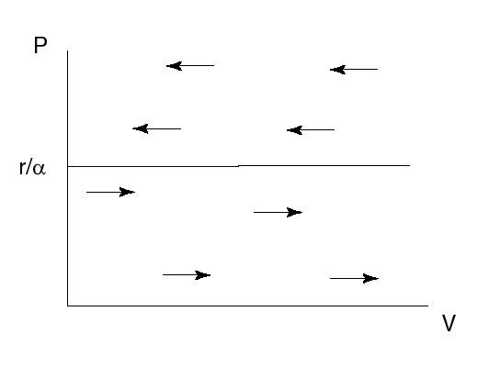
Lotka-Volterra predator-prey model
Prey dynamics if predator density is constant

Slide 17
Lotka-Volterra predator-prey model
In the absence of the prey the predator population will decrease
The predator’s death rate is q
In the absence of prey, the predator population changes as:

Slide 18
Lotka-Volterra predator-prey model
β is the amount of energy gained per unit of time. (If e is the conversion efficiency, β=eα)
The numerical response is βV
The predator’s growth rate is

Slide 19
Lotka-Volterra predator-prey model
The per capita predator growth rate is
The per capita predator growth rate is independent of predator density
If the prey density is low, the predator population decreases, if it is high it increases

Slide 20
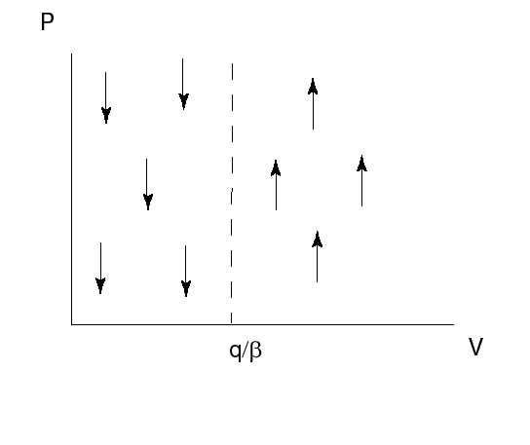
Lotka-Volterra predator-prey model
Predator dynamics if prey density is constant

Slide 21
Lotka-Volterra predator-prey model
The densities of predator and prey change simultaneously
This is described by a system of 2 differential equations:
This model is known as the Lotka-Volterra predator-prey model

Slide 22
Learning outcomes
Understand the logic underlying the Lotka-Volterra predator model

Slide 24
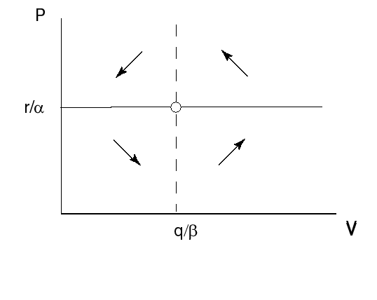
Lotka-Volterra predator-prey model
Combined isoclines

Slide 25
Lotka-Volterra predator-prey model
The prey equilibrium density is given by q/β: only depends on the parameters relating to the predator.
The predator equilibrium density is given by r/α only depends on the parameters relating to the prey.

