Slide 1

2020-21 2-1 Interspecific competition between two species Generalised Logistic Growth
Vincent Jansen
vincent.jansen@rhul.ac.uk

Slide 2
Outline
2-1 Generalised Logistic Growth
2-2 The Lotka-Volterra Interaction model
2-3 Equilibria and Stability
2-4 Apparent Competition

Slide 3
Logistic Growth
rk
-rk

Slide 4
Intraspecific competition
Competition between individuals of the same species reduces the per capita growth rate
This can be for various reasons
Competition for resources (exploitation competition)
Direct effects (e.g. fighting, interference competition)
This motivated the logistic model for density dependent growth

Slide 5
Interspecific competition
Competition between individuals of different species also has the potential to reduce the growth rate
This can be for the same reasons
exploitation competition
interference competition

Slide 6
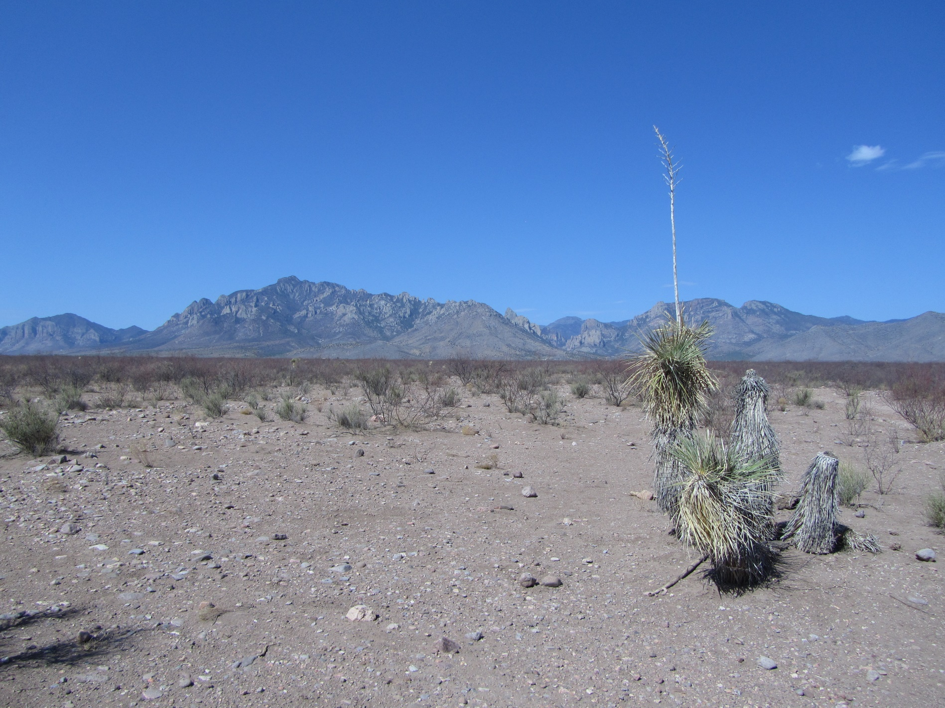
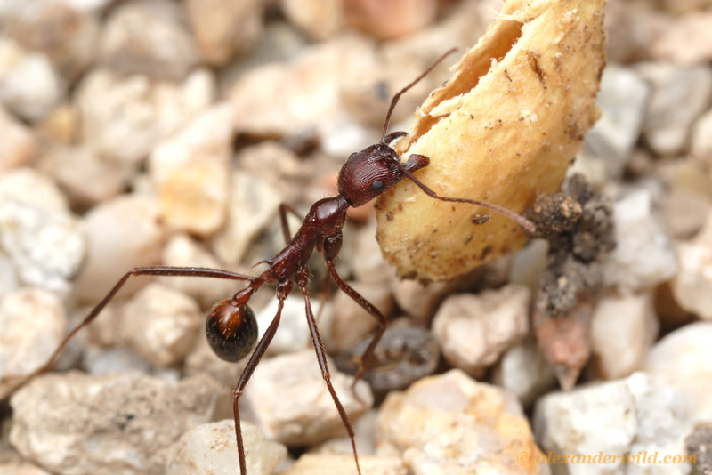
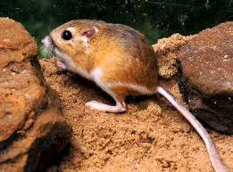
Notes:
Novomessor cockarelli granivorous ant, Dipodomys ordii, Ord’s kangaroo rat

Slide 7
Interspecific competition
 | Rodents removed | Ants removed | Rodents and ants removed | control
Ant colonies | 543 | - | - | 318
Rodent nrs | - | 144 | - | 122
Seed density relative to control | 1.0 | 1.0 | 5.5 | 1.0
Competition between rodents and granivorous ants (After Brown and Davidson, 1977)

Slide 8
Interspecific competition
Species coexist, but often do better in each other’s absence
Competition reduces the population size of the competitors

Slide 9
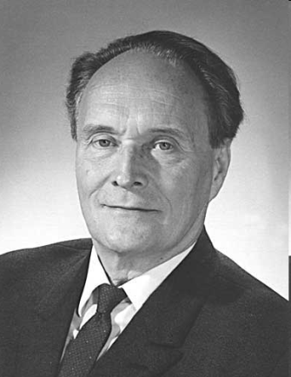
Gause’s experiments
G. F. Gause (1934) studied the competition between protozoans
He asked ‘will one species … drive the other one out completely, or will a certain equilibrium become established between them? ‘
Notes:
Gause applied for a fellowship through the Rockefeller Foundation to study with Pearl but was denied, perhaps because he was only 22 years old. He then published The Struggle for Existence in 1934 to improve his chances but he was still denied. Gause earned his BSc at Moscow University in 1931 and his DBiolSc in 1940.

Slide 10
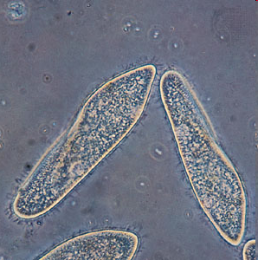
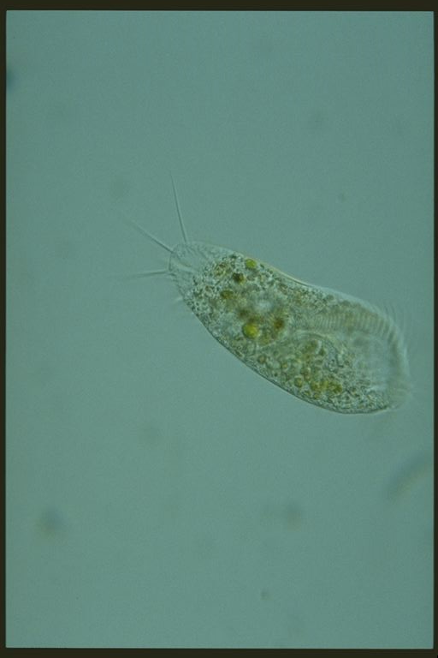
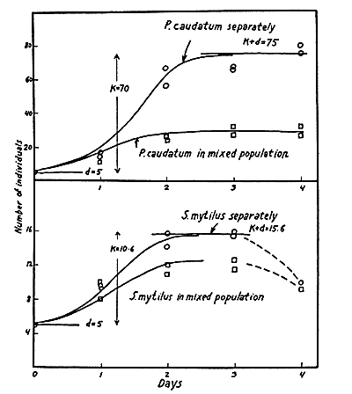

Gause’s experiments
He found coexistence
The population sizes are smaller in mixed cultures
Notes:
Stylonychia mytilus, Paramecium caudatum

Slide 11
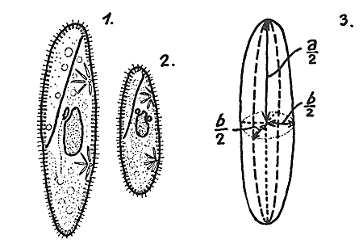
Gause’s experiments
Next look at the competition between two very similar species:
Paramecium caudatum
Paramecium aurelia

Slide 12
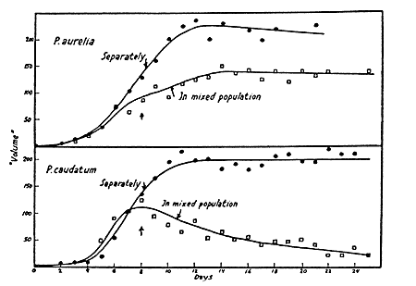
Gause’s experiments
He found exclusion of one species by another

Slide 13
Logistic Growth
Intraspecific competition can be described by the logistic model
The per capita growth rate decreased with increasing population size:

Slide 14
Generalised Logistic Growth
To describe competition between two species we will use
N₁: size of pop. of species 1
N₂: size of pop. of species 2
The max. per capita growth rate of species 1 is r₁, the carrying capacity of species 1 is k₁ (r₂, k₂ for species 2)

Slide 15
Generalised Logistic Growth
We will assume that the per capita growth rate of species 1 will decrease with the density of species 1 and species 2:
α is the competition coefficient (also called the equivalence number)
Population growth of species 1:

Slide 16
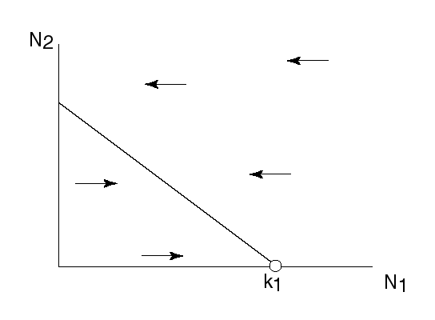
Generalised Logistic Growth
If the density of species 2 is constant, interspecific competition results in a reduction of the carrying capacity for species 1:
Or

Slide 17
Generalised Logistic Growth
Similarly, for the per capita growth rate of species 2 we assume:
β is the competition coefficient (also called the equivalence number)
Population growth of species 2:

Slide 18
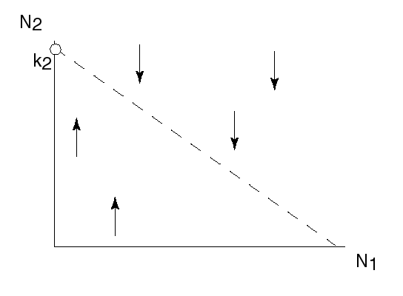
Generalised Logistic Growth
If the density of species 1 were constant, interspecific competition results in a reduction of the carrying capacity for species 2:
Or

Slide 19
Lotka-Volterra interaction model
The densities of the two species change simultaneously
This is described by a system of 2 differential equations:
This model is known as the Lotka-Volterra interaction model

Slide 20
Learning outcomes
Understand how intraspecific and interspecific competition both result from a reduction of the growth rate.
Understand the rationale behind the Lotka-Volterra interaction model

