Slide 1

2020-21 2-2 Interspecific competition between two species The Lotka-Volterra Interaction model
Vincent Jansen
vincent.jansen@rhul.ac.uk

Slide 2
Outline
2-1 Generalised Logistic Growth
2-2 The Lotka-Volterra Interaction model
2-3 Equilibria and Stability
2-4 Apparent Competition

Slide 3
Lotka-Volterra interaction model
Describes how the densities of two competing species change simultaneously
It is a system of 2 differential equations:

Slide 4
Lotka-Volterra interaction model
The curves on which either species does not grow are called isoclines
The isoclines delimit the parts of the state space for which the density of that species increases or decreases in number
By combining the isoclines for the two species we can get an idea of the population dynamics

Slide 5
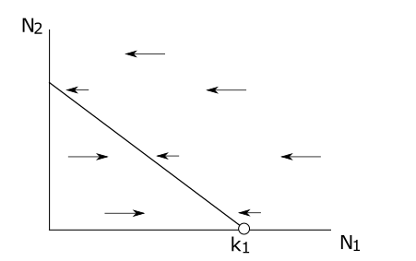
Isoclines

Slide 6
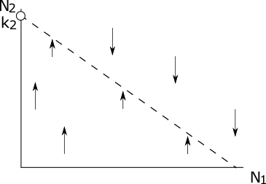
Isoclines

Slide 7
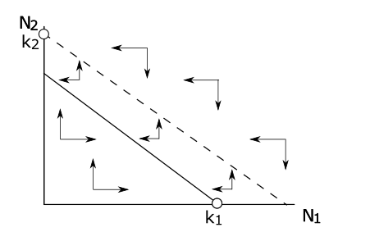
Inferring dynamics from the isoclines

Slide 8
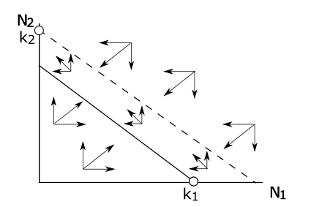
Inferring dynamics from the isoclines

Slide 9
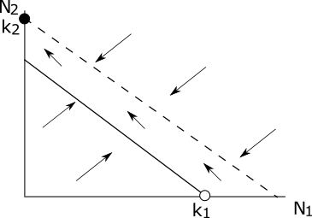
Lotka-Volterra interaction model: exclusion

Slide 10


Lotka-Volterra interaction model: exclusion
We can numerically solve the differential equations and plot the solutions against time
Species 2 outcompetes and excludes species 1

Slide 11
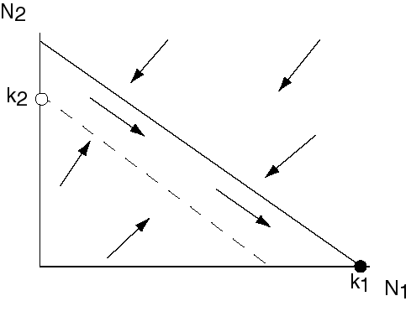
Lotka-Volterra interaction model: exclusion
Other outcomes of the model:
Species 1 can outcompete species 2

Slide 12

Lotka-Volterra interaction model: exclusion
This happens for different parameters
This looks very similar to Gause’s result

Slide 13
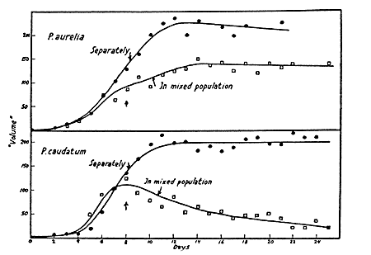
Gause’s experiments: Exclusion

Slide 14
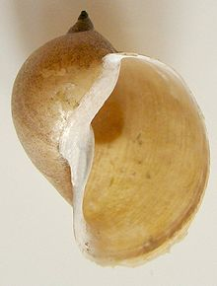
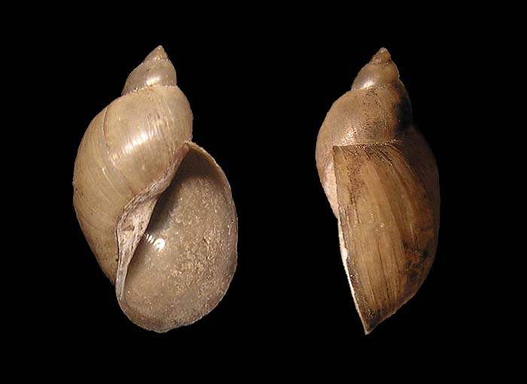
Exclusion of a watersnail in Wraysbury
Radix peregra and Radix auricularia are quite similar species. Their ranges overlap largely
R. auricularia tends to be found in large rivers. They are normally not found together.
Why? Do they simply occupy different habitat, or do they exclude each other?
Radix auricularia
Radix peregra
Radix aurucolaria

Slide 15
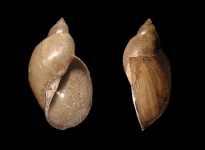

Exclusion of a watersnail in Wraysbury
R. Peregra closed bars, R. auricularia open bars
Adam and Lewis (1992) J. Moll. Stud. 58:227-8

Slide 16
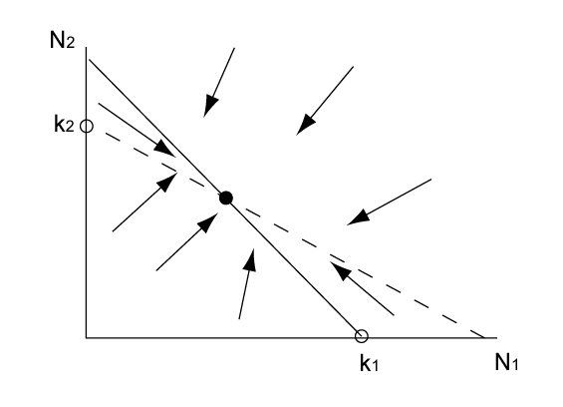
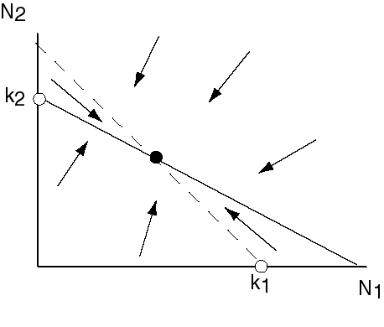
Lotka-Volterra interaction model: coexistence
Other outcomes of the model:
Species 1 and 2 can coexist

Slide 17





Lotka-Volterra interaction model: coexistence
This for different parameters
Gause also found coexistence

Slide 18
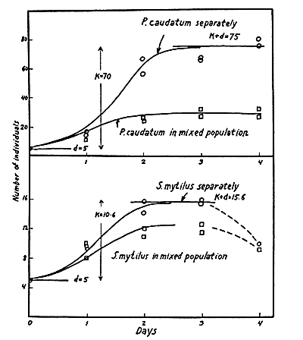
Gause’s experiments: Coexistence
Notes:
Stylonychia mytilus, Paramecium caudatum

Slide 19
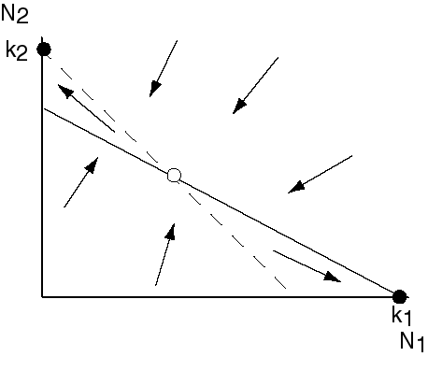
L-V interaction model: alternative stable states
Another outcome of the model:
An unstable equilibrium exists, yet there is no lasting coexistence. The winner of the competition depends on the initial conditions

Slide 20


Alternative stable states
This for different parameters again
Either species 1 outcompetes species 2
Or, for different initial conditions, but the same parameters, the outcome is reversed

Slide 21


Alternative stable states

Slide 22
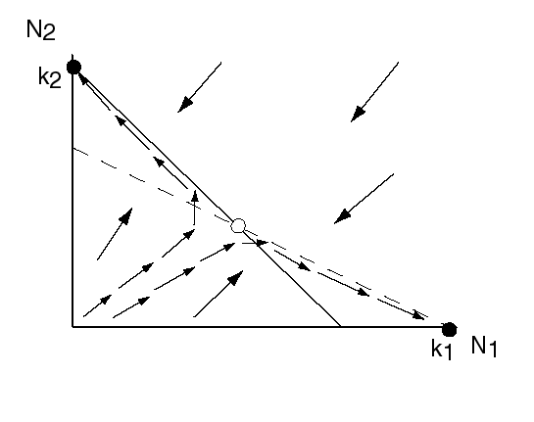
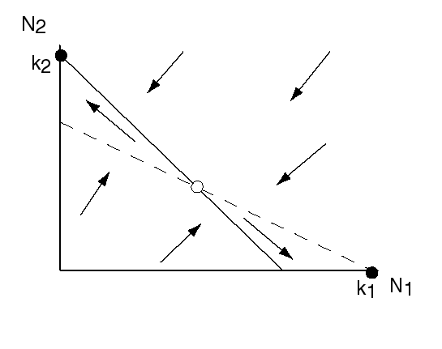
Alternative stable states

Slide 23
The phase plane
The previous plot captures the information about the solution in a very convenient way
Rather than plotting N₁ and N₂ versus time, we have plotted the values of N₁ and N₂ at various time points
The solution traverses the N₁, N₂ plane over time, the path it covers is called an orbit
The N₁, N₂ plane is the phase plane
All orbits together give you the phase portrait

Slide 24
Do Practical 2: Investigate the phase portrait of the Lotka-Volterra competition model

Slide 25
The phase plane

Slide 26
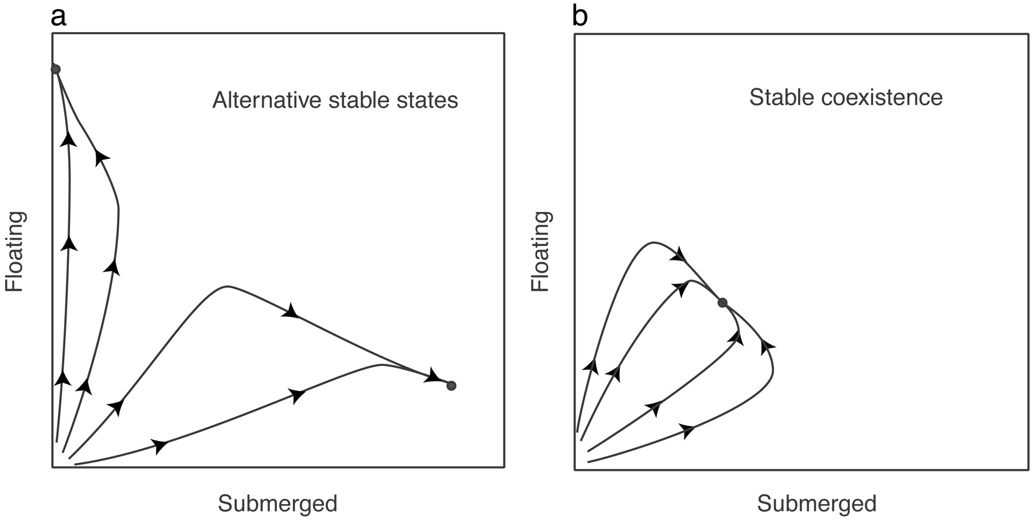
Theoretical growth trajectories in competition experiments of a submerged plant and a floating plant
Scheffer M et al. PNAS 2003;100:4040-4045
©2003 by The National Academy of Sciences
Notes:
(a) If two stable states exist, trajectories of simulations with our model end in either of the two states, depending on initial conditions. (b) By contrast, trajectories of simulations converge to the same point if there is a single equilibrium. The latter simulations are performed with hs = 0.2, rs = 1.2, and the other parameters at default values (see Table 1).

Slide 27

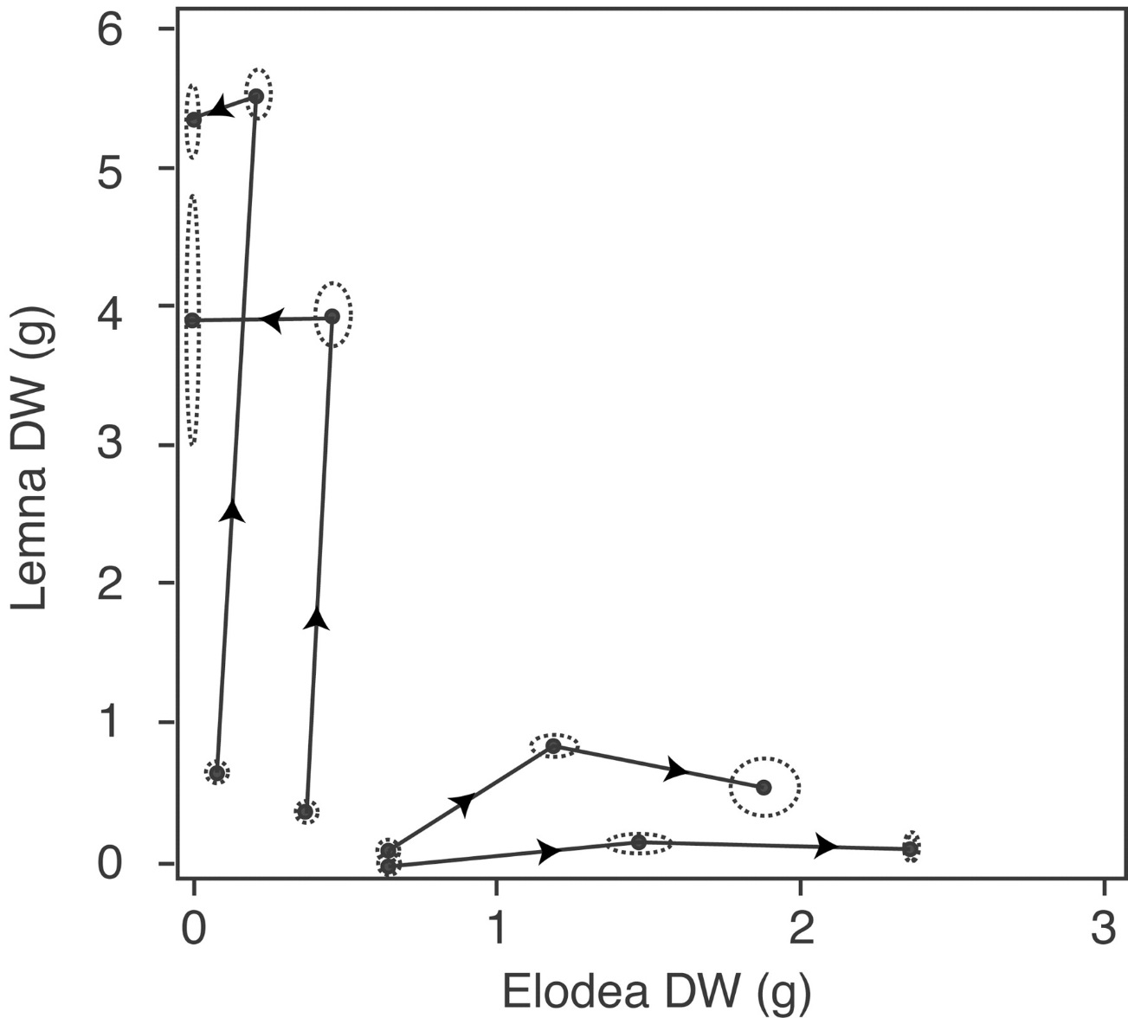

Observed growth trajectories in competition experiments of a submerged plant (Elodea) and a floating plant (Lemna) tend to different final states, depending on the initial plant densities
Scheffer M et al. PNAS 2003;100:4040-4045
©2003 by The National Academy of Sciences
Notes:
Growth trajectories in competition experiments of a submerged plant (Elodea) and a floating plant (Lemna) tend to different final states, depending on the initial plant densities. All experiments were performed under the same conditions. Biomass is plotted for all experiments at the 1st, 23rd, and 57th day. Dashed ellipses indicate SDs of replicate experiments.

Slide 28
Alternative Stable States in freshwater lakes
The two species compete for light and nutrients:
If the floating plants become dominant they block out light, preventing establishment of the benthic species
If the benthic plants become dominant they sequester the nutrients, preventing establishment of the floating species
The same principle seems to apply to many freshwater lakes, and explains the sudden change in turbidity in freshwater lakes under eutrophication (see Scheffer et al. 2001)

Slide 29
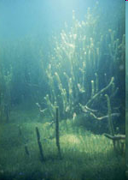
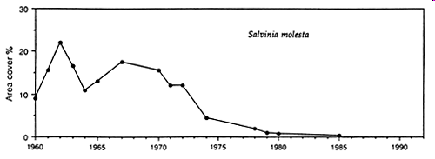
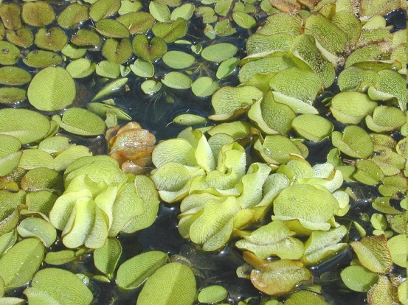
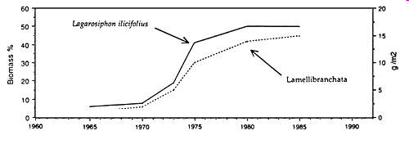
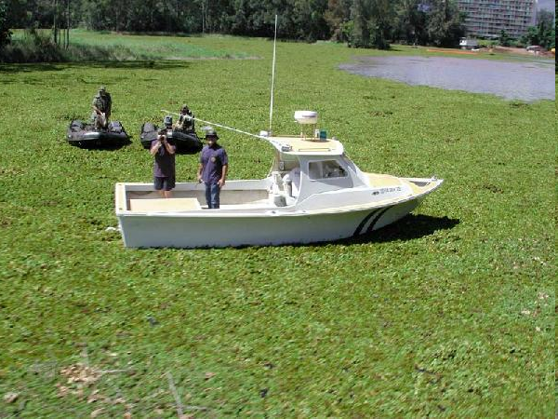
Changes in vegetation on Lake Kariba
Lagarosiphon major
Salvina molesta
Lake Kariba: coverage of Salvinia molesta, changes in the benthic (Lamellibranchiata) and aquatic macrophyte biomass (Lagarosiphon). (From Karenge and Kolding, 1995).
Notes:
Lamellibranchiata
Lemlibranchata: (Science: zoology) a class of mollusca including all those that have bivalve shells, as the clams, oysters, mussels, etc.

Slide 30
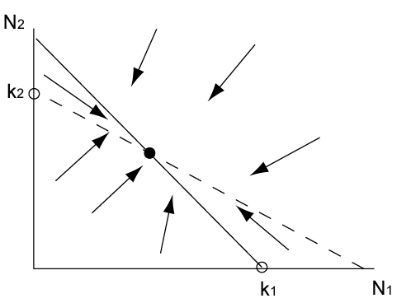
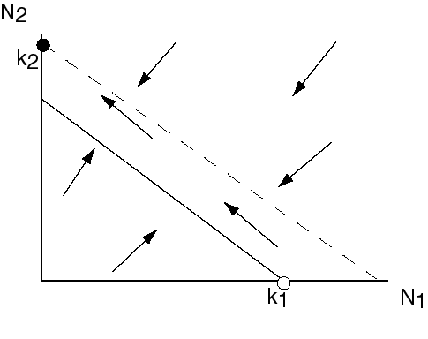
The outcomes of competition
Species 1 excludes 2
Species 2 excludes 1
Coexistence
Alternative stable states

Slide 31
Learning outcomes
Know what an isocline is and how they can be used to infer dynamics
Know the possible outcomes of competition
Understand phase plots

