Slide 1

2020-21 3-1 Alternative stable states, phase shifts and catastrophic transitions. Chaos and unpredictability Phase Shifts and Catastrophic Transitions
Vincent Jansen
vincent.jansen@rhul.ac.uk

Slide 2
Outline
3-1 Phase Shifts and Catastrophic Transitions
3-2 Alternative Stable States in Coral Reefs
3-3 Evidence for Alternative Stable States
3-4 Chaos and unpredictability

Slide 3
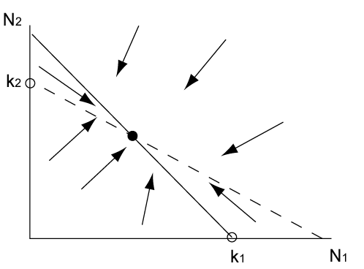
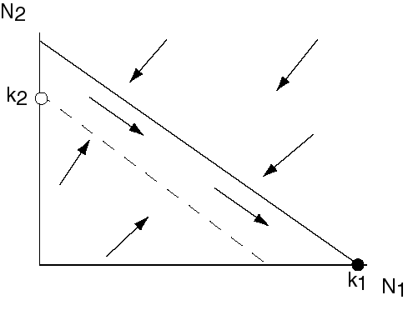
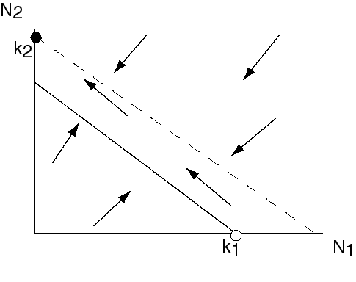
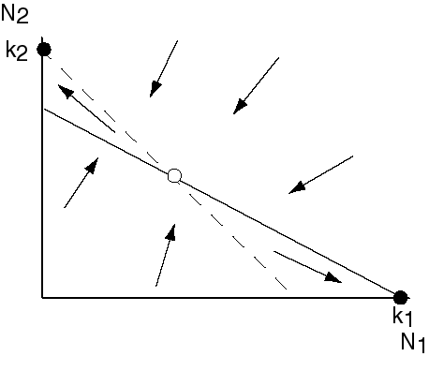
Dynamics of LV model and classification as bifurcations
α
k₁/k₂
k₁/k₂
1/β

Slide 4
Dynamics of LV model and classification as bifurcations
Transitions happen when
1/β=k₁/k₂
α=k₁/k₂
Or, written differently, when
k₂=k₁/α
k₂=k₁β

Slide 5
Bifurcations in the LV model
Codim 2 Bifurcation diagram of LV competition model
k₂
k₂=k₁/α
k₂=k₁β
k₁

Slide 6
What happens if we change the carrying capacity?
k₁/α
k₁/α
k₁/α
k₁
k₁
k₁

Slide 7
Phase shift
N₂ only
N₁ and N₂
N₁ only
N₂
k₂α
k₂/β
k₁

Slide 8
Phase shift
N₂ only
N₁ and N₂
N₁ only
N₁
k₂α
k₂/β
k₁

Slide 9
Bifurcations in the LV model
Codim 2 Bifurcation diagram of LV competition model
k₂
k₂=k₁β
k₂=k₁/α
k₁

Slide 10
Other option if we change the carrying capacity (for different α and β)

Slide 11
Alternative Stable States, Catastrophic transition
N₂
N₁ or N₂
N₂
N₁
k₂/β
k₂α
k₁

Slide 12
Alternative Stable States, Catastrophic transition
N₁
N₁
N₁ or N₂
N₂
k₂/β
k₂α
k₁

Slide 13
Codim 2 Bifurcation diagram of LV competition model
k₁
N₂*
k₂
k₂=k₁β
k₂=k₁/α
k_{1/}/α
k₁β
k₁
k₂
k₁

Slide 14
Generic situation
Bifurcation diagram of the metapopulation with rescue effect
p
Eigenvalue is 0 at this point
m
A fold bifurcation (also called saddle-node)

Slide 15
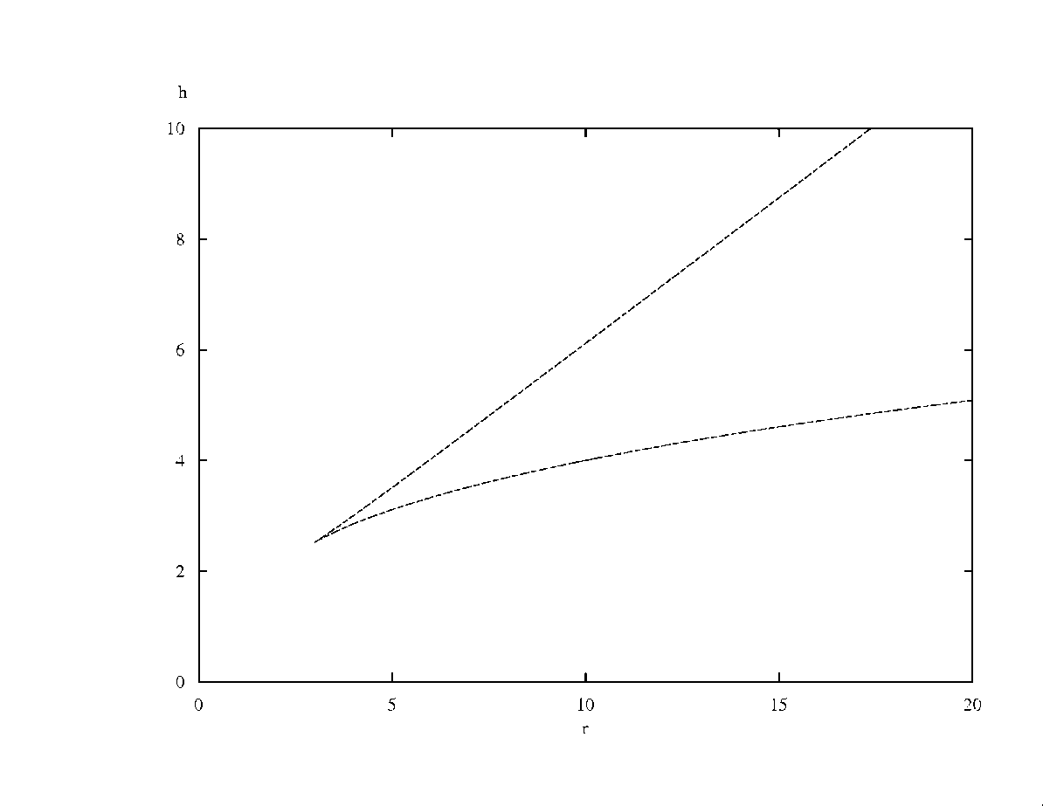
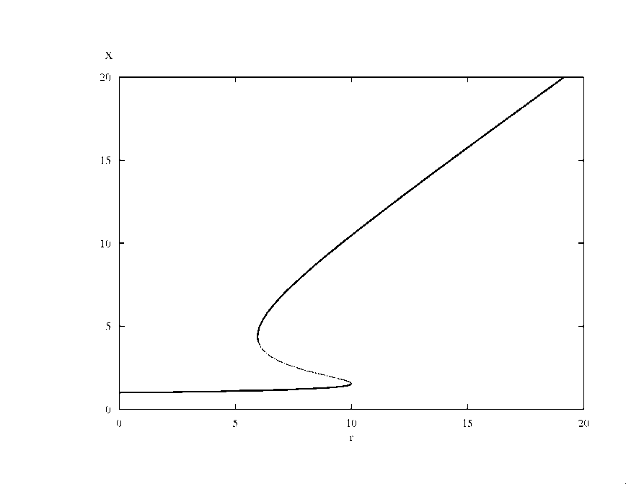
Generic situation
Generic codim 2 Bifurcation diagram
This is a cusp bifurcation
h
x
r
r

Slide 16
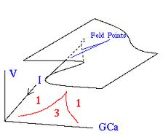
Generic situation
Generic codim 2 Bifurcation diagram
This is cusp bifurcation
h
x
r
r

Slide 17
Learning outcomes
Understand how a change in carrying capacity can bring about a qualitative change in the dynamics: a bifurcation
the difference between a phase transition and catastrophic transition

