Slide 1

2020-21 5-2 Epidemiological models. Measles, flu, covid The SIR model
Vincent Jansen
vincent.jansen@rhul.ac.uk

Slide 2
Outline
5-1 Host and pathogens. The reproductive number
5-2 The SIR model
5-3 Measles
5-4 Pandemics: Flu and Covid

Slide 3
SIS model
S
I

Slide 4
More elaborate: the SIR model
Susceptible hosts can be infected by parasites
Infected hosts carry the parasite
I will assume that all infected hosts transmit the parasite (not doing so leads to a SEIR model, E stands for Exposed)
Recovered (immune) hosts do not transmit the parasite and cannot be infected
S
I
R

Slide 5
More elaborate: the SIR model
In its simplest form the SIR model takes the form
S
I
R

Slide 6
Solution: an epidemic
S
R
Fraction of population
I
Note: after an initial increase the disease disappears in this case
Time (years)

Slide 7
Effect of decreasing the transmission rate
Infecteds as fraction of population
Time (years)

Slide 8
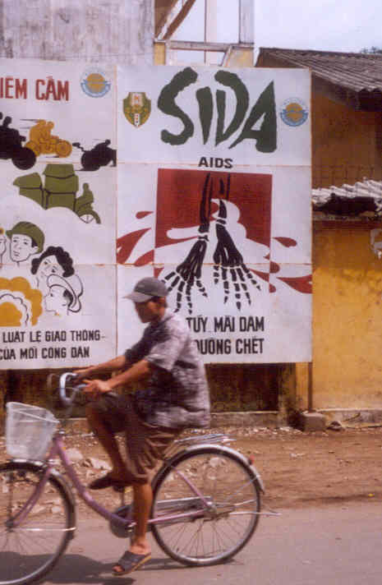
Campaign against AIDS in Vietnam

Slide 9
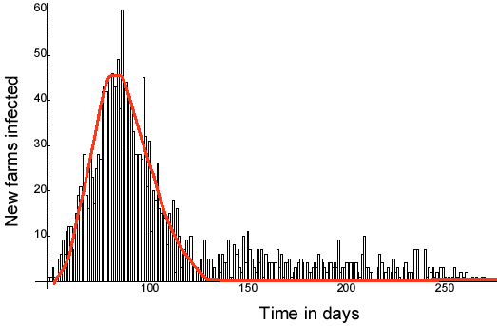
Outbreak of Foot and Mouth Disease in 2001

Slide 10
A more elaborate SIR model
The model can easily be extended
For instance, if we add natural death (with rate μ) and disease induced mortality, ν, we get (if we replace all dead by newborns)
μN+vI
βIS/N
γI
S
I
R
μS
(μ+ν)Ι
μR

Slide 11
More elaborate: the SIR model
The model reads:
μN+vI
βIS/N
γI
S
I
R
μS
(μ+ν)Ι
μR

Slide 12
Now susceptibles are born into the population the disease can become endemic
R
Fraction of population
S
I
Time (years)

Slide 13
If new susceptibles are born into the population the disease can become endemic
Note the oscillatory behaviour. This is similar to the behaviour of prey-predator models
This is caused by the slow build up of susceptibles, that then get immunised in an epidemic

Slide 14
SIR model
When is an epidemic possible?
This is asking if the disease-free equilibrium S=N, I=0, R=0 is unstable.

Slide 15
SIR model
When is an epidemic possible?
This turns out to be R₀ >1

Slide 16
R₀ for the SIR model
Note: formula not very practical in many cases.
Nr of susceptibles infected per unit of time
Average duration of infection
R₀ =
1
βS₀/N
βS₀/N
x
=
μ+v+γ
μ+v+γ
S₀=The number of susceptibles in population without disease
γI
I
(μ+ν)Ι

Slide 17
R₀: The basic reproductive number
If the reproductive number < 1 the nr of infecteds decreases
If the reproductive number > 1 the nr of infecteds increases, possibly leading to epidemic

Slide 18
To control and eradicate a disease R₀ has to be reduced below 1
R₀
βS₀/N
=
μ+v+γ
How to control a disease:
Reduce transmission (β)
Reduce the duration of the infections (γ, ν)
Reduce the fraction of susceptibles (S₀/N)

Slide 19
Reduce Transmission
Reduce vector population (malaria, dengue)
Stop movement (Ebola)
Use of mosquito nets (malaria)
Use of condoms (STDs)
Isolate infected hosts (tuberculosis, plague, SARS, Ebola)

Slide 20
Reduce duration of infection
Treatment with antibiotics (bacterial infections) or antivirals
Treatment of malaria
But some treatments can prolong infectious period, e.g. suppression of fever

Slide 21
Increase disease induced mortality
Not a realistic option for human population
Can be applied to animal diseases:
Culling (FMD, swine fever)

Slide 22
Decrease number of susceptibles
Vaccination
births (1-p)
births (p)
βIS/N
γI
S
I
R
V
μS
μR
μV

Slide 23
Other models
Can be easily constructed using these building blocks
Some examples:
Vertical Transmission
Vaccination
births
births
births
βIS/N
γI
S
I
R
V
μS
(μ+ν)I
μR
μV

Slide 24
Vaccination
If a fraction p is vaccinated, a fraction 1-p is susceptible
The basic reproductive number in a vaccinated population is:
R_{0p}
β(1-p)S₀/N
=(1-p)R₀
=
μ+v+γ
The fraction that needs to be vaccinated to eradicate the disease is:
p_{c}=1-1/R₀

Slide 25
Learning outcomes
Understand how models and knowledge of the reproductive number can be used to understand the dynamics of a disease
Understand how this can be used as a basis for public health policies and disease management

