Slide 1

1-1 Single species models, stability, metapopulations: Exponential growth in discrete time
Vincent Jansen
vincent.jansen@rhul.ac.uk

Slide 2
Outline
1-1 Exponential Growth discrete time
1-2 Exponential Growth continuous time
1-3 Logistic growth, stability
1-4 Metapopulations

Slide 3
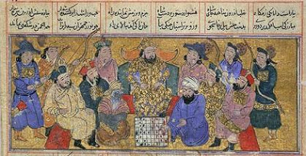
Exponential Growth
The simplest model for growth is to assume that the net per capita growth is density independent
The idea goes back many centuries
The courtier and the Persian king
Notes:
According to legend, a courtier presented the Persian king with a beautiful, hand-made chessboard. The king asked what he would like in return for his gift and the courtier surprised the king by asking for one grain of rice on the first square, two grains on the second, four grains on the third etc. The king readily agreed and asked for the rice to be brought. All went well at first, but the requirement for 2 n − 1 grains on the nth square demanded over a million grains on the 21st square, more than a million million (aka trillion) on the 41st and there simply was not enough rice in the whole world for the final squares.

Slide 4


Slide 5
Exponential Growth
This gives the sequence: 1,2,4,8,16,32,64,128,256,512, etc.
or 2⁰, 2¹, 2², 2³, 2⁴ etc
The courtier would get 18446744073709551615 grains of rice, that is about 5 x 10¹¹ metric tons, more than 500 times the current yearly global rice production!

Slide 6
grains
squares

Slide 7
Log₂[grains]
squares

Slide 8
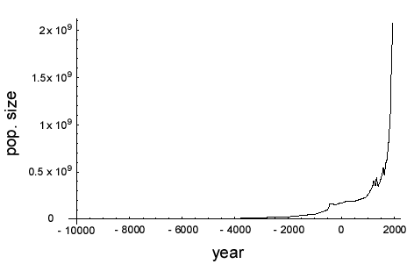
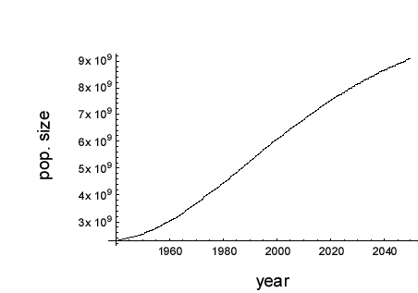
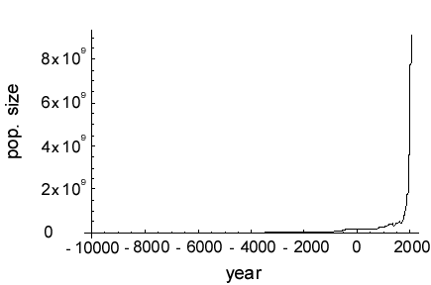
The growth of the human population

Slide 9
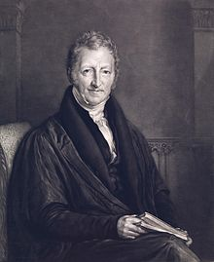
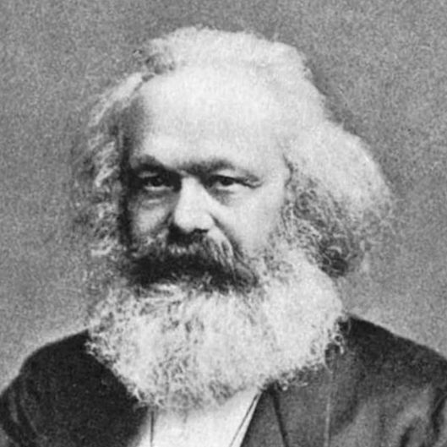
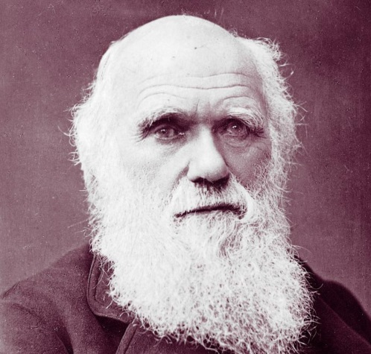
Human population growth
The end is nigh!
Does the human population grow exponentially? Can we characterise human population growth?
Malthus wrote an essay (1789) in which he claims that the human population grows geometrically (=exponentially)
The view has been very influential
The reverend Thomas Malthus
Revolution!
Marx
Evolution!
Darwin
Notes:
This claim still resonates today, see e.g. Albert Bartlett’s view on human population growth

Slide 10
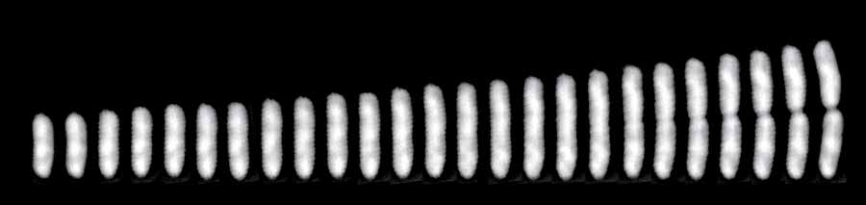
Bacterial population growth
A single E. coli cell dividing
Bacteria multiply by dividing in 2
So you get 1,2,4,8,16,32 etc bacteria
This is a geometric series (all terms powers of 2)
Notes:
http://ucsdnews.ucsd.edu/pressrelease/study_sheds_light_on_what_causes_cells_to_divide

Slide 11
Bacterial Growth
Absorbancy
Escherichia coli grown on minimal salts and complex medium
Time (mins)
Absorbancy
Time (mins)
http://biology.clc.uc.edu/fankhauser/labs/microbiology/growth_curve/growth_curve.htm

Slide 12
Humans vs Bacteria
Humans
Bacteria
Absorbancy
Time (mins)
Time (mins)

Slide 13
Do human and bacterial populations grow in the same way?
Obviously the time scale is different
But are the growth curves the same or different?
To find out we will build a simple model for exponential (geometric) growth, and see if Malthus was right.
Exponential!
The reverend Thomas Malthus

Slide 14
Exponential Population Growth
The size of the population at time point t is N_{t}
If we assume births and death rates are proportional to the size of the population:
Births = b N_{t}
Deaths = d N_{t}
This amounts to assuming that the probability of a person giving birth (or dying) is independent of population size.
b: per capita birth rate
d: per capita death rate

Slide 15
Exponential Growth (discrete time)
With a constant per capita birth and death rate we find a growth process similar to the accumulation of interest:
N_{t+1}-N_{t} =bN_{t}-dN_{t}=rN_{t} (r=b-d, is the net per capita growth rate)
or
N_{t+1}=(1+b-d) N_{t}=(1+r)N_{t}
General solution:
N_{t}=N₀(1+r)^{t}

Slide 16
Exponential growth (discrete time)
A simple prediction:
If growth is exponential then the logarithm of the population size increases linearly
where a=ln(N₀) and b=ln(1+r) .

Slide 17
Exponential Growth

Slide 18
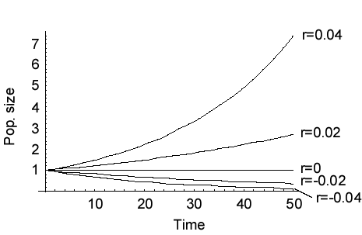
Exponential growth
The net growth rate r=b-d

Slide 19
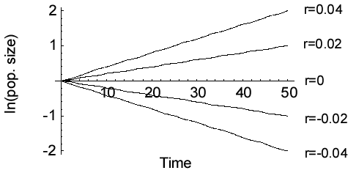
Exponential growth

Slide 20
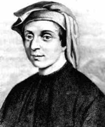
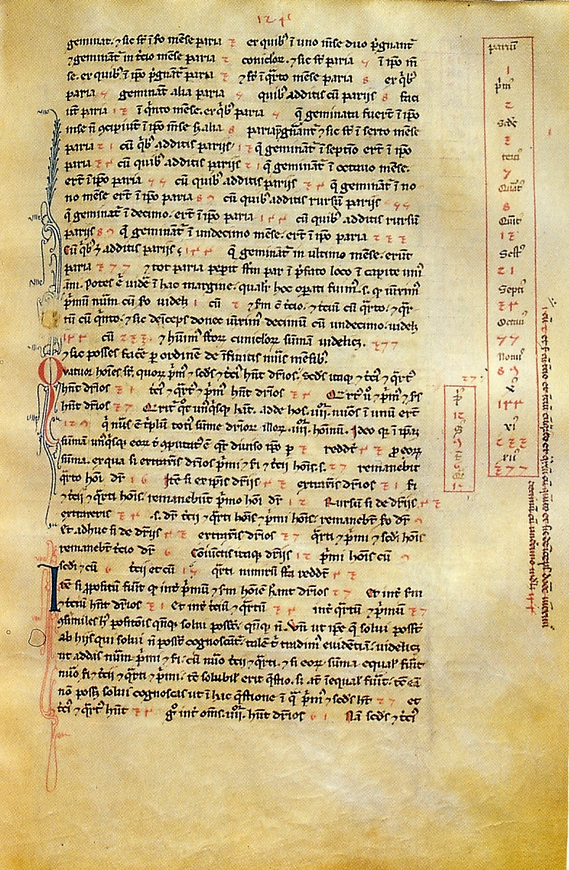
The Fibonacci sequence
Leonardo of Pisa (Fibonacci)
(c. 1170 – c. 1250)
Page from the Liber Abaci, with the Fibonacci sequence
Suppose a newly-born pair of rabbits, one male, one female, are put in a field. Rabbits are able to mate at the age of one month so that at the end of its second month a female can produce another pair of rabbits. Suppose that our rabbits never die and that the female always produces one new pair (one male, one female) every month from the second month on. How many pairs will there be in one year ?

Slide 21
The Fibonacci sequence
Leonardo of Pisa (Fibonacci)
(c. 1170 – c. 1250)
Suppose a newly-born pair of rabbits, one male, one female, are put in a field. Rabbits are able to mate at the age of one month so that at the end of its second month a female can produce another pair of rabbits. Suppose that our rabbits never die and that the female always produces one new pair (one male, one female) every month from the second month on. How many pairs will there be in one year ?

Slide 22
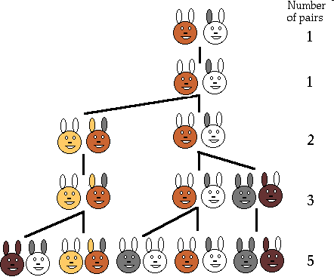
1,1,2,3,5,8,13,21,34,55,89,144

Slide 23
Fibonacci’s rabbits
ln[nr of rabbits]
time

Slide 24
Learning outcomes
Understand the discrete time exponential growth model and appreciate the assumptions it is based on

