Slide 1

1-2 Single species models, stability, metapopulations Exponential growth in continuous time
Vincent Jansen
vincent.jansen@rhul.ac.uk

Slide 2
Outline
1-1 Exponential Growth discrete time
1-2 Exponential Growth continuous time
1-3 Logistic growth, stability
1-4 Metapopulations

Slide 3
Bacterial Growth
Absorbancy
Escherichia coli grown on minimal salts and complex medium
Time (mins)
Absorbancy
Time (mins)
http://biology.clc.uc.edu/fankhauser/labs/microbiology/growth_curve/growth_curve.htm

Slide 4
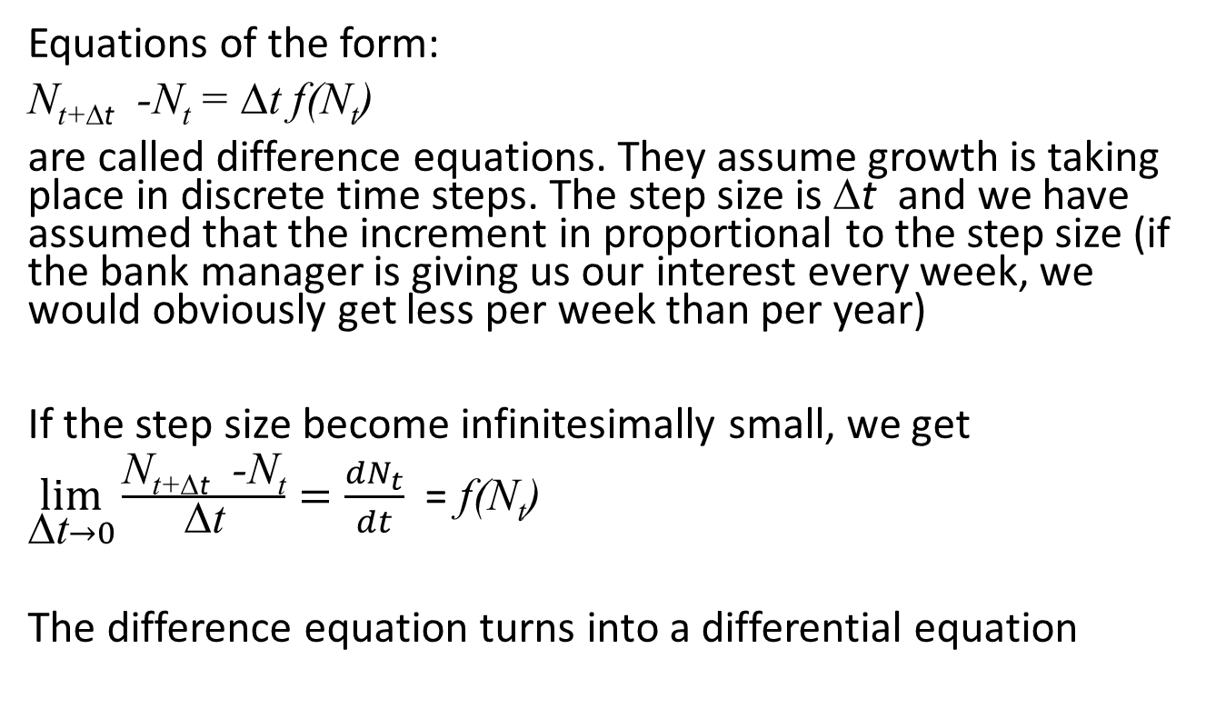
Exponential Growth (discrete time)
Equations of the form:
N_{t+Δt} -N_{t} = Δt f(N_{t})
are called difference equations. They assume growth is taking place in discrete time steps. The step size is Δt and we have assumed that the increment in proportional to the step size (if the bank manager is giving us our interest every week, we would obviously get less per week than per year)
If the step size become infinitesimally small, we get
$\lim_{\text{D}\text{t}→0}{\frac{\text{N}\text{t}\text{+}\text{D}\text{t} \text{−}\text{Nt}}{\text{D}\text{t}}}=\frac{dN_{t}}{dt}$ = f(N_{t})
The difference equation turns into a differential equation

Slide 5
Exponential growth (continuous time)
If we assume constant per capita birth and death rates:
Which can be rewritten as
where r=b-d is the per capita growth rate .
This is the exponential growth model for overlapping generations
b N – d N = (b - d) N
r N

Slide 6
Exponential growth in continuous time
r N
Previous examples were in discrete time
The differential equation
Can be solved to give:
Where N(0) is the population size at time t=0 and e is a constant (the base of the natural logarithm) with value ≈2.718

Slide 7
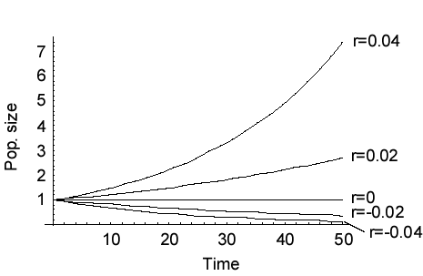
Exponential growth
The net growth rate r=b-d

Slide 8
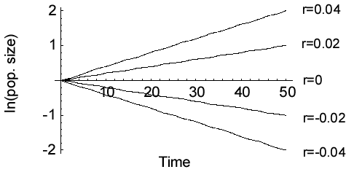
Exponential growth

Slide 9
Humans vs Bacteria analysed
So let’s see, do humans or bacterial populations show exponential (=geometric growth)?

Slide 10
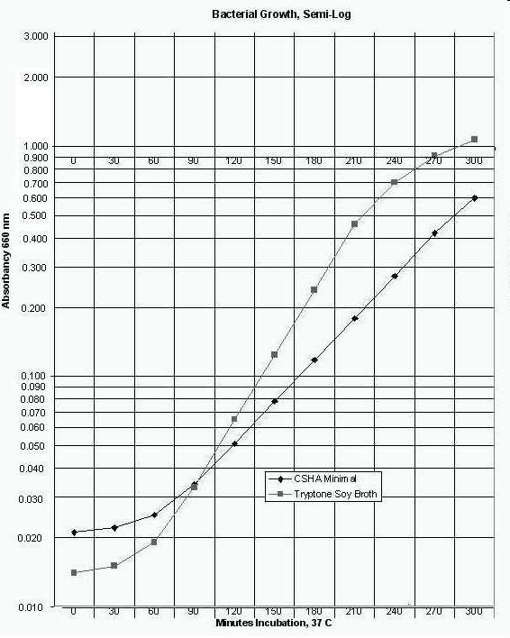
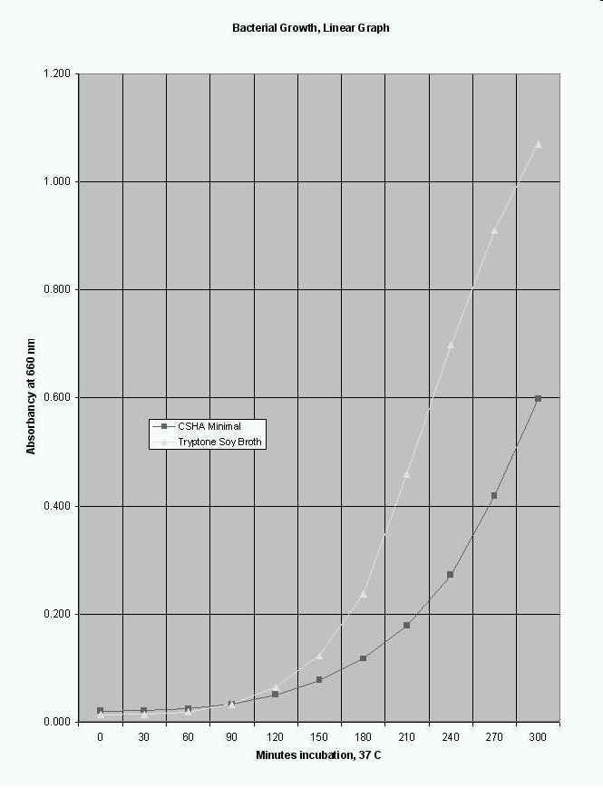
Example: Bacterial Growth
Escherichia coli grown on minimal salts vs complex media
http://biology.clc.uc.edu/fankhauser/labs/microbiology/growth_curve/growth_curve.htm

Slide 11
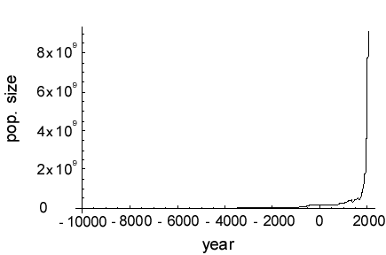
Human Population Growth

Slide 12
Growth Rate
We can use the exponential model to calculate per capita growth rates
If we measure the population at times 0 and T the model predicts:
Solving for r we find

Slide 13
Are growth rates constant for bacteria?
Simple medium
Complex medium
Growth rate
Time (mins)
Time (mins)

Slide 14
Are human population growth rates constant?

Slide 15
Doubling Time
This is also illustrated by the doubling time
For the human population doubling time was, over the last 12000 years, approx. 900 years
From 1950 until now it was approx. 35 years

Slide 16
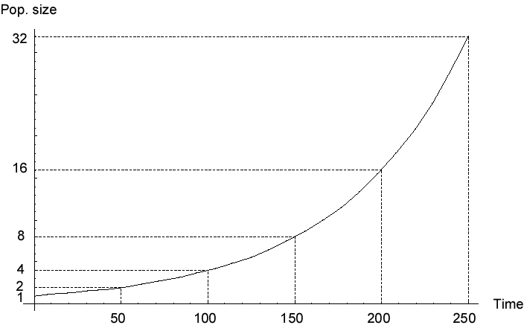
Doubling Time
In the exponential growth model the population sizes double in a given amount of time.
This is called the doubling time

Slide 17
Doubling Time
To calculate the doubling time we solve:
Solving for t_{double} we find:

Slide 18
Doubling Time
The doubling time of the bacterial population is about 50 mins.
For the human population it was, over the last 12000 years, approx. 900 years
From 1950 until now it was approx. 35 years

Slide 19
Density Dependence
For the exponential model we assumed the per capita growth rate is independent of the population size
Let’s see if that is correct

Slide 20
Are growth rates constant for bacteria?
Simple medium
Complex medium
Growth rate
Absorbancy (density)
Absorbancy (density)

Slide 21
Density Dependence in the Human population

Slide 22

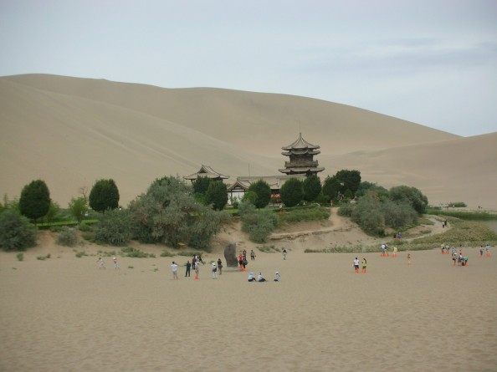
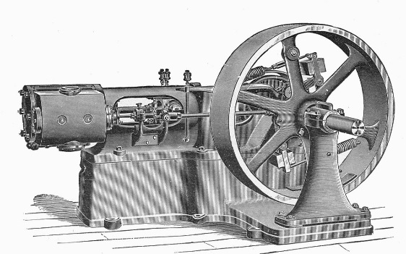

Density Dependence in the Human population
For big populations the growth rate declines with size
But initially the growth rate increased with sizes: the bigger the population got the better we did.
This is where Malthus went wrong: humans are not like bacteria, and we have not ran out of resources yet

Slide 23
Learning outcomes
Understand the continuous time exponential growth model and appreciate the assumptions it is based on

