Slide 1

2020-21 4-2 Predator-prey models, limit cycles, Hopf bifurcation The Lotka-Volterra predator-prey model
Vincent Jansen
vincent.jansen@rhul.ac.uk

Slide 2
Outline
4-1 Trophic Interactions, D’Ancona and Volterra
4-2 The Lotka-Volterra predator-prey model
4-3 Variations on the predator-prey theme
4-4 Spatial predator-prey interactions

Slide 3
Lotka-Volterra predator-prey model
The Lotka-Volterra predator-prey model is described by a system of 2 differential equations:

Slide 4
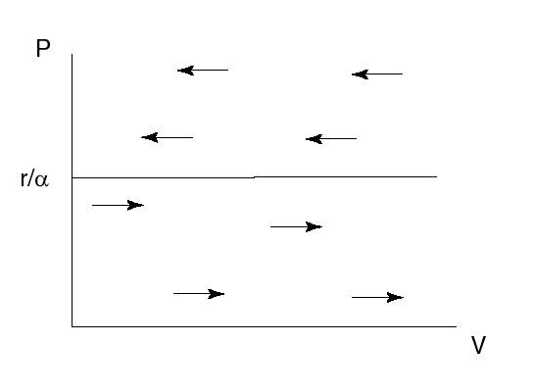
Lotka-Volterra predator-prey model
Prey dynamics if predator density is constant

Slide 5
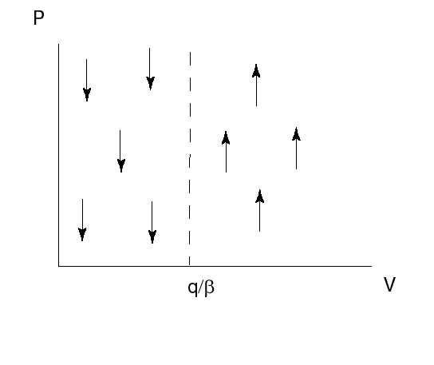
Lotka-Volterra predator-prey model
Predator dynamics if prey density is constant

Slide 6
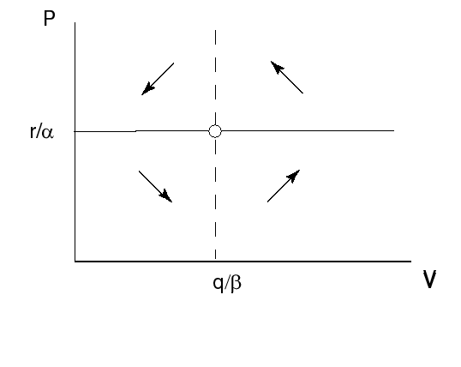
Lotka-Volterra predator-prey model
Combined isoclines

Slide 7
Lotka-Volterra predator-prey model
The prey equilibrium density is given by q/β: only depends on the parameters relating to the predator.
The predator equilibrium density is given by r/α only depends on the parameters relating to the prey.

Slide 8
Lotka-Volterra predator-prey model with fishery effort
If we assume that fish is caught with rate f, the model reads:
The prey equibrium is now V*=(q+f)/β
The predator equilibrium is now P*=(r-f)/α

Slide 10
Lotka-Volterra predator-prey model
A reduced fishing effort (directed at prey and predatory fish) will have two effects: it increases the predator’s equilibrium density and decreases the prey’s equilibrium density
This can explain D’Ancona’s observation why relatively more predator fish was caught after a reduced fishing effort

Slide 11
Lotka-Volterra predator-prey model, dynamics
Combined isoclines

Slide 12
Lotka-Volterra predator-prey model
The solutions oscillate over time, the amplitude depends on the initial condition much like the motion of a pendulum
Solution over time

Slide 13


Slide 14
Lotka-Volterra predator-prey model
r/α
q/β
Solution as an orbit in a phase plot

Slide 15
Stability
To find the stability we use the distance from the equilibrium x=V-V* and y=P-P* linearise the system, to find

Slide 16
Stability
After substituting the equilibrium values we find that the Jacobian matrix is
Is the equilibrium stable?

Slide 17

Stability
Determinant:$rq>0,$Trace: 0
On the brink of stability/instability
Eigenvalues are $±i \sqrt{rq}.$ A pair of complex eigenvalues with zero real part.

Slide 18
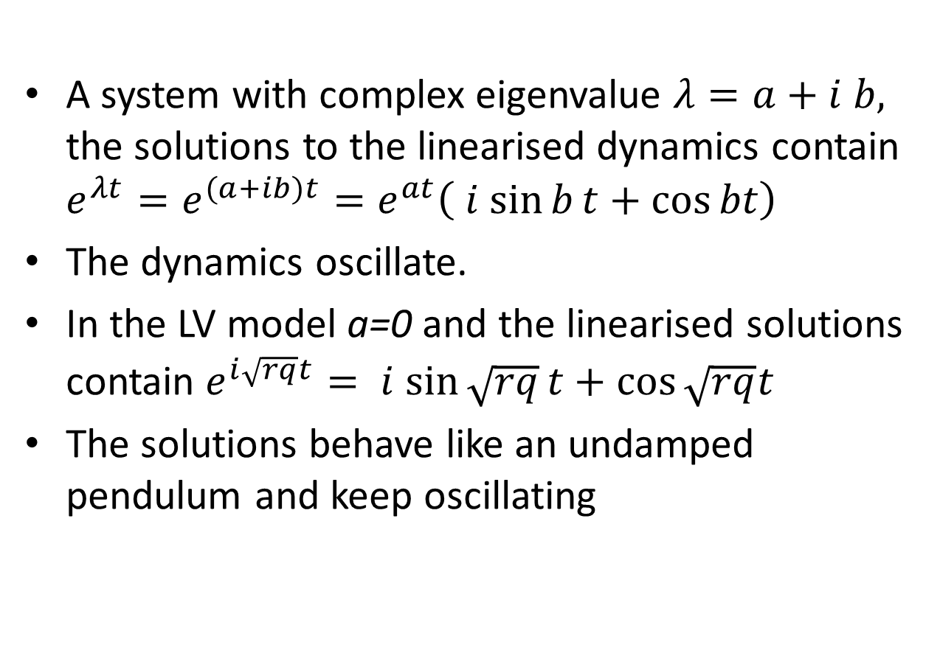
Stability
A system with complex eigenvalue $λ=a+i b,$ the solutions to the linearised dynamics contain $e^{λt}=e^{(a+ib)t}=e^{at}\left(i sin{b}t+\cos{bt}\right)$
The dynamics oscillate.
In the LV model a=0 and the linearised solutions contain $e^{i\sqrt{rq}t}=i sin{\sqrt{rq}}t+\cos{\sqrt{rq}t}$
The solutions behave like an undamped pendulum and keep oscillating

Slide 19
Stability
The model has a constant of motion:
Over one cycle, the value of H is constant.
If the starting point moves away from one cycle, after on revolution you are back to where you started, you remain the same distance from the other cycle
The cycles are therefore all neutrally stable.

Slide 20
Lotka-Volterra predator-prey model
Because the model is on the brink of stability/instability it is very sensitive to a change in the assumptions, slightly changing the assumptions will make (real part of) the eigenvalues +ive or -ive
For this reason it is said that the L-V predator-prey model is not robust

Slide 21
Lotka-Volterra predator-prey model
Assumptions of the model
No delays
No (age, spatial) structure
No prey density dependence
Constant prey capture rate

Slide 22
Learning outcomes
Understand the logic underlying the Lotka-Volterra predator model and its limitations

