Slide 1
1. Ancestral states and optimising data on trees

Slide 2
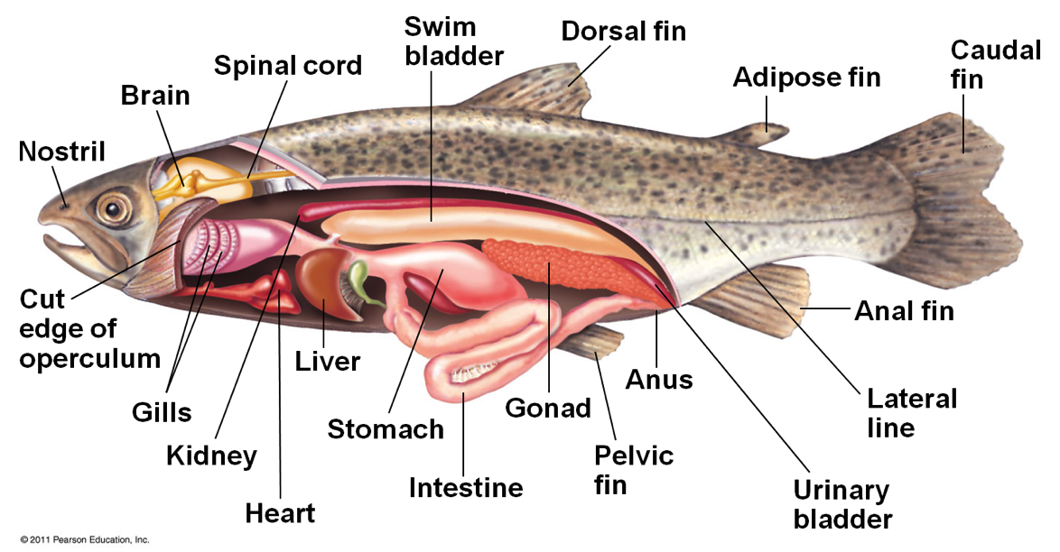
Which evolved first: the swim bladder or the lung?

Slide 3
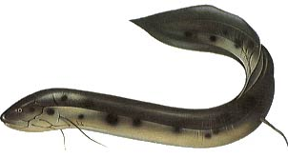
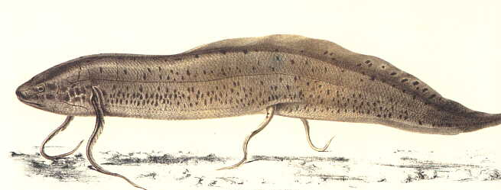
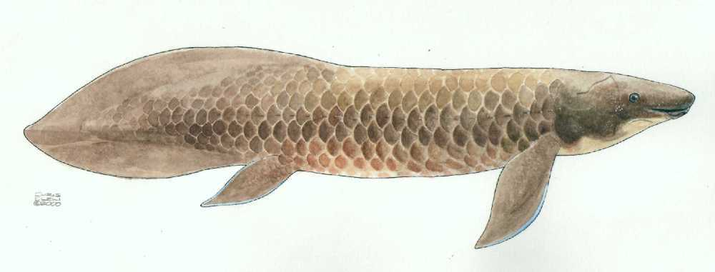
Lungfishes
Protopterus – 4 spp.
Africa
Lepidosiren paradoxa – from South America
Neoceratodus forsteri
Australia
Proper lobate fins
Notes:
The South American and African genera have little whip-like pectoral fins.

Slide 4
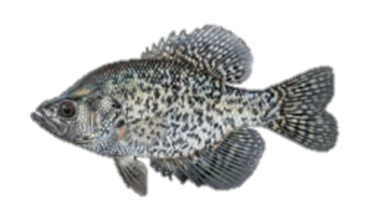
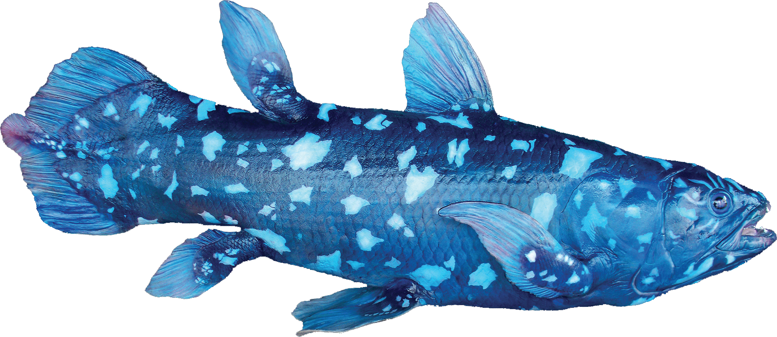
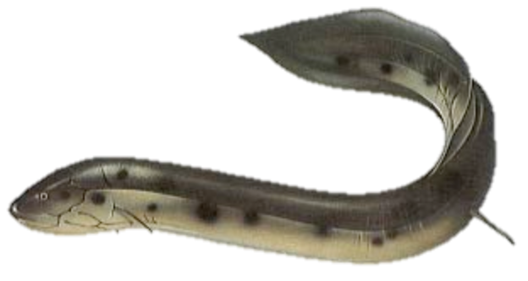


Slide 5
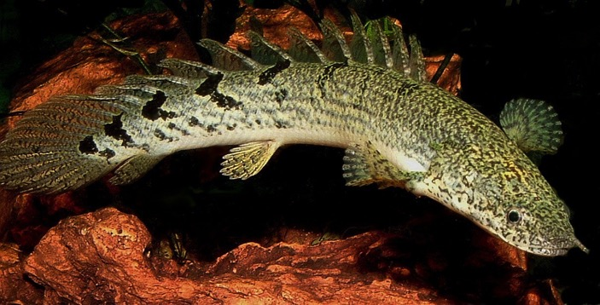
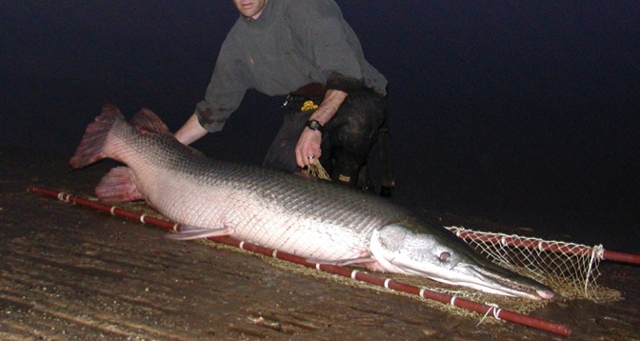
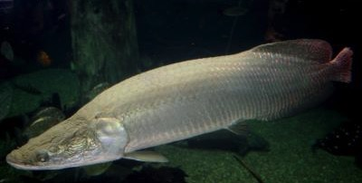
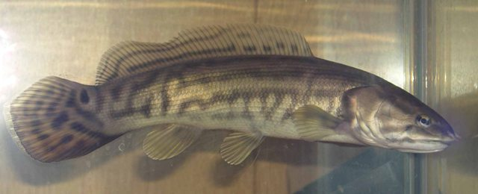
The air-breathing fishes
Air-breathing is very common among fishes
Bichir
Gar
Arapaima (a giant teleost)
Bowfin
Notes:
In fact, air breathing is common in bony fishes. We find it in both lobe-fins and ray-fins, suggesting it is a primitive feature for all bony vertebrates. In some species, it has re-evolved, in different forms.

Slide 6




Which evolved first: the swim bladder or the lung?
SB
Lung
Lung
Lung
Neither
Lung
SB

Slide 7
Which evolved first: the swim bladder or the lung?
SB
Lung
Lung
Lung
Neither
Lung
SB
Notes:
The sequence of synapomorphies is the sequence of the evolution of a character.

Slide 8
Part I. Parsimony (Semi-formally)

Slide 9
0
0
1
1
1
Notes:
Apply the data to the corresponding tips. Proceed downward from the tips towards the root.

Slide 10
Fitch downpass (postorder)
A
T
G
C
C
C
A
{C,G}
{A,C}
{C,G,T}
{C}
{C}
{A,C}
Notes:
Apply the data to the corresponding tips. Proceed downward from the tips towards the root.

Slide 11
Fitch downpass (postorder)
Construct preliminary ancestral state sequences
If descendant branches have common states:
Reconstruction is the intersection of those states
Otherwise:
Reconstruction is the union of those states

Slide 12
Fitch downpass (postorder)
Only provides a preliminary set of ancestral state reconstructions
Doesn’t account for information at deeper nodes (because the downpass hasn’t reconstructed them yet)
Final reconstructions requires bringing information up from the root.

Slide 13
Final estimate: Fitch uppass (preorder)
A
T
G
C
C
C
A
[C]
{C,G}
{A,C}
[C]
[C]
{C,G,T}
[C]
{C}
{C}
[C]
{A,C}
[A,C]
Notes:
Apply the data to the corresponding tips. Proceed downward from the tips towards the root.

Slide 14
Part II. Parsimony (formally)

Slide 15
The Sankoff method
More explicit
Matrix of transformation weights (‘costs’)
The Q matrix
 | A | C | G | T
A | - | 1 | 1 | 1
C | 1 | - | 1 | 1
G | 1 | 1 | - | 1
T | 1 | 1 | 1 | -

Slide 16
Minimising changes under Sankoff parsimony
The minimum length S of a character on a tree is
Which we compute for each node a using
Where:
l and r denote left and right descendants, respectively.
S₀ is the root node.
c_{ij} and c_{ik} are the cost of transitions from states i to j and i to k, respectively.
Notes:
This looks a lot worse than it is.

Slide 17
1
2
3
4
5
A
C
G
G
T
0 | ∞ | ∞ | ∞
∞ | 0 | ∞ | ∞
∞ | ∞ | 0 | ∞
∞ | ∞ | 0 | ∞
∞ | ∞ | ∞ | 0
1 | 1 | 2 | 2
2 | 2 | 1 | 1
3 | 3 | 1 | 2
 | A | C | G | T
A | - | 1 | 1 | 1
C | 1 | - | 1 | 1
G | 1 | 1 | - | 1
T | 1 | 1 | 1 | -
A | C | G | T
3 | 3 | 3 | 4

Slide 18
The Sankoff (matrix) method
We can, in effect, score a tree by considering all possible reconstructions at every single node.
Computationally intensive, but has some advantages.
For instance, varying character weights

Slide 19
Ordering expressed as a matrix
Unordered (Fitch)
Ordered (Wagner)
 | 0 | 1 | 2 | 3
0 | - | 1 | 1 | 1
1 | 1 | - | 1 | 1
2 | 1 | 1 | - | 1
3 | 1 | 1 | 1 | -
 | 0 | 1 | 2 | 3
0 | - | 1 | 2 | 3
1 | 1 | - | 1 | 2
2 | 2 | 1 | - | 1
3 | 3 | 2 | 1 | -

Slide 20
1
2
3
4
5
A
C
G
G
T
0 | ∞ | ∞ | ∞
∞ | 0 | ∞ | ∞
∞ | ∞ | 0 | ∞
∞ | ∞ | 0 | ∞
∞ | ∞ | ∞ | 0
 | A | C | G | T
A | - | 2.5 | 1 | 2.5
C | 2.5 | - | 2.5 | 1
G | 1 | 2.5 | - | 2.5
T | 2.5 | 1 | 2.5 | -
A | C | G | T
Notes:
We can change the weights, if we believe some transformations to be more costly than others.

Slide 21
Fitch vs. Sankoff
Fitch is intuitive
Fitch is computationally easier
Sankoff is more explicit
Allows for varying of weights

Slide 22
Part III. Models of Character Change
An intuitive look at going beyond parsimony

Slide 23
Branch lengths
The (mean) number of substitions/transformations along a branch
i.e. the number of synapomorphies supporting a node

Slide 24
Parsimony does not model time
0
0
1
1
1
1
0
0
In effect: a character’s weight diminishes over branch length
Notes:
Apply the data to the corresponding tips. Proceed downward from the tips towards the root.

Slide 25
Probability of change accumulates over time…
Classic Poisson process
P(no change)
t
Notes:
Follows the classic ‘waiting time’ model

Slide 26
Parsimony will therefore ‘miss’ (or overestimate) changes
1
1
0
1
1
0
1
1
1
1
0
0
0
0
0
Notes:
Apply the data to the corresponding tips. Proceed downward from the tips towards the root.

Slide 27
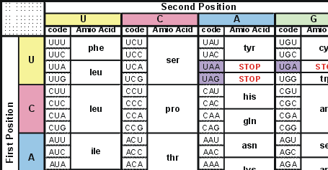
Models of evolutionary change
There might be some things we can know about evolution
We can set up ‘rules’ to constrain character evolution
Consider third codon positions

Slide 28
Non-coding DNA
Non-coding DNA is more likely to evolve neutrally
e.g introns vs. exons
So, it will evolve according to different “rules” than coding DNA

Slide 29
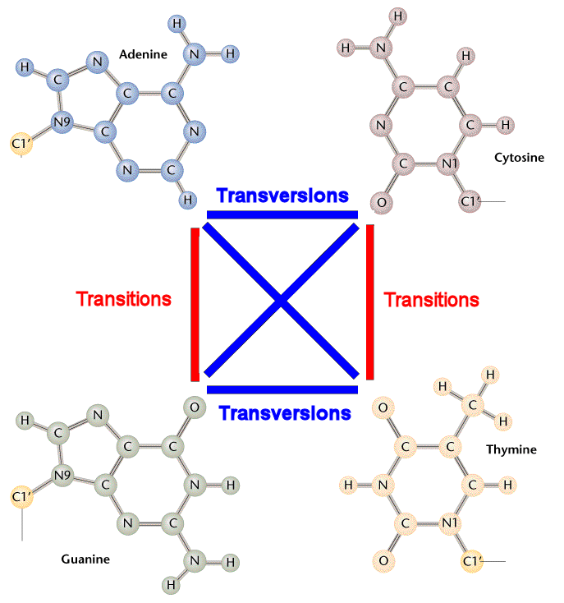
Transition/transversion ratios
Approx. 2/3 of single base polymorphisms are transitions
Changes within types are more frequent
i.e. pyr -> pyr more frequent than pyr->pur
And vice versa.

Slide 30
The Q matrix revisited
Now we can specify a maximum likelihood model of evolutionary change
Weights are, in effect, rates of change
 | A | G | C | T
A | - | 1 | 1 | 1
G | 1 | - | 1 | 1
C | 1 | 1 | - | 1
T | 1 | 1 | 1 | -
 | A | G | C | T
A | - | 0.5 | 0.2 | 0.5
G | 0.5 | - | 0.5 | 0.2
C | 0.2 | 0.5 | - | 0.5
T | 0.5 | 0.2 | 0.5 | -
Notes:
We can specify probabilities, but what does any of this mean? These probabilities are instantaneous rates, but they need some kind of scaling factor…

Slide 31
Real probabilities are rarely known
We therefore set constraints
Need to estimate parameter values
 | A | G | C | T
A | - | 0.2 | 0.5 | 0.2
G | 0.2 | - | 0.2 | 0.5
C | 0.5 | 0.2 | - | 0.2
T | 0.5 | 0.2 | 0.5 | -

Slide 32
Real probabilities are rarely known
We therefore set constraints
Need to estimate parameter values
E.g. Kimura two-parameter model
 | A | G | C | T
A | - | κ | 1 | 1
G | κ | - | 1 | 1
C | 1 | 1 | - | κ
T | 1 | 1 | κ | -
κ = transition/transvertion rate ratio
Notes:
This matrix acts as a constraint on the estimate of phylogeny.

Slide 33
More complicated models
µ is the instantaneous rate probability (usually drawn from a random distribution, e.g. gamma)
And π_{k} is the frequency of base k (i.e. A, C, G or T)

Slide 34
More complicated models
 | A | G | C | T
A | - | µaπ_{G} | µbπ_{C} | µcπ_{T}
G | µaπ_{A} | - | µdπ_{C} | µeπ_{T}
C | µbπ_{A} | µbπ_{G} | - | µfπ_{T}
T | µcπ_{A} | µeπ_{G} | µfπ_{c} | -

Slide 35
Calculating the likelihood of a tree
Calculate probabilities for all possible nucleotides (or states) at each node
Add them up.
A
C
G
G
T
0 | ∞ | ∞ | ∞
∞ | 0 | ∞ | ∞
∞ | ∞ | 0 | ∞
∞ | ∞ | 0 | ∞
∞ | ∞ | ∞ | 0
t₁
t₂
t₅
t₄
t₇
t₆
t₃
t₈
- | µaπ_{G} | µbπ_{C} | µcπ_{T}
µaπ_{A} | - | µdπ_{C} | µeπ_{T}
µbπ_{A} | µbπ_{G} | - | µfπ_{T}
µcπ_{A} | µeπ_{G} | µfπ_{c} | -

Slide 36
Conclusions
Ancestral state reconstructions allow us to use trees to infer past evolutionary states/episodes
Parsimony and likelihood methods intimately related
Likelihood allows explicit modelling of time dimensions
Likelihood methods allow for explicit models involving rates and the estimation of those parameters

