Slide 1



Modular Ontology Learning with Topic Modelling over Core Ontology
Presenter:
Authors:
Affiliations:
Date:
Ziwei XU
Ziwei XU, Mounira Harzallah,
Fabrice Guillet, Ryutaro Ichise
University of Nantes, LS2N, France;
National Institute of Informatics, Japan
4th-6th Sep 2019
23rd International Conference on Knowledge-Based and Intelligent Information & Engineering Systems (KES 2019)

Slide 2
OUTLINE
I
Introduction
II
Related work
III
Adaptation over LDA algorithm
IV
Experiments and results
V
Conclusion
Experiment and results
Notes:
Section3 includes:
Data preprocessing
Supportive information embedding
Twice trained LDA

Slide 3
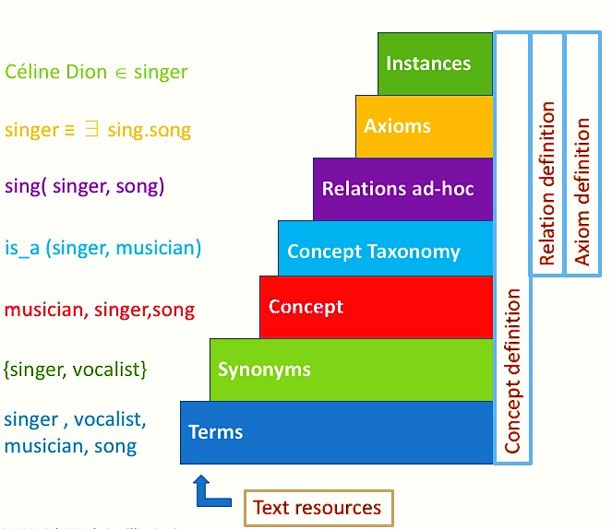
I. INTRODUCTION
--- i. Ontology learning from text
How to learn ontology from text?
Ontology Learning can perform manually, automatically or semi-automatically:
bottom-up approach
Top-down approach
Mixed approach
1
What is our focus in this paper?
2
Plain text → Noun Phrases (NPs) → Synonyms of NPs → Concept →
Concept Taxonomy
Ontology learning layer cake (Buitelar et al. 2005)
Notes:
To mention NPs

Slide 4
I. INTRODUCTION
--- ii. The interested scope(1/3)
This paper focuses on “domain ontology” and “core ontology”
Ontology building starts from core ontology (with core concepts), and directs at domain ontology
Core ontology is a basic and minimal ontology (core concepts and principle relations)
Core concepts
corresponds to the names of sub-domain
are expected to extended with sub-concepts, in order to define a taxonomy of each subdomain
Notes:
“domain ontology” and “core ontology”

Slide 5
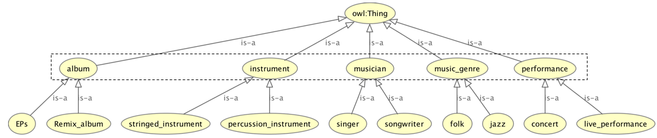
I. INTRODUCTION
--- ii. The interested scope(2/3)
sub concepts
core ontology
core concepts
Fig. 1: The core ontology and its sub concepts.
Notes:
Domain based /// how to deconsite the modules//… seperately decompise them separately, detail with them deeply. Ex. Human body (different sections). Separate to express and clear defination for module …

Slide 6
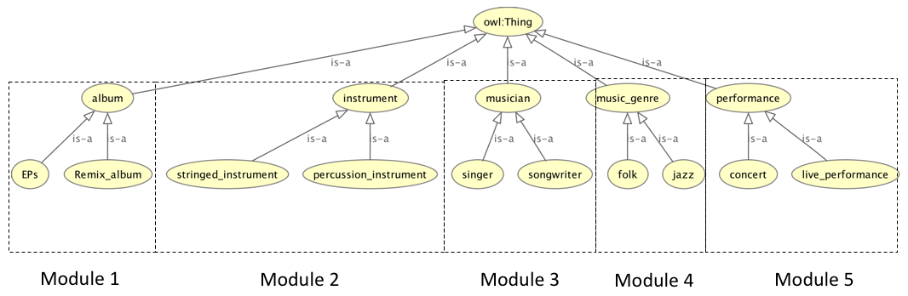
I. INTRODUCTION
--- ii. The interested scope(3/3)
Fig. 2: The domain modular ontology.
Notes:
Interst: the limiation and interests of module (isolate modules). Independent , even relations betweenm them, we can describe seprately. Fist blcoks then merge blocks. Hypernym relation… “song is intruments, in album”→ external relations, internal relation. That is why we start from here ..

Slide 7
I. INTRODUCTION
--- ii. The direction --- iii. Our proposal
Goals and Difficulties
Modular domain ontology learning
Goals:
1). To cluster the prominent terms of each subdomain.
2). To discover hypernym relations between terms in each subdomain.
The predicted difficulties:
How to label clusters to be close to the insights of subdomains?
1). To learn NPs clusters by the adapted topic modelling, twice-trained LDA.
2). To integrate the supportive knowledge embedding techniques with the topic models
3). To find the hypernym relations by morphology and contribute to build a modular ontology
Solutions and Methods
Notes:
Contribution: the fact to have NP extraction not word extraction. Supportive knowledge embedding. Topic modeling LDA. The “twice trained LDA” should detail later.

Slide 8
OUTLINE
I
Introduction
II
Related work
III
Adaptation over LDA algorithm
IV
Experiments and results
V
Conclusion
Experiment and results

Slide 9
II. RELATED WORK
(1/2)
1. Topic modeling participates in ontology learning:
1.Topic Modeling
to apply knowledge base with LDA[11]
to provide feature space of terms from LDA[18,22,24]
4. Domain Ontology
2. Clustering participates in ontology learning:
2. Clustering
k-means and affinity propagation [7, 13,23]
3. Relation Discovery
Gaps: use topic model for clustering
Difficulties: terms might belong to multiple clusters, not only one
Notes:
Put transition and pot highlight and focus. The end of slide to put reference directly.

Slide 10
II. RELATED WORK
(2/2)
3. Relation discovery participates in ontology learning:
1.Topic Modeling
4. Domain Ontology
pattern-based methods [8]
use ‘dependency path’ to rediscover the hand-designed patterns to learn hypernym relation [21]
use predefined hypernym relation on Wordnet [5]
Gap: hypernym discovery between noun phrases in specific domain are ignored
2. Clustering
4. Domain ontology :
3. Relation Discovery
to develop sub-domains by core concepts [1]
to develop sub-domain by topics [15]
Gap: The sub-domains are not enriched by related terms
Notes:
Gap 4 → supportive knowledge

Slide 11
OUTLINE
I
Introduction
II
Related work
III
Adaptation over LDA algorithm
IV
Experiments and results
V
Conclusion
Experiment and results
Notes:
Section3 includes:
Data preprocessing
Supportive information embedding
Twice trained LDA

Slide 12
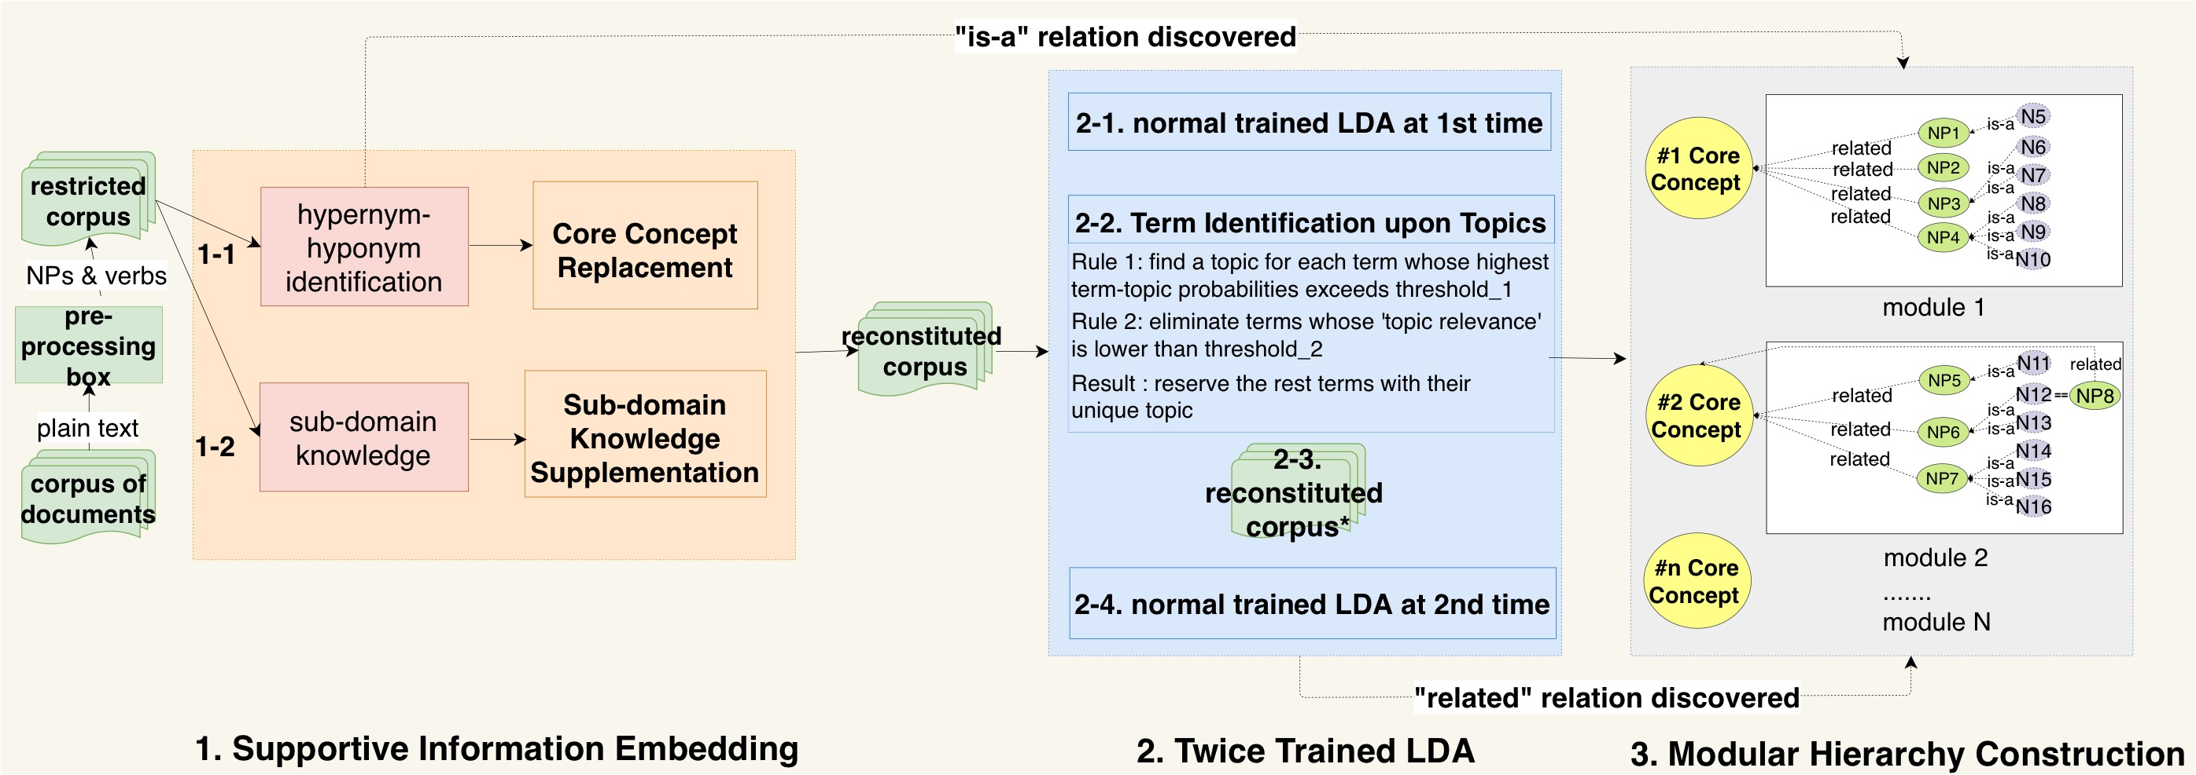
III. ADAPTATION OVER LDA
--- i. The workflow
Notes:
An example for a paragraph “ 1-1 and 1-2”. Even for the core concepts..

Slide 13
III. ADAPTATION OVER LDA
--- ii. Data preprocessing
Text
pre-processing
Corpus Reconstruction
Original Corpus
For each document, it includes:
a plain text
The supportive information(a core concept and a list of supportive terms)
One sentence from plain text:
In 2014, the DBSCAN algorithm was awarded the test of time award at the leading data mining conference KDD.
For each plain text:
only extract NPs as subject or object and their co-occurred verbs in sentences
stored into new separate documents, namely "restricted corpus”
After processing and reconstruction:
DBSCAN algorithm, award, the test of time award
restricted corpus
Notes:
Link to the previous graph (zoom out), more slide… and exanaole

Slide 14
III. ADAPTATION OVER LDA
--- i. The workflow
Notes:
An example for a paragraph “ 1-1 and 1-2”. Even for the core concepts..

Slide 15
III. ADAPTATION OVER LDA
--- iii. Supportive information embedding
(Approach 2):
to find terms and replace them by their related core concepts.
Advantages:
The size of vocabulary is reduced; the frequency of core concepts increase; …
In-text examples:
1). Core Concept Replacement
…kernel based entropy dimensionality reduction machine learning….
…parallelized c4.5 decision tree algorithm machine learning….
new corpus
(Approach 3):
to directly add a list of supportive terms to document
(Approach 4):
to replace those appending terms in Approach 3 by the related core concepts
….Validity index; Cross validation; Dimensionality reduction algorithm
….Machine learning; Machine learning; Machine learning
2). Subdomain
knowledge supplementation
Notes:
Examples.

Slide 16
III. ADAPTATION OVER LDA
--- i. The workflow

Slide 17
III. ADAPTATION OVER LDA
--- iv. Twice trained LDA
Notes:
2-1…. Matrix (in probabilties), two matrix and highligh t the terns for each threshold

Slide 18
OUTLINE
I
Introduction
II
Related work
III
Adaptation over LDA algorithm
IV
Experiments and results
V
Conclusion
Experiment and results

Slide 19
IV. EXPERIMENTS AND RESULTS
--- i. Experiments(1/2)
Purpose: to evaluate the data preparation and knowledge embedding techniques for term clustering
Procedures: to extract 4 different datasets from corpus and apply with 4 different approaches respectively.
Evaluation: use two metrics for term classification evaluation, e.g. precision and adjusted rand score.
The 4 different learned datasets, 4 different approaches and 2 learning methods
Approach1
Data as itself without transformation
Data1 (NPs*)
Data2 (NPs*+verbs)
Approach2
Normal
trained LDA
Core concept replacement over basics
Pre-processed Corpus
Data3 (NPs)
Data4 (NPs+verbs)
Approach3
Keywords supplementation over basics
Twice
trained LDA
Approach4
Both Approach2 and Approach3 over basics
* denotes the terms appearing in Gold Standard
Notes:
The * denotes the terms appearing in Gold Standard. Data-N means this dataset will be trained by normal LDA, while Data-T means this dataset will be trained by twice LDA.
Not data, “learned dataset”…. Delete last row. And define * /// no operation; as itself (data without tramsformation) ; supportive knowlrddhe for Approch 2 and 3/. Bracket with supportive knowledge…. Three colomn : 4 data, 4 approcha, 2 learned methods

Slide 20
IV. EXPERIMENTS AND RESULTS
--- i. Experiments(2/2)
Number of topics: 50
The confidence of experiments :
Iteration of experiments: 10 times
Value for evaluation: mean value over 10 iterations
Partition of dataset:
the 80% datasets serves for label prediction of clustering;
the rest 20% is used for evaluation
Index of evaluation:
Adjusted Rand Index[10]: it measures the agreement between two partitions.
If agree perfectly, the value will reach 1, otherwise 0.
Precision: it presents intuitively the proportion of true labeled terms
The higher the value, the partitions are more similar to Gold Standard.
Notes:
How much times for each lerning and mean value presentated. How to computer rand score between …. The number of topics before that. LDA process them at the beginning. Cross validation we use. The part of dataset, validate the rest. Labelling from gold standard. Add another slide bfore explaing the results.
80% → prediction based on GS
20% → human evaluation for no-label terms, whether their new predicted label is consist with human beings knowledge.

Slide 21
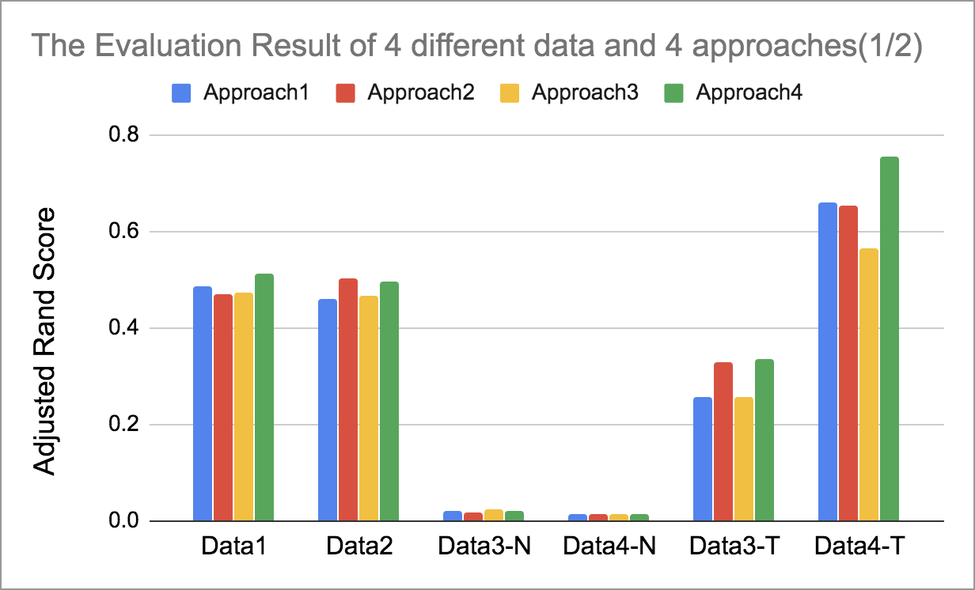
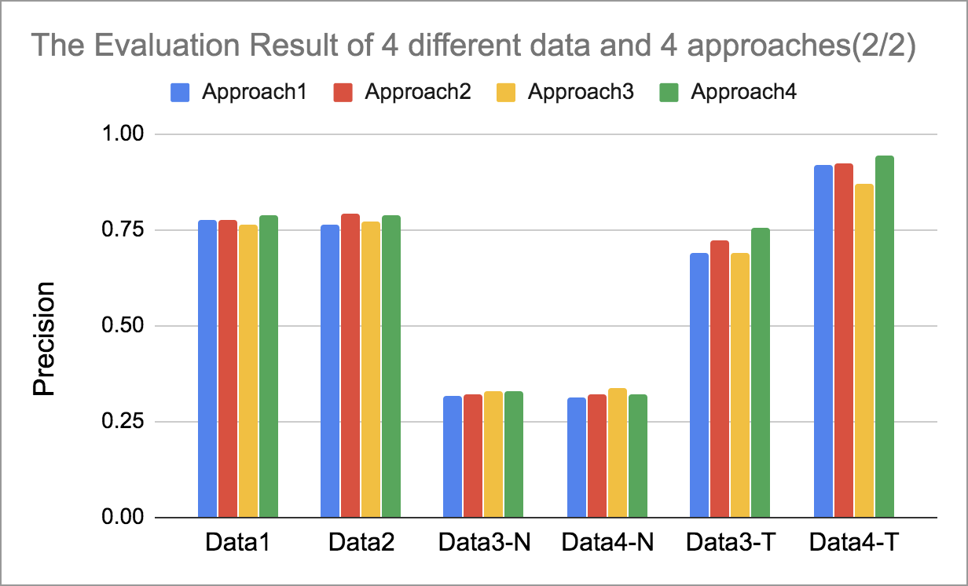
IV. EXPERIMENTS AND RESULTS
--- ii. Results(1/2)
The twice trained LDA strategy can effectively identify terms into partitions,
with around twice increase in precision than that of normal LDA training.
The combination of core concept replacement technique and subdomain knowledge
supplementation contributes the significant improvement in modular taxonomic
hierarchy construction of subdomains.
Notes:
Dataset3 vs data4 ,, with vernbs.
The different approaches (blue vs red …)
The composition of data (Data1 vs Data2)
Normal trained LDA vs. Twice trained LDA (Data#-N vs Data#-T )

Slide 22
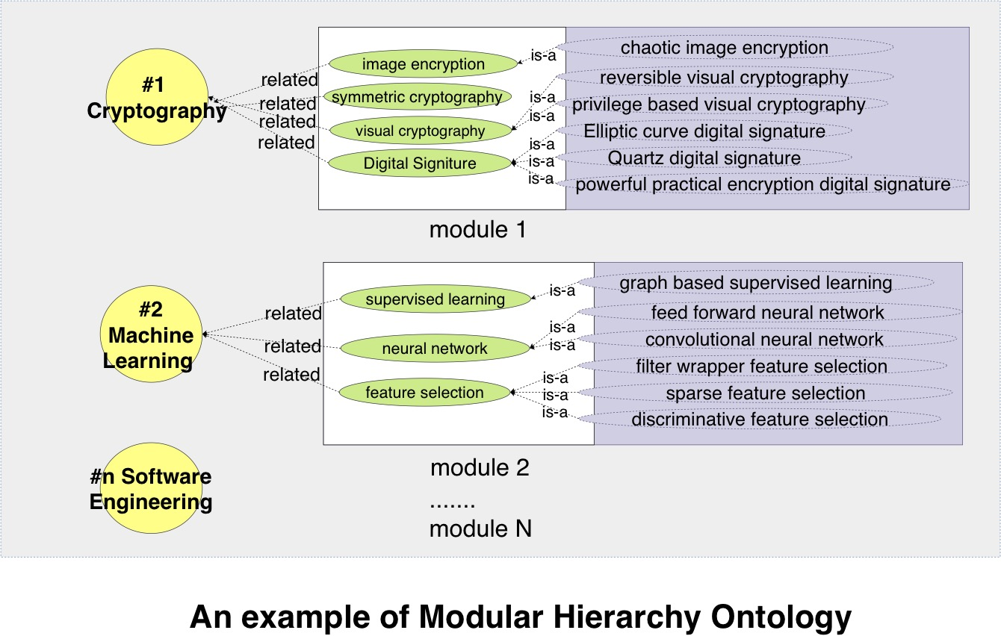
IV. EXPERIMENTS AND RESULTS
--- ii. Results(2/2)
Notes:
Domain + keywords:
Cryptography : digital signature (elliptic curve digital signature algorithm; quartz digital signature scheme; powerful practical encryption digital signature scheme)
elliptic curve cryptography
visual cryptography …
Machine learning:
supervised learning
Unsupervised learning
Label learning
Kernel learning
Software engineering:
Multi-agent system
Model transformation
Process assessment
…

Slide 23
OUTLINE
I
Introduction
II
Related work
III
Adaptation over LDA algorithm
IV
Experiments and results
V
Conclusion
Experiment and results

Slide 24
The results show that (1/2):
The twice trained LDA strategy can effectively identify terms into partitions, with around twice increase in precision than that of normal LDA training.
V. CONCLUSION
The results show that (2/2):
The combination of core concept replacement technique and subdomain knowledge supplementation contributes the significant improvement in modular taxonomic hierarchy construction of subdomains.
OUR PROPOSAL
We employ twice trained LDA to identify terms into subdomains:
1). apply supportive information embedding techniques to LDA training, for term clustering and concept discovery.
2). use the hypernym relations of subdomains to construct a modular taxonomic hierarchy.
Future work:
identify the ad-hoc relation inside each module
find some links between subdomains to organize a more sophisticated and interrelated ontology.
Notes:
Result prove → result shows ; copy these 1 and 2 into the result presentation . Before conlusion, in experiment part, modulat hierarchy conslusion : give the examples for theat modulat ontology (1 or 2 clusters)

Slide 25
Reference
[1] Besbes,G.,Baazaoui-Zghal,H.,2015.Modularontologiesandcbr-basedhybridsystemforwebinformationretrieval.MultimediaTools and Applications 74, 8053–8077.
[5] Dey,K.,Shrivastava,R.,Kaushik,S.,2016.Aparaphraseandsemanticsimilaritydetectionsystemforusergeneratedshort-textcontent
on microblogs, pp. 2880–2890.
[7] Frey,B.J.,Dueck,D.,2007.Clusteringbypassingmessagesbetweendatapoints.science315,972–976.
[8] Hearst,M.A.,1992.Automaticacquisitionofhyponymsfromlargetextcorpora,AssociationforComputationalLinguistics.pp.539–545.
[10] Hubert,L.,Arabie,P.,1985.Comparingpartitions.Journalofclassification2,193–218.
[11] Kim,D.,Wang,H.,Oh,A.,2013.Context-dependentconceptualization,AAAIPress.pp.2654–2661.
[13] Louge,T.,Karray,M.H.,Archimède,B.,2018.Investigatingamethodforautomaticconstructionandpopulationofontologiesforservices:
Performances and limitations, in: 2018 IEEE/ACS 15th International Conference on Computer Systems and Applications (AICCSA), IEEE.
pp. 1–6.
[15] Mustapha, N.B., Aufaure, M.A., Zghal, H.B., Ghezala, H.B., 2012. Modular ontological warehouse for adaptative information search,
Springer. pp. 79–90.
[18] Rani,M.,Dhar,A.K.,Vyas,O.,2017.Semi-automaticterminologyontologylearningbasedontopicmodeling.EngineeringApplications
of Artificial Intelligence 63, 108–125.
[21] Snow,R.,Jurafsky,D.,Ng,A.Y.,2005.Learningsyntacticpatternsforautomatichypernymdiscovery,in:Advancesinneuralinformation
processing systems, pp. 1297–1304.
[22] Wang,W.,Barnaghi,P.M.,Bargiela,A.,2011.Learningskosrelationsforterminologicalontologiesfromtext,IGIGlobal.pp.129–152.
[23] XU,Z.,Harzallah,M.,Guillet,F.,2018.Comparingoftermclusteringframeworksformodularontologylearning,SCITEPRESS-Science
and Technology Publications, Seville, Spain. pp. 128–135.
[24] Yeh,J.h.,Yang,N.,2008.Ontologyconstructionbasedonlatenttopicextractioninadigitallibrary,Springer.pp.93–103.

Slide 26
Thank you
Notes:
Give my contact ;
Give the labels of my affiliations

