Slide 1
NEURAL NETWORKS
Insert Instructor Name
Title, Company

Slide 2
LEARNING OBJECTIVES
PROGRESSING IN YOUR DATA SCIENCE CAREER
Neural Networks concept
Perceptrons and sigmoid neurons
Neural Networks architecture
CNN

Slide 3
COURSE
PRE-WORK

Slide 4
PRE-WORK REVIEW
Define the data science workflow
Apply course information to your own professional interests

Slide 5
OPENING
WHAT ARE NEURAL NETWORKS

Slide 6
NEURAL NETWORKS
Neural Networks model the brain and the nervous system
Neural networks, a beautiful biologically-inspired programming paradigm which enables a computer to learn from observational data
Neural networks and deep learning currently provide the best solutions to many problems in image recognition, speech recognition, and natural language processing
An Artificial Neural Network (ANN) is an information processing paradigm that is inspired by the biological nervous systems, such as the human brain’s information processing mechanism.

Slide 7
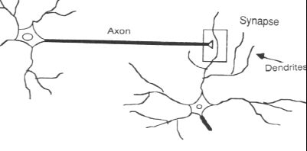
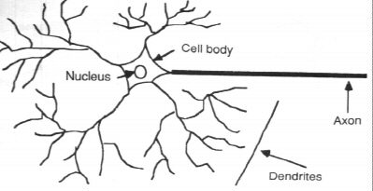
NEURAL NETWORKS
In the human brain, a typical neuron collects signals from others through a host of fine structures called dendrites.
The neuron sends out spikes of electrical activity through a long, thin stand known as an axon, which splits into thousands of branches.
At the end of each branch, a structure called a synapse converts the activity from the axon into electrical effects that inhibit or excite activity in the connected neurons.

Slide 8
INTRODUCTION
PERCEPTRONS AND SIGMOID

Slide 9
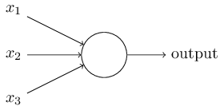
PERCEPTRONS
Perceptrons are type of artificial neuron were developed in the 1950s and 1960s by the scientist Frank Rosenblatt, inspired by earlier work by Warren McCulloch and Walter Pitts
A perceptron takes several binary inputs, x1,x2,…, and produces a single binary output

Slide 10
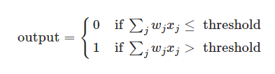
PERCEPTRONS
Rosenblatt proposed a simple rule to compute the output. He introduced weights, w1,w2,… real numbers expressing the importance of the respective inputs to the output
The neuron's output, 0 or 1, is determined by whether the weighted sum ∑jwjxj is less than or greater than some threshold value (a parameter of the neuron)

Slide 11
PERCEPTRONS
For example suppose the weekend is coming up, and you've heard that there's going to be a cheese festival in your city. You like cheese, and are trying to decide whether or not to go to the festival. You might make your decision by weighing up three factors:
Is the weather good?
Does your boyfriend or girlfriend want to accompany you?
Is the festival near public transit? (You don't own a car).
We can represent these three factors by corresponding binary variables x1,x2 and x3. For instance, we'd have x1=1 if the weather is good, and x1=0 if the weather is bad and so on.

Slide 12
PERCEPTRONS
Suppose you absolutely adore cheese, but perhaps you really loathe bad weather, and there's no way you'd go to the festival if the weather is bad
One way to model this is to choose a weight w1=6 for the weather, and w2=2 and w3=2 for the other conditions.
Finally, suppose you choose a threshold of 5 for the perceptron. With these choices, the perceptron implements the desired decision-making model, outputting 1 whenever the weather is good, and 0 whenever the weather is bad

Slide 13
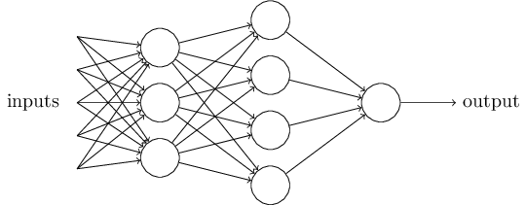
PERCEPTRONS
When choosing a threshold of 3, then the perceptron would decide that you should go to the festival whenever the weather was good or when both the festival was near public transit and your boyfriend or girlfriend was willing to join you

Slide 14

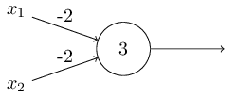
PERCEPTRONS
The first change is to write ∑jwjxj as a dot product, w⋅x≡∑jwjxj, where w and x are vectors whose components are the weights and inputs, respectively.
The second change is to move the threshold to the other side of the inequality, and to replace it by what's known as the perceptron's bias, b≡−threshold. You can think of the bias as a measure of how easy it is to get the perceptron to output a 1

Slide 15
NEURAL NETWORKS LEARNING
Suppose we have a network of perceptrons that we'd like to use to classify handwriting digits.
The inputs to the network might be the raw pixel data from a scanned, handwritten image of every digit.
We'd like the network to learn weights and biases so that the output from the network correctly classifies the digit

Slide 16
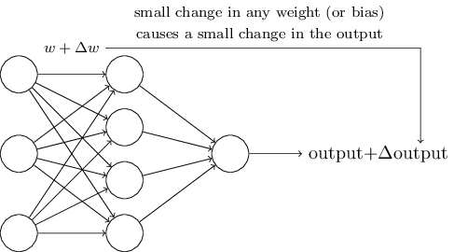
NEURAL NETWORKS LEARNING
In order to make the network learn, a small change in some weight or bias will be forward propagated to the output and cause a small change
we could use this fact to modify the weights and biases to get our network learn the desired output when training the network

Slide 17
SIGMOID NEURON
Perceptrons don’t allow this to happen as small change in the weights or bias of any single perceptron in the network can sometimes cause the output of that perceptron to completely flip, say from 0 to 1.
That’s why we need to introduce new type of neurons called sigmoid neurons which is similar to perceptrons in sense of having inputs, weights, bias and output
The difference is that the input can take values between 0 and 1 instead of either 0 or 1

Slide 18



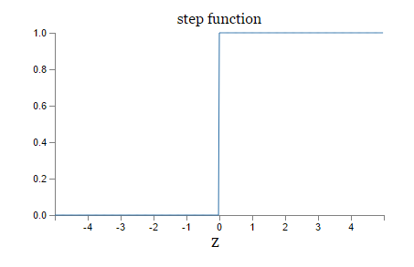
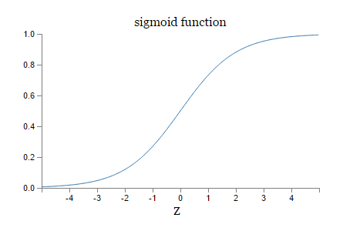
SIGMOID NEURON
The output of sigmoid neuron is based on the function which is called the sigmoid function and is defined:

Slide 19
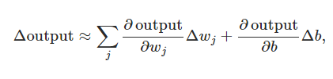
SIGMOID NEURON
The smoothness of σ means that small changes Δwj in the weights and Δb in the bias will produce a small change Δoutput in the output from the neuron.
Δoutput is a linear function of the changes Δwj and Δb in the weights and bias

Slide 20
INTRODUCTION
NEURAL NETWORK ARCHITECUTRE

Slide 21
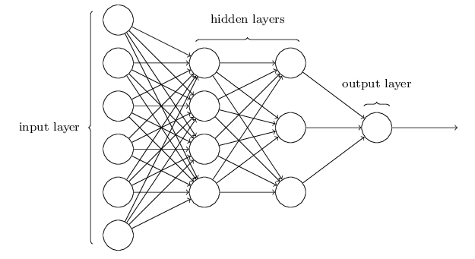
NEURAL NETWORK ARCHITECTURE
Neural networks consist of set of layers. Those layers can be classified as:
Input layer
Hidden layer
Output layer

Slide 22
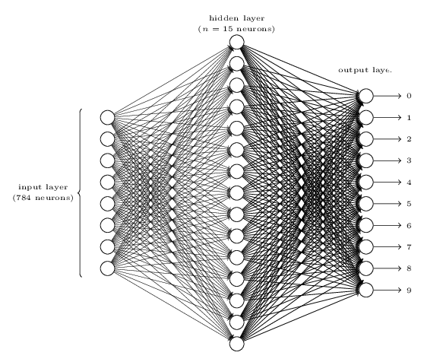
NEURAL NETWORK ARCHITECTURE
Going back to the handwritten digits recognition example, we have to classify the digit image where the input is an image of 28*28 pixels (784 neurons) and the output is one of the numbers (0 → 9)

Slide 23

LEARNING WITH GRADIENT DESCENT
We have the following cost function (also known as the mean squared error MSE)
The aim of the training algorithm will be to minimize the cost C(w,b)
Minimizing can be done using Gradient Descent approach which tries to find the global minimum of the cost function C

Slide 24


LEARNING WITH GRADIENT DESCENT
We will replace the tuple (w,b) with v so the cost function is C(v)
Suppose we have only two neurons v1,v2. Small changes in each one of them cause small change in the cost function
We want to choose Δv1 and Δv2 so as to make ΔC negative. To figure out how to make such a choice it helps to define Δv to be the vector of changes in v, Δv≡(Δv1,Δv2)^{T}
We'll also define the gradient of CC to be the vector of partial derivatives

Slide 25


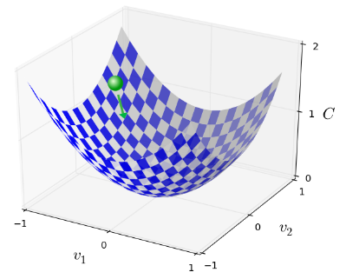
LEARNING WITH GRADIENT DESCENT
Based on what we have defined so far ΔC can be defined as the following
We can choose Δv to be as where η is a small positive parameter (known as the learning rate).

Slide 26
LEARNING WITH GRADIENT DESCENT
Computing the gradient of the cost function can be done using an algorithm called backpropagation which is an expression for the partial derivative ∂C/∂w of the cost function C with respect to any weight w (or bias b).
Ultimately calculating the partial derivatives ∂C/∂w^{l}_{jk} and ∂C/∂b^{l}_{j} for each individual neuron (neuron j at layer l and k at layer l-1)
We first introduce an intermediate quantity, δ_{j}^{l}, which we call the contribution in error of the j^{th} neuron in the l^{th} layer. Backpropagation will give us a procedure to compute the error δ^{l}_{j} and then will relate δ_{j}^{l} to ∂C/∂w^{l}_{jk} and ∂C/∂b^{l}_{j}

Slide 27
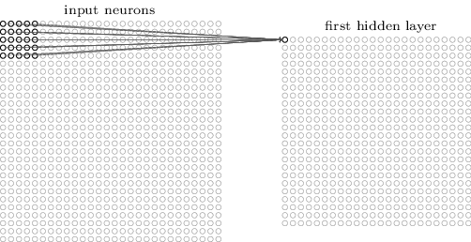
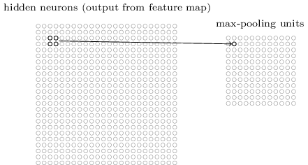
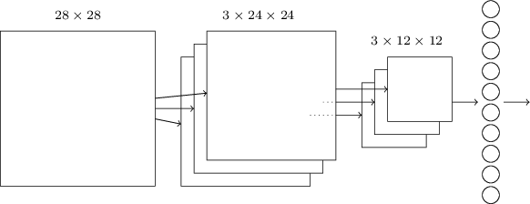
CONVOLUTIONAL NEURAL NETWORKS
Multiple local receptive fields (filters or kernels)
Shared weights and biases cross hidden neurons
Pooling layers (mainly max-pooling)

Slide 28
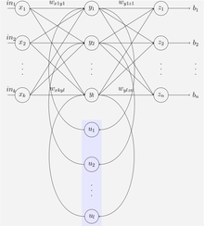
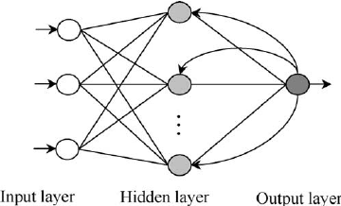
RECURRENT NEURAL NETWORKS
(RNN) is a class of artificial neural network where connections between units form a directed cycle. This creates an internal state of the network which allows it to exhibit dynamic temporal behavior

Slide 29
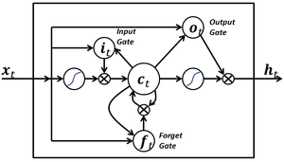
LSTM
LSTM: Is a recurrent neural network (RNN) architecture. Unlike traditional RNNs, an LSTM network is well-suited to learn from experience to classify, process and predict time series when there are time lags of unknown size and bound between important events.
LSTM blocks contain three or four "gates“
Input gate
Output gate
Forget gate

Slide 30
CONCLUSION
TOPIC REVIEW

Slide 31
CONCLUSION
Neural Networks concept
Perceptrons and sigmoid neurons
Neural Networks architecture
CNN
RNN and LSTM

Slide 32
COURSE
BEFORE NEXT CLASS

Slide 33
DUE DATE
BEFORE NEXT CLASS
Project: Final Project, Part 5!!

Slide 34
LESSON
CREDITS

Slide 35
CITATIONS
THANKS FOR THE FOLLOWING
Title, Author: link
Title, Author: link
Title, Author: link

Slide 36
LESSON
Q & A

Slide 37
LESSON
EXIT TICKET
DON’T FORGET TO FILL OUT YOUR EXIT TICKET

Slide 38
THANKS!
NAME
Body Level One
Body Level Two
Body Level Three
Body Level Four
Body Level Five
Body Level One
Body Level Two
Body Level Three
Body Level Four
Body Level Five
Optional Information:
Email?
Website?
Twitter?

