Slide 1

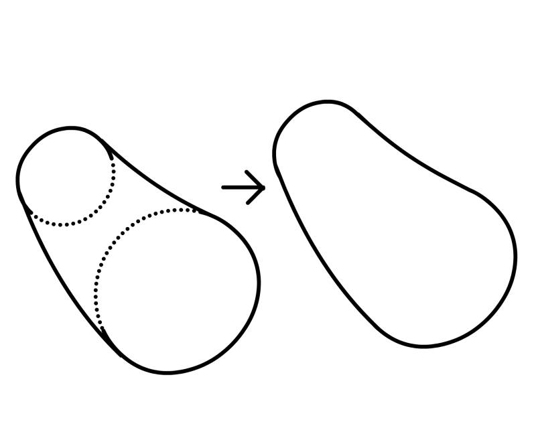
rookery.com

Slide 2
Mail Client
An E-mail client, or more formally known as Mail User Agent is an application which is used to check mails.
Through this Mail Client, user can check mails and send mails inside and outside the domain.
Web Mail client provides functionality to user to check mails without downloading them.
User can access their account from any computer which has internet connection.

Slide 3
Multipurpose Internet Mail Extensions
MIME protocol is used to add attachment facility in mail client.
Mail will be send by composition of SMTP and MIME protocols.
MIME protocol will convert data in appropriate format so that client can send files across internet.

Slide 4
Simple Mail Transfer Protocol
SMTP is an internet protocol which is used for E-mail transmission across internet.
SMTP is specified for outgoing mail transport and uses TCP port 25.
SMTP is last updated by RFC 5321, which includes the extended SMTP.

Slide 5
Internet Message Access Protocol
IMAP is used to retrieve mails from server.
The current version IMAP4rev1 is defined by RFC 3501.
IMAP allows to retrieve E-mail from server. Client can check mails by sending request to server.
Messages can be deleted directly from server, so cleaning up of mailbox will be easier for user.

Slide 6
Some Methods from JavaMail API
Store.Connect(hostname,username,password); used for opening the connection with the store of the particular user, used when authenticating the user
Transport.connect(host,username,password);used to connect to the server for sending the mail.
Transport.sendMessage(message,message.getAllRecipents());used to sending the mails to specified recipents.

Slide 7
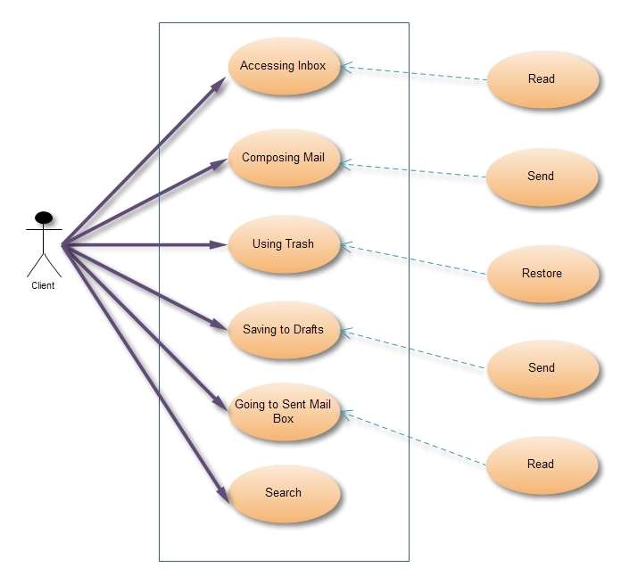
Use Case Diagram

Slide 8
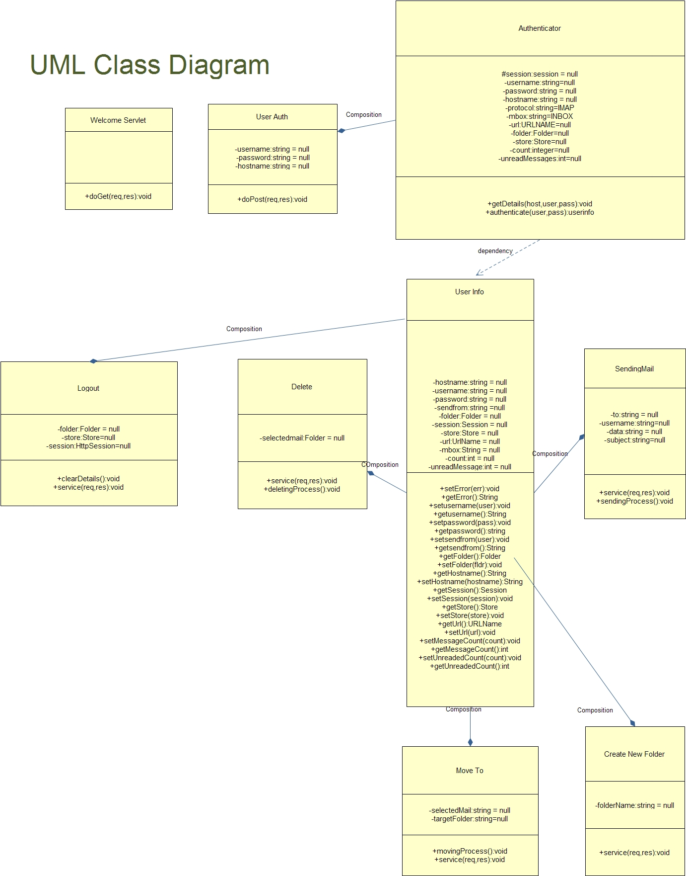

Slide 9
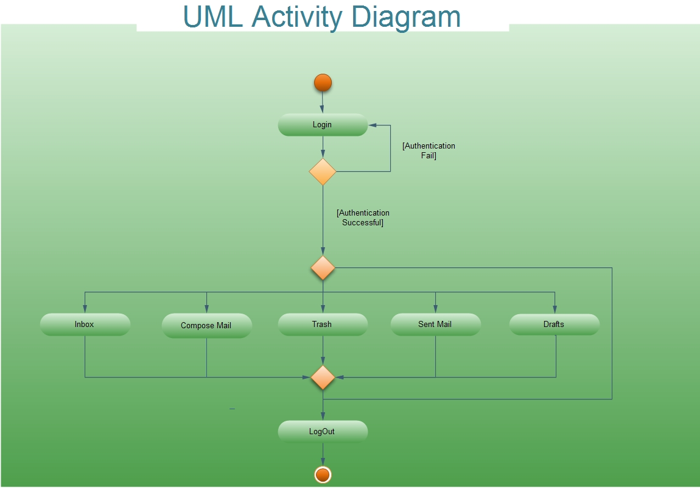
LOGIN ACTIVITY DIAGRAM

Slide 10
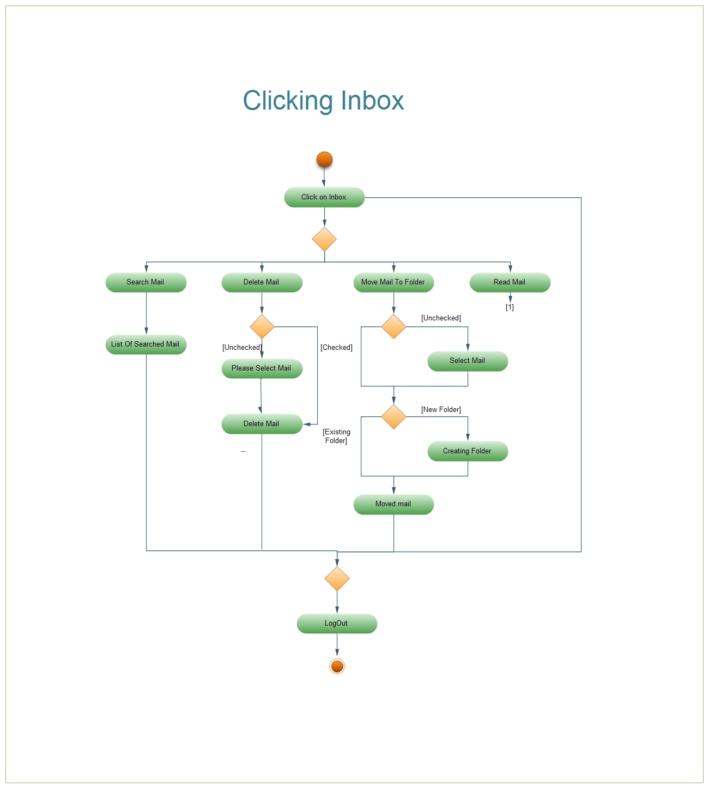

Slide 11
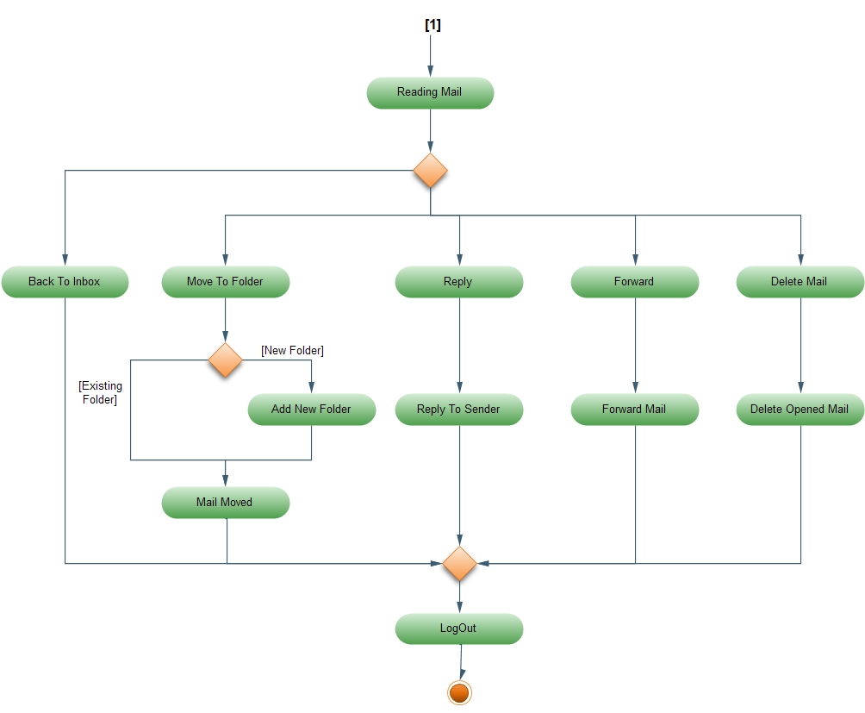

Slide 12
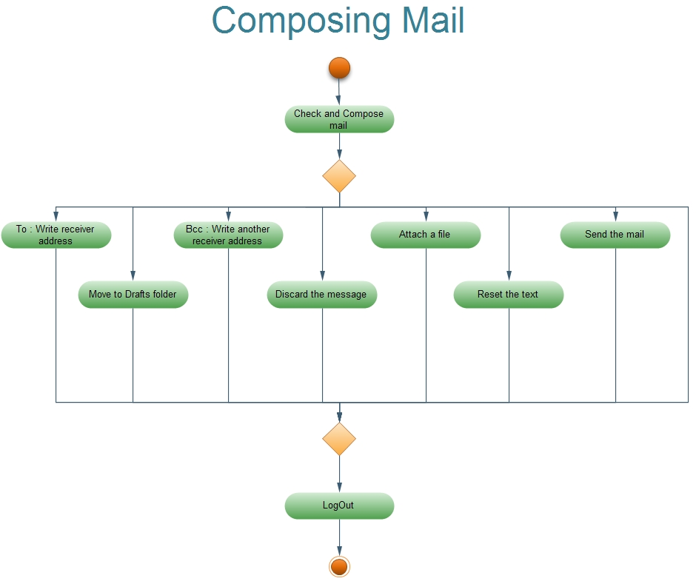

Slide 13
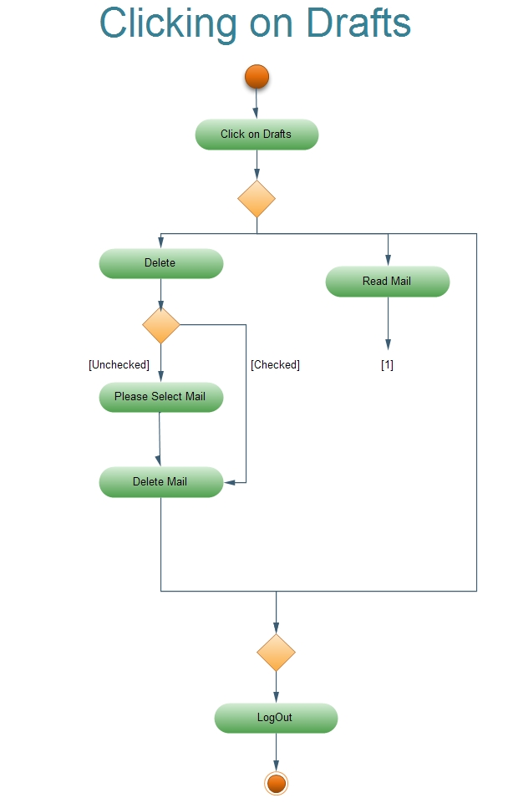

Slide 14
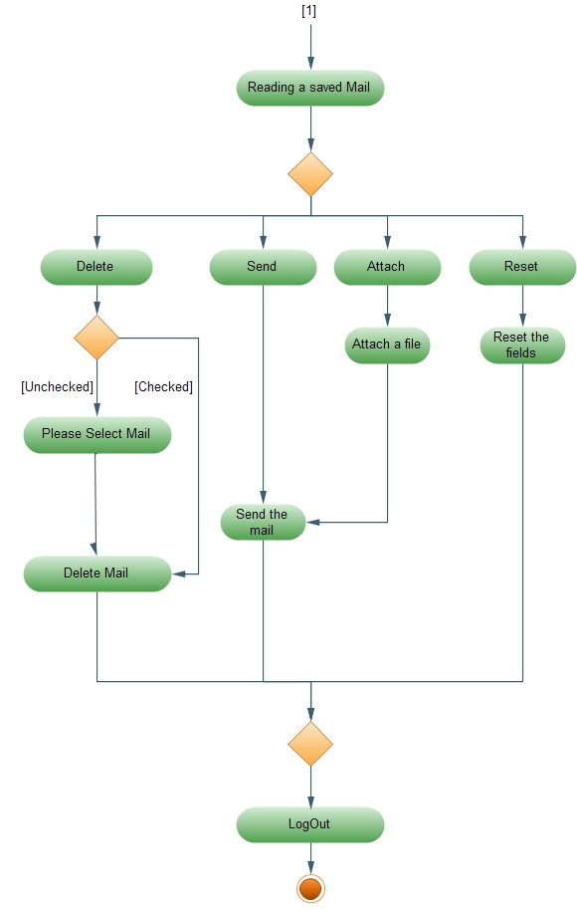

Slide 15
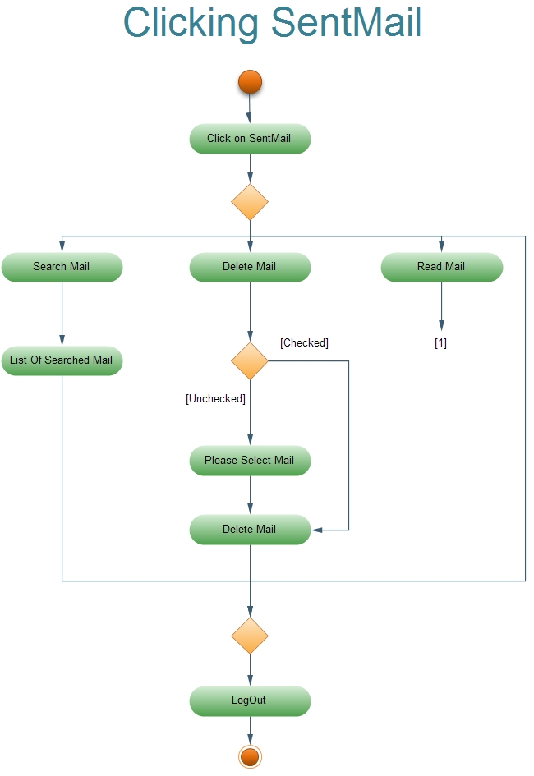

Slide 16
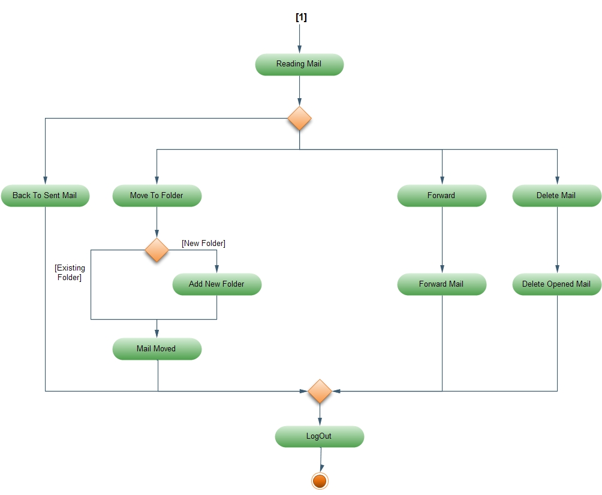

Slide 17
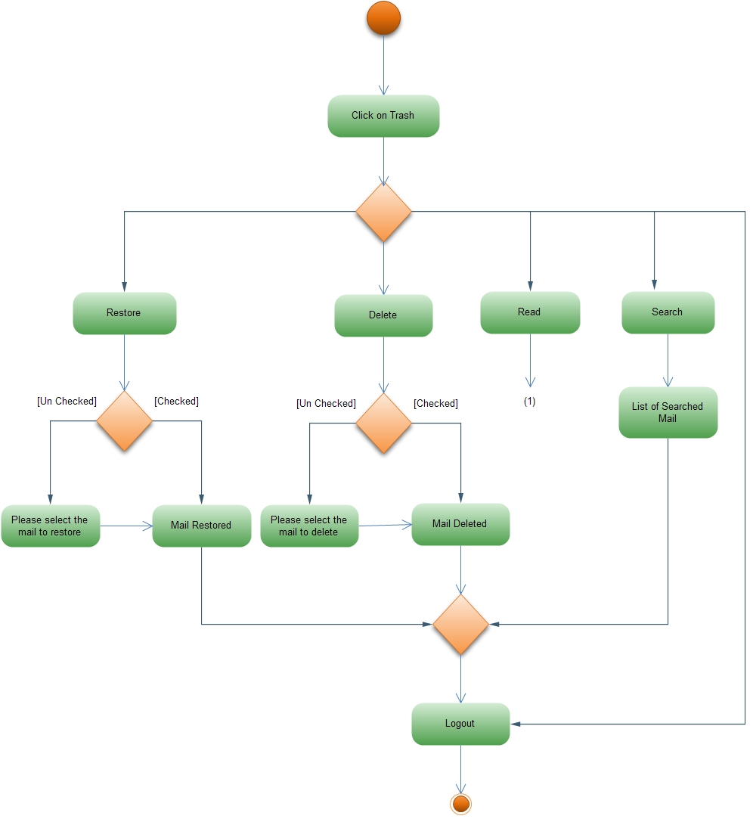

Slide 18
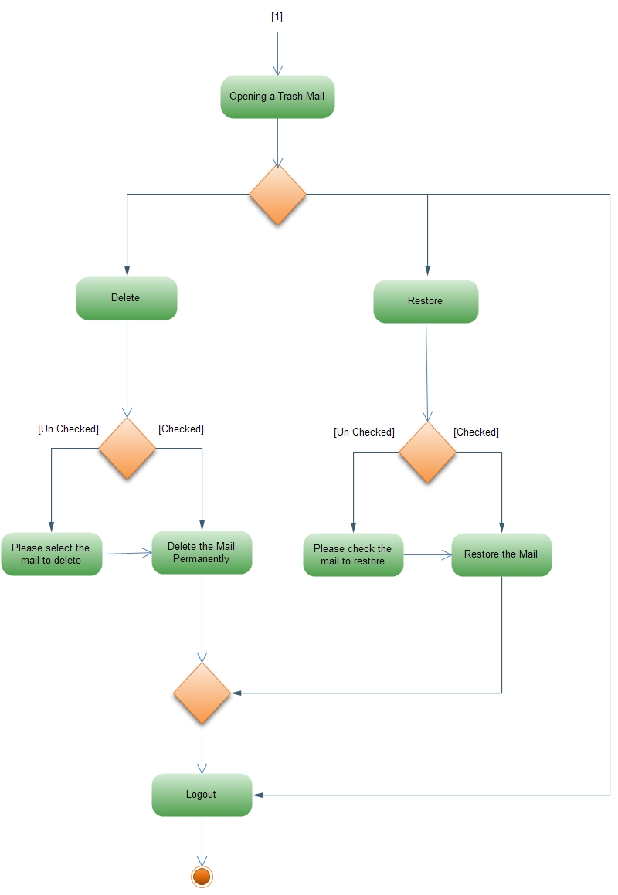

Slide 19
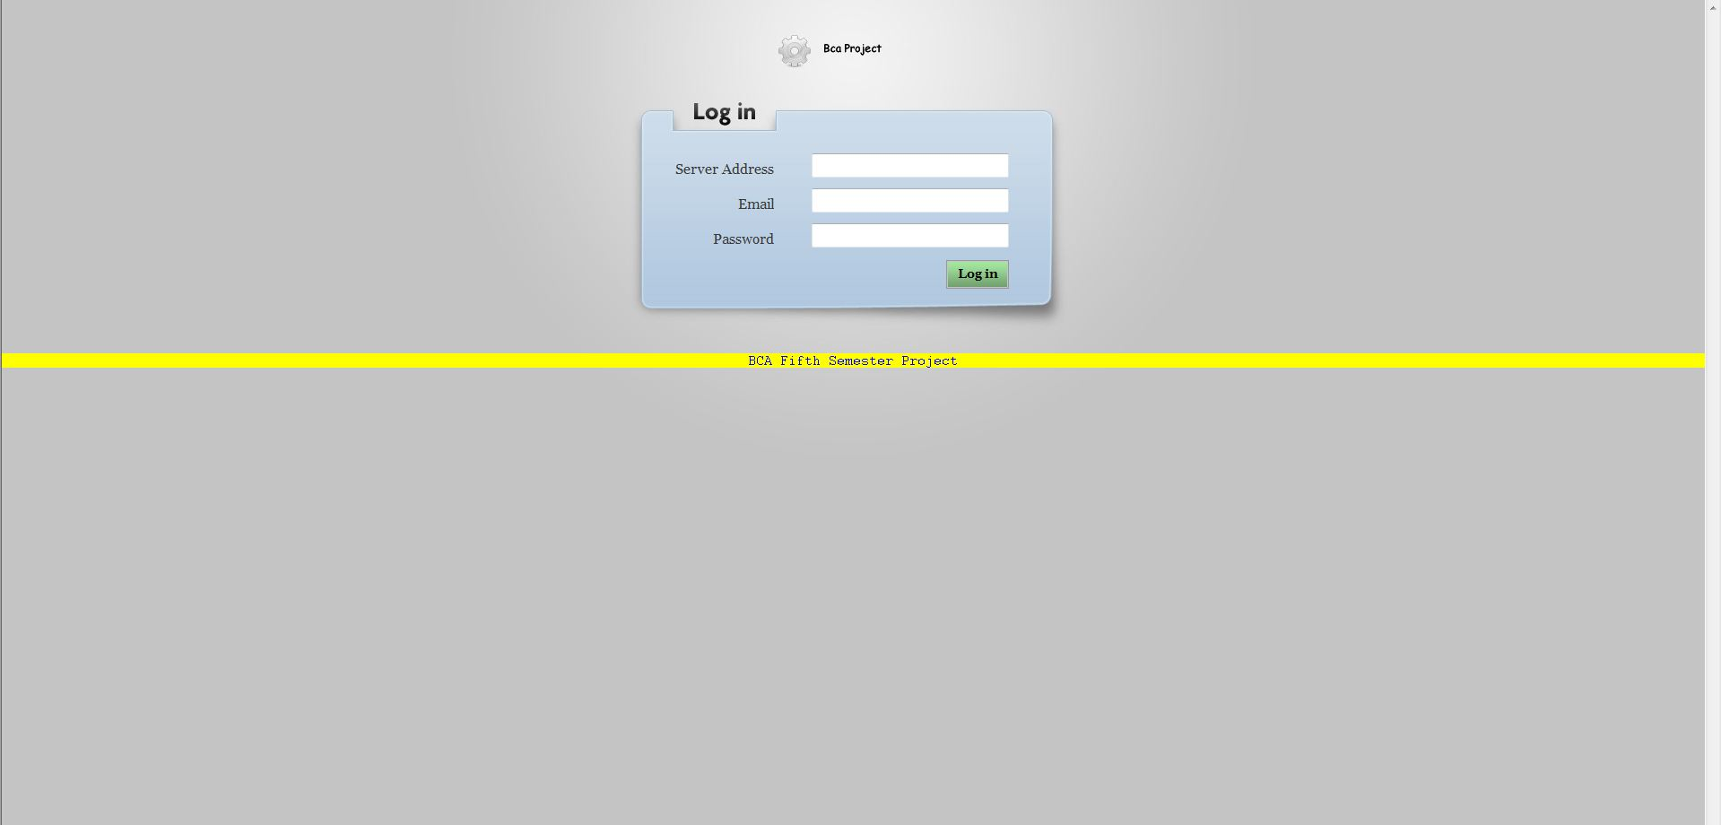

Slide 20
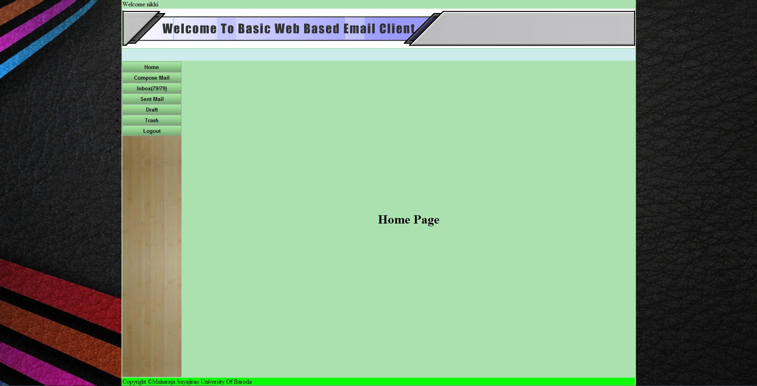

Slide 21
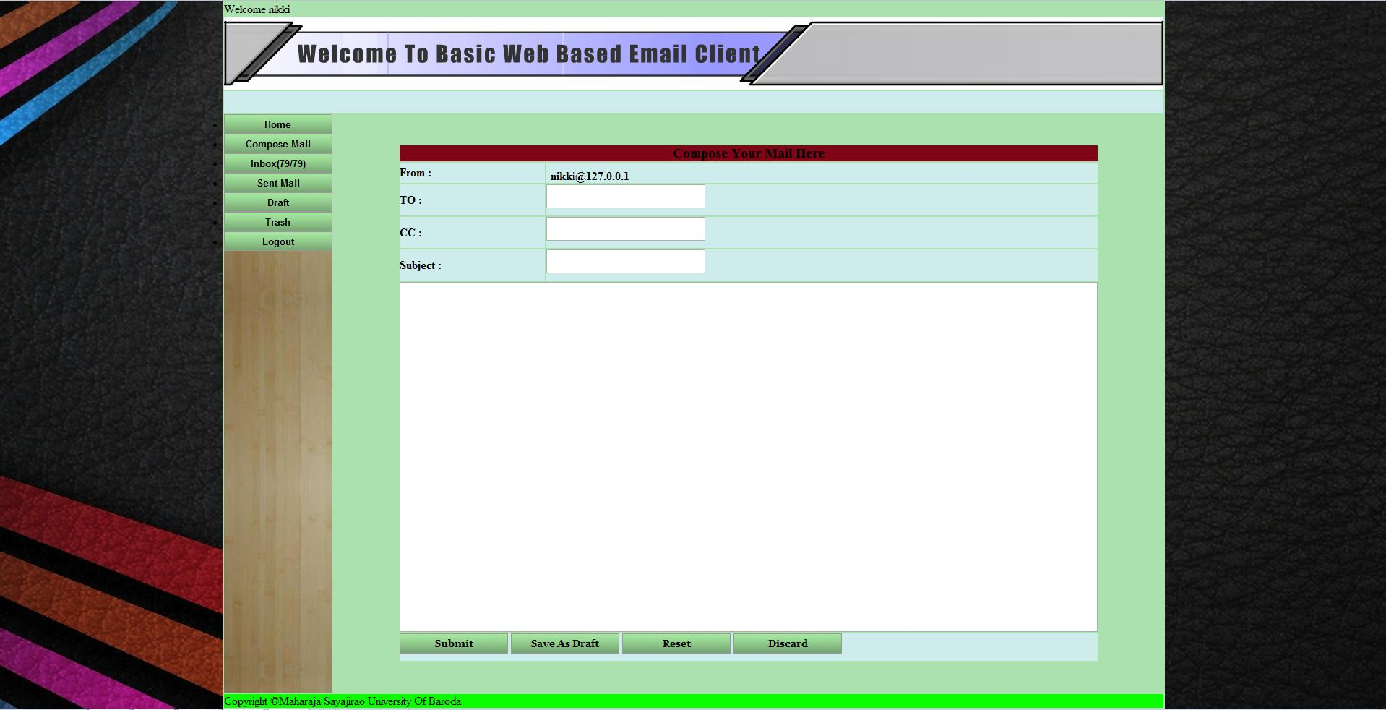

Slide 22
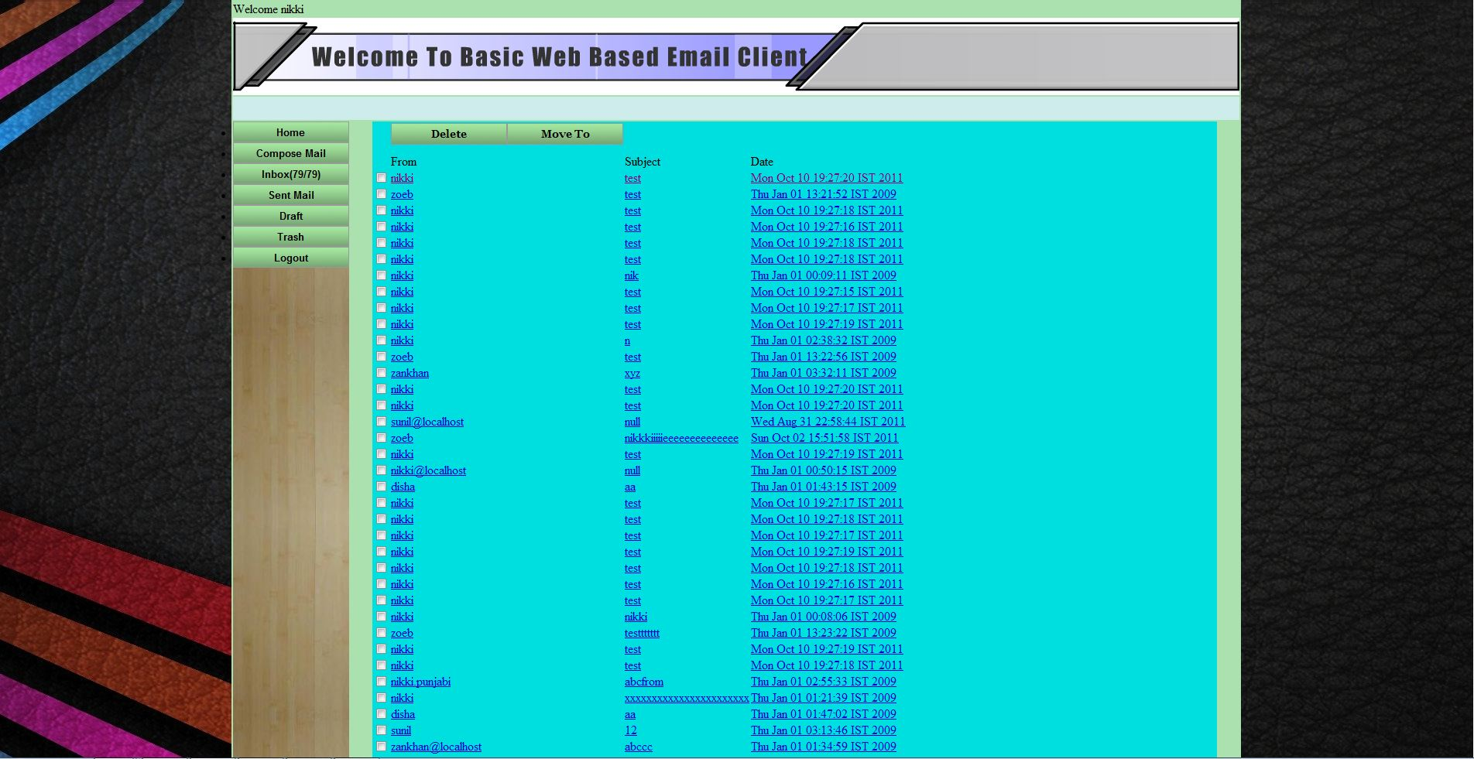

Slide 23
Thank You !
Members:
Disha Shah
Nikki Punjabi
Zankhan Joshi
Zoebali Maknojia

