Slide 1
Chapter 3 – Operators

Slide 2
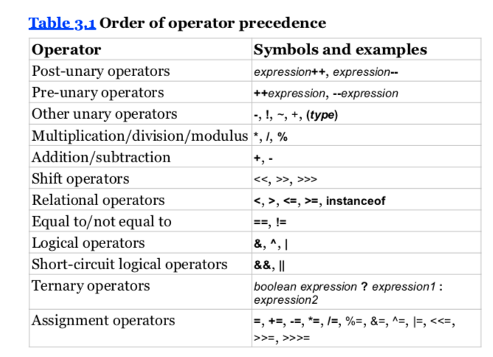
unary
arithmetic
binary
Gotchas
First thing to look out for is
whether the statement compiles
Unless overridden with parentheses (make sure they are in pairs); no []

Slide 3



Increment and Decrement Operators
int parkAttendance = 0;
System.out.println(parkAttendance);
System.out.println(++parkAttendance);
System.out.println(parkAttendance);
System.out.println(parkAttendance--);
System.out.println(parkAttendance);
Return new value
//0
//1
//1
//1
//0
Return original value
on the same line:
lion = 4 (because of ++lion)
original value 4 is returned despite lion--
int lion = 3; int tiger = ++lion * 5 / lion--;
System.out.println("lion is " + lion); System.out.println("tiger is " + tiger);
tiger = 4*5 / 4 [lion = 3]
lion is 3
tiger is 5
OR
tiger = ++lion * 5/3 tiger = ++2 * 5/3
= 3*5/3
lion

Slide 4
Numeric Promotion
int x = 1;
long y = 33;
var z = x * y;
If two values have different data types, Java will automatically promote one of the values to the larger of the two data types.
If one of the values is integral and the other is floating-point, Java will automatically promote the integral value to the floating-point value’s data type.
Smaller data types, namely, byte, short, and char, are first promoted to int any time they’re used with a Java binary arithmetic operator, even if neither of the operands is int.
After all promotion has occurred and the operands have the same data type, the resulting value will have the same data type as its promoted operands.
double x = 3.33; short y = 2; double result = x * y;
short x = 10;
short y = 3;
var z = x * y;
unary operators are excluded
floating-point literals are assumed to be double, unless postfixed with an f,

Slide 5

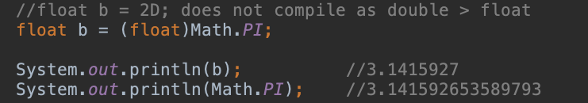
Assigning Values
compiler error if it detects that you are trying to convert from larger to smaller data types without casting.
Casting
the compiler automatically casts smaller data types to larger ones.
Casting is optional and unnecessary when converting to a larger or widening data type,
but it is required when converting to a smaller or narrowing data type.

Slide 6
Compound Assignment Operators
long goat = 10; int sheep = 5; sheep = sheep * goat; // DOES NOT COMPILE
long goat = 10;
int sheep = 5;
sheep *= goat;
The compound operator will first cast sheep to a long
apply the multiplication of two long values
then cast the result to an int.

Slide 7
unperformed side effect
int rabbit = 6; boolean bunny = (rabbit >= 6) || (++rabbit <= 7); System.out.println(rabbit);
because rabbit >= 6 is true, the increment operator on the right side of the expression is never evaluated, so the output is 6.

