Slide 1
The Final Last Cut Waltz
Being Good Citizens in a World of Data

Slide 2
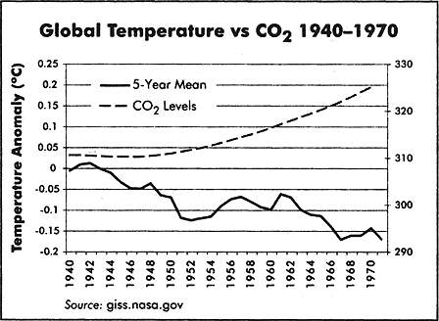
Michael Crichton Is a Climate Change Denier

Slide 3
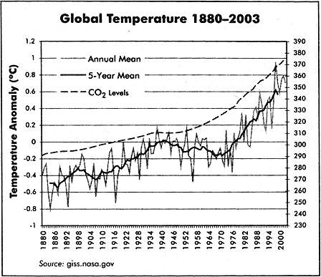
Did he play a trick on us?

Slide 5
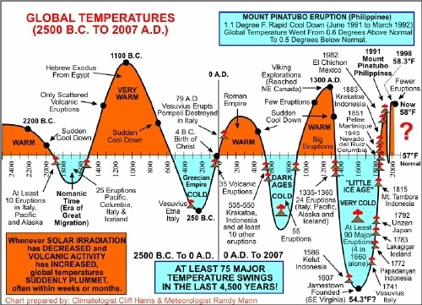
A Longer Time Scale

Slide 6
What’s The Message Here?
Data is no substitute for critical thinking
Corollary: common sense is dangerous
Correlation Does Not Equal Causation
Maybe global temperature drives CO₂
Maybe a 3rd unknown factor is involved
The “Global Experiment” is impossible (or at least highly undesirable)
More Temperature Data…
Will not necessarily fix this
Does help with modeling
Think extra-globally
What do we know about CO₂
What do we know about climatic history?
Actually when we look at everything, the case is pretty strong

Slide 7
How Can We Test Theories When Experiments Aren’t Practical
Einstein didn’t know how

Slide 8
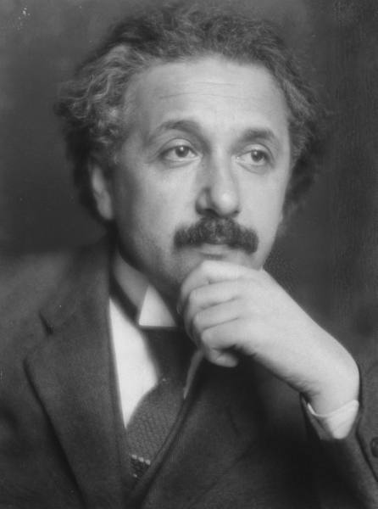
Einstein Had A Problem
His theory of relativity seemed to address the short comings of Newtonian physics
His prediction of curved space was very difficult to test
Things were really small and really big

Slide 9

Testing Relativity With an Observation
Arthur Stanley Eddington devised the eclipse experiment
Technically this is not an experiment
Natural Experiment
Why is it so powerful?

Slide 10
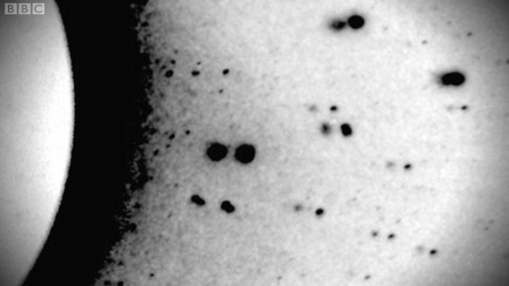
It’s Not Always About Experiments
The Prediction Was Risky!
The predictions were precise
Failure was clear and well defined
Newtonian physics also predicted deflection
But only by half as much
Is relativity proven?
Why are things like climate change so much harder?

Slide 11
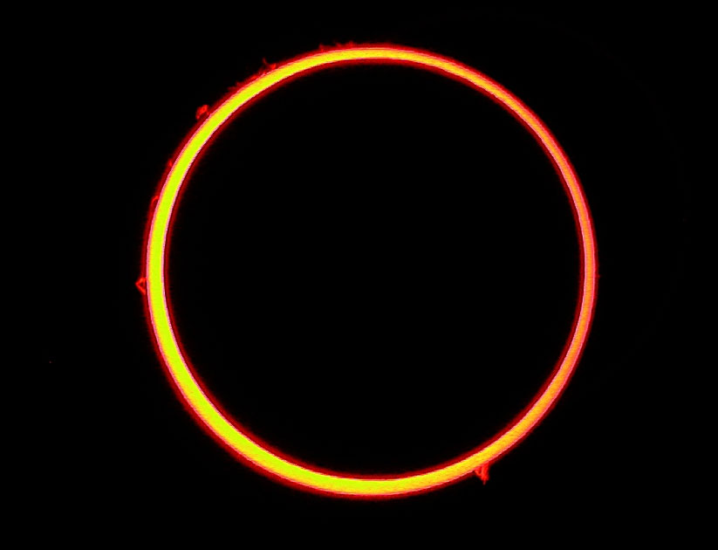
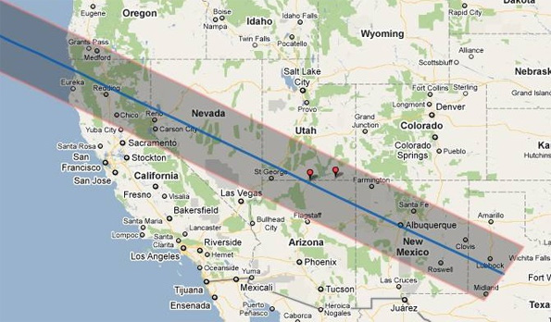
Aside: Annular Eclipse May 20, 2012

Slide 12
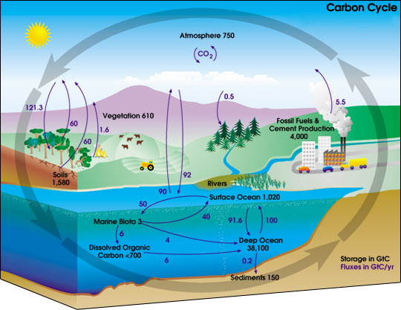
Ways To Work Around Correlation
Learn A Lot About the System
Physicists have it easy
Biology and Weather are COMPLEX
Risky Predictions
Predicting the past
Reductionism
Break the problem into smaller parts
What do we know about
CO₂
Warming Cycles
Weather Patterns
…

Slide 13
How to approach data/science/research
A Semi-Practical Approach For A Good Citizen

Slide 14
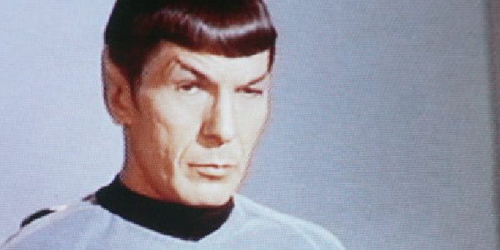
Be Skeptical
Oh, people can come up with statistics to prove anything, Kent. 14% of people know that.
-Homer Simpson-

Slide 15
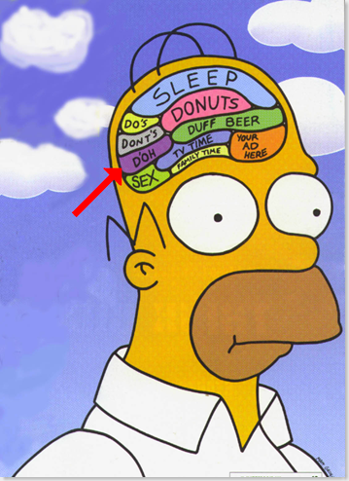
But Don’t Be Homer
Oh, Lisa, you and your stories: Bart's a vampire, beer kills brain cells. Now let's go back to that... building... thingie... where our beds and TV... is.

Slide 16
Pay Attention to First Principles
Does it make sense?
Ideally you have
Previous evidence
Sound Theory
Basic Principles
NOT – would I like to believe it.
How Does It Compare to Competing Theories?
Are they all testable?
What evidence do the other theories enjoy?
(Sorry, divine intervention is not allowed)
Neither are arguments about financial cost

Slide 17

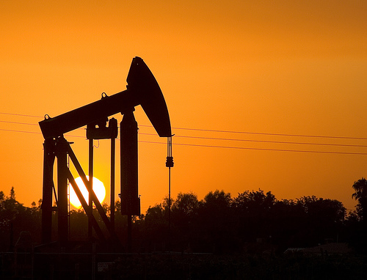
Consider The Motivations of the Players
Cigarette companies have a lot to lose
American Cancer Society?
Oil companies and automobile have a lot to lose
Average citizen ?
Men have a lot to lose in gender inequality
Women?

Slide 18
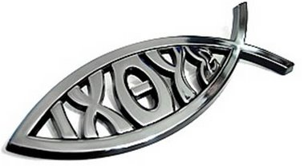





Is The Discussion Even Really Relevant?

Slide 19
Is The Theory Testable?
Is Global Warming Testable?
What are we testing?
Is Evolution Testable?
Intelligent Design?
Is Inequality in Water Rights Testable
What are the competing hypotheses?
Is Gender Inequality Testable?
What are we measuring?
Testability, a property applying to an empirical hypothesis, involves two components: (1) the logical property that is variously described as contingency, defeasibility, or falsifiability, which means that counterexamples to the hypothesis are logically possible, and (2) the practical feasibility of observing a reproducible series of such counterexamples if they do exist. In short, a hypothesis is testable if there is some real hope of deciding whether it is true or false of real experience. Upon this property of its constituent hypotheses rests the ability to decide whether a theory can be supported or falsified by the data of actual experience. If hypotheses are tested, initial results may also be labeled inconclusive.

Slide 20
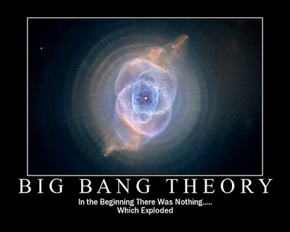
Be Aware of a Theory’s (and Data’s) Boundaries
What are the boundaries of the big bang theory?
A theory of everything is a theory of nothing
"I don't like to push you, Kettering, but you science boys (and girls) tend to get all wrapped up in your test tubes and the obvious things escape your
attention. I've got to have something to report. I want action, not theory.“
- From the movie The Brain Eaters

Slide 21
How Big Is Your Data?
Its Not How Big Your Data Is It’s How You Use It?

Slide 22
Top 10 Databases in 2010
World Data Centre for Climate (6.2 PB)
National Energy Research Scientific Computing Center (2.6 PB)
AT&T (323 TB)
Google (91 million searches, 50% of searches)
Sprint (2.85 Trillion Records)
ChoicePoint (250 TB)
YouTube (45 TB)
Amazon (42 TB)
Central Intelligence Agency (?? How does he know?)
Library of Congress (20TB)
What is the correct way to compare this?
Volume?
Objects?
Impact?
How much data world wide?

Slide 23
Little Big Data
The Top 10 Databases account for
0.0034% of Global Storage
Big Data Really Isn’t That Big
But the problem is interesting
How do we link all this data together?

Slide 24
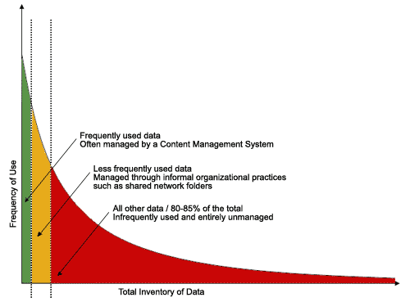
A Really Important Distribution
Most Data Is Unused and Unmanaged
Most Data Is Small
Number Of Data Sets
Size of Data (Bytes)

Slide 25

Big Impact of Small (Managed) Data
http://www.youtube.com/watch?v=heaK44PW5ko&feature=g-all-s&context=G263cc50FAAAAAAAAAAA
http://stevekochscience.blogspot.com/2011/02/open-data-success-story.html
http://www.kochlab.org/files/Passivation/

Slide 26
What Steve Does…
Right
Wrong
Generate High Quality Data
Keeps it pretty organized
Release data in a timely manner
Gives lots of background
Uses social media
Lack of metadata (formal)
Data is difficult to navigate
Limited sys-admin

Slide 27

Final Thoughts
Nothing is proven
All the good stuff is theory
Data & Theory work together
Critical thinking is always important
Big Data is made from small data
Big Ideas ?

