Slide 1
Data Visualization
In 10 Minutes

Slide 2
What Are We Trying To Do?
Convey Complex Data In Simple Ways
Tell A Story
Simplify Complex Things

Slide 3
High Data-Ink Ratio
How Would You Visualize
Men: 4
Women: 30

Slide 4
The Least Amount of Ink
Men: 4
Women: 30

Slide 5
Eliminate Chart Junk

Slide 6
Eliminate Chart Junk

Slide 8
There Is Not Enough Ink

Slide 10
Data Density

Slide 11
Every Graphical Element Has A Function
Color is a Graphical Element
Why Is IBM Blue?
Shapes Are Graphical Elements
How does a circle make you feel ?
How does a triangle make you feel?
Lines are Graphical Elements
Lines suggest a relationship.

Slide 12
http://www.gapminder.org/world/#$majorMode=chart$is;shi=t;ly=2003;lb=f;il=t;fs=11;al=30;stl=t;st=t;nsl=t;se=t$wst;tts=C$ts;sp=5.59290322580644;ti=2010$zpv;v=0$inc_x;mmid=XCOORDS;iid=phAwcNAVuyj1jiMAkmq1iMg;by=ind$inc_y;mmid=YCOORDS;iid=phAwcNAVuyj2tPLxKvvnNPA;by=ind$inc_s;uniValue=8.21;iid=phAwcNAVuyj0XOoBL_n5tAQ;by=ind$inc_c;uniValue=255;gid=CATID0;by=grp$map_x;scale=log;dataMin=295;dataMax=79210$map_y;scale=lin;dataMin=19;dataMax=86$map_s;sma=49;smi=2.65$cd;bd=0$inds=;modified=75

Slide 13
http://www.flickr.com/photos/walkingsf/4521616274/

Slide 14
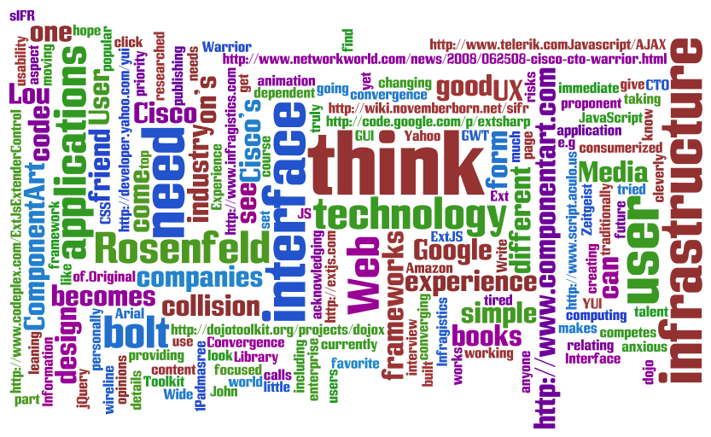

Slide 15
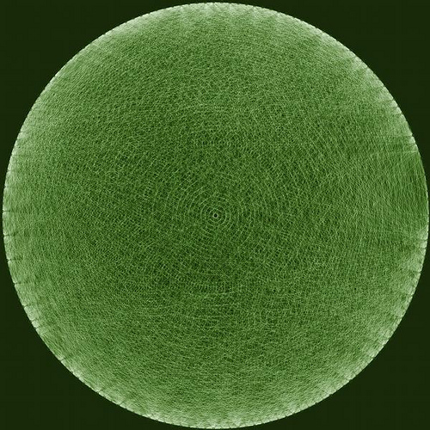

Slide 16
Take Home Messages
It’s ok to make your figures attractive
It’s ok to be artistic, but not just for arts’ sake
It’s necessary for your figures to tell a story
It’s not good to add extra elements just because
KISS (Keep It Simple)
Better said – Keep it as simple as possible.

