Slide 1
eXtensible Style Language Transformations
XSLT

Slide 2
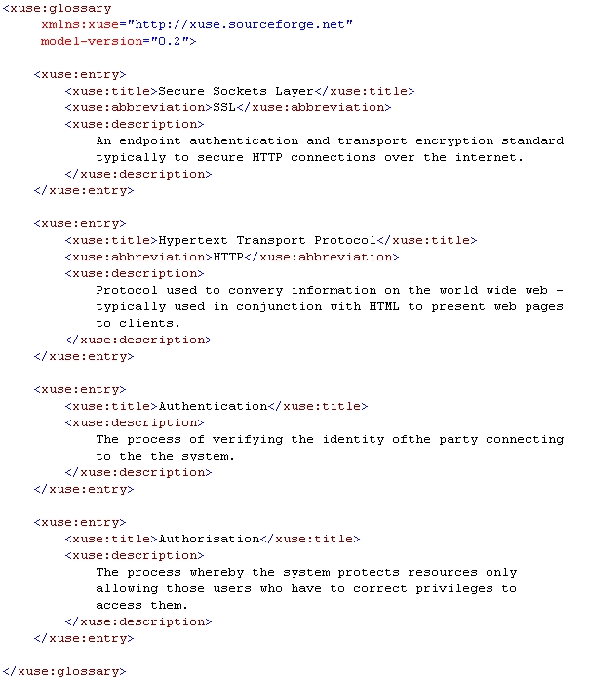
XML Is Ugly
Machine Readable
Human Readable
We can apply CSS
That’s a lot of work

Slide 3
Different Schemas Same Essential Data
Schema B
Schema A
Schema C

Slide 4
What We Want
XML
Some Process
XML
PDF
HTML
Latex
RDBS

Slide 5
What We Want
XML
XSLT
XML
PDF
HTML
Latex
RDBS

Slide 6
Why Use XSLT?
XML Document
HTML
Latex
PDF
XML
…

Slide 7
The Three Main Concepts To XSLT
XML
DOM
XPath
Parser
Document
Object
Model
XSLT

Slide 8
The Three Main Concepts To XSLT
This You Should Know
XML
DOM
XPath
Parser
This You
Ignore
This Is
Important
XSLT
This Is Important

Slide 9
Document Object Model
Document
Root <html>
Element <head>
Element <body>
Element <title>
Element <link>
Element <div>
Element <div>
Element <h1>
Text <Hello World!>
Element <p>
Text <I’m an example!>
Text <Sample>
Attribute <href>
Attribute <rel>
<!DOCTYPE html SYSTEM "http://www.w3.org/TR/xhtml1/DTD/xhtml1-transitional.dtd"> <html xmlns="http://www.w3.org/1999/xhtml"> <head> <title>Sample</title> <link href="style.css" rel="stylesheet"/> </head> <body> <div> <h1>Hello World!</h1> </div> <div> <p>I'm an example!</p> </div> </body> </html>

Slide 10
Why DOM Is Useful
Document
Root <html>
Element <head>
Element <body>
Element <title>
Element <link>
Element <div>
Element <div>
Element <h1>
Text <Hello World!>
Element <p>
Text <I’m an example!>
Text <Sample>
Attribute <href>
Attribute <rel>
Provides a standard interface
Standard work flows
Standard APIs
Standard Class Libraries
Conceptual Framework
Standardize HTML
Standardize Data Models

Slide 11
XPath
Element <body>
Element <div>
Element <div>
Element <h1>
Text <Hello World!>
Element <p>
Text <I’m an example!>
A way to navigate the document tree.
Extract document fragments
Example: get just the body of the document.

Slide 12
XPath
<bookstore>
<book category="cooking">
<title lang="en">Everyday Italian</title>
<author>Giada De Laurentiis</author>
<year>2005</year>
<price>30.00</price>
</book>
<book category="children">
<title lang="en">Harry Potter</title>
<author>J K. Rowling</author>
<year>2005</year>
<price>29.99</price>
</book>
<book category="web">
<title lang="en">XQuery Kick Start</title>
<author>James McGovern</author>
<author>Per Bothner</author>
<author>Kurt Cagle</author>
<author>James Linn</author>
<author>Vaidyanathan Nagarajan</author>
<year>2003</year>
<price>49.99</price>
</book>
<book category="web" cover="paperback">
<title lang="en">Learning XML</title>
<author>Erik T. Ray</author>
<year>2003</year>
<price>39.95</price>
</book>
</bookstore>
/bookstore/book
Book is the context node.
This XPath returns all of the
green nodes.
Context nodes are where you
are at in the document tree.
It is odd to think about, but we are at all
books at once.

Slide 13
DEMO

Slide 14
XPath
<bookstore>
<book category="cooking">
<title lang="en">Everyday Italian</title>
<author>Giada De Laurentiis</author>
<year>2005</year>
<price>30.00</price>
</book>
<book category="children">
<title lang="en">Harry Potter</title>
<author>J K. Rowling</author>
<year>2005</year>
<price>29.99</price>
</book>
<book category="web">
<title lang="en">XQuery Kick Start</title>
<author>James McGovern</author>
<author>Per Bothner</author>
<author>Kurt Cagle</author>
<author>James Linn</author>
<author>Vaidyanathan Nagarajan</author>
<year>2003</year>
<price>49.99</price>
</book>
<book category="web" cover="paperback">
<title lang="en">Learning XML</title>
<author>Erik T. Ray</author>
<year>2003</year>
<price>39.95</price>
</book>
</bookstore>
/bookstore/book/author
Author is the context node.
This XPath returns all of the
green nodes.
In this case
they are all text nodes.

Slide 15
Absolute vs. Relative
Absolute path -
context is bookstore
<bookstore>
<book category="cooking">
<title lang="en">Everyday Italian</title>
<author>Giada De Laurentiis</author>
<year>2005</year>
<price>30.00</price>
</book>
<book category="children">
<title lang="en">Harry Potter</title>
<author>J K. Rowling</author>
<year>2005</year>
<price>29.99</price>
</book>
<book category="web">
<title lang="en">XQuery Kick Start</title>
<author>James McGovern</author>
<author>Per Bothner</author>
<author>Kurt Cagle</author>
<author>James Linn</author>
<author>Vaidyanathan Nagarajan</author>
<year>2003</year>
<price>49.99</price>
</book>
<book category="web" cover="paperback">
<title lang="en">Learning XML</title>
<author>Erik T. Ray</author>
<year>2003</year>
<price>39.95</price>
</book>
</bookstore>
/bookstore
author
book/author
Relative path -
Returns all author
nodes
Relative path -
Returns author
nodes that are
child nodes
of book

Slide 16
XPath Axes And Examples
AxisName | Result | Example
ancestor | Selects all ancestors (parent, grandparent, etc.) of the current node | book/ancestor::* book/ancestor::bookstore
ancestor-or-self | Selects all ancestors (parent, grandparent, etc.) of the current node and the current node itself. | book/ancestor-or-self::*
Attribute (@) | Selects all attributes of the current node | //title[@lang] (Title nodes with language attribute) //book[@category="web"]/title (Get titles of books where category = web)
Child (/) | Selects all children of the current node | /bookstore/book
Descendant (//) | Selects all descendants (children, grandchildren, etc.) of the current node | //title (get all titles)
descendant-or-self | Selects all descendants (children, grandchildren, etc.) of the current node and the current node itself | book/descendent-or-self::*
following | Selects everything in the document after the closing tag of the current node | Book/following::*
following-sibling | Selects all siblings after the current node | book/following-sibling::*
namespace | Selects all namespace nodes of the current node | //namespace::example.com (searches entire document for namespace)
Parent (/..) | Selects the parent of the current node | book/.. (moves up to bookstore)
preceding | Selects all nodes that appear before the current node in the document, except ancestors, attribute nodes and namespace nodes | author/preceding::title
preceding-sibling | Selects all siblings before the current node | author/preceding-sibling::*
self | Selects the current node | book/self::*

Slide 17
DEMO

Slide 18
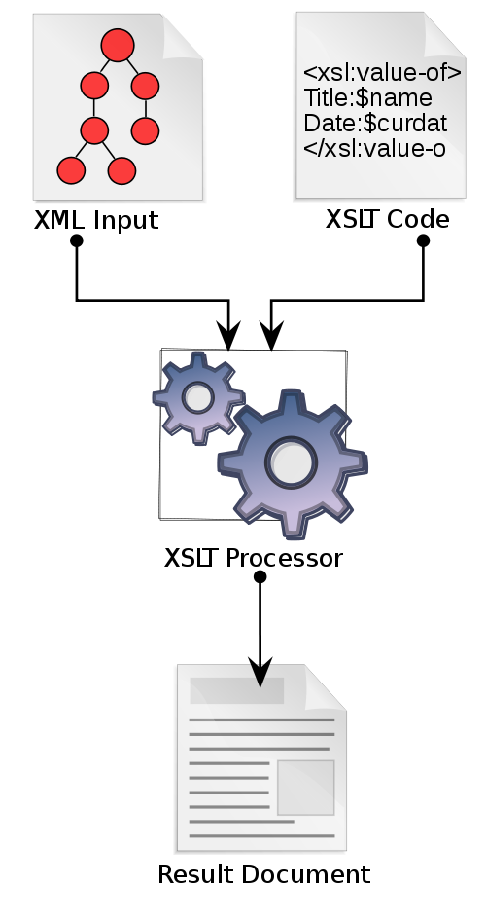
What Is XSLT?
XSLT
Java, PHP, C++ …
Declarative
XML
Procedural
Text

Slide 19
There Two Versions..Three Versions of XSLT
Client side processing
Light Weight
User has some control
Server side processing
Bigger footprint
Provider has more control

Slide 20
DEMO

Slide 21
Alternatives To XSLT
XML
DOM
XPath
Language
Java
PHP
Python
Write Your
Own Parser
Program
Most Languages Have
Support For These

Slide 22
Alternatives To XSLT
XML
DOM
DOM Class Library Methods
Language
Java
PHP
Python
Write Your
Own Parser
Program
GetElementsByName()
GetElementsByAttribute()
GetElementByID()
AppendChild()
CreateElement()
…
Most Languages Have
Support For These

Slide 23
Assignment

