Slide 1
Research Data Librarian
Robert Olendorf
University Libraries
University of New Mexico

Slide 2
Outline
Background
Job
Projects
Skills I Use

Slide 3
My Background
Setting The Stage

Slide 4
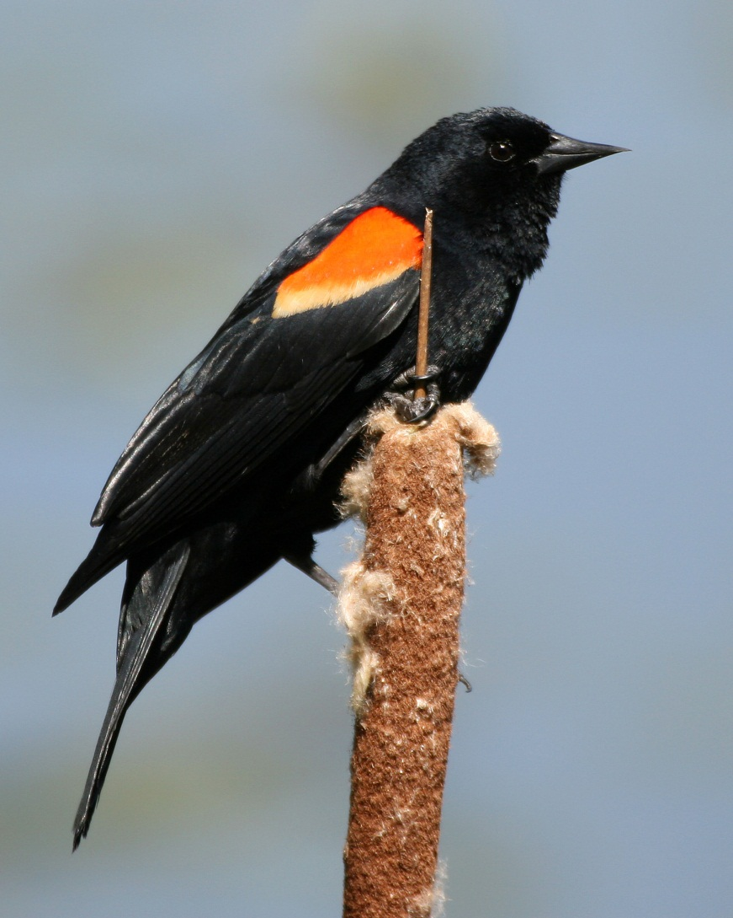
What I Was
20 Years in Behavioral Ecology/Evolutionary Biology
Field Work
Worked with many types of data
Standard tabular data
DNA Sequences
Images
Sound Recordings
Simulations (Genetic Algorithms)
Worked in highly collaborative environments

Slide 5
More Recently
MLS
Focused on Bioinformatics and Data Curation
Currently
Research Data Librarian

Slide 6
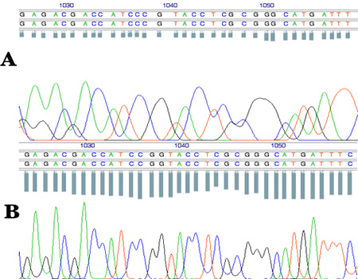
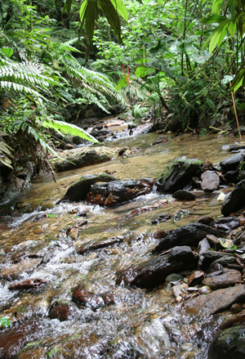
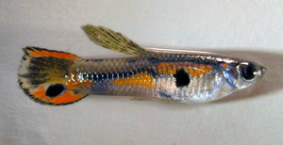
Guppy Project

Slide 7
Guppy Project
4 Primary Investigators
3 Different Institutions
3 Different countries
Diverse Types of Data
Field data in notebooks (Trinidad)
Images (Trinidad & Toronto)
DNA Sequences (Illinois)
Data Collected in the Lab (Toronto Illinois)
Sequence data was from a 3rd Party Vendor

Slide 8
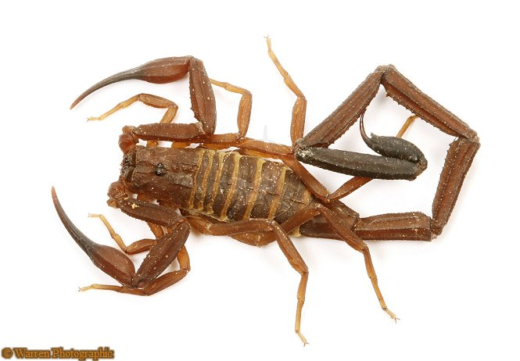
Guppy Project – Challenges
Keeping Data Consistent Across Distance
Even with good communication, we often had difficulties sharing data
Format Issues
Lack of Metadata
Lack of Common Standard
Loss of Data
Missing/Illegible Data Sheets
Machine Failure

Slide 9
Guppy Project – Challenges
Data Loss/Corruption
With so many hands touching the data
Data entry often varied
Data was lost or corrupted due to error
Lack of Automation
Tens of thousands of guppies
Hundreds of thousands of sequences
Most data was entered by hand (high error rate)

Slide 10
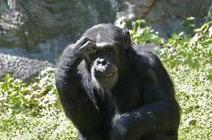
Analysis
There has got to be a better way.

Slide 11
Library Work
Working With Data

Slide 12
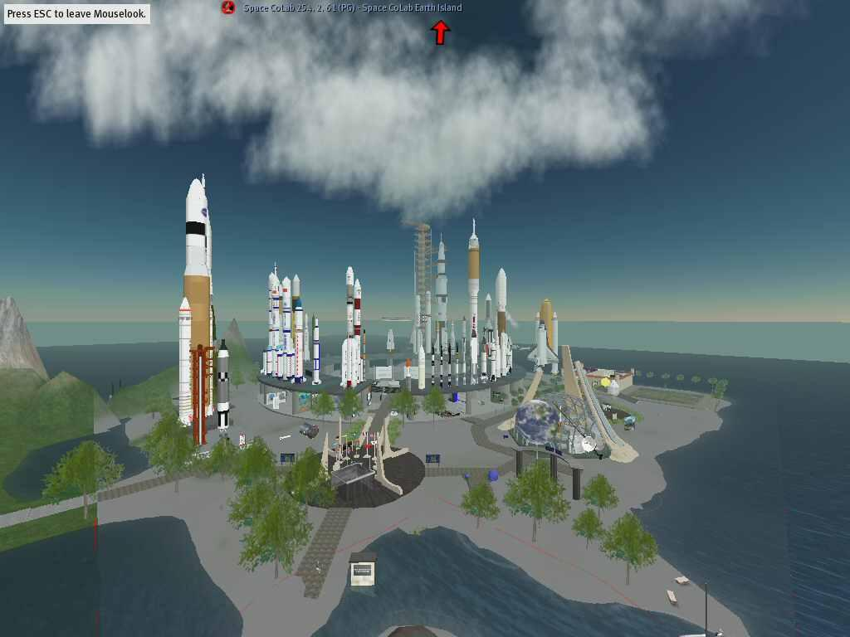
Preserving Virtual Worlds
Archiving Second Life
Complex Programming
Required AI with no resources
Complex linking of databases
Highly Complex Intellectual Property
Hundreds of Creators
Orphan Objects
Mixed Objects

Slide 13
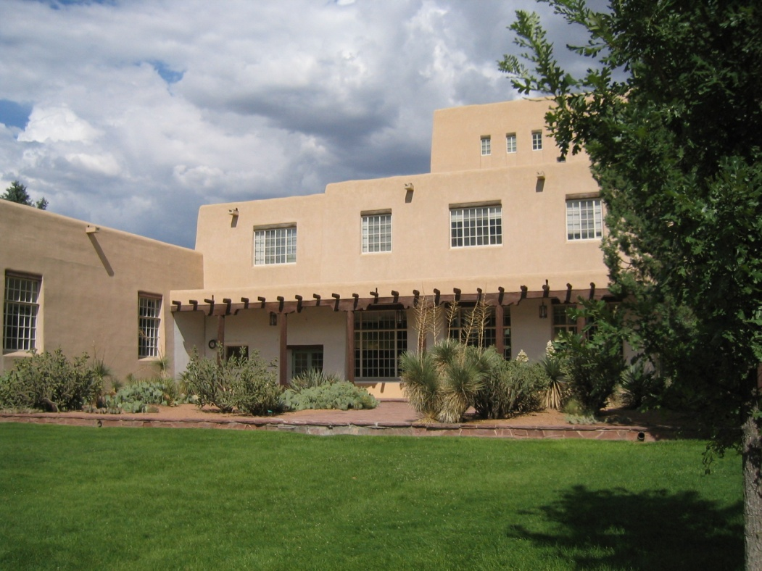
Job
Research Data Librarian
What The Wanted
Someone to tell them what they wanted
Need to work with faculty
Experience with Research Data
Experience with Digital Preservation
Willingness to do traditional librarian tasks
Programming Skills
Familiarity with metadata standards
…
…

Slide 14
What The Job Really Is What I Made It
Research Support
Data Management Plans
Data Curation
Computer Forensics
Collaboration
Working with faculty in an increasingly informatics oriented environment
CO-PI on several grants
Advocate for Open Science
Developing a Data Repository
Actual Librarianship

Slide 15
Data Management Plans
Required By Many Funding Agencies
Purpose
Encourage better data management
Require thought about how to disseminate data
I wrote 30 or so last year
Think the number will decrease

Slide 16
Why DMPs Sorta Suck
They don’t really help researchers manage data better
Most researchers continue their old practices
“Will comply with University standards” – there are none
DMPs are too short to really explain this
Little enforcement
Many critical issues are easily overlooked
Guidelines are often vague or overlook important issues

Slide 17
Why DMPs Are Sorta Cool
Encourages interaction with librarians and other research support staff
Often issues are discovered through this interaction
Intellectual Property Right Issues
Better data practices (small steps)
Collaboration
Awareness of Open Data

Slide 18

The Future Of DMPs
More agencies will require them
Faculty will write their own
Most grants are down to the wire
It’s not rocket surgery – after they have seen one they usually get it.
As faculty do their own, they will often miss important details.

Slide 19
Collaboration
The Future of Data Librarianship

Slide 20

Why Librarians Are Important Collaborators
Organize Data
Reduce time spent on data management
Increase validity and accuracy of data
Curate Data
Increase usefulness and lifespan of data
Increase breadth of usefulness
Promote data
Increase impact and visibility of data

Slide 21
Projects
Molecular Physics
Cave Microbiology
Legacy Astronomical Data
Herbaria
Neuro-Imaging

Slide 22
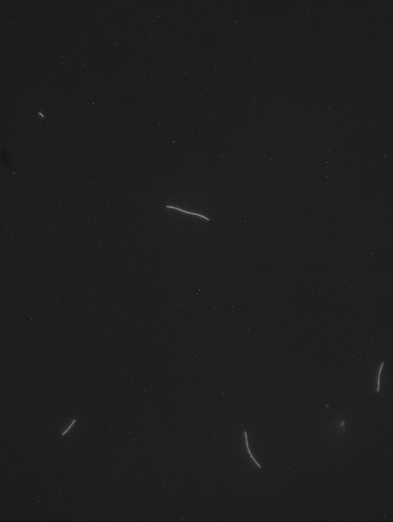
Molecular Physics
http://openwetware.org/wiki/Koch_Lab:Data/MT_Gliding_Assay_Readme_File
http://www.youtube.com/watch?v=heaK44PW5ko&context=C40aed45ADvjVQa1PpcFMjWx5kDQ6C8xao52fQpCgvxqxtkPaSX3Q=
http://stevekochscience.blogspot.com/2011/02/open-data-success-story.html

Slide 23
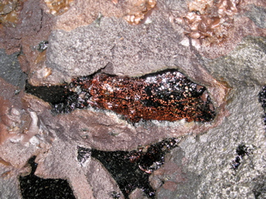
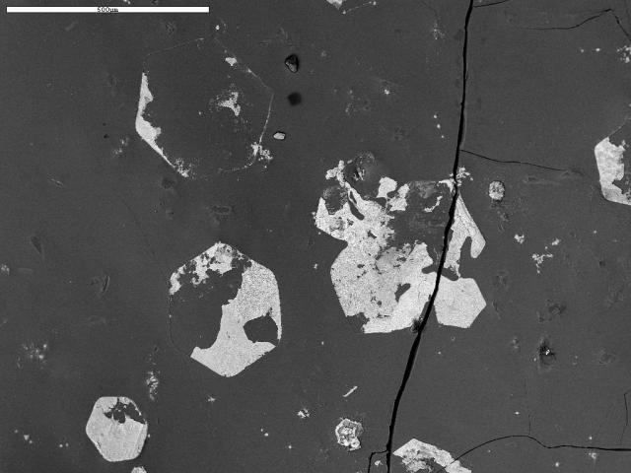
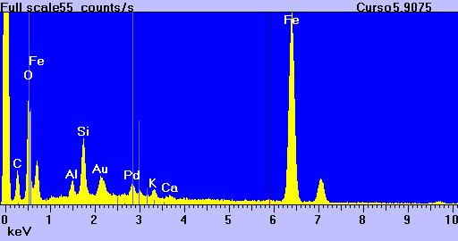
Cave Microbiology
http://idec.aisti.org
http://olendorf.org/idec/

Slide 24
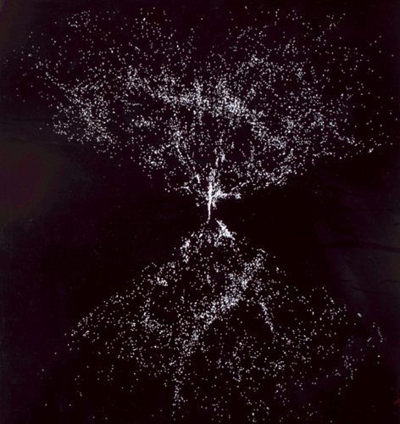
Legacy Astronomical Data
Thousands of files on found hard drives on a raid array
Associated observation notes
Paper
Floppies
Zips
Hardware is failing making data recovery difficult

Slide 25
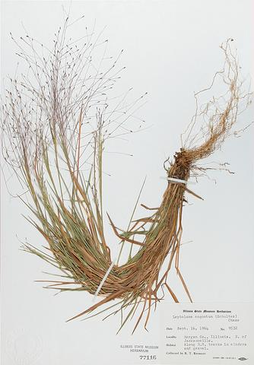
Herbarium
The herbarium wants to
Spend less time as sys-admin
Better automate procedures
Create better more interoperable metadata
We are also exploring bringing all University museum data into the library
More efficient
Better linking of data

Slide 26
Neuro-Imaging
Faculty is a recent convert to open data
Her data is one of a kind and very expensive
Very archaic and inefficient workflow
Little documentation
She is an enthusiastic and exciting colleague
Recently took lead of NSF Neuroscience Program

Slide 27
Advocacy
My New Open Life Style

Slide 28
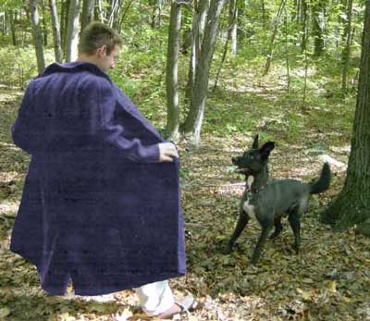
Open Data and Research
Most of my work is open on github

Slide 29
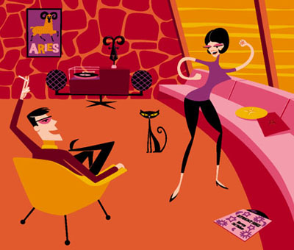
My New Open Lifestyle
Better Collaboration
Easier Communication
I pay attention to details
Copyright is established
I think
https://github.com/olendorf
https://github.com/olendorf/teaching/blob/master/maryland-lecture.pptx

Slide 30
Data Archving
Other Fun Stuff

Slide 31
System Overview

Slide 32
Packaging - Metadata
XFDU
Developed by CCSDS at NASA
A structural metadata standard
A container for all other metadata
Can recursively contain other XFDUs
Premis
Preservation Metadata
Developed by the Library of Congress
Automating much of the process
Allows us to handle very heterogeneous data
Other Possiblities
METS
RDF (with appropriate vocabulary(
FOXML

Slide 33
Example Data Model
XFDU - File
XFDU - Directory
Premis
XFDU – PDI Meta
OME
Premis
XFDU – PDI Meta
XFDU - Descriptive
OME
XFDU - Descriptive
LOM
XFDU - Behavior
XFDU - Software
XFDU - Directory
XFDU - Behavior
XFDU - Software
Premis
XFDU – PDI Meta
OME
XFDU - Descriptive
XFDU - Behavior
XFDU - Software

Slide 34

Questions/Discussion
Email: olendorf@unm.edu
Github: https://github.com/olendorf
Website (in development): http://openlybadlibrarian.com

