Slide 1
Data Data Everywhere Not a Bit To Think

Slide 2
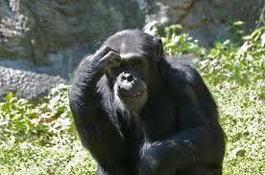
What Is Data?
Am I Data?

Slide 3
Definitions of Data
Factual information (as measurements or statistics) used as a basis for reasoning, discussion, or calculation.
Information output by a sensing device or organ that includes both useful and irrelevant or redundant information and must be processed to be meaningful
Information in numerical form that can be digitally transmitted or processed.
Factual information, especially information organized for analysis or used to reason or make decisions.

Slide 4
Some Famous Philosophers of Data and Knowledge
Data is a precious thing and will last longer than the systems themselves. Tim Berners-Lee (Computer Scientist, Inventor of the World Wide Web)
Experts often possess more data than judgment. Colin Powell (Army General, Secretary of State)
Biographical data, even those recorded in the public registers, are the most private things one has, and to declare them openly is rather like facing a psychoanalyst. Italo Calvino (Author)
Data is not information, information is not knowledge, knowledge is not understanding, understanding is not wisdom. Clifford Stoll (Astronomer, Author) Data is what distinguishes the dilettante from the artist. George V. Higgins (Lawyer, Professor, Crime Novelist)
Facts are meaningless. You could use facts to prove anything that's even remotely true!
Home Simpson (Nuclear Safety Engineer, Philosopher)

Slide 5
How Data Fits In
Theory
The Scientific Method!!!
Hypothesis
Analysis
Prediction(s)
Test
(Experiment)

Slide 6
How Data Fits In
Data
Theory
The Scientific Method!!!

Slide 7
How Data Fits In
Data
Theory
The Scientific Method!!!
Hypothesis
Analysis
Prediction(s)
Test
(Experiment)
Data

Slide 8
So What Does The Scientific Method Mean To Us?

Slide 9
What Characteristics Should We Attach To Data?

Slide 10
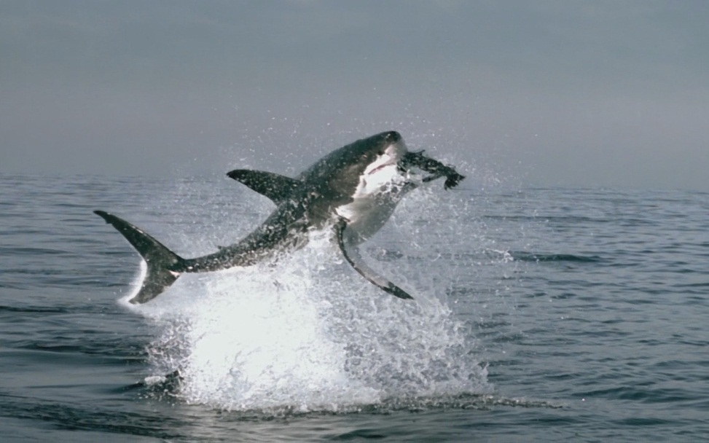

What’s more dangerous at the Beach?
"Falling coconuts kill 150 people worldwide each year, 15 times the number of fatalities attributable to sharks."
http://www.shark.org.au/quotes.html
http://www.straightdope.com/columns/read/2405/are-150-people-killed-each-year-by-falling-coconuts

Slide 11
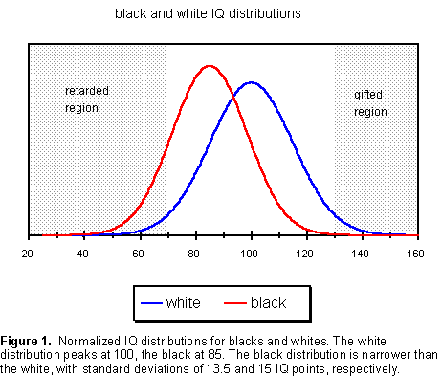
Racial Inequalities and IQ

Slide 12
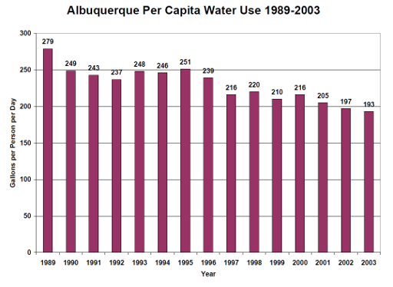
Good News

Slide 13
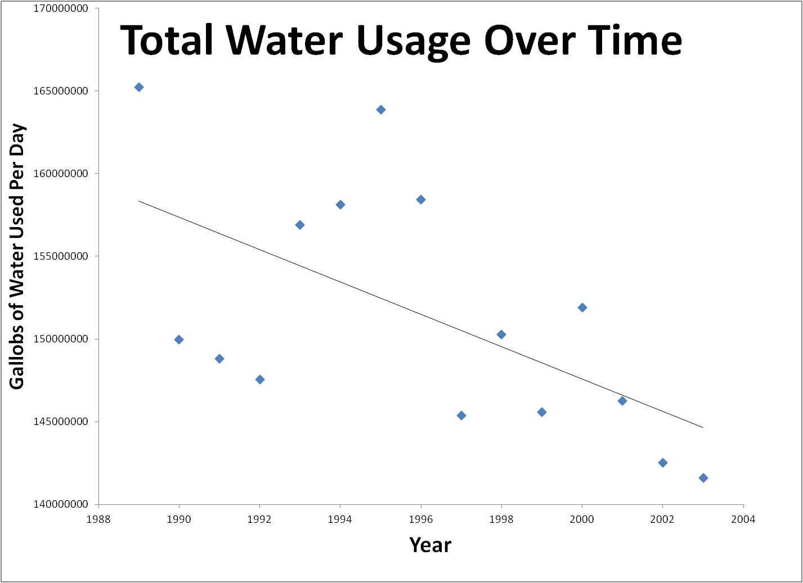
WOW!

Slide 14
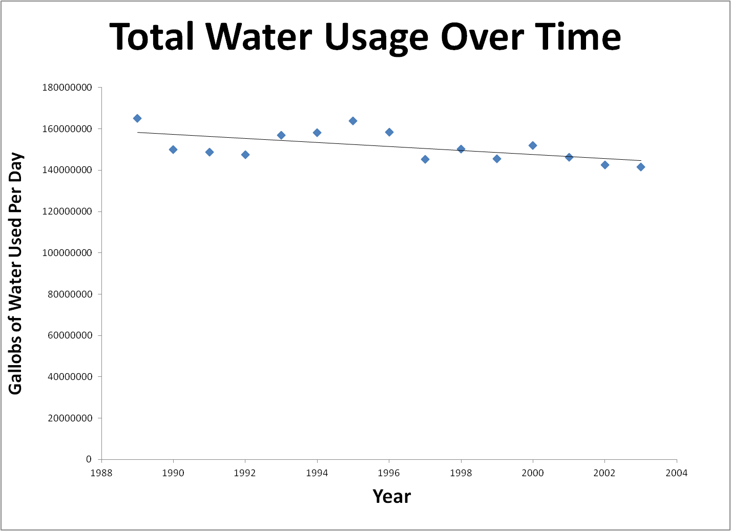
WOW?

Slide 15
WOW?
Very Hypothetical Sustainable Levels

Slide 16
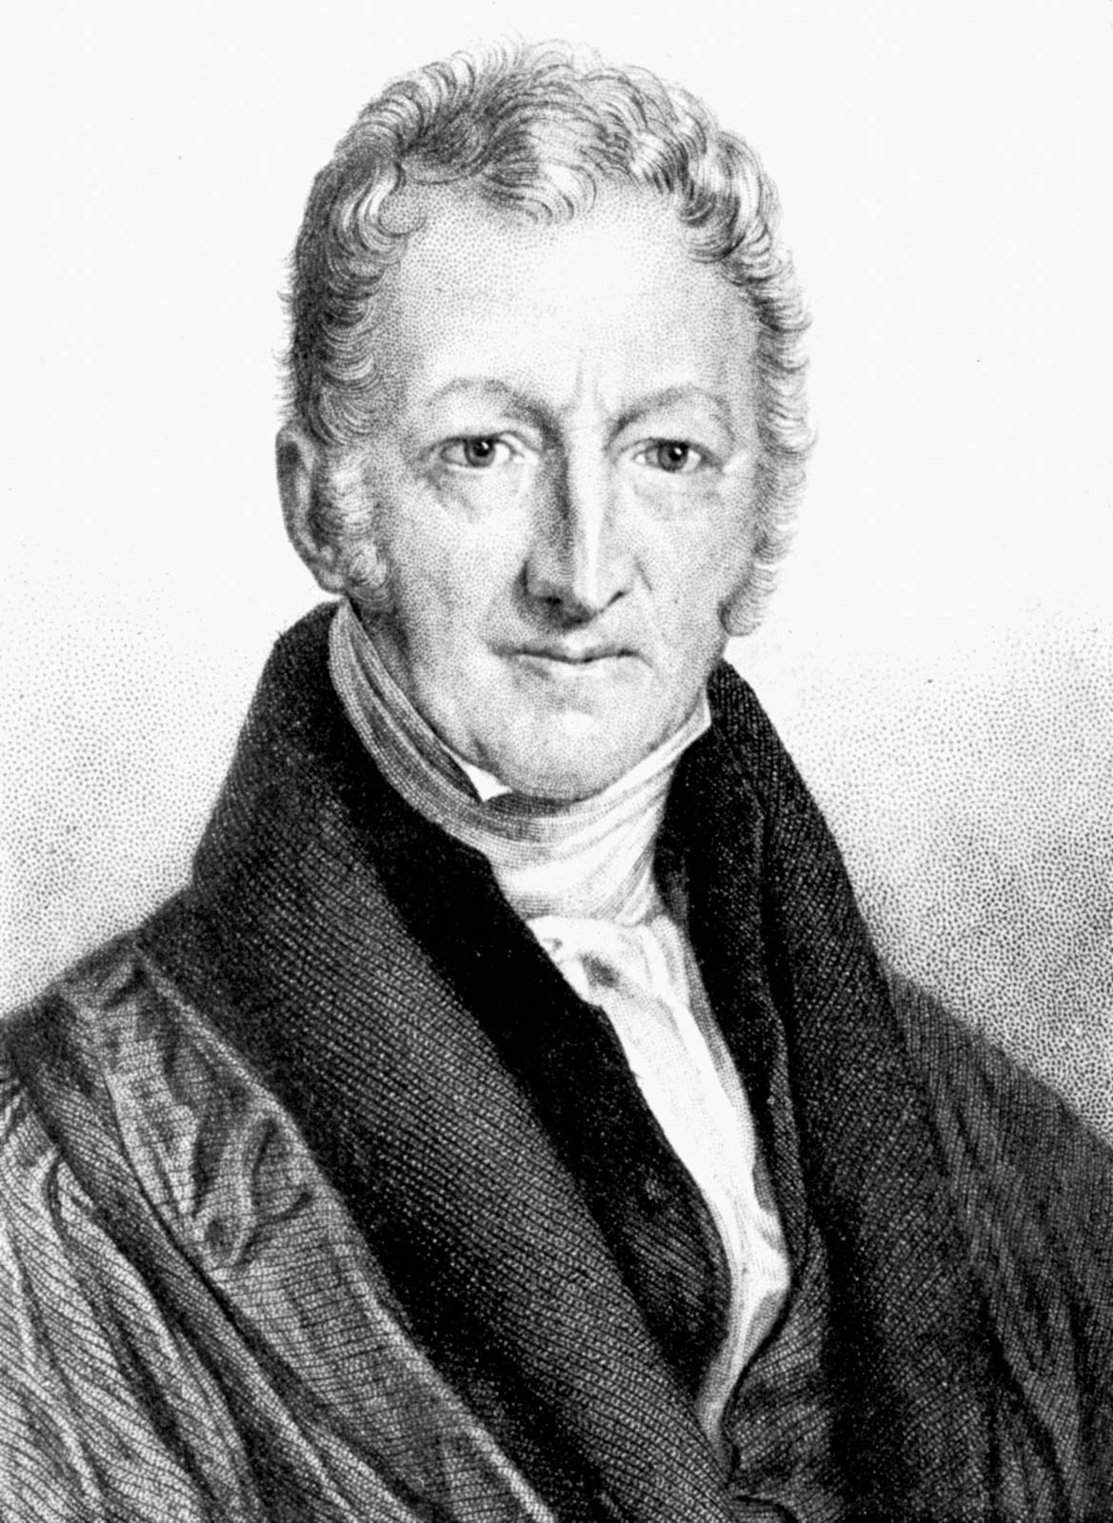
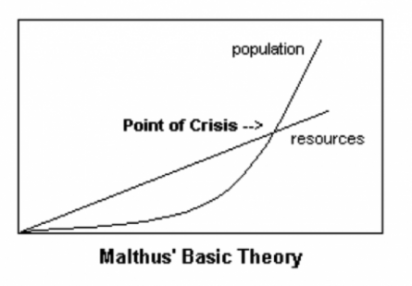
Thomas Malthus – Theory of Scarcity

Slide 17
How We Ask Questions
Women Water and Work
Water is scarce.
Women often suffer from inequality.
Water is not evenly or fairly distributed.
Can we solve the water scarcity issue by solving inequality issues?
Can we solve inequality issues by solving water issues?

Slide 18
Assignment!
Work through the ADVANCED WATER FOOTPRINT calculator.
Write an essay about it. (1 page)
Suggested Themes
Strengths
Weaknesses
Assumptions
Annoying me in an intelligent way is good.
Post your writing on the blog
http://womenwaterwork.org/

Slide 19
Working Openly
The idea is to share and collaborate
Your writing is your own
Borrowing with attribution is recommended
Commenting on your classmates work is a nice thing to do
Editing your work in response to others’ writing and comments is good
PLAGARISM IS RIGHT OUT!!

