Slide 1
The Final Last Cut Waltz
Being Good Citizens in a World of Data

Slide 2
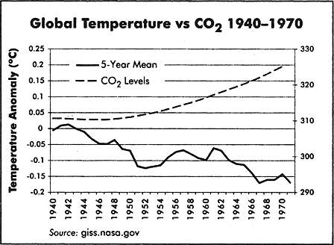

Slide 3
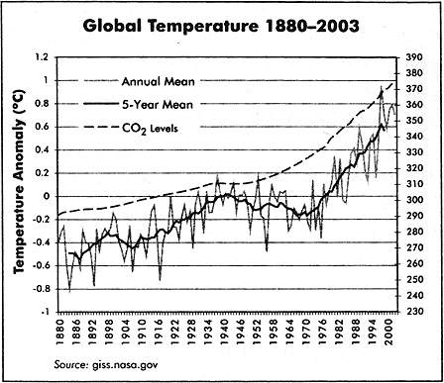

Slide 5
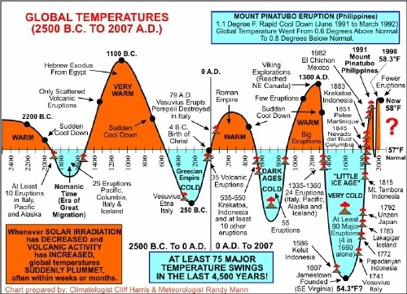
A Longer Time Scale

Slide 6
What’s The Message Here?
Data is now substitute for critical thinking
Corollary: common sense is dangerous
Correlation Does Not Equal Causation
Maybe global temperature drives CO₂
Maybe a 3rd unknown factor is involved
The “Global Experiment” is impossible
More Temperature Data…
Will not necessarily fix this
Does help with modeling
Think extra-globally
What do we know about CO₂
What do we know about climatic history?
Actually when we look at everything, the case is pretty strong

Slide 7
How Can We Test Theories When Experiments Aren’t Practical
Einstein didn’t know how

Slide 8
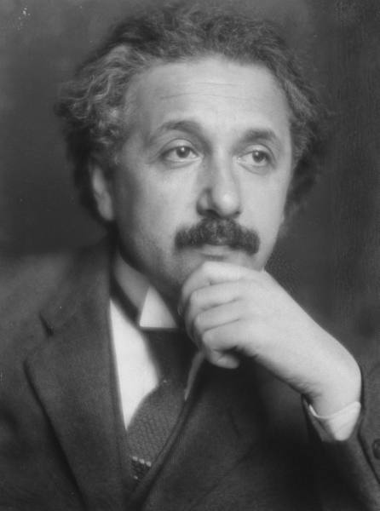
Einstein Had A Problem
His theory of relativity seemed to address the short comings of Newtonian physics
His prediction of curved space was very difficult to test
Things were really small and really big

Slide 9

Testing Relativity With an Observation
Arthur Stanley Eddington devised the eclipse experiment
Technically this is not an experiment
Natural Experiment
Why is it so powerful?

Slide 10

It’s Not Always About Experiments
The Prediction Was Risky!
The predictions were precise
Failure was clear and well defined
Newtonian physics also predicted deflection
But only by half as much
Is relativity proven?
Why are things like climate change so much harder?

Slide 11
How to approach data/science/research
A Semi-Practical Approach

Slide 12

Be Skeptical
Oh, people can come up with statistics to prove anything, Kent. 14% of people know that.
-Homer Simpson-

Slide 13
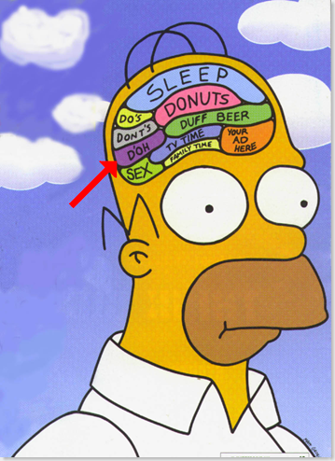
But Don’t Be Homer
Oh, Lisa, you and your stories: Bart's a vampire, beer kills brain cells. Now let's go back to that... building... thingie... where our beds and TV... is.

Slide 14
Pay Attention to First Principles
Does it make sense?
Ideally you have
Previous evidence
Sound Theory
Basic Principles
NOT – would I like to believe it.
How Does It Compare to Competing Theories?
Are they all testable?
What evidence do the other theories enjoy?
(Sorry, divine intervention is not allowed)
Nor is arguments about financial cost

Slide 15

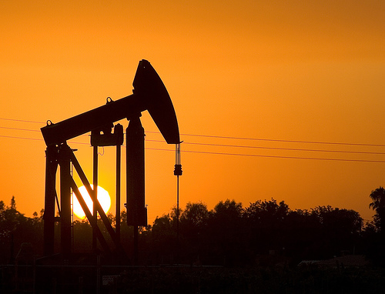
Consider The Motivations of the Players
Cigarette companies have a lot to lose
American Cancer Society
Oil companies and automobile have a lot to lose
Average citizen ?

Slide 16
How Big Is Your Data?
My Data Is Bigger Than Your Data?

Slide 17
Top 10 Databases in 2010
World Data Centre for Climate (6.2 PB)
National Energy Research Scientific Computing Center (2.6 PB)
AT&T (323 TB)
Google (91 million searches, 50% of searches)
Sprint (2.85 Trillion Records)
ChoicePoint (250 TB)
YouTube (45 TB)
Amazon (42 TB)
Central Intelligence Agency (?? How does he know?)
Library of Congress (20TB)
What is the correct way to compare this?
Volume?
Objects?
Impact?
How much data world wide?

Slide 18
Little Big Data
The Top 10 Databases account for
0.0034% of Global Storage
Big Data Really Isn’t That Big
But the problem is interesting
How do we link all this data together?

Slide 19

Big Impact of Small Data
http://www.youtube.com/watch?v=heaK44PW5ko&feature=g-all-s&context=G263cc50FAAAAAAAAAAA
http://stevekochscience.blogspot.com/2011/02/open-data-success-story.html
http://www.kochlab.org/files/Passivation/

Slide 20
What Steve Does
Right
Wrong
Generate High Quality Data
Keeps it pretty organized
Release data in a timely manner
Gives lots of background
Uses social media
Lack of metadata (formal)
Data is difficult to navigate
Limited sys-admin

Slide 21

Final Thoughts
Nothing is proven
Critical Thinking is always important
Data & Theory work together
Big Data is made from small data
Big Ideas ?

