Slide 1




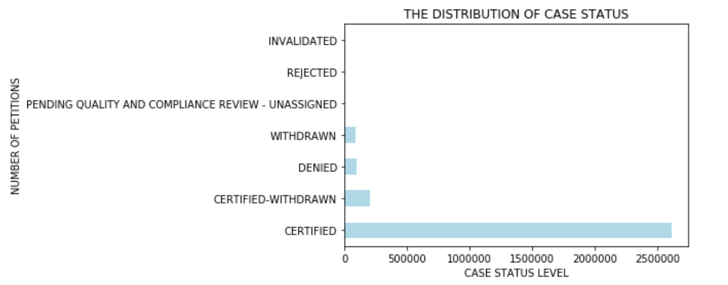
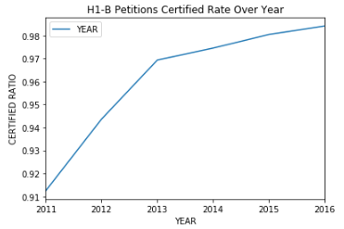
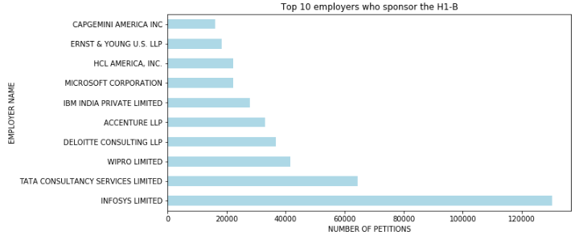
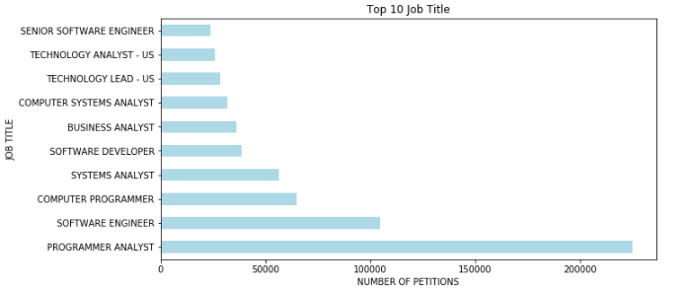
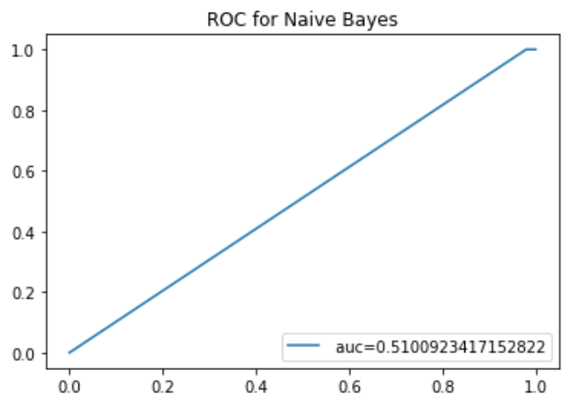
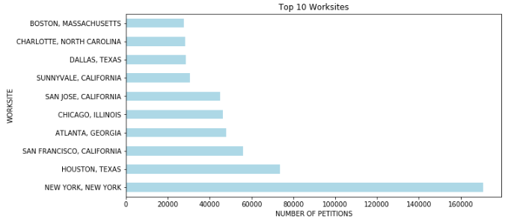
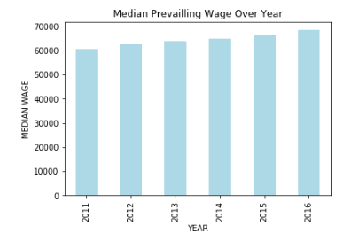
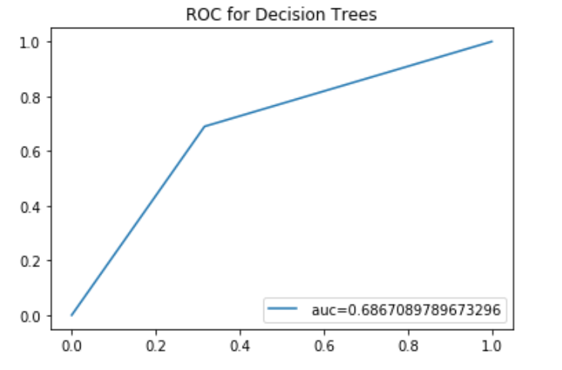
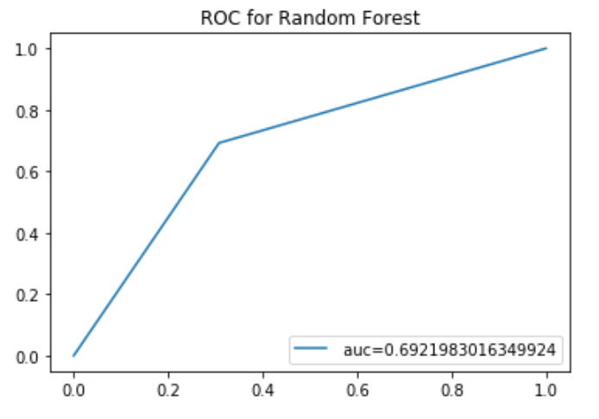
H1-B Visa Petitions Analysis
Xun Zhou (zhoux6@rpi.edu)
Rensselaer Polytechnic Institute, 110 8th St., Troy, NY, 12180 United States
Abstract
2. Descriptive Analysis:
The target variable - Case Status - has 7 categories as shown in Figure 1. But this report will only focus on the foreigners who were ‘Certified’ or ‘Denied’ with H1-B visa. After removing other values, I found that there are 2,615,623 ‘Certified’ records, while the number of the ‘Denied’ records is only 94,346. It is highly imbalanced and needs further data balancing.
I then plot the certified rate over year in Figure 2. It can be found that the certified rate of H1-B petitions is increasing from 0.91 to 0.98 over years. Candidates are more likely to get certified than before.
Figure 3 to Figure 5 shows the Top 10 Employers, Top 10 Job Title, Top 10 Worksites among all applications. It can be found that INFOSYS LIMITED, TATA CONSULTANCY SERVICE, WIPRO LIMITED rank top 3 employers who sponsor the H1B and they are all Indian IT companies. Also, 9 out of the 10 top job titles are related to the computer science. Meanwhile, the NEW YORK, HOUSTON, SAN FRANCISCO, ATLANTA, CHICAGO are the most common cities where applicants work in.
Moreover, the median prevailing wage over year is shown in Figure 6.
downsampling method to randomly resample without replacement from the majority (Certified) class to create a new subset of observation equal in size to the minority (Denied) class. After downsampling, the data size will be 187,522. Then I split it into training (70%) and test (30%) set.
3. Model Applied
I applied 3 different classifiers for prediction and evaluated the performance of each model.
Naive Bayes: Naive Bayes is a simple, fast yet effective probabilistic classifier that makes classifications using the Maximum A Posteriori decision rule in a Bayesian setting.
Decision Trees: This is a non-parametric supervised learning method and it uses a tree-like model of decisions and their possible consequences, including chance event outcomes, resource costs, and utility.
Random Forest: Random forest is based on many decision trees and each of these decision tree takes a subset of independent variables randomly. In this way, the diversity increases and a more robust prediction result can be achieved.
4. Model Evaluation
After applying these classifier models on the data with certain hyperparameter values, they are evaluated using precision score, recall score, F1 score, ROC and AUC.
The H1-B visa is an employment-based, non-immigrant visa category which allows foreigners to work legally in the United States at a company in a specialty occupation such as medicine, economics, computing, business and so on. It is usually applied for and held by international students with at least a bachelor's degree and work in a full time job.
This poster will identify the important factors that may affect the final status of H1-B Visa petitions, and predict the final status of the H1-B Visa petitions using various features. In this way, it provides a probability for both applicants and employers to predict the chances of being certified with H1-B visa and what aspects they should improve to increase their chances.
I will start by introducing the dataset, followed by some EDA & descriptive analysis. Then I will show the feature engineering. The last part of this poster is the model application and performance.
Figure 1. The Distribution of Case Status
Figure 2. H1-B Petitions
Certified Rate Over Year
Data Description
The dataset comes from the Kaggle dataset ‘H-1B Visa Petitions 2011-2016’, which includes H-1B petitions data from 2011 to 2016 with 10 variables and about 3 million observations overall. The independent variables are as below:
Case Status: The final status of the application.
Employer Name: Name of employer sponsoring the H1-B visa.
SOC Name: Occupational name along with the SOC code.
Job title: Job title being requested.
Full time position: Where Y indicates a full time employment and N indicates a part time position.
Prevailing wage: The annual prevailing wage for the requested occupation in USD amount.
Year: Year when the H1-B visa petition was filed.
Worksite: City and State information of this applicant's intended work region.
Longitude: The longitude of the corresponding worksite.
Latitude: The latitude of the corresponding worksite.
The precision for Naive Bayes Model is 0.75 on average. The recall is only 0.51 and the F1-score is barely 0.36. More importantly, the AUC for this model is only 0.51.
Figure 3. Top 10 employers who sponsor the H1-B
Figure 4. Top 10 Job Title
Figure 7. Naïve Bayes ROC Curve
I tried to tune the Decision Trees Model by changing the hyperparameter like max_depth and min_sample_leaf. After tuning, the precision,recall, and
EDA & Descriptive Analysis
Figure 5. Top 10 Worksites
Figure 6. Median Prevailing Wage Over Year
1. Missing Values:
It can be found that there are few missing values in the most columns except for “lon” and “lat” columns. And even for this two columns, the percentage of missing data is only 3.3% of the entire dataset. So I removed missing values in ‘EMPLOYER_NAME’, ‘SOC_NAME’,‘JOB_TITLE’,‘FULL_TIME_POSITION’ and ‘PREVAILING_WAGE’. Meanwhile, since the information that 'lon' and 'lat' convey can be covered by the the 'worksite' variables, I will drop this 2 variables.
Model Application & Performance
1. Feature Engineering
Since there are too many unique values in some categorical variables, it is impossible to use these variables directly in the model. To make the model more accurate and robust, I need to create new variables as below and extract as much information as I can from original features:
‘EMPLOYER_TYPE’: Extract employer information ( University or Company) from ‘EMPLOYER_NAME’.
‘OCCUPATION’: Extract 9 different occupation type from ‘SOC_NAME’.
‘STATE’: Extract state information from ‘Worksite’.
The features I put in the model will then be: CASE_STATUS,FULL_TIME_POSITION,PREVAILING_WAGE,YEAR,EMPLOYER_TYPE,OCCUPATION,STATE.
2. Resampling & Train/Test Split
To deal with the imbalanced problem, I consider utilizing
Figure 8. Decision Trees ROC Curve
F1-score for this model are 0.687. The AUC increased to 0.686.
By increasing the n_estimators to 100, and changing the max_depth to 14, the precision, recall, F1-score both increased to 0.69. And the AUC
Table 1. Missing Values
Variable | Missing Number
EMPLOYER_NAME | 18
SOC_NAME | 15893
JOB_TITLE | 10
'FULL_TIME_POSITION | 1
'PREVAILING_WAGE | 53
lon | 97971
lat | 97071
Figure 9. Random Forest ROC Curve
also increased to 0.692. Obviously, random forest has the best performance.
Table 2. Model Performance Evaluation
Sponsors:
Model | Precision | Recall | F1 | AUC
Naive Bayes | 0.75 | 0.51 | 0.36 | 0.51
Decision Trees | 0.69 | 0.69 | 0.69 | 0.687
Random Forest | 0.69 | 0.69 | 0.69 | 0.692
Glossary:
EDA –an approach to analyzing data sets to summarize their main characteristics
Precision – the ratio of correctly predicted positive observations to the total predicted positive observations
Recall – the ratio of correctly predicted positive observations to the all observations in actual class
F1 Score – the weighted average of both precision and recall score
Resources:
https://www.kaggle.com/nsharan/h-1b-visa https://elitedatascience.com/imbalanced-classes
https://www.analyticsvidhya.com/blog/2015/06/tuning-random-forest-model/ https://medium.com/@mohtedibf/indepth-parameter-tuning-for-decision-tree-6753118a03c3
https://www.kaggle.com/nmcuong81/h1-b-analysis-and-predictions

