Slide 1
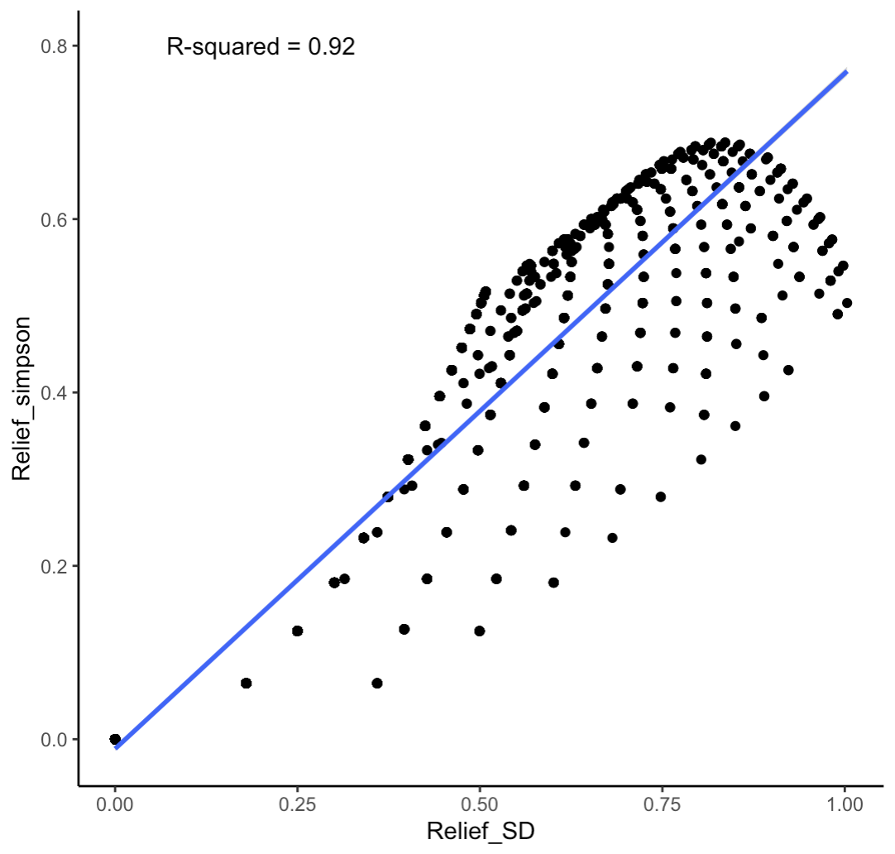
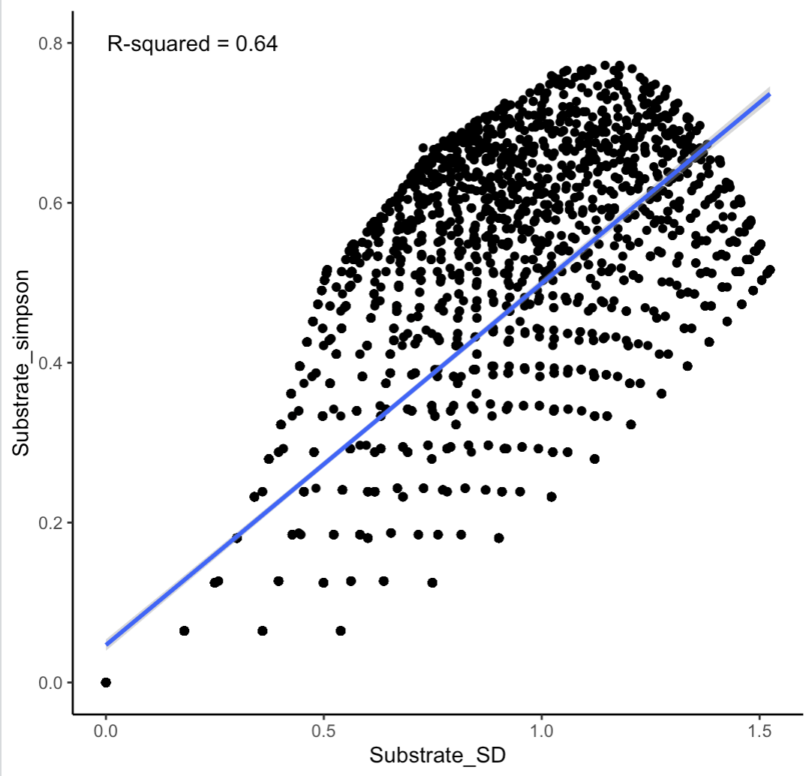
25% .1-1m
25% 0-.1m
25% 1-2m
25% 2+m
60% bedrock
0% boulder
3% cobble
38% sand
SD is relatively lower when two relief types are closer quantitatively, Simpson doesn’t take into account quantitative distance
SD is relatively lower when two substrate types are closer quantitatively, Simpson doesn’t take into account quantitative distance
Best fit line
40% .1-1m
50% 0-.1m (grouped with .1-1m)
10% 1-2m
0% 2+m
i.e.
80% .1-1m (quant = 0)
20% 2m+ (quant = 2)
i.e.
80% bedrock (quant = 4)
20% sand (quant = 1)
90% bedrock
6% boulder
3% cobble
0% sand
SD is relatively higher when two relief types are further away quantitatively, Simpson doesn’t take into account quantitative distance
SD is relatively higher when two substrate types are further away quantitatively, Simpson doesn’t take into account quantitative distance
Best fit line

