Slide 1



Metabolic hypothesis Metabolism scales exponentially with temperature, therefore we expect more arrivals and departures in years with warmer temperature extremes
Seasonality hypothesis Species that live in highly seasonal environments have unique adaptations that widen their thermal performance curve, therefore we expect few arrivals and departures in years with high seasonality
Tropicalization hypothesis Arrivals and departures correspond with the magnitude and direction of temperature change as species track temperature isotherms poleward
Opportunistic hypothesis Arrivals and departures correspond with the magnitude of temperature change regardless of whether a region has experienced warming or cooling as species move through space to track preferred temperature conditions
Raw maximum
Metabolism ∝ $e^{−E/kT_{B}}$
Temperature
Metabolism
Raw minimum
J
Month
D
Environmental Temperature
High seasonality tolerant
Temperature
Performance
Seasonality
High seasonality intolerant
J
Month
D
Environmental Temperature
Warming
5˚C
Change in temperature from previous year
28˚C
Cooling
Year
Warming
Magnitude of change in temperature from previous year
Cooling
Year
Notes:
The exponential increase in metabolic rate with temperature is described the the Boltzmann Arrhenius factor, E = activation energy of respiratory complex, k = Boltzmann’s constant, Tb is the body temperature in the basal state in Kelvin
Metabolism versus temp ref: Patricia Schulte

Slide 2
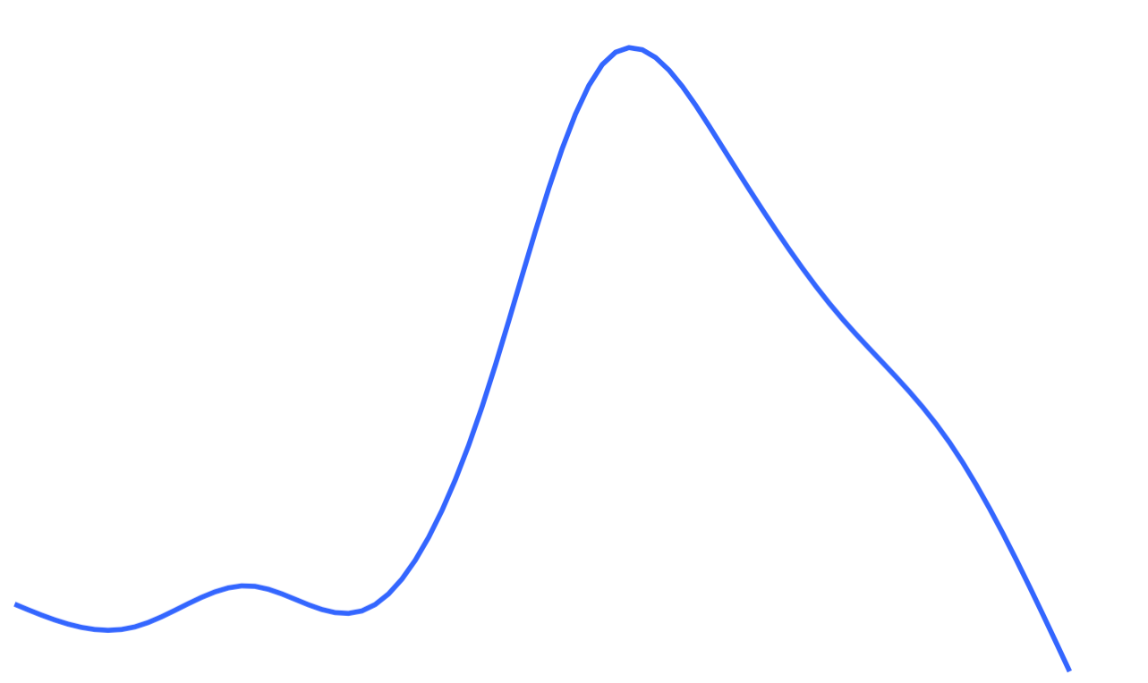
Maximum
Temperature
Seasonality
Minimum
J
Month
D

