Slide 1
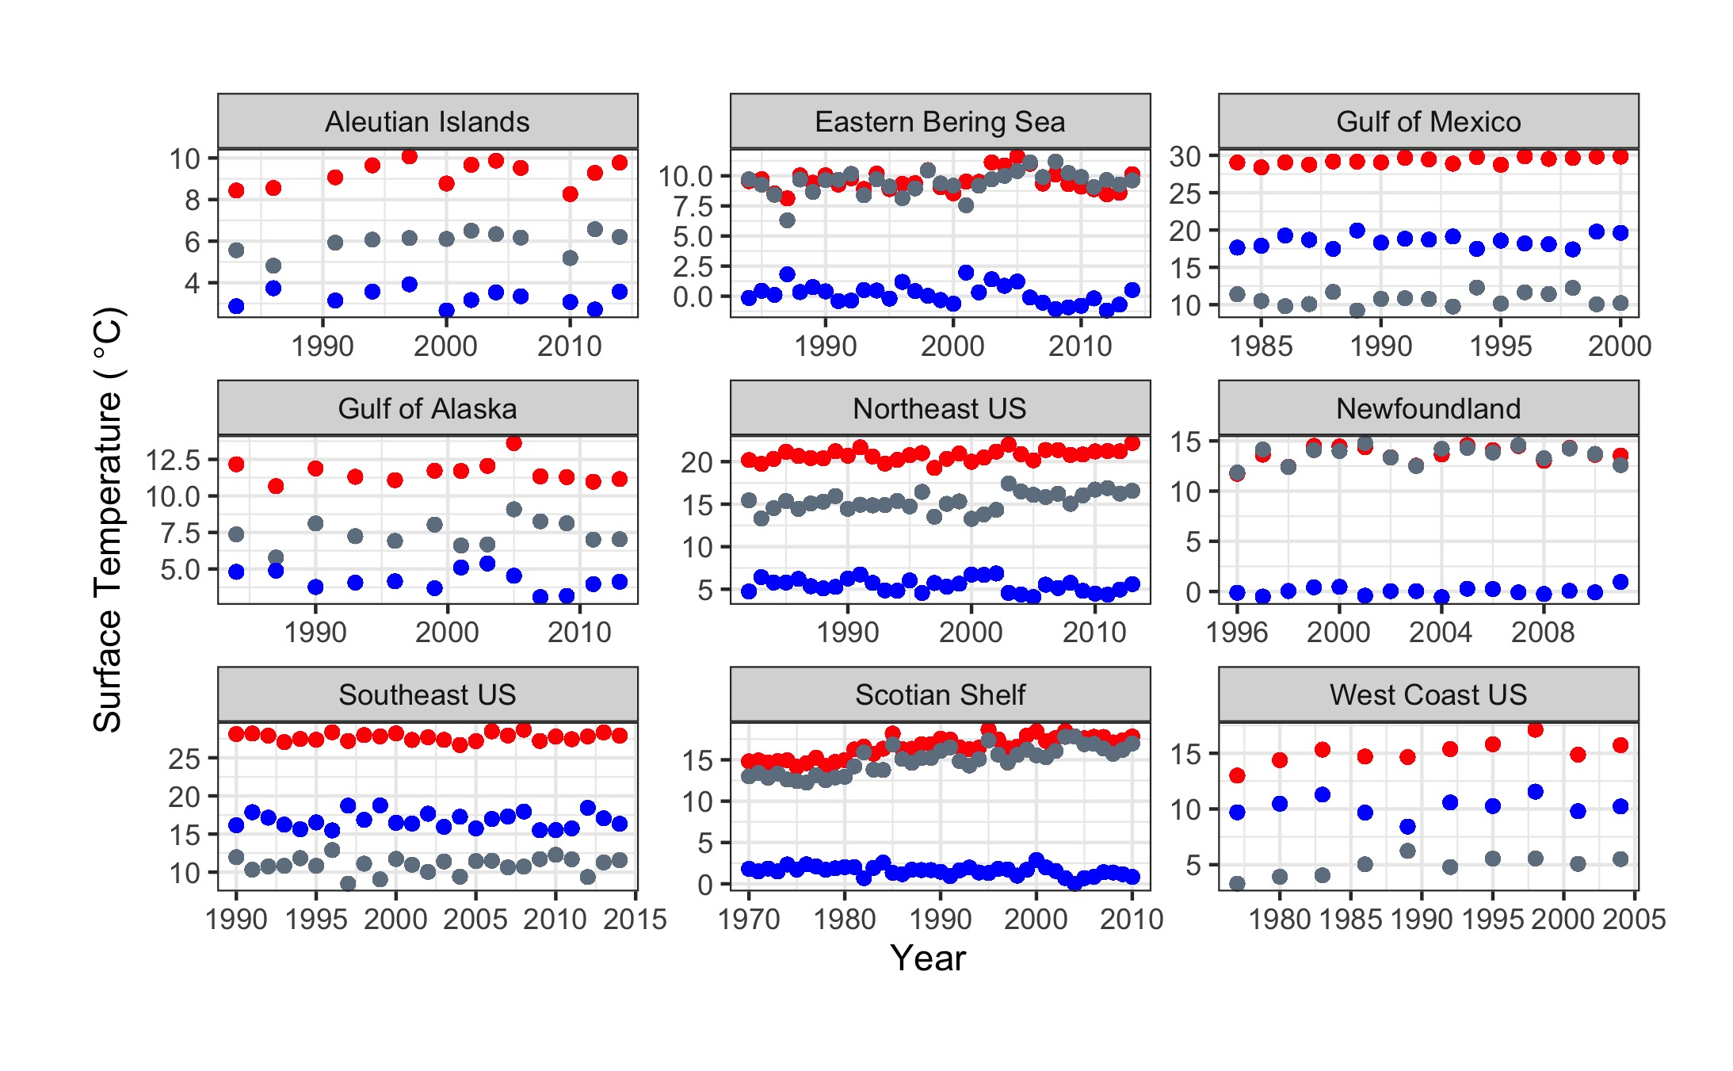
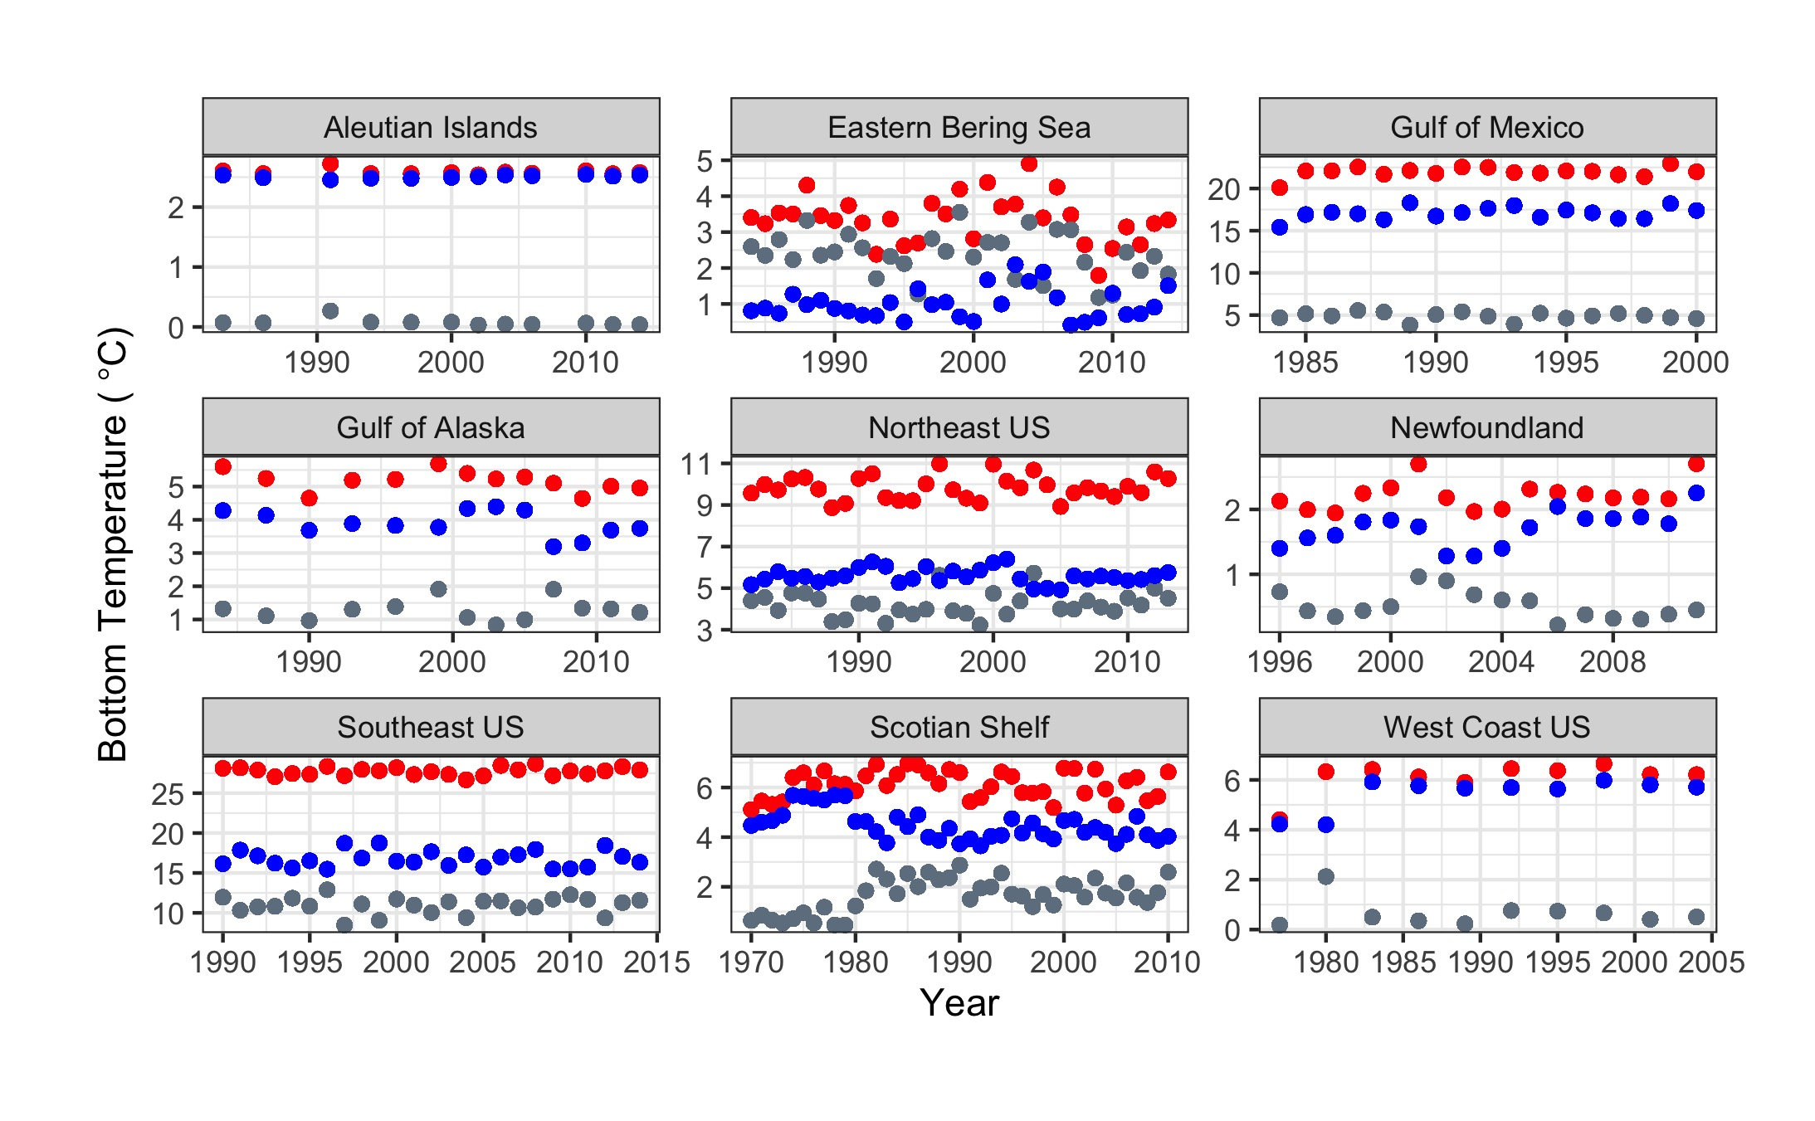
Temperature Metric
Maximum
Seasonality
Minimum

