Slide 1
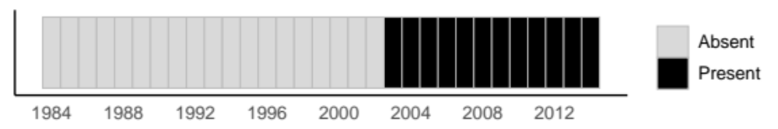







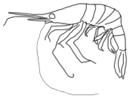
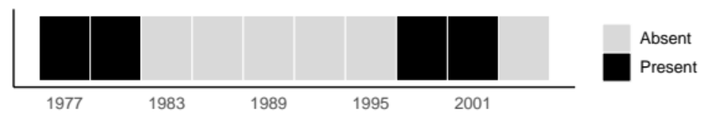
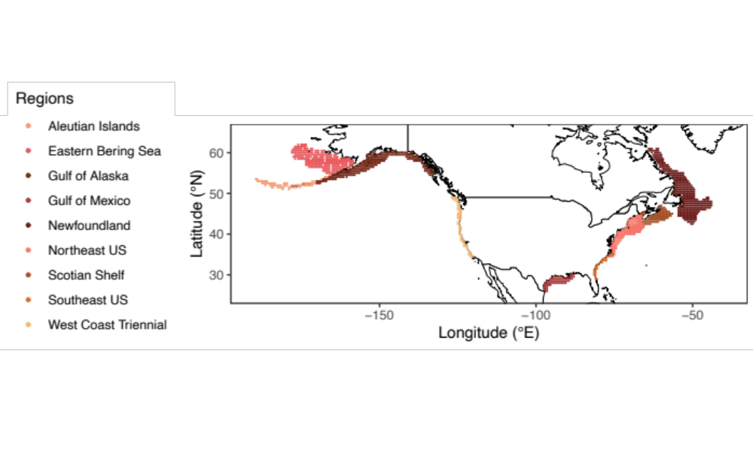
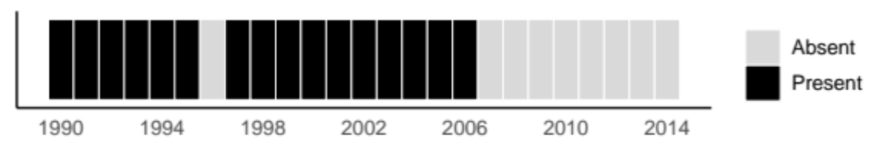
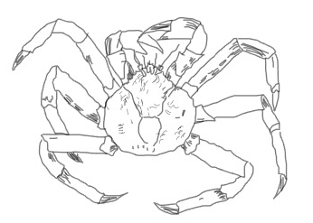
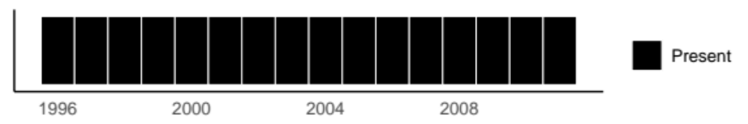
Eastern Bering Sea
Northern sea nettle
Chrysaora melanaster
Arrival
West Coast US
Alaskan pink shrimp
Pandalus eous
Sequential Arrivals and Departures
Eastern Bering Sea
Newfoundland
Gulf of Alaska
Aleutian Islands
West Coast US
Scotian Shelf
Gulf of Mexico
Northeast US
Southeast US
Southeast US
Tomtate
Haemulon aurolineatum
Departure
Newfoundland
Snow crab
Chionoecetes opilio
Consistently Present
Notes:
Nettle: Brodeur et al. 2008: https://www-sciencedirect-com.proxy.libraries.rutgers.edu/science/article/pii/S0079661108000487?casa_token=SZc1goYAX5gAAAAA:WakyZGNPmaKLoAzB-0TwYzaUxRt0JYdwXrMtOdNP8pgurli3dz2eNi8QCIKlZ80TZ-o5GkZI
Tomate decline (likely due to lionfish): https://www.nature.com/articles/srep32169
Shrimp: https://www.webpages.uidaho.edu/fish510/PDF/ShrimpAnderson.pdf, sampled well by survey, and good indicators of ecosystem regime shifts
Snow crab: consistently common invert around Newfoundland: https://www.mun.ca/osc/oscedu/copilio.php, https://link.springer.com/content/pdf/10.1007/s11160-014-9349-7.pdf

