Slide 1
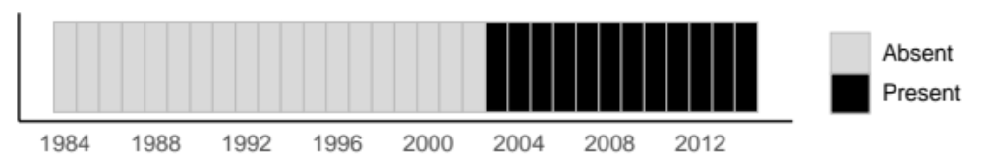







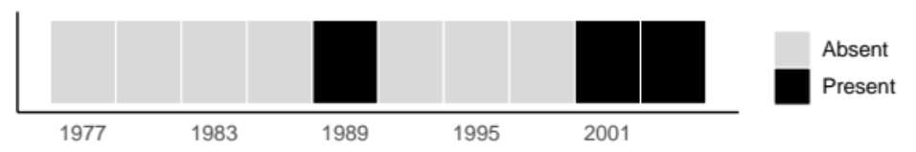
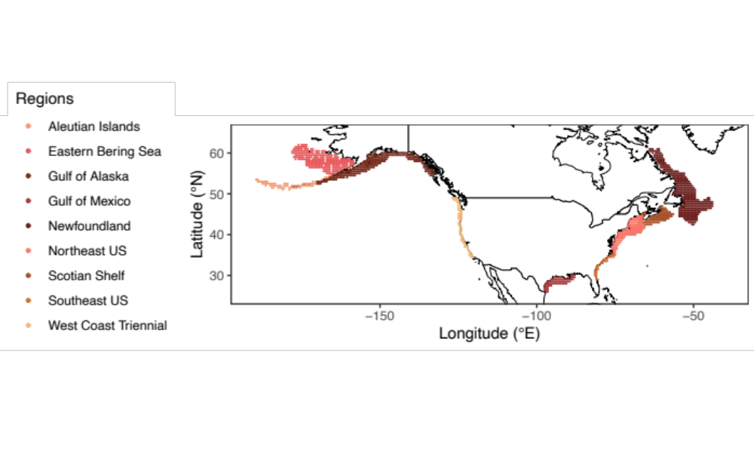
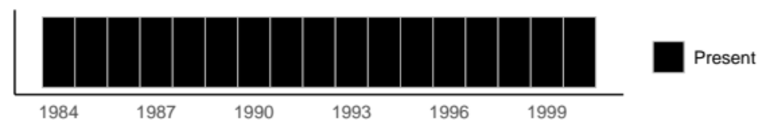
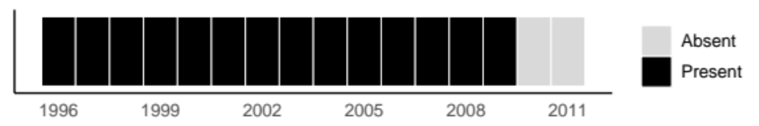



Eastern Bering Sea
Northern sea nettle
Chrysaora melanaster
2003 Arrival
West Coast US
Sea slug sp.
Pleurobranchaea californica
Sequential Arrivals and Departures
Eastern Bering Sea
Newfoundland
Gulf of Alaska
Aleutian Islands
West Coast US
Scotian Shelf
Gulf of Mexico
Northeast US
Southeast US
Gulf of Mexico
Broad-striped anchovy
Anchoa hepsetus
Consistently Present
Newfoundland
Arctic eelpout
Lycodes reticulatus
2010 Departure
Notes:
https://thenounproject.com/search/?q=jelly+fish&i=469940
https://thenounproject.com/search/?q=anchovy&i=1370242
https://thenounproject.com/search/?q=fish&i=3795190

Slide 2


Slide 3








Slide 4











Slide 5




Slide 6


Eastern Bering Sea
Newfoundland
Gulf of Alaska
Aleutian Islands
West Coast US
Scotian Shelf
Gulf of Mexico
Northeast US
Southeast US

