Slide 1



Metabolic hypothesis Metabolism scales exponentially with temperature, therefore we expect more arrivals and departures in years with warmer temperature extremes
Seasonality hypothesis Species that live in highly seasonal environments have unique adaptations that widen their thermal performance curve, therefore we expect few arrivals and departures in years with high seasonality
Tropicalization hypothesis Arrivals and departures correspond with the magnitude and direction of temperature change as species track temperature isotherms poleward
Opportunistic hypothesis Arrivals and departures correspond with the magnitude of temperature change regardless of whether a region has experienced warming or cooling as species move through space to track preferred temperature conditions
Raw maximum
Metabolism ∝ $e^{−E/kT_{B}}$
Temperature
Metabolism
Raw minimum
J
Month
D
Environmental Temperature
High seasonality tolerant
Temperature
Performance
Seasonality
High seasonality intolerant
J
Month
D
Environmental Temperature
Warming
5˚C
Change in temperature from previous year
28˚C
Cooling
Year
Warming
Magnitude of change in temperature from previous year
Cooling
Year
Notes:
The exponential increase in metabolic rate with temperature is described the the Boltzmann Arrhenius factor, E = activation energy of respiratory complex, k = Boltzmann’s constant, Tb is the body temperature in the basal state in Kelvin
Metabolism versus temp ref: Patricia Schulte

Slide 2
Metabolic hypothesis Smith et al. 1998 Claireaux et al. 2006 Dillon et al. 2012
Seasonality hypothesis Conover 1992 Yamahira and Conover 2002 Beaukhof et al. 2019
Tropicalization hypothesis Jablonski et al. 2013 Brown 2014 Vergés et al. 2016
Opportunistic hypothesis Godínez-Domínguez et al. 2000 Funes-Rodríguez et al. 2006 Day et al. 2018
Raw maximum
Higher movement →
More arrivals,
More departures
Lower movement →
Fewer arrivals,
Fewer departures
Temperature
Speed of Movement
Raw minimum
1
2
3
Year
Environmental Temperature
Seasonality
Lower seasonality →
More arrivals,
Fewer departures
Higher seasonality →
Fewer arrivals,
More departures
Temperature
Temperature
1
2
3
1
2
Year
Year
Warming
Warming → Arrivals of warm-water species in temperate regions
Baseline
Cooling
Warming
Temperature
Latitude
Cooling
1
2
3
Marine Diversity
Year
Cooling → Departures of cold-water species from temperate regions
Absolute temperature change
More arrivals and departures in years of large changes in temperature
Temperature
Arrivals
Departures
1
2
3
Cooling
No Change
Warming
Year
Temperature Change
Notes:
(Hawkins et al. 2003; Brown 2014; Vergés et al. 2014). Tropicalization may also be paired with borealization and subsequent departure of higher-latitude species (Fossheim et al. 2015; Punzón et al. 2021).

Slide 3
Metabolic hypothesis Smith et al. 1998 Claireaux et al. 2006 Dillon et al. 2012
Seasonality hypothesis Conover 1992 Yamahira and Conover 2002 Beaukhof et al. 2019
Tropicalization hypothesis Jablonski et al. 2013 Brown 2014 Vergés et al. 2016 Chaudhary et al. 2021
Opportunistic hypothesis Godínez-Domínguez et al. 2000 Funes-Rodríguez et al. 2006 Day et al. 2018
Raw maximum
Higher movement →
More arrivals,
More departures
Temperature
Metabolism
Lower movement → Fewer arrivals,
Fewer departures
Raw minimum
1
2
3
Year
Environmental Temperature
Seasonality
Lower seasonality →
More arrivals,
Fewer departures
Higher seasonality →
Fewer arrivals,
More departures
Temperature
Temperature
1
2
3
1
2
Year
Year
Warming
Warming → Arrivals of warm-water species in temperate regions
Baseline
Cooling
Warming
Temperature
Latitude
Cooling
1
2
3
Marine Diversity
Year
Cooling → Departures of cold-water species from temperate regions
Absolute temperature change
More arrivals and departures in years of large changes in temperature
Temperature
Arrivals
Departures
1
2
3
Cooling
No Change
Warming
Year
Temperature Change
Notes:
(Hawkins et al. 2003; Brown 2014; Vergés et al. 2014). Tropicalization may also be paired with borealization and subsequent departure of higher-latitude species (Fossheim et al. 2015; Punzón et al. 2021).

Slide 4
Metabolic hypothesis
Seasonality hypothesis
Tropicalization hypothesis
Opportunistic hypothesis
Raw maximum
Higher movement,
More arrivals,
More departures
Temperature
Metabolism
Lower movement, Fewer arrivals,
Fewer departures
Raw minimum
1
2
3
Low
High
Year
Raw Temperature
Seasonality
Lower seasonality,
More arrivals,
Fewer departures
Higher seasonality,
Fewer arrivals,
More departures
Temperature
Count
Departures
Arrivals
1
2
3
Low
High
Year
Seasonality
Warming
Warming → Arrivals of warm-water species in temperate regions
Baseline
Cooling
Warming
Temperature
Latitude
Cooling
1
2
3
Marine Diversity
Year
Cooling → Departures of cold-water species from temperate regions
Absolute temperature change
More arrivals and departures in years of large changes in temperature
Temperature
Arrivals
Departures
1
2
3
Cooling
No Change
Warming
Year
Temperature Change
Notes:
(Hawkins et al. 2003; Brown 2014; Vergés et al. 2014). Tropicalization may also be paired with borealization and subsequent departure of higher-latitude species (Fossheim et al. 2015; Punzón et al. 2021).

Slide 5
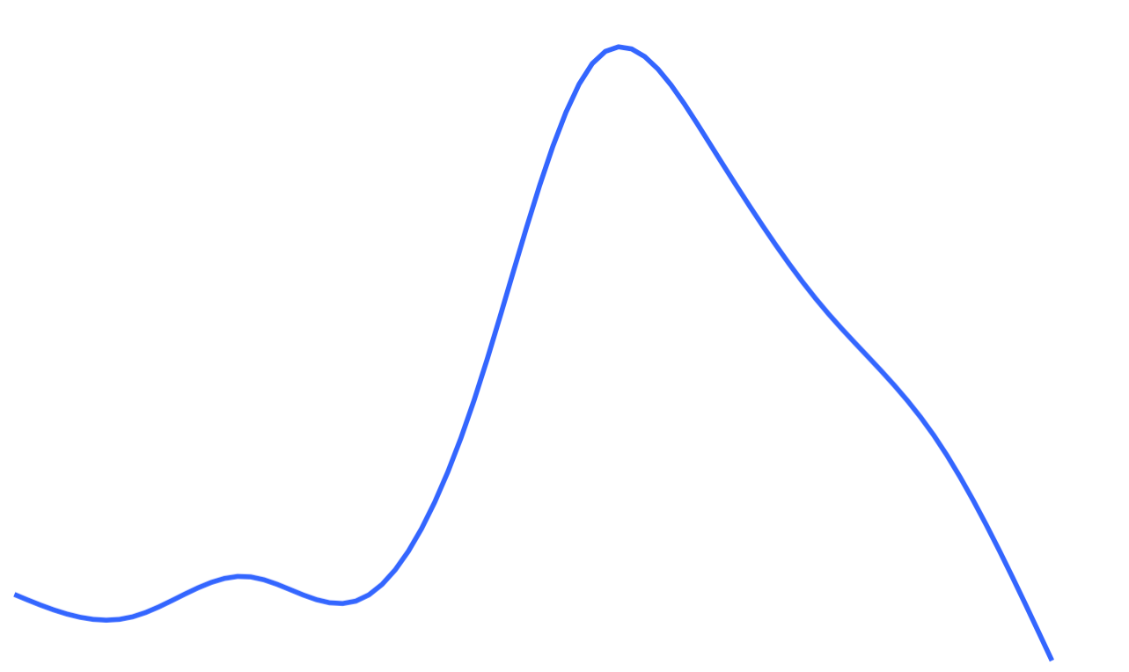
Maximum
Temperature
Seasonality
Minimum
J
Month
D

Slide 6
Absolute temperature change
Temperature
1
2
3
Year

