Slide 1
Simple
Gulf of Mexico
Greater amberjack
1 type, 1 split, 2 end holders
Intermediate
Mid-Atlantic
Black sea bass
2 types, 2 splits, 12 end holders
Complex
New England
GOM Atlantic cod
5 types, 5 splits, 6+ end holders
Remainder
State catch
Set asides
Incidental catch
Sector
Commercial (20%)
Recreational (80%)
Commercial (45%)
Recreational (55%)
Commercial (62.6%)
Recreational (37.5%)
Allocation type
Spatial
Sector
Subsector
Seasonal
Catch share
State | Allocation | State | Allocation
ME | 0.25% | NJ | 19.42%
NH | 0.25% | DE | 5.00%
MA | 12.62% | MD | 10.68%
RI | 10.68% | VA | 19.41
CT | 3.00% | NC | 10.68%
NY | 8.00%
Spatial
Subsector
Sector program (catch share)
Common pool
Trimester | Allocation
1 | 49%
2 | 33%
3 | 1.8%
Seasonal
Individual potential sector contributions associated with program “sectors”
Catch share

Slide 2
Simple
Gulf of Mexico
Greater amberjack
1 type, 1 split, 2 end holders
Intermediate
Mid-Atlantic
Black sea bass
2 types, 2 splits, 12 end holders
Complex
New England
GOM Atlantic cod
5 types, 5 splits, 6+ end holders
Remainder
State catch
Set asides
Incidental catch
Sector
Commercial (20%)
Recreational (80%)
Commercial (45%)
Recreational (55%)
Commercial (62.6%)
Recreational (37.5%)
Allocation type
Spatial
Sector
Subsector
Seasonal
Catch share
State | Allocation | State | Allocation
ME | 0.25% | NJ | 19.42%
NH | 0.25% | DE | 5.00%
MA | 12.62% | MD | 10.68%
RI | 10.68% | VA | 19.41
CT | 3.00% | NC | 10.68%
NY | 8.00%
Spatial
Subsector
Sector program (catch share)
Common pool
Trimester | Allocation
1 | 49%
2 | 33%
3 | 1.8%
Seasonal
Individual potential sector contributions associated with program “sectors”
Catch share

Slide 3
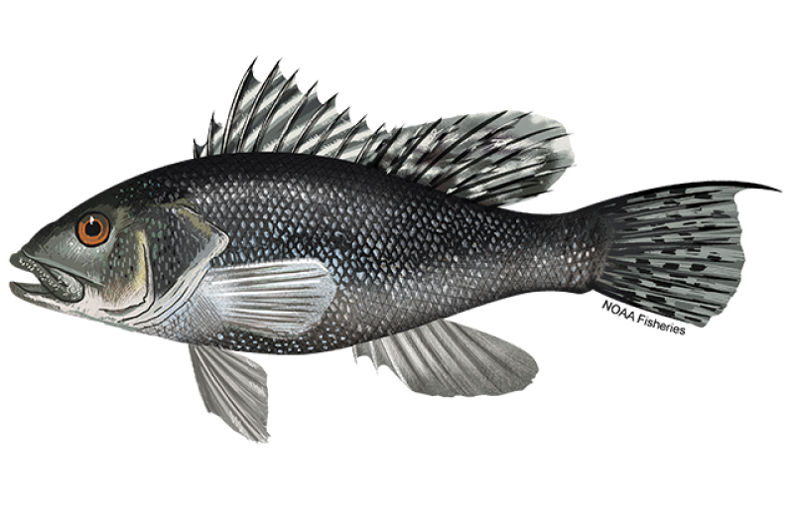
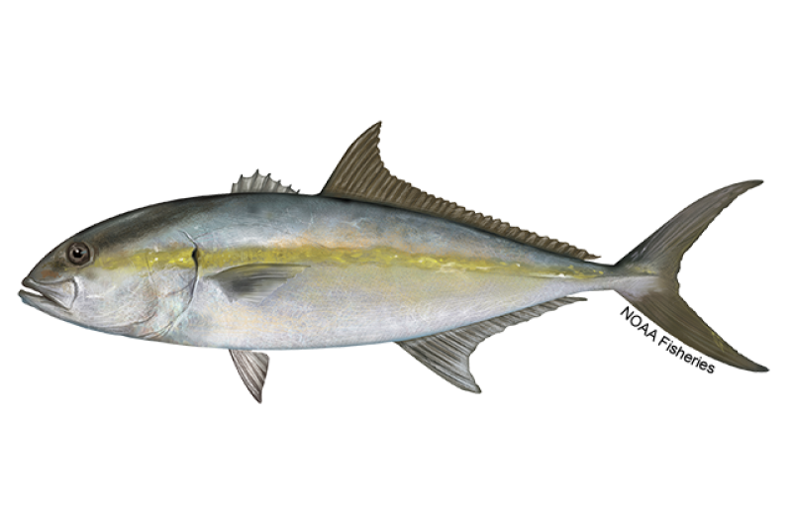
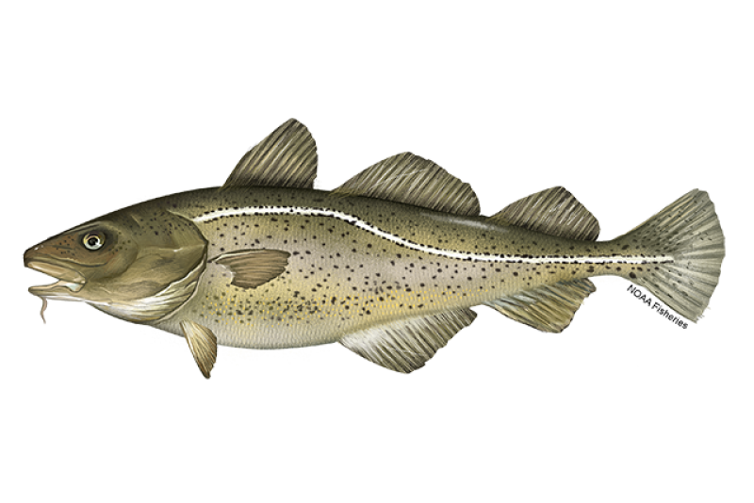
Simple
Gulf of Mexico
Greater amberjack
1 type, 1 split, 2 end holders
Intermediate
Mid-Atlantic
Black sea bass
2 types, 2 splits, 12 end holders
Catch
Commercial (20%)
Recreational (80%)
Catch
Commercial (45%)
Recreational (55%)
ME (0.25%)
NH (0.25%)
MA (12.62%)
RI (10.68%)
CT (3.00%)
NY (8.00%)
NJ (19.42%)
DE (5.00%)
MD (10.68%)
VA (19.41%)
Complex
New England
GOM Atlantic cod
5 types, 5 splits, 6+ end holders
NC (10.68%)
Catch
Remainder
Estimated state catch
Estimated incidental catch
Commercial (62.5%)
Recreational (37.5%)
Allocation type
Set-aside
Sector
Spatial
Subsector
Seasonal
Catch share
Common pool
Sector program
Trimester 1 (49%)
Trimester 2 (33%)
Individual potential sector contributions
Trimester 3 (18%)
Notes:
Figures from NOAA

Slide 4
Simple
Gulf of Mexico
Greater amberjack
1 type, 1 split, 2 end holders
Intermediate
Mid-Atlantic
Black sea bass
2 types, 2 splits, 12 end holders
Catch
Commercial (20%)
Recreational (80%)
Catch
Commercial (45%)
Recreational (55%)
ME (0.25%)
NH (0.25%)
MA (12.62%)
RI (10.68%)
CT (3.00%)
NY (8.00%)
NJ (19.42%)
DE (5.00%)
MD (10.68%)
VA (19.41%)
Complex
New England
GOM Atlantic cod
5 types, 5 splits, 6+ end holders
NC (10.68%)
Catch
Remainder
Estimated state catch
Estimated incidental catch
Commercial (62.5%)
Recreational (37.5%)
Allocation type
Set-aside
Sector
Spatial
Subsector
Seasonal
Catch share
Common pool
Sector program
Trimester 1 (49%)
Trimester 2 (33%)
Individual potential sector contributions
Trimester 3 (18%)
Notes:
Figures from NOAA

