Slide 1
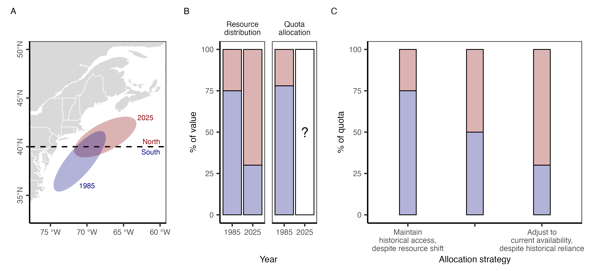

Transfers
$$
Mid-Atlantic black sea bass
75% historical landings,
25% current distribution
East Georges Bank haddock
10% historical landings,
90% current distribution

Slide 2
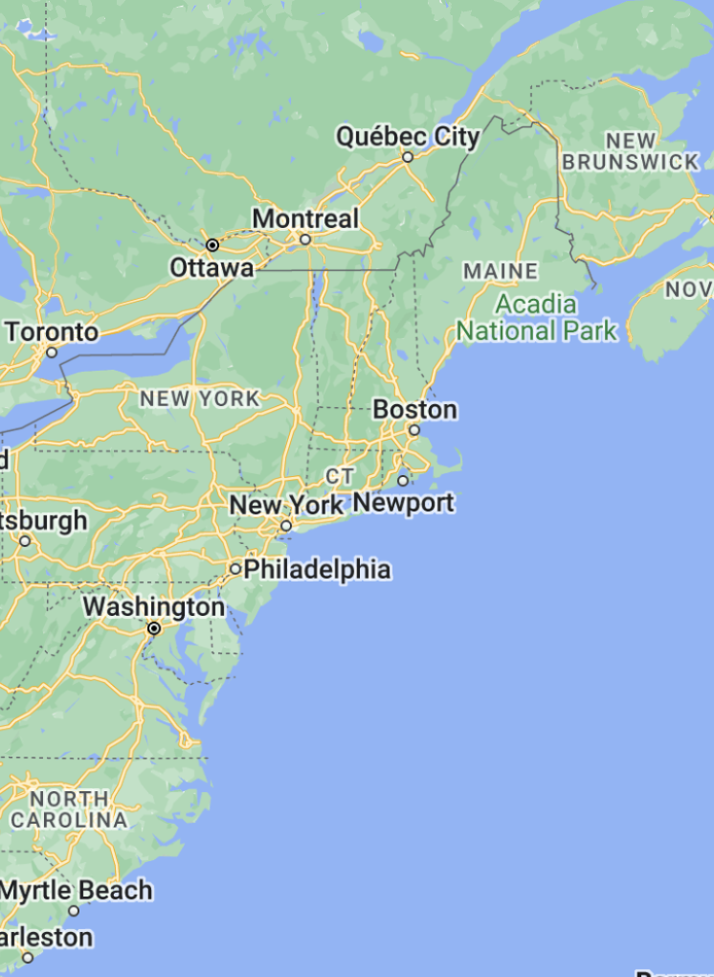
A
B
Resource
distribution
Quota
allocation
C
2025
Trading
Northern
zone
?
Southern
zone
1985
1985
2025
1985
2025
Maintain
historical access,
despite resource shift
Middle ground
Adjust to
current availability, despite historical reliance
Example: Bluefish
Example: Black sea bass

