Slide 1
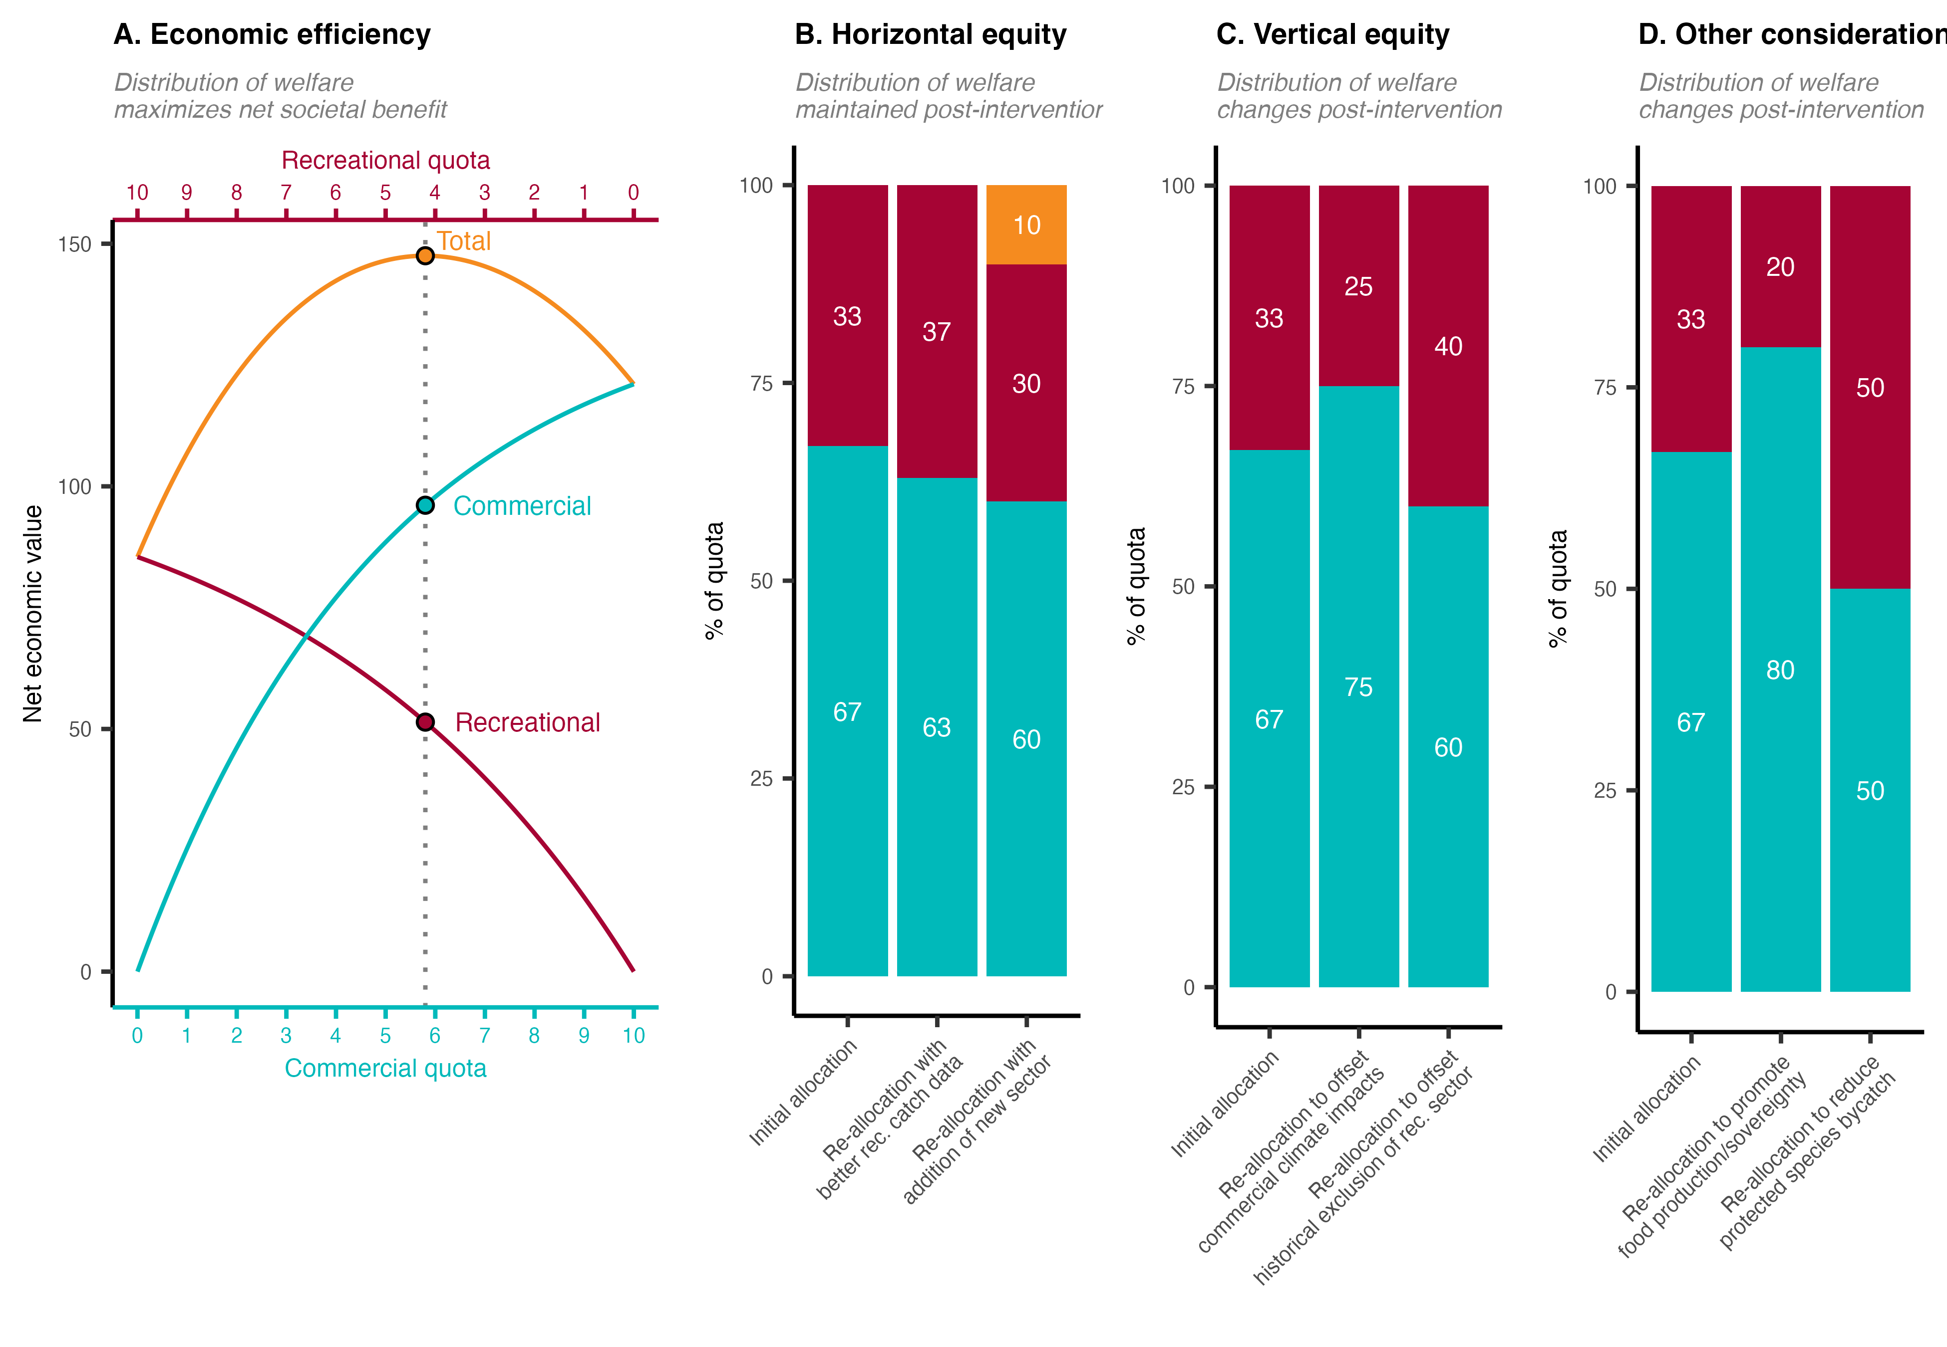
Original
sectors
33
67
Horizontal equity with correction
Horizontal equity within original sectors

Slide 2
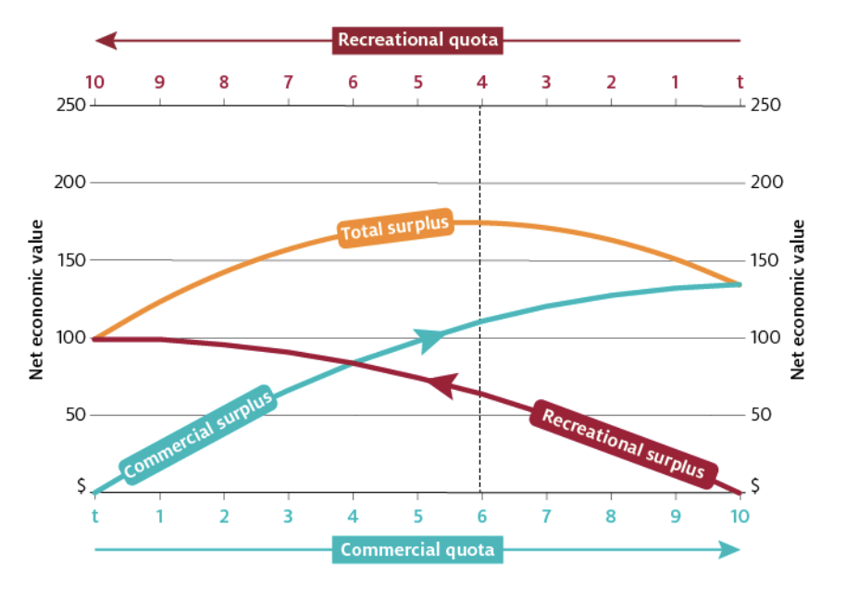
A. Economic efficiency
Distribution of welfare
maximizes net societal benefit
B. Horizontal equity
Distribution of welfare
remains the same post-intervention
C. Vertical equity
Distribution of welfare
changes post-intervention
33
40
33
33
25
40
20
50
33
75
80
67
60
67
Original sectors
60
60
67
50
10
Initial allocation
Initial allocation
Re-allocation
with better rec. catch
Re-allocation
with new sector addition
Re-allocation to offset
commercial climate impacts
Re-allocation to offset historical exclusion of rec. sector
Re-allocation to reduce
protected species bycatch
Re-allocation to promote food production/sovereignty
Horizontal equity with correction
Horizontal equity within original sectors
Notes:
Optimal: Edward (1990) to Mazur et al. (2020)

