Slide 1
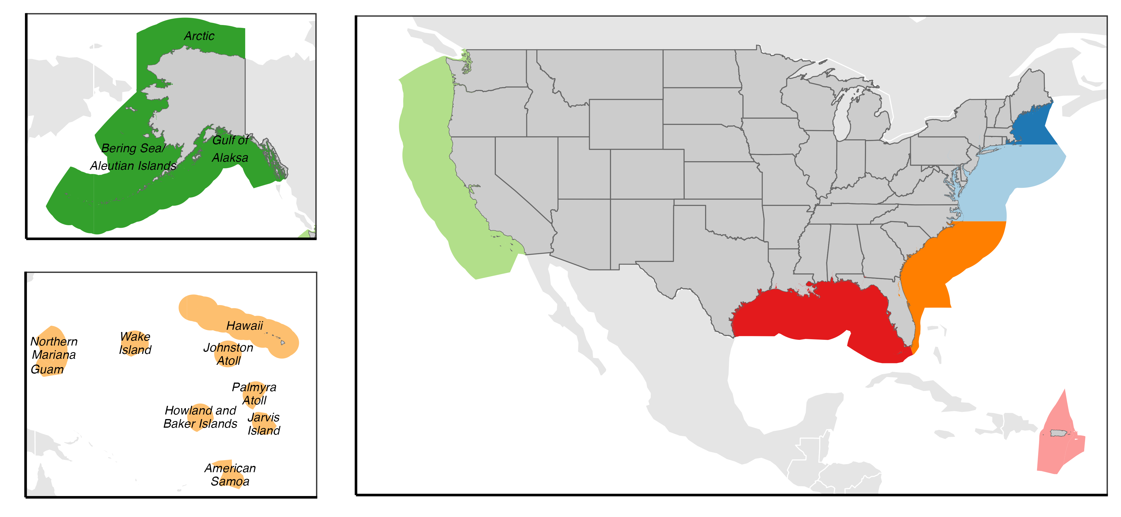
North Pacific
X FMPs,
X stocks
New England
X FMPs, X stocks
Mid-Atlantic
X FMPs,
X stocks
Pacific
X FMPs, X stocks
Gulf of Mexico
X FMPs, X stocks
Gulf of Mexico
X FMPs, X stocks
Western Pacific
X FMPs, X stocks
Caribbean
X FMPs, X stocks

Slide 2
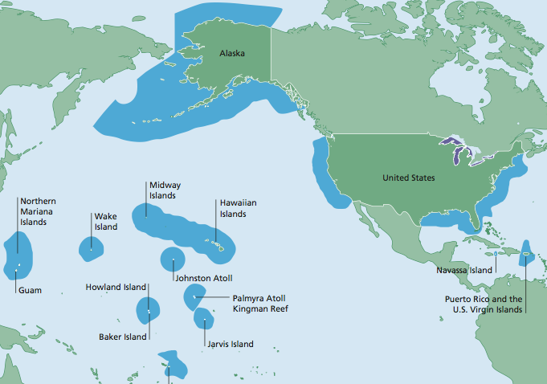
Arctic
North Pacific
6 FMPs, X stocks
Bering Sea / Aleutian Islands
Gulf of Alaska
New England
9 FMPs, X stocks
Pacific
4 FMPs, X stocks
Western Pacific
5 FEPs, X stocks
Mid-Atlantic
5 FMPs, X stocks
South Atlantic
6 FMPs, X stocks
Hawaii
Gulf of Mexico
3 FMPs, X stocks
Caribbean
X FMPs, X stocks
Mariana (Guam)
Pacific Remote Islands
American Samoa

